Slide 1
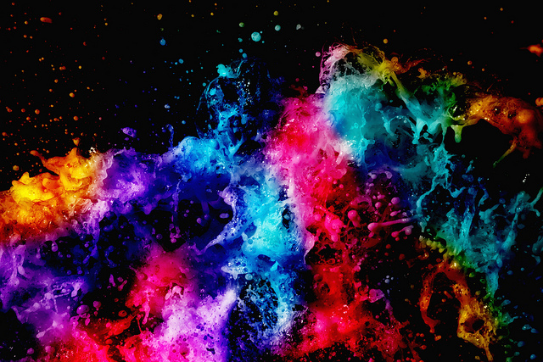
Colour!

Slide 2

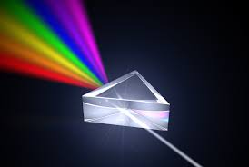
Light
We know that pure white light from the sun is actually made from many colours.

Slide 3
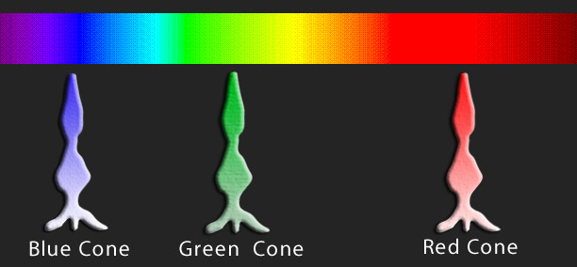
Mixing light – additive mixing
Mixing pure red light, green light and blue light back together in equal amounts recreates pure white light!
In fact, mixing red, green and blue light together in different amounts can make any other colour.
This is how our eyes work with colour. We have specialised cells on our retinas called cone cells, and the cone cells come in 3 types, each one sensitive to either red, green or blue light.

Slide 4
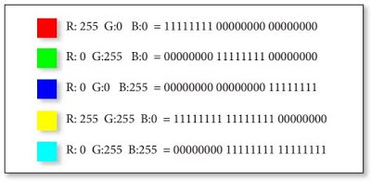
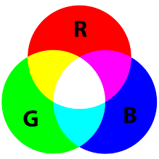
Computers and light
Computers use the RGB system for display on screen
8 bit binary numbers are used to represent how much of each colour (red, green and blue) need to be mixed together to make a particular colour.
8 bit binary numbers have 256 combinations. So we can make colours from 256 possible amounts of red, 256 possible amounts of green and 256 possible amounts of blue.
That’s 256 x 256 x 256 different colours!

Slide 5
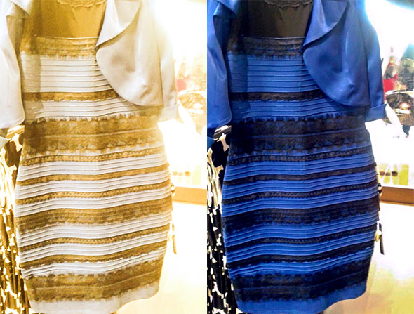
How we see colour
The colours we normally see day to day come from reflected light.
A pink dress looks pink because pink is the colour that the material of the dress is NOT soaking up! The pink colour is reflected away from the dress into our eyes.
Plants are green because they DON’T use green light. Plant leaves soak up red and blue light from the sun and the left over green light is scattered away.
This way of making colours is called subtractive mixing.

Slide 6
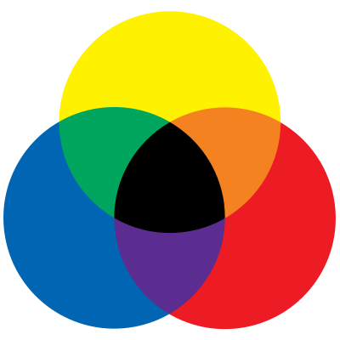
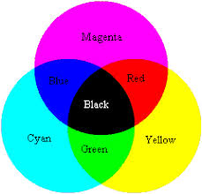
Mixing paint – subtractive mixing
When we mix paints together. The mixing follows the rules that we are more familiar with.
Art students are taught the RYB system of primary colours which predates scientific knowledge of colour mixing. Science has taught us the more accurate subtractive model.
RYB
Subtractive

Slide 7
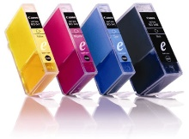
Modern printing
Modern printing uses the subtractive system using the 3 primaries of Cyan, Magenta and Yellow. Although black can be made by mixing all 3 colours, a separate black is included as a 4th colour because it is used so often.

