Slide 1
Your journey to top marks in the initial ideas section
Design Idea 1
Draw at least 1 idea in the style of a designer or design movement AND explain how the shape reflects the designers style.
Design Idea 2
2. Draw at least 1 idea taking inspiration from the images in your product analysis AND explain how you have been influenced by the shape, texture, pattern, colour in the photos
Design Idea 3
3. Draw at least 1 idea taking inspiration from your primary observation drawings AND explain how you have been influenced by the shape, texture, pattern, colour of the photos
(3) Or combine the best bits from 2 different concepts to make a different idea. Explain how you have combined the best bits and how the design has improved.
YES
YES
5. Label all the features of each design.
explain
The unique selling points
Material
Colour / finish
Possible construction method
How is it suitable for a retail chain for interior design and furnishings?
How it will work? (like where would the bulb go, knives/mugs go)
How it is easy to clean
How have you incorporated characteristics of the Bauhaus style (simple lines, industrial look, use of geometric shapes, functional, use of technology, minimalism)
Design Idea 4
4a. Draw at least 1 idea that is sensible and one you think you would be happy to make in 10 hours. Explain how you think you could make it and write what tools, equipment and materials you could use.
4b. On your drawings 1-4, draw 1 with a stencil motif decoration, 1 with an engraving motif decoration, 1 with an embossed motif decoration, 1 with a debossed motif decoration.
YES
YES
8. Number each design and CHECK that you have explained what inspired the shape.
YES
6. Write a summary explaining how you have used the different researches and different visual sources (the photos) to give you ideas and how and what it has been inspired by.
Style = simple lines, industrial look, use of geometric shapes, use of modern materials like plywood, metal, glass, concrete, functional, use of technology, minimalism
7. Cut out and stick next to your design idea a photo of a room. Draw a box on the photo to show the scale of your design in the room.
YES
YES

Slide 2
Design Ideas
BTEC Level 1 and 2 First Extended Certificate in Art & Design
Unit 2 – CREATIVE PROJECT IN ART AND DESIGN

Slide 3
Design Ideas
BTEC Level 1 and 2 First Extended Certificate in Art & Design
Unit 2 – CREATIVE PROJECT IN ART AND DESIGN

Slide 4
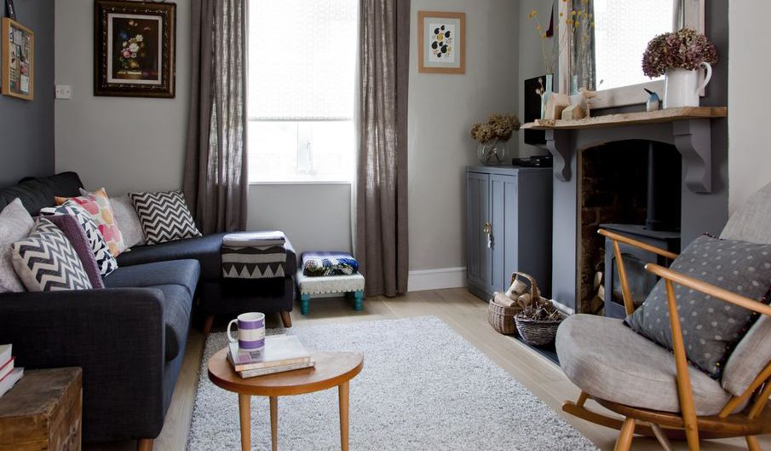
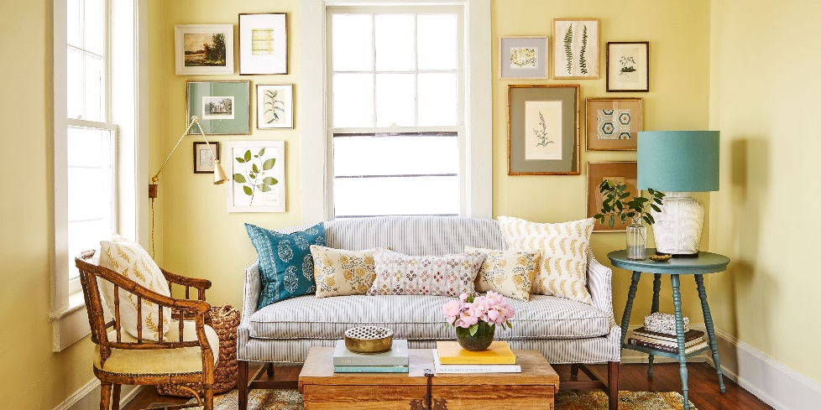
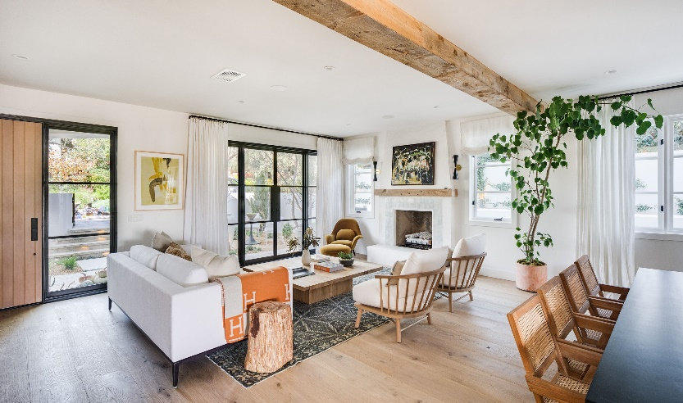
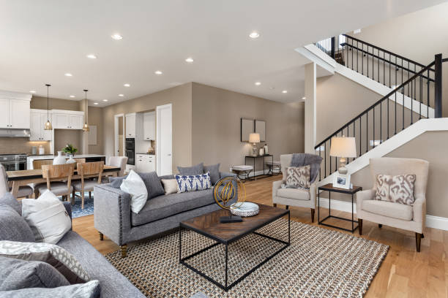
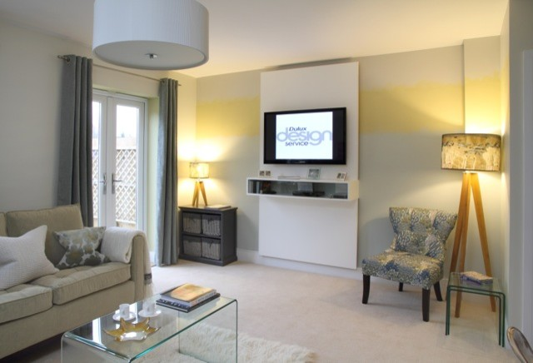
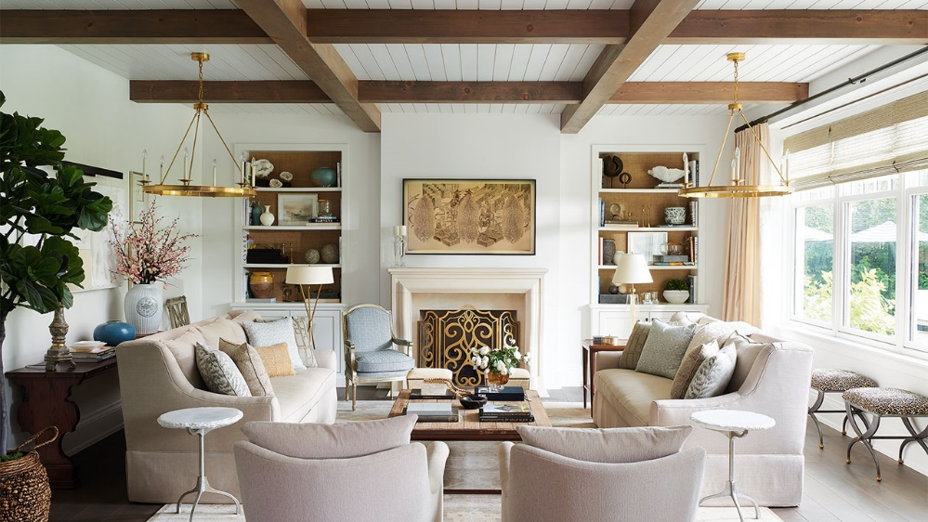
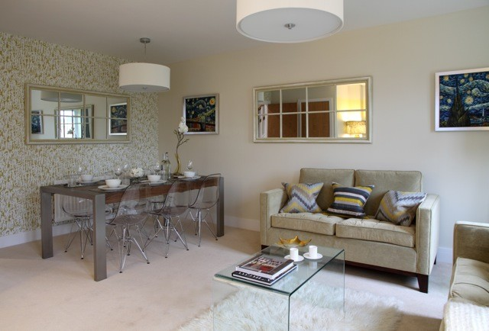
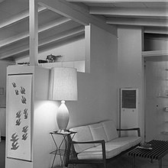
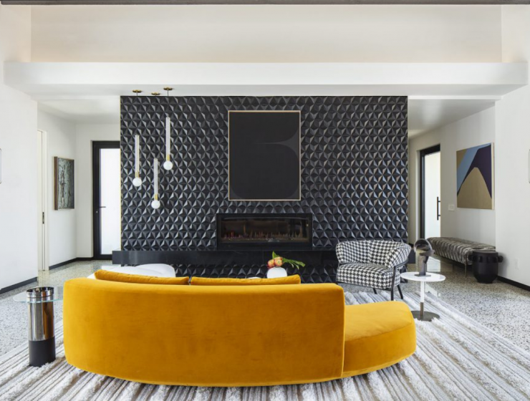
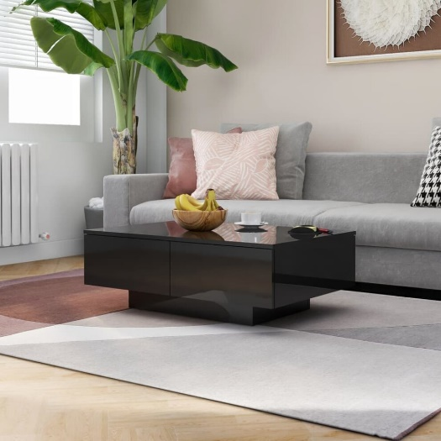
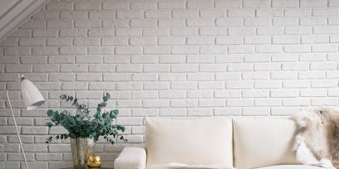
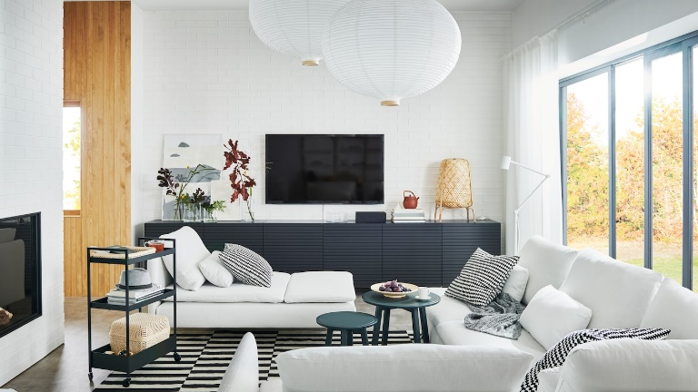
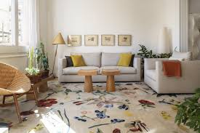
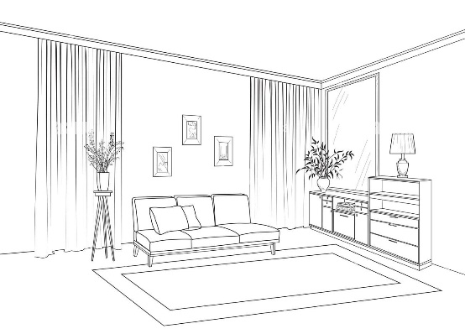

Slide 5
