Slide 1
TREES
Trees have inspired artists from different times and cultures. From your research into this subject develop your own personal response to trees.

Slide 2
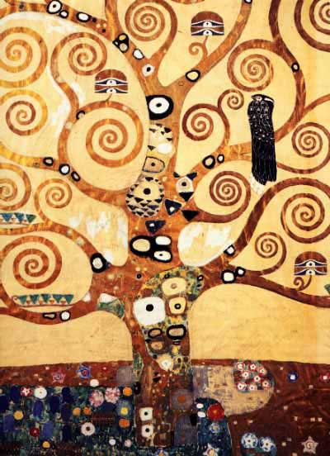
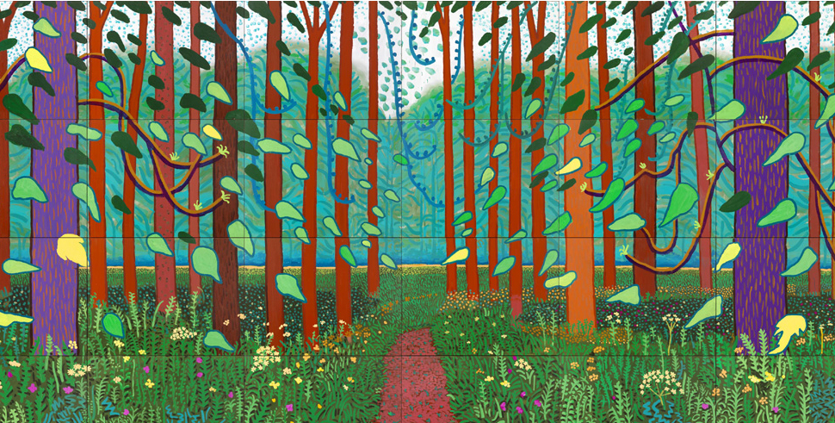
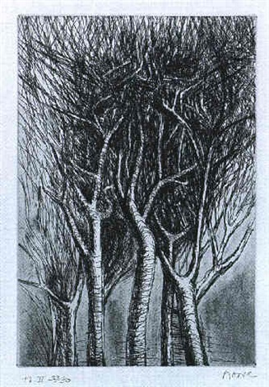
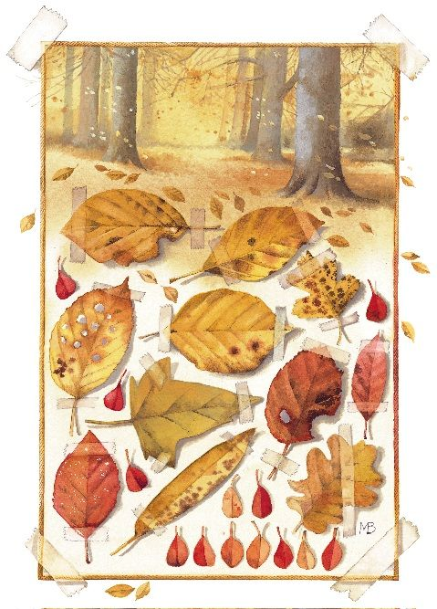
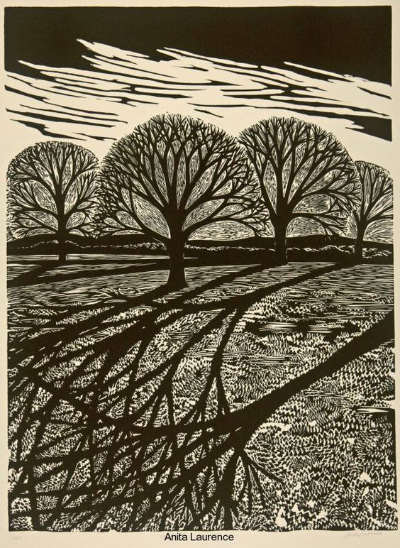
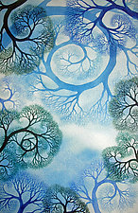
TREES

Slide 3
FLOWERS
Flowers have inspired artists and designers such as Elizabeth Blackadder and Georgia O’Keeffe. Abigail Hutton designs wall coverings and soft furnishings developed from detailed floral observations.
Use your studies of flowers and references to the work of others to help you produce a final outcome in any media.

Slide 4
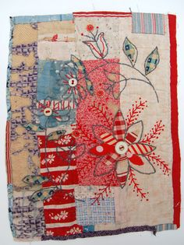
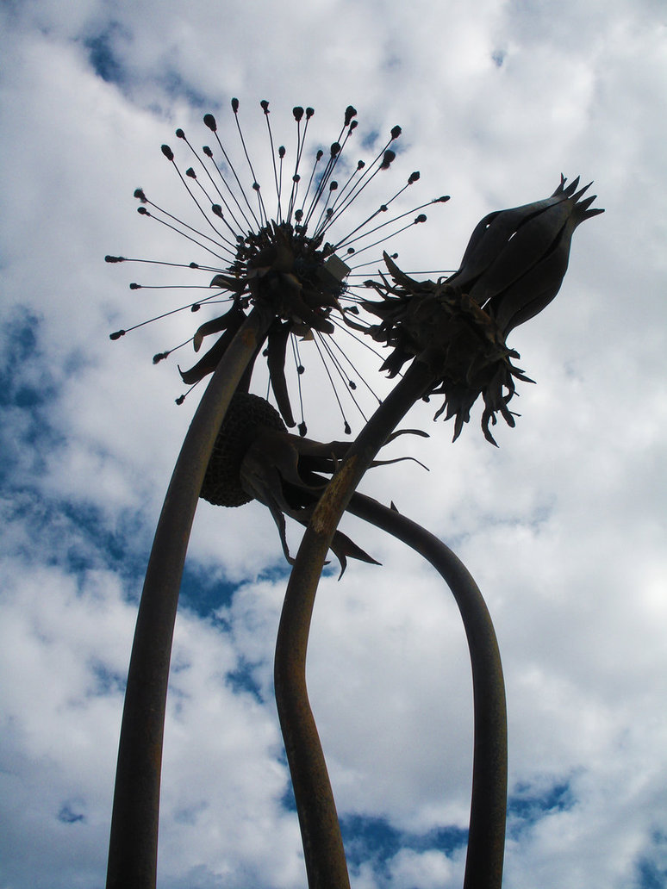
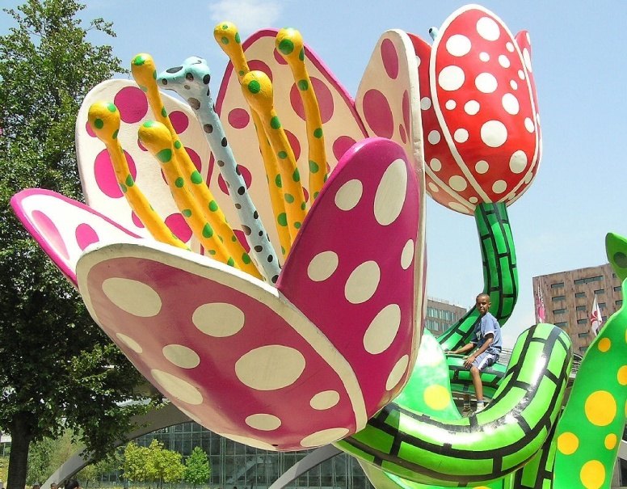
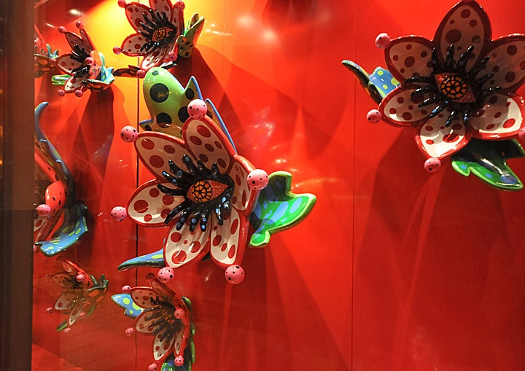
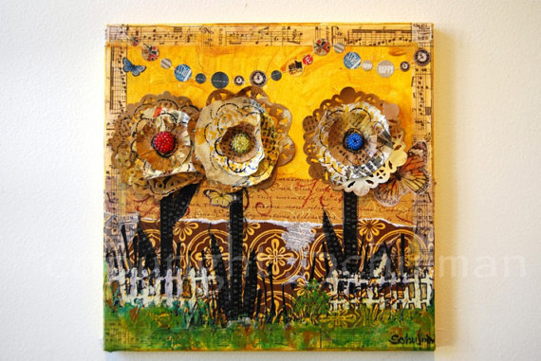
FLOWERS

Slide 5
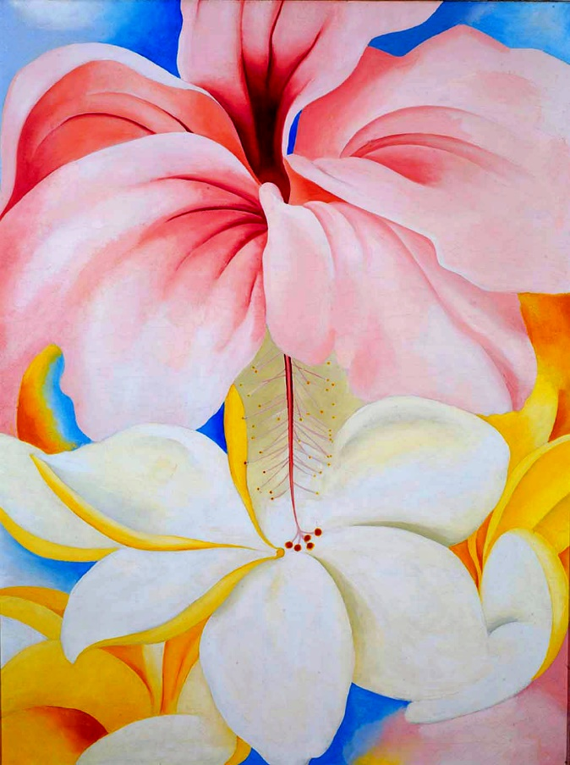
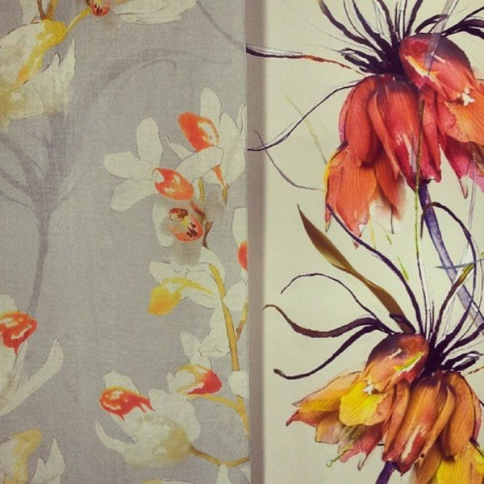
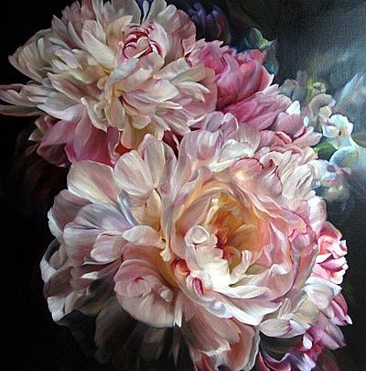
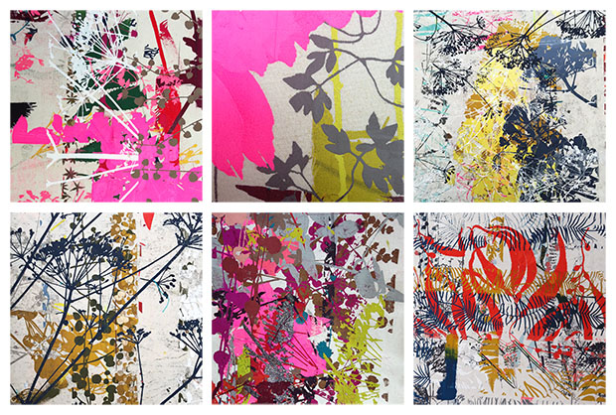
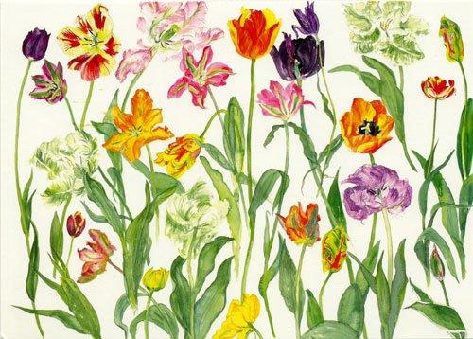
FLOWERS

Slide 6
FRUIT & VEGETABLES
Much of the fruit and vegetables we eat have interesting colours, patterns and textures. Taking the theme ‘inside and out’ focus on the contrast between the interior and exterior surfaces of pieces of fruit and/or vegetables. (Georgia O’Keeffe, Emma Dibben, Kate Malone, Orla Kiely).
Use your studies of fruit and/or vegetables and references to the work of others to help you produce a final outcome in any media.

Slide 7
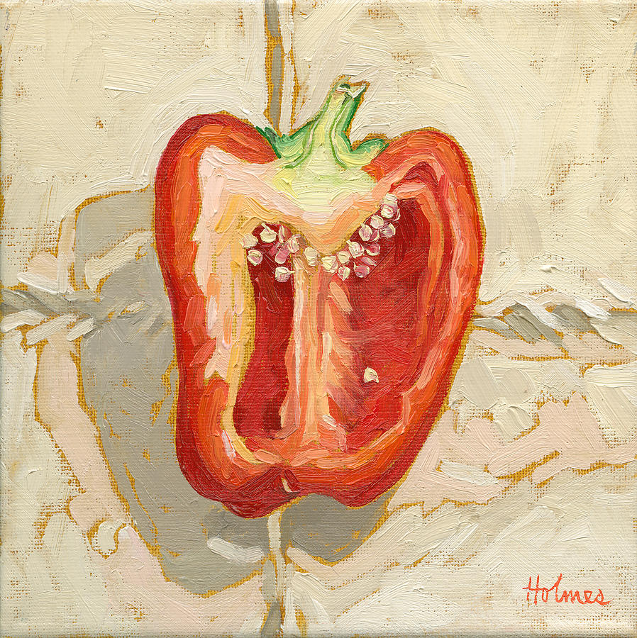
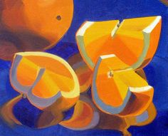
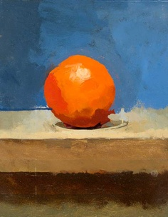
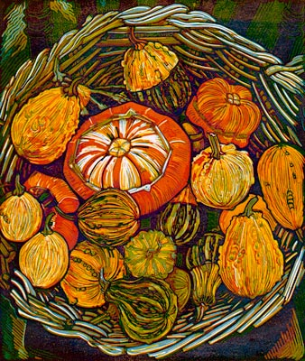
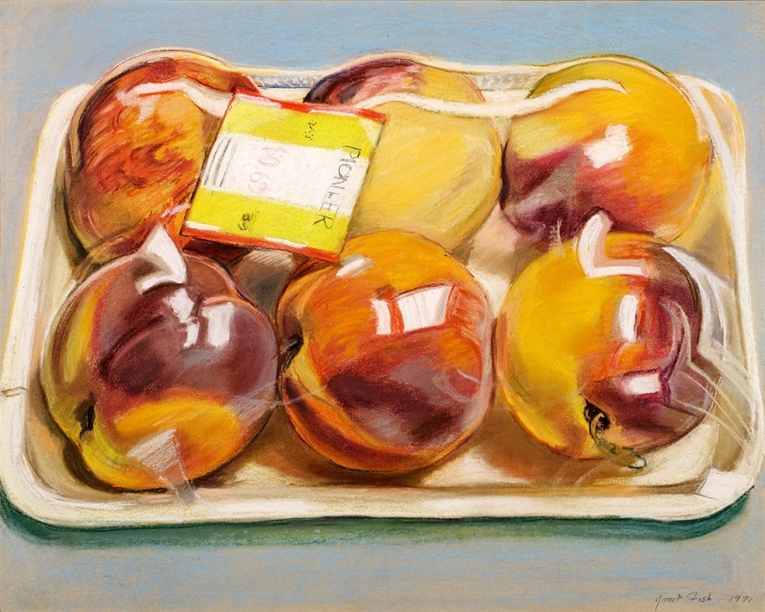
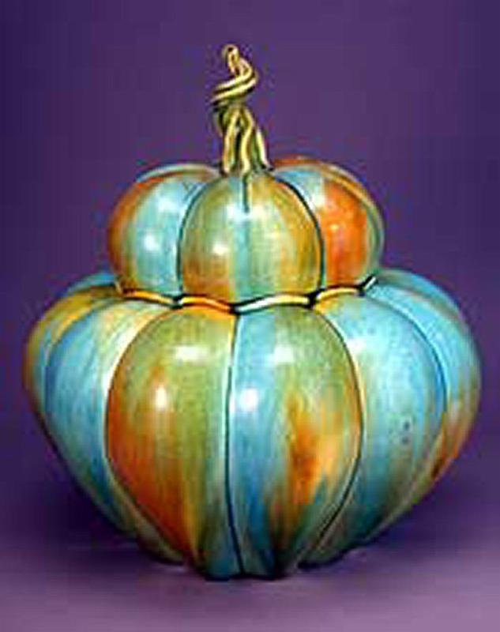
FRUIT & VEGETABLES

Slide 8
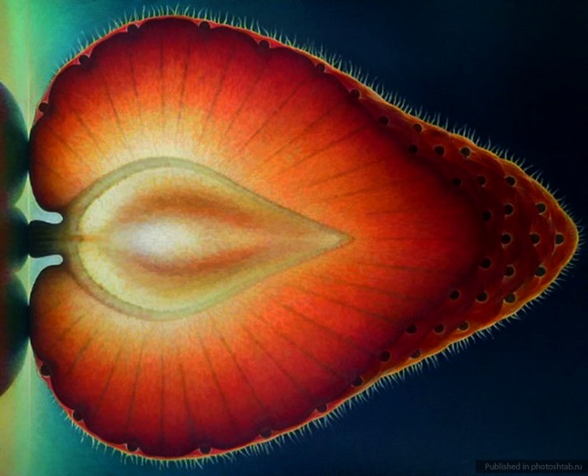
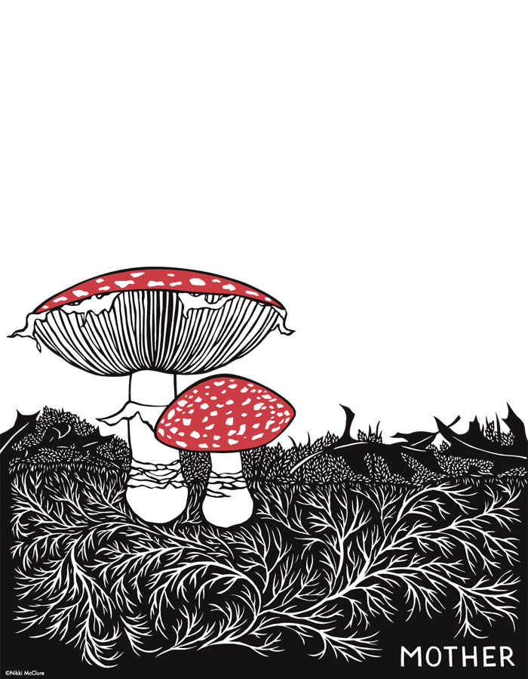
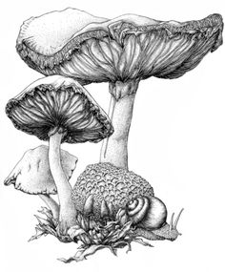
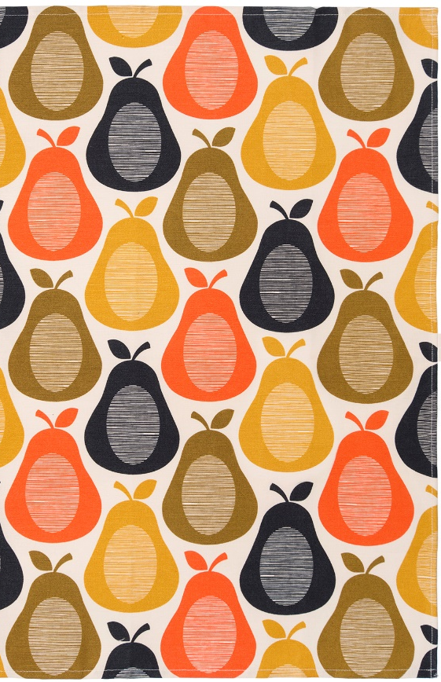
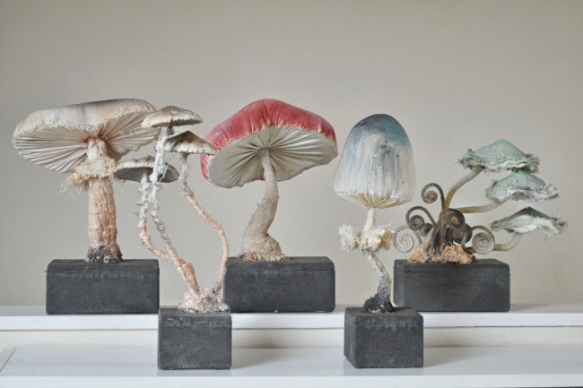

Slide 9
SURROUNDINGS
Artists are often inspired by their surroundings. Barbara Rae creates colourful prints and paintings inspired by landscape. The British printmaker Angie Lewin is fascinated by the native plants of Britain. She focuses on hedgerow and meadow plants which most consider to be weeds. Ceramicist Jennifer McCurdy is inspired by the symmetry and asymmetry of nature's forms. Living on the island of Martha's Vineyard she strives to make work which reflects the balance of nature which surrounds her.
Research appropriate sources and create your own response to Surroundings.

Slide 10
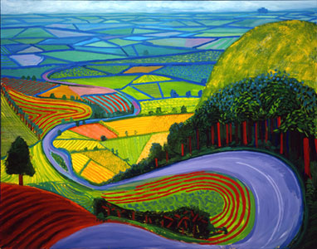
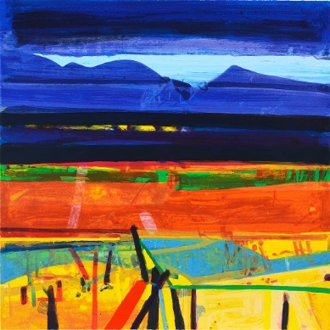
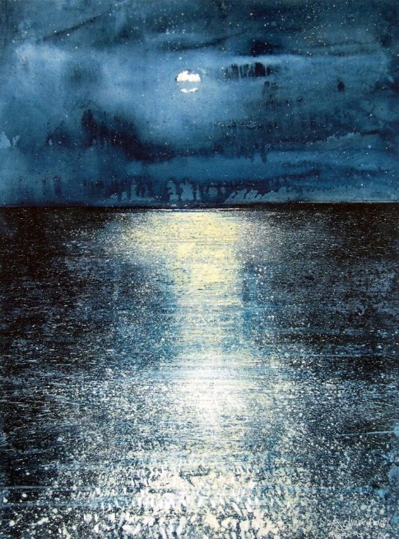
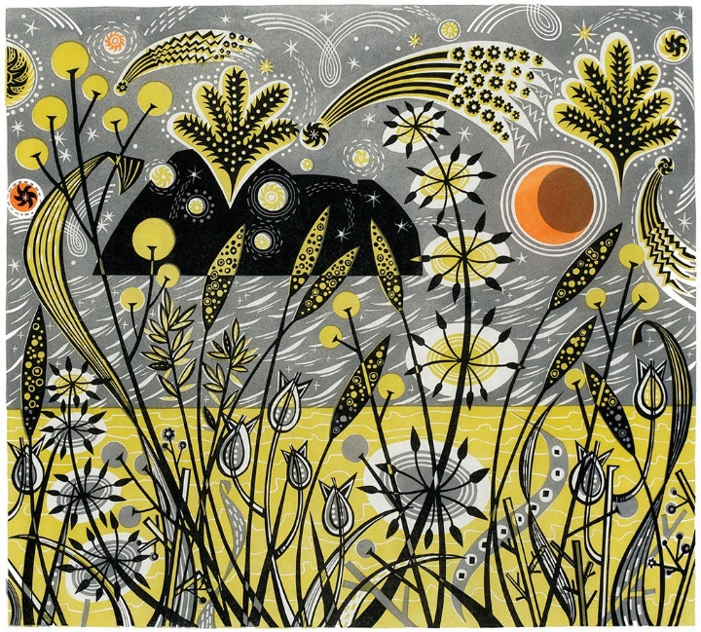
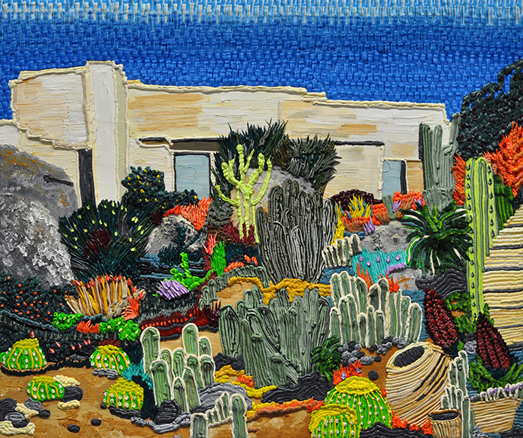
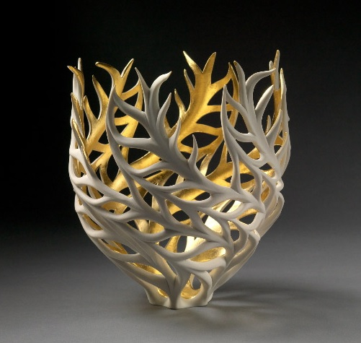
SURROUNDINGS

Slide 11
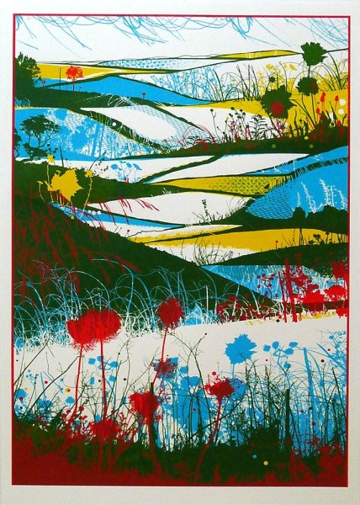
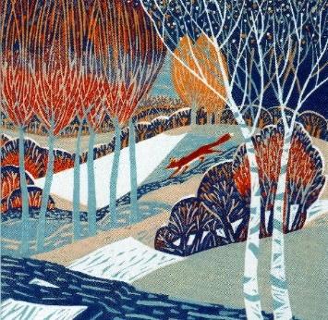
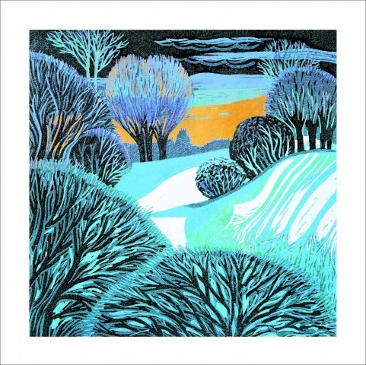

Slide 12
BRITISH WILDLIFE
In Art & Design, animals have been depicted in a variety of ways. Sophie Ryder sculpted the hare as a symbolic subject, textile artist Nicola Henley makes embroidered panels reflecting the aerial movement of coastal birds. Mark Powell reuses old envelopes as canvases to produce incredible biro drawings of Birds. Study appropriate sources and produce your own work inspired by British wildlife.

Slide 13
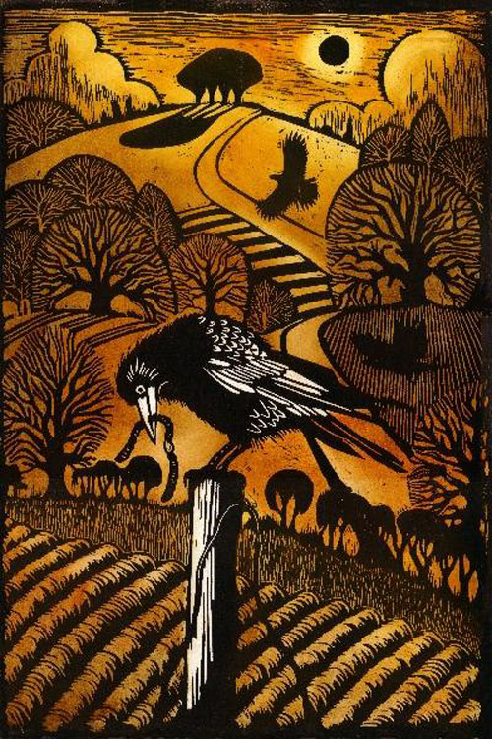
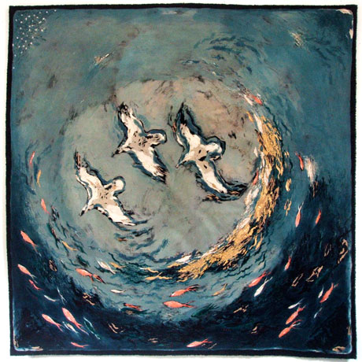
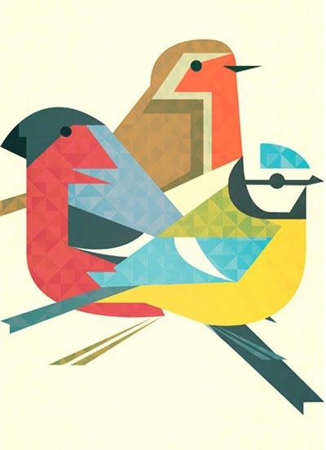
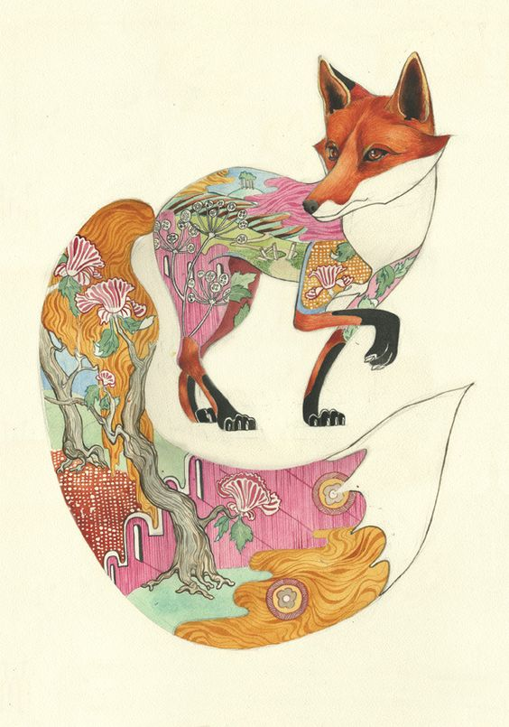
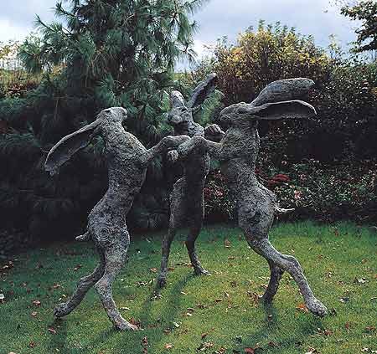
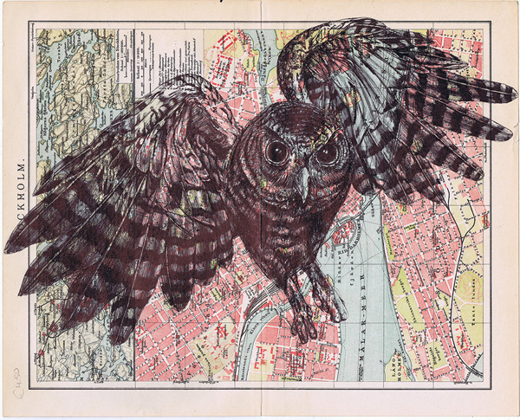
BRITISH WILDLIFE

Slide 14
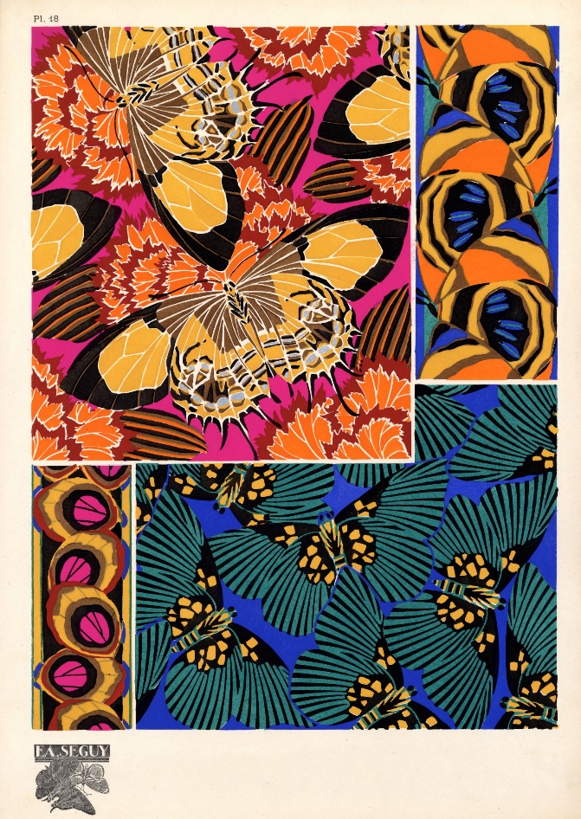
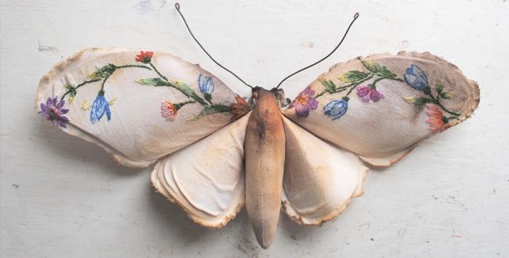
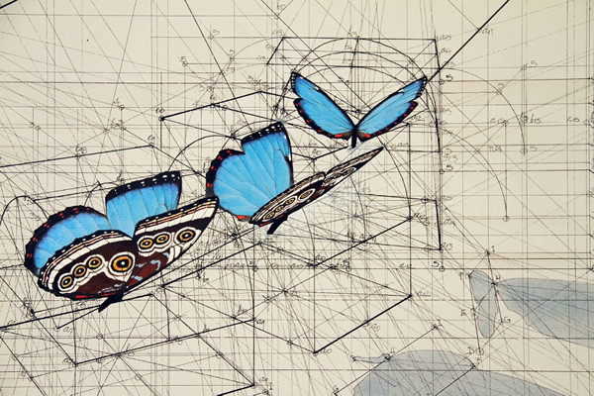
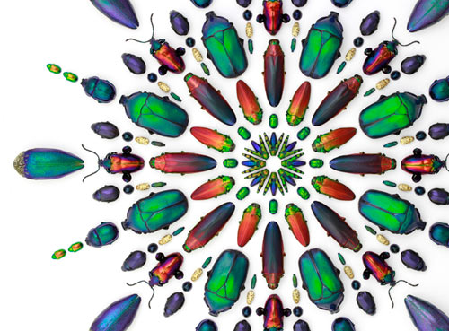
INSECTS

Slide 15
