Slide 1
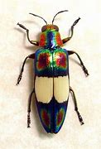
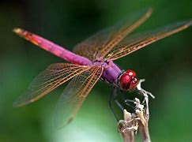
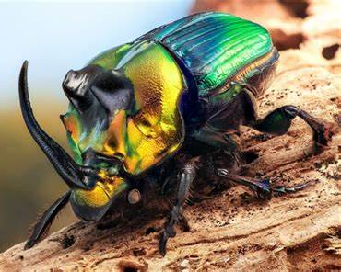
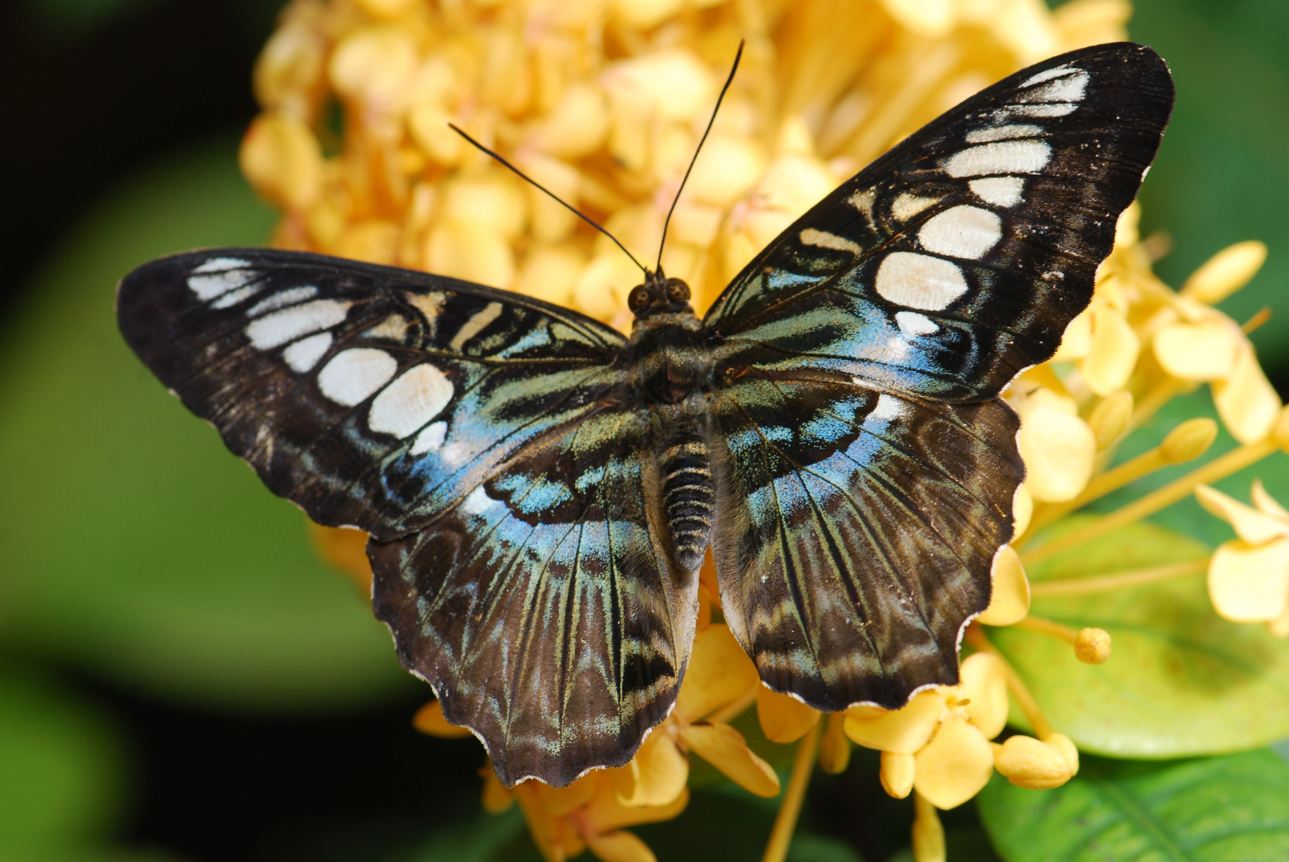
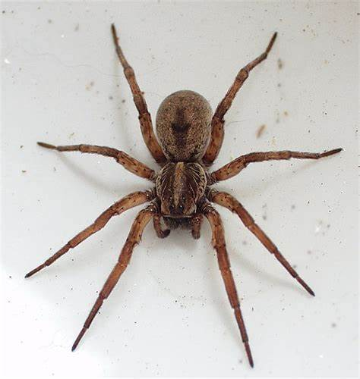
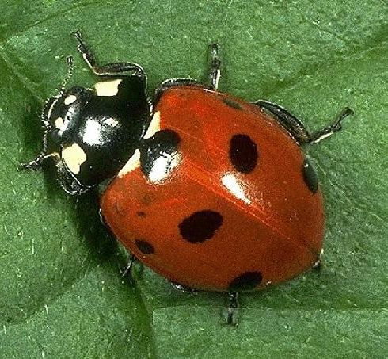
Year 8 : Freaky Creepy
Lesson 1
Draw an insect of your choice. Find an image to draw from on the internet, use any media that you have available to you , try to fill an A4 page with your drawing.

Slide 2
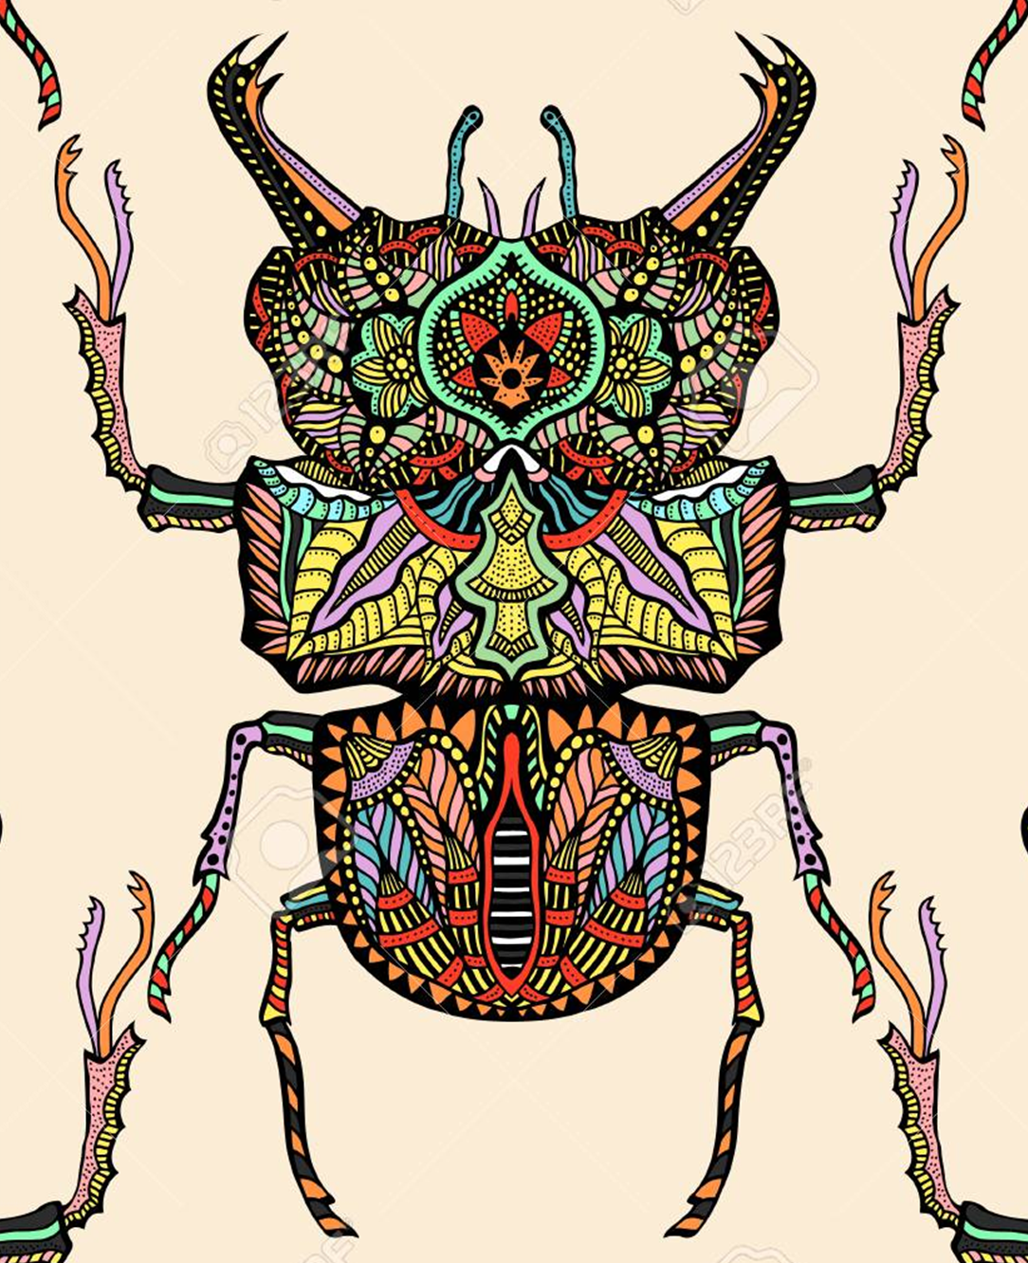
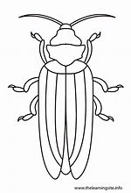
Lesson 2
Draw the OUTLINE of an insect of your choice. Fill the shape with intricate, detailed patterns in colour or black & white

Slide 3
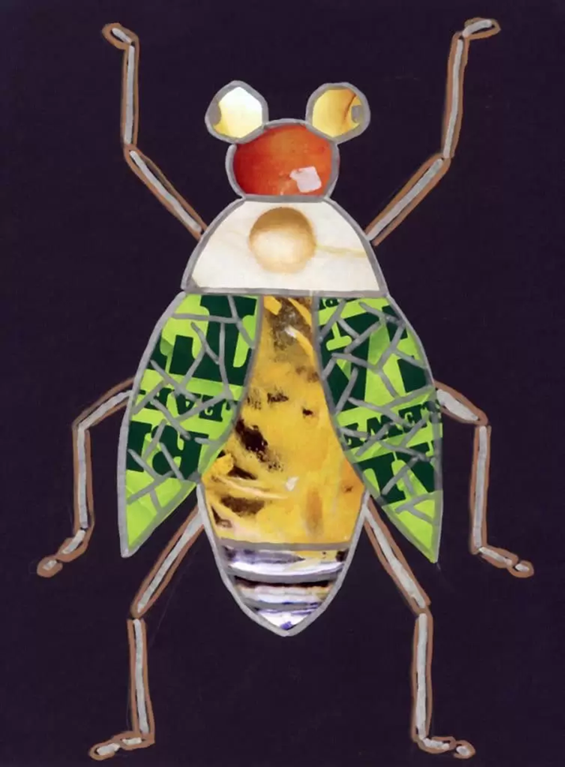
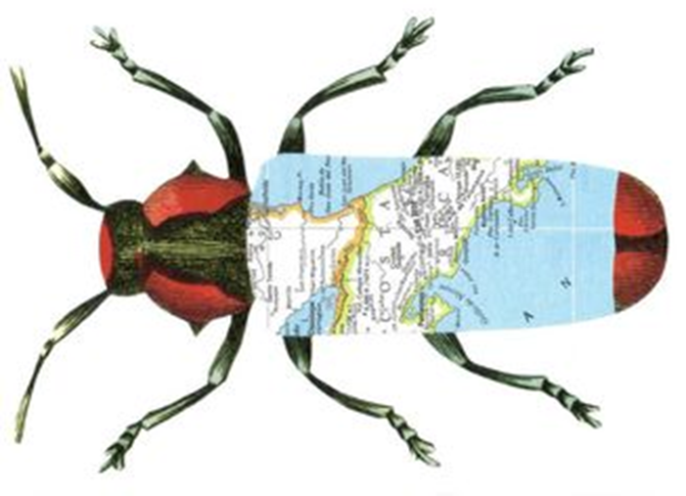
Lesson 3 & 4
Create a collage of an insect using any materials that you have available to you. You could use magazines, any paper surfaces, fabric
Use A3 paper, look at the examples for ideas

Slide 4
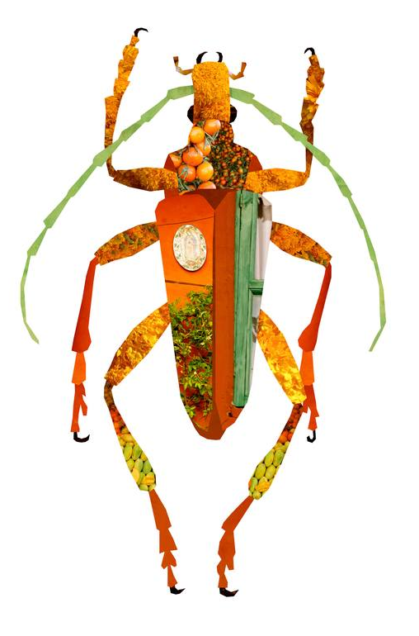
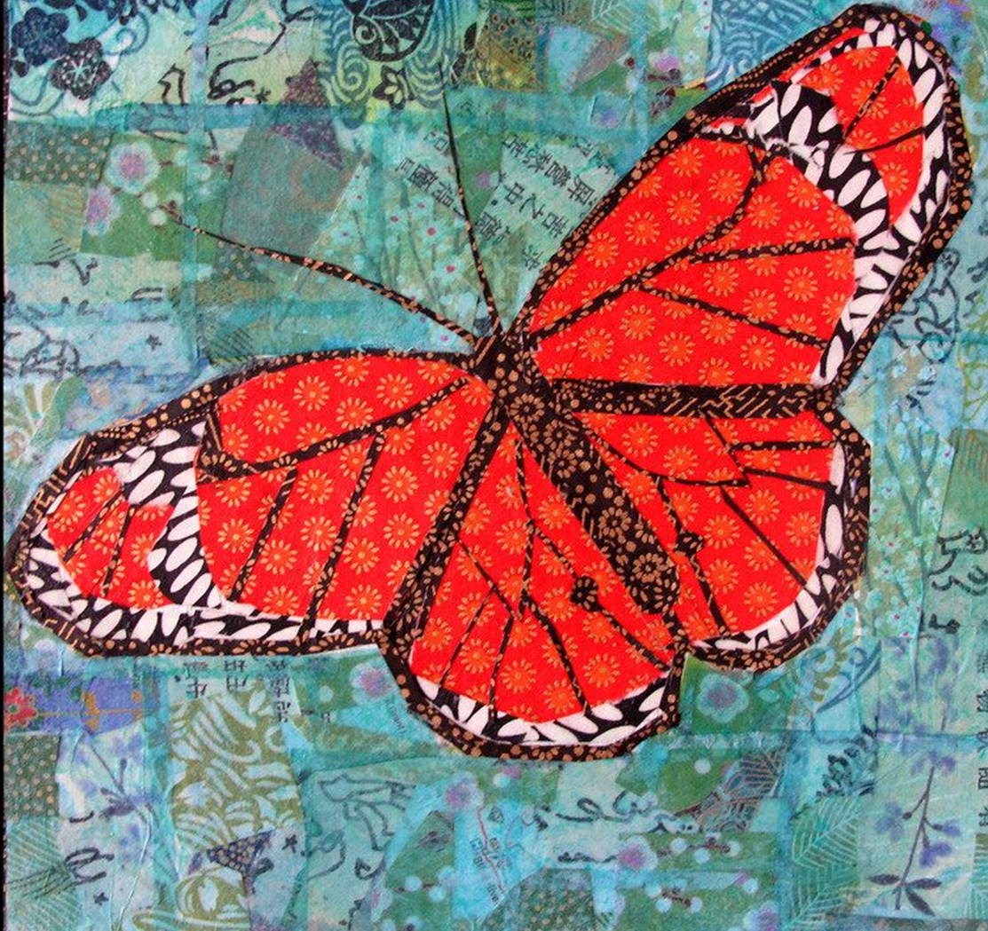

Slide 5
Lesson 5 & 6
Find a Youtube clip to follow on how to draw an insect of your choice. Use pencil
You can use the links here that I have found or choose your own
How to draw a bumble bee
https://www.youtube.com/watch?v=PMzxlV59mSE
How to draw a Tarantula
https://www.youtube.com/watch?v=I3MMI-UcLfA
How to draw a butterfly
https://www.youtube.com/watch?v=I3MMI-UcLfA

