Slide 1
Yr. 7 Art
Food Glorious Food
01.03.2022– 4.04.2022

Slide 2
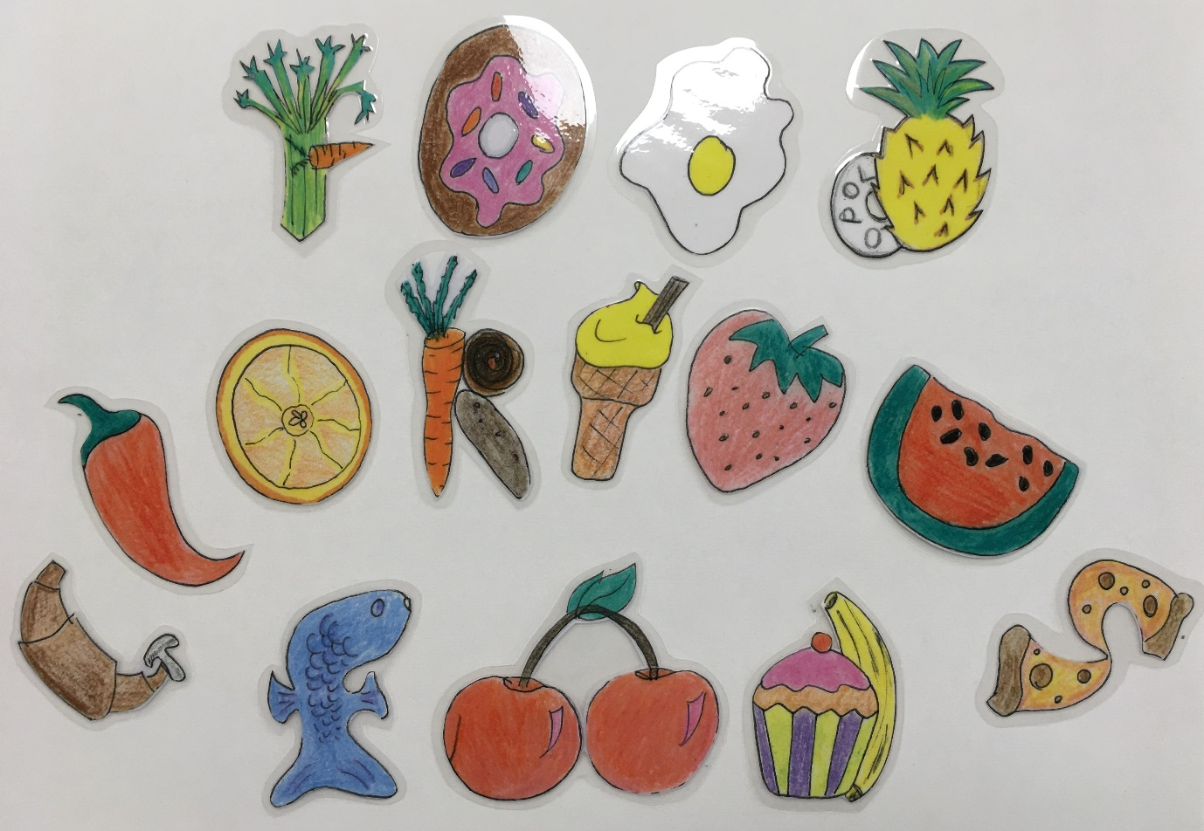
Title – Week 1 &2
Create the title ‘Food Glorious Food’ by drawing images of food to represent the different letters.

Slide 3

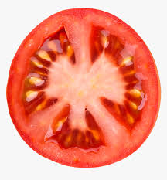
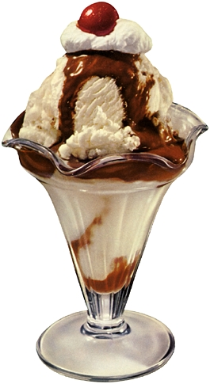
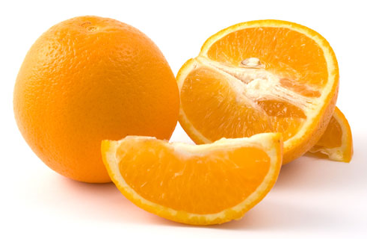
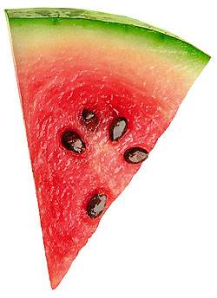
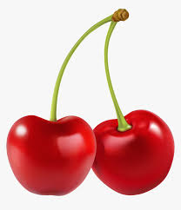
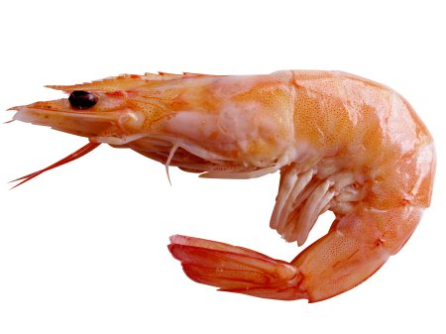
To help you get started look at these images of food and see if you can recognise letters of the alphabet.

Slide 4
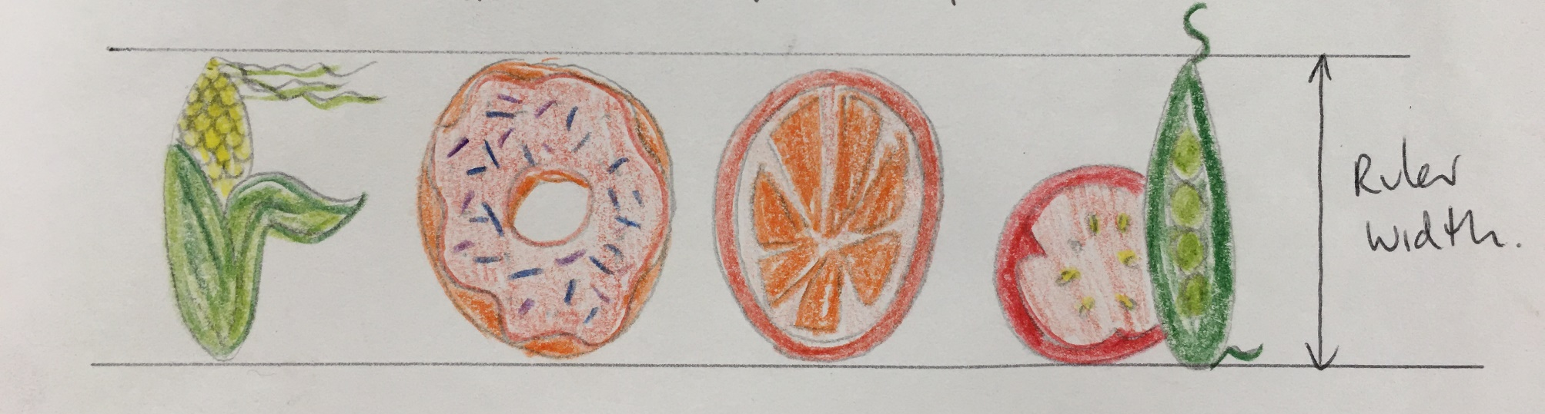
Draw your letters on an A4 piece of paper.
It’s a good idea to use guide lines to help with the size. The width of a 30cm rule is a good size to use.
Colour them in.
Cut them out, keep safe!

Slide 5
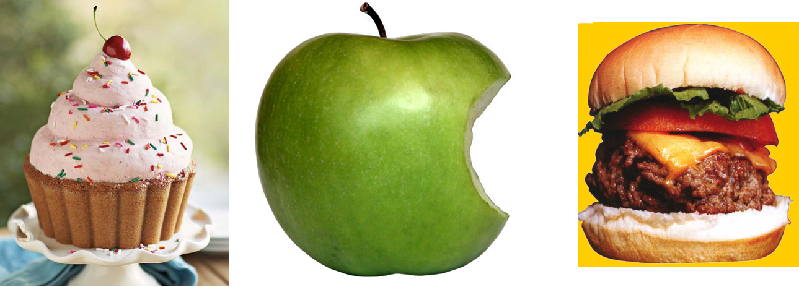
Draw a full colour image of an easily recognisable food item. This should fill an A4 page
E.G. A cup cake, piece of fruit, hamburger
Background design. Week 3

Slide 6
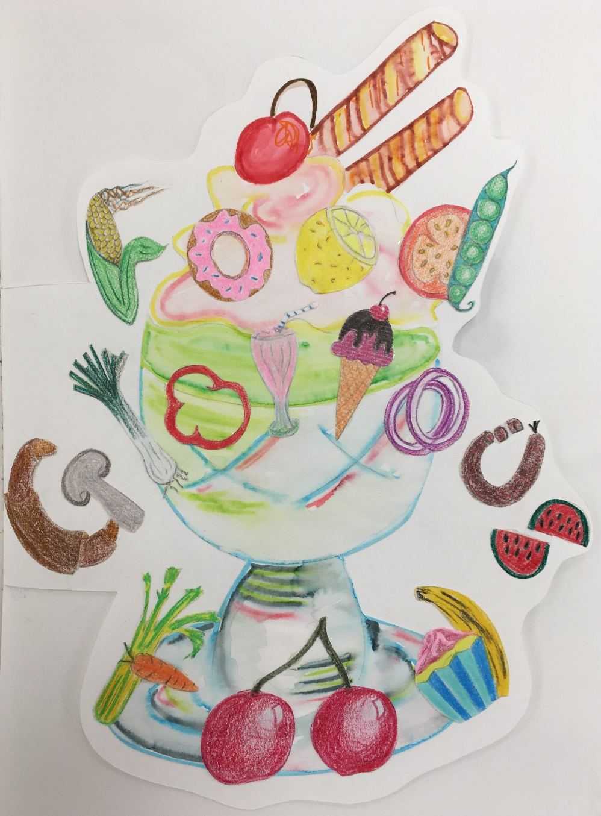
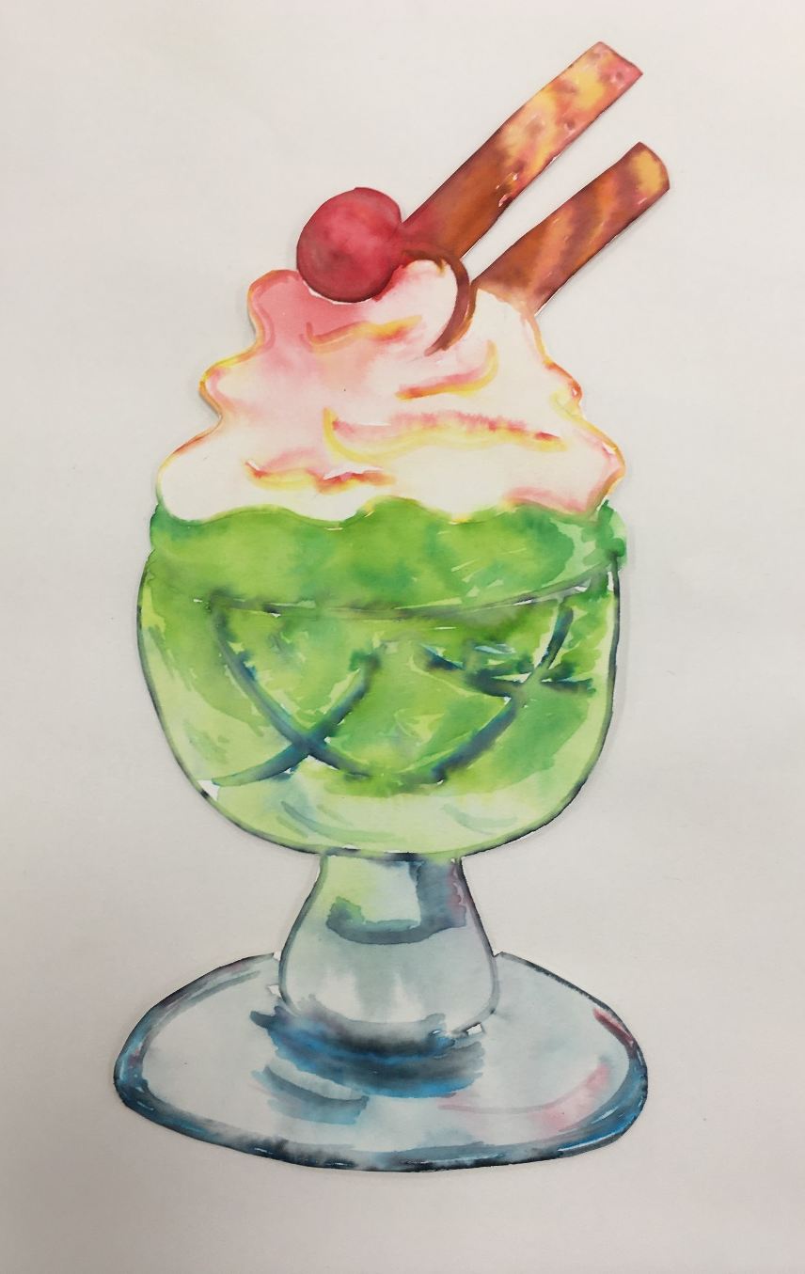

Slide 7
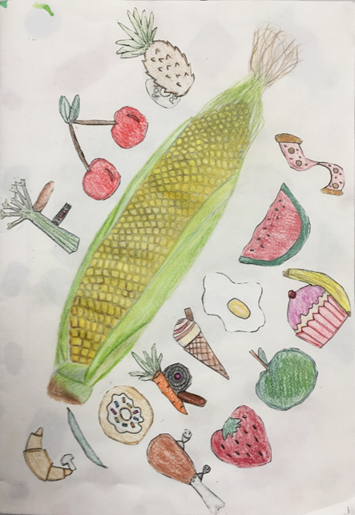
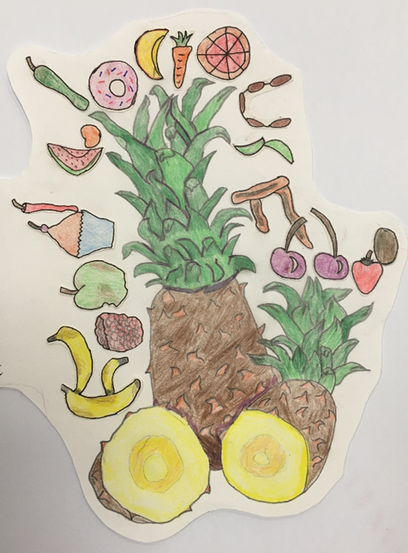
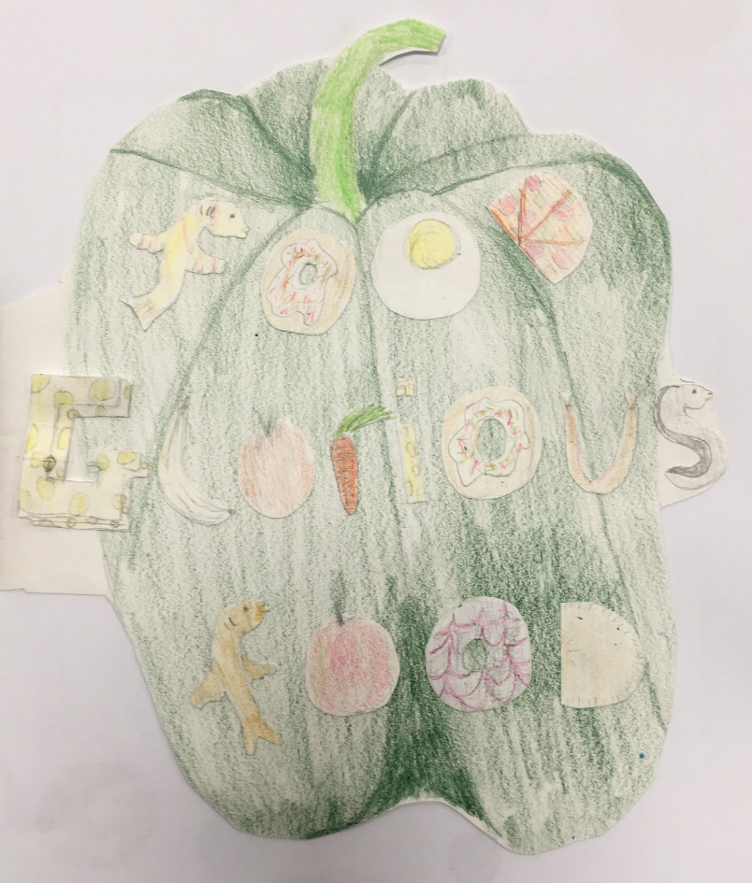
Glue your cut out letters onto your background design.
Week 3 cont.

Slide 8
Dingbats Quiz. Week 4
What are Dingbats?
Dingbats are visual word puzzles from which a well known phrase or saying has to be identified.
For example
            ( Answer - Pie in the Sky)
See how many of these food related Dingbats you can solve on the next slide.
SπKY

Slide 10
Extra Challenge…..
Can you create your own food / drink related dingbat???

Slide 11
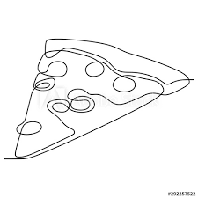
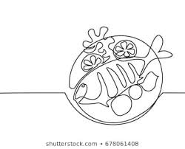
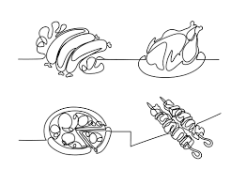
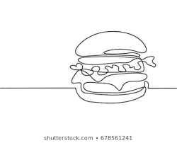
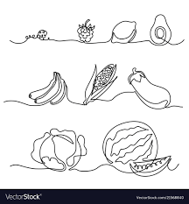
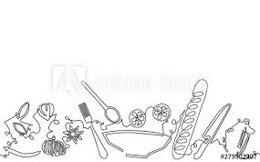
Continuous line drawing. Week 5

Slide 12
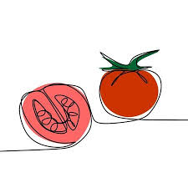
Continuous line drawing
Use either a pen or pencil.
Select an item of food to draw e.g. tomato Ketchup bottle / Marmite Jar / a sandwich / ice cream….
On an A4 piece of paper draw the food item without taking your pen / pencil off the page. It’s harder than it sounds!
Due to the nature of the style of drawing this will not be a perfect representation.
Add colour (you may take your pen /brush off the page for this part)

Slide 13
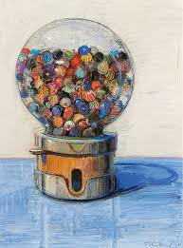
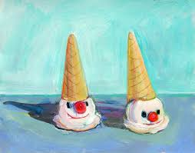
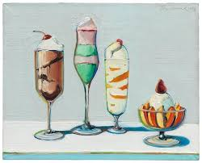
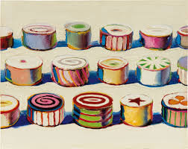
Produce an A3 research page on Wayne Thiebaud, remember to include;
Research Artist – Week 6 & 7
  Title (name of the Artist)
  Information about the artist
  Your opinion of the artist work
  A collection of images by the artist
  A Drawing or painting in the style of Wayne Thiebaud

