Slide 1

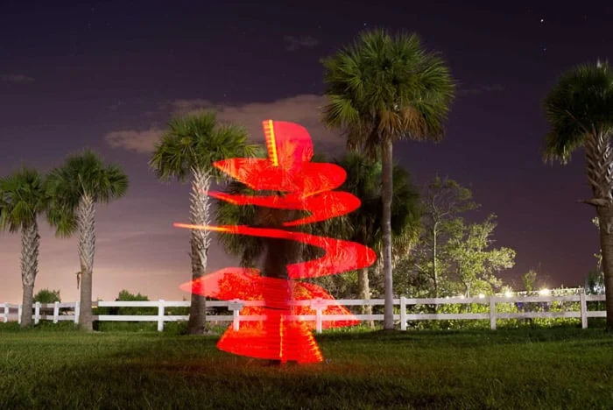


The 30 Day Creative Photography Project – 30 Trick Photography Ideas

Slide 2
Year 11 Photography
https://expertphotography.com/30-creative-photography-projects/
Visit this website. Choose a technique to try at home. Ensure that you take plenty of photographs to be used at school when you return.

