Slide 1


Year 7 German rotation 1: Echo 1 textbook, chapter 1
If pupils are absent from lessons they should spend time revising and learning vocabulary. All of the vocabulary for this term is on the following slides. First of all, they should recap the vocabulary which they learned the previous week. Then they should start to learn the next section of vocabulary which they have not yet covered in class. This could be done by using the look, cover, write, check method or by making flashcards etc. It should also be copied in to their orange books. There are also a few tasks to complete. A plan for the term is on the next slide.
Pupils can also revise vocabulary on Linguascope-
Username is kingshill password is mfl123*
Any new vocabulary they learn can be written in their orange books or on paper.
If pupils wish to do extension work they can access free MFL lessons on the Oak National Academy website:
https://classroom.thenational.academy/subjects-by-key-stage

Slide 2
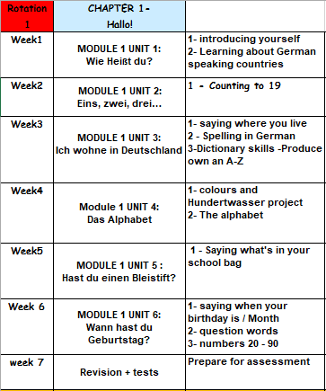

Slide 3

WEEK 1 – w/c 3rd Jan
This term you will study German. Make a German title page in your orange book. Ideas for the design are below (Do not do anything to do with Nazi Germany please):

Slide 4
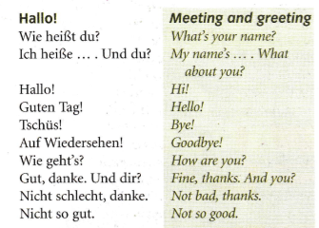
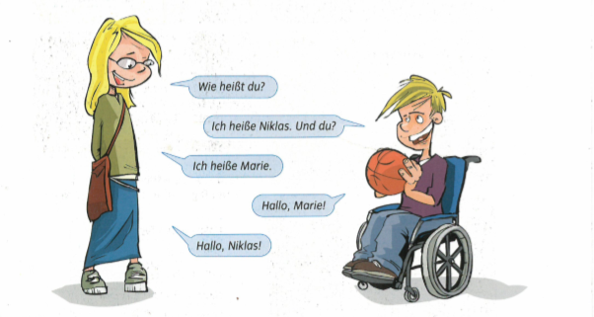
Copy this vocab in to your book and learn it.
Read the conversation. Translate it in to English

Slide 5



Slide 6
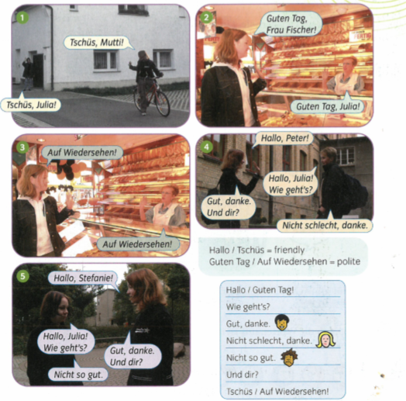
Listen to the conversation and read along. Work out what it means in English.

Slide 7
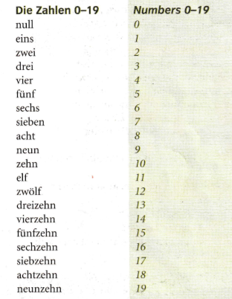

WEEK 2 – w/c 10th Jan
Copy this vocab in to your book and learn it.

Slide 8
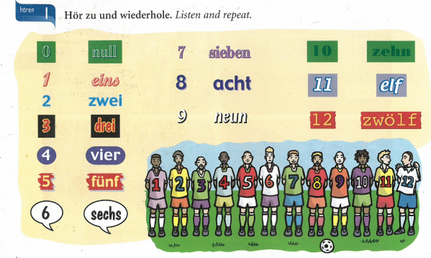

Slide 9

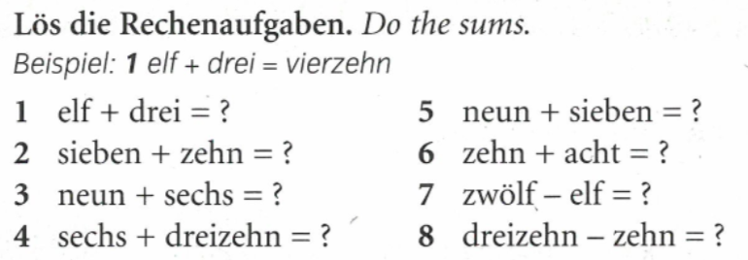
Practise your numbers on Linguascope next.

Slide 10
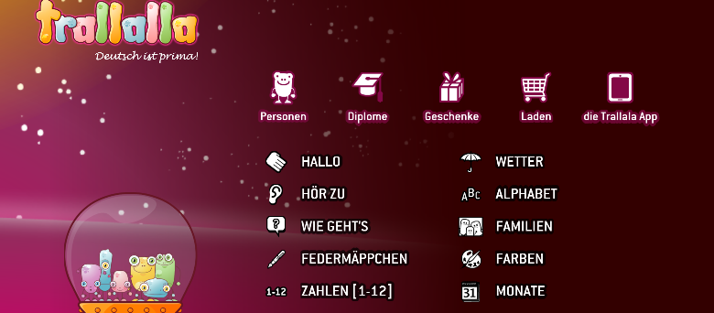
Practise the numbers 1-12 on the elementary section of Linguascope. Username = kingshill Password = bonjour123

Slide 11
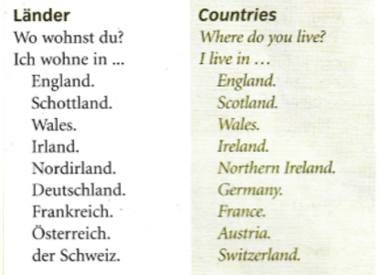
WEEK 3 – w/c 17th Jan
Copy this vocab in to your book and learn it.

Slide 12
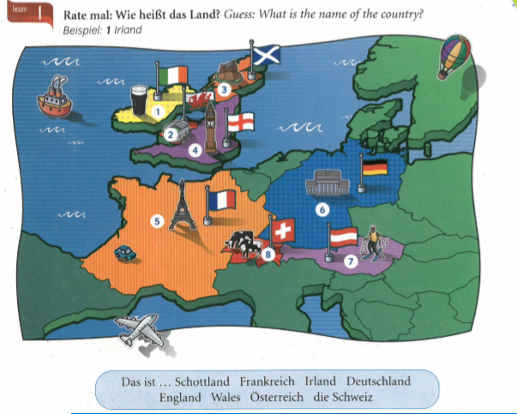

Slide 13


Slide 14
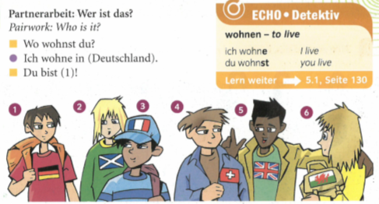
Write a sentence for each person as though you are them, e.g.
1. Ich wohne in Deutschland

Slide 15
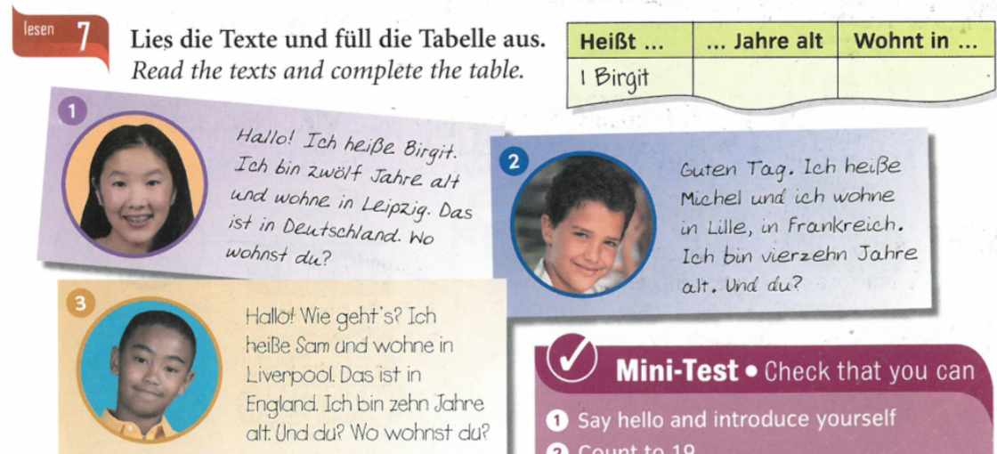
Practise your countries on Linguascope next.

Slide 16
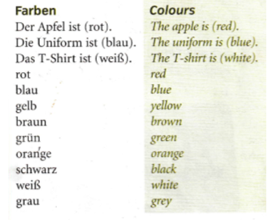
WEEK 4 – w/c 24th Jan
Copy this vocab in to your book and try and learn it.

Slide 17
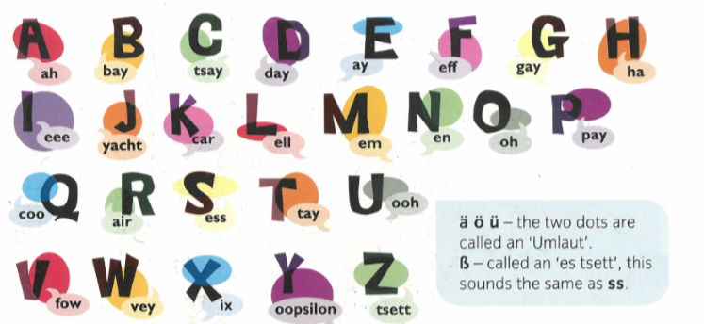
Listen and repeat

Slide 18
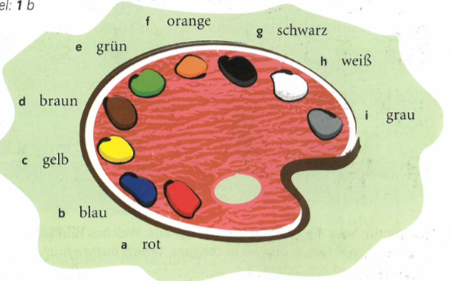
Make a colours poster in your book

Slide 19
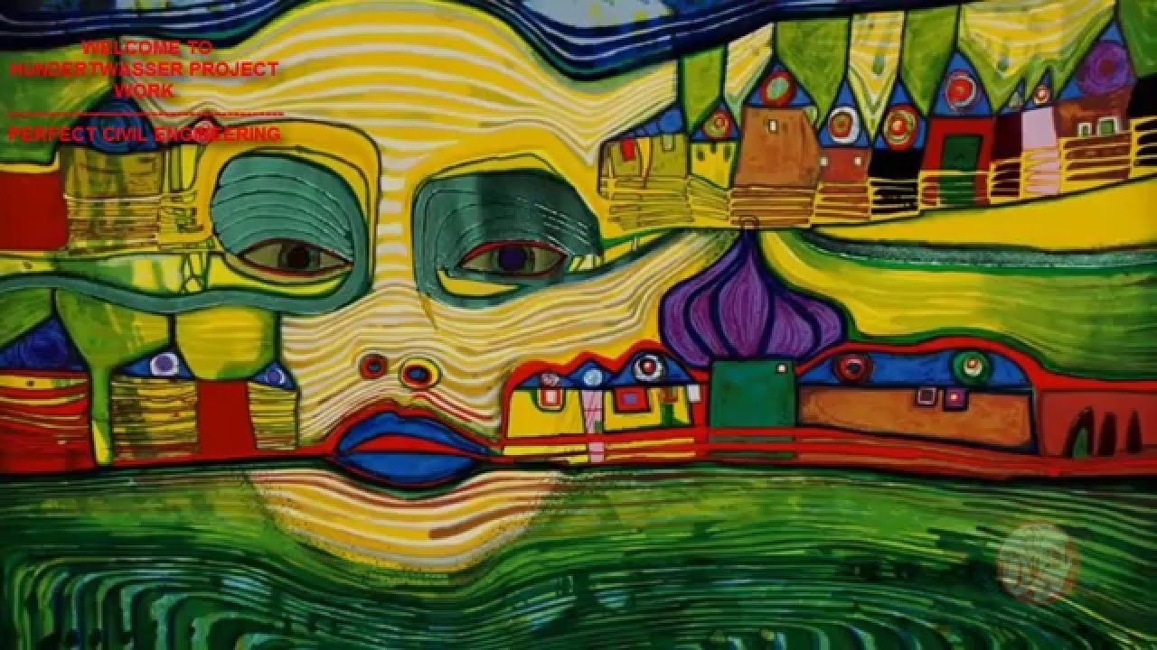
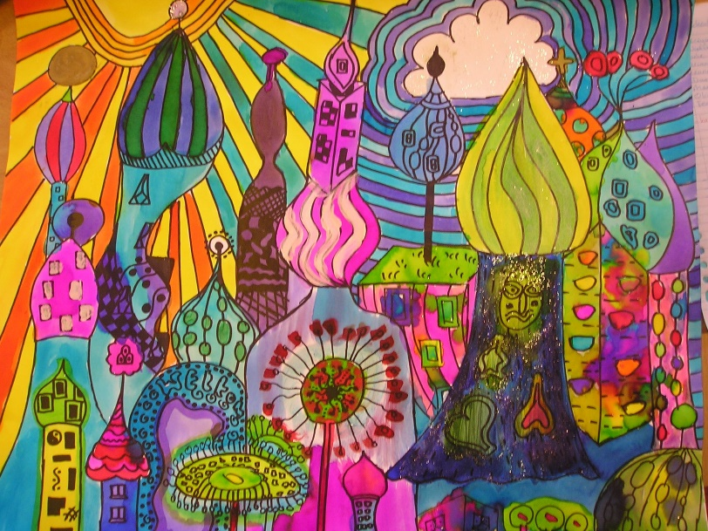
Hundertwasser
This week we are looking at something cultural. Look at the following slides about the Austrian artist Hundertwasser. Then have a go at some art in his style.
German Culture and Art lesson Year 7

Slide 20
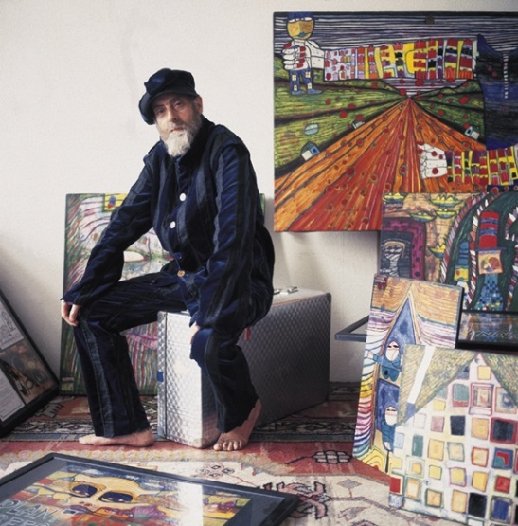
Friedensreich Regentag Dunkelbunt Hundertwasser was an Austrian-born New Zealand artist and architect who worked also in the field of environmental protection.
Born: 15 December 1928, Vienna, Austria
Died: 19 February 2000, Pacific Ocean
Period: Modern art
Full name: Friedrich Stowasser
Structures: Hundertwasserhaus,
KunstHausWien, Waldspirale, Kuchlbauer Tower
Hundertwasser would wear odd socks and often odd shoes. He did not like how people all dressed the same . How fashion dictated what people wore and felt that each person should dress with an individual style.

Slide 21
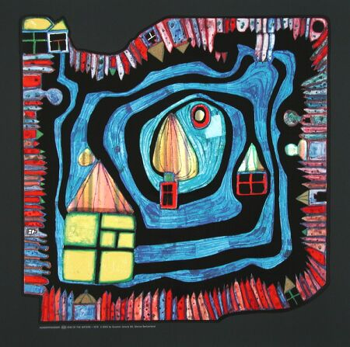
Hundertwasser loved the shapes of features on buildings.
What do you see in this artwork of his?

Slide 22
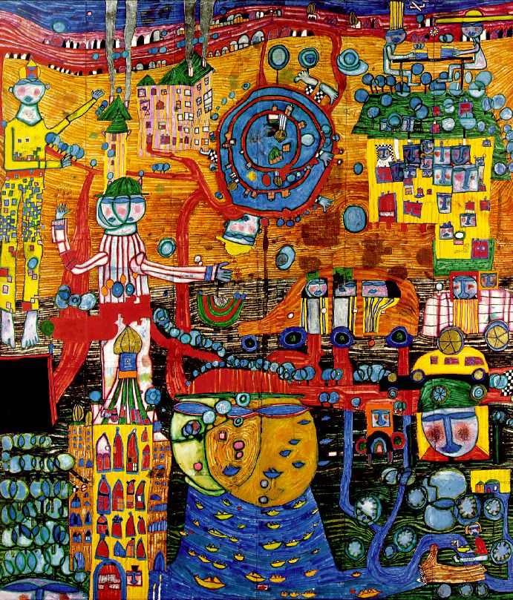
Welche Farben sind da? (Which colours are there?)
1. Write down in the back of your book in German all the colours you see
rot
blau
gelb
weiß
grün
schwarz
gold
grau
braun

Slide 23
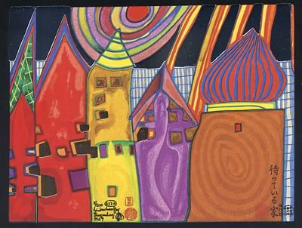
More Hundertwasser buildings in artwork

Slide 24
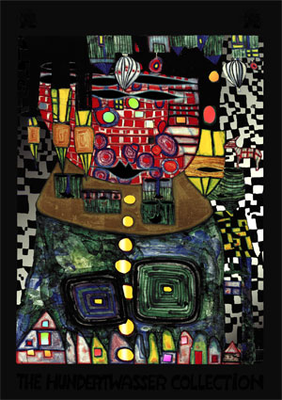

Slide 25
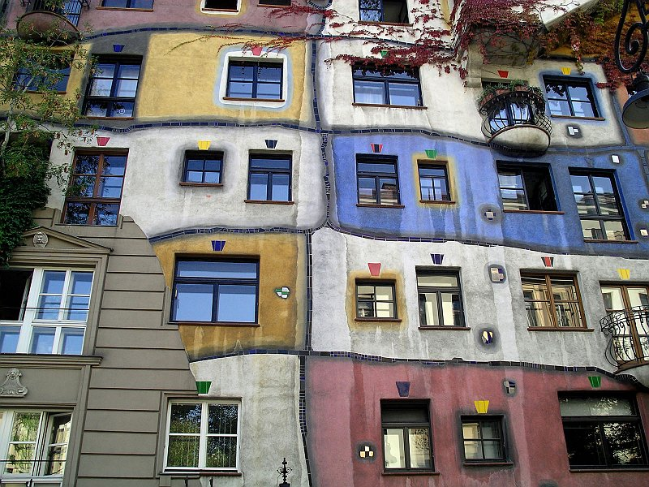
He also liked to paint real buildings.

Slide 26
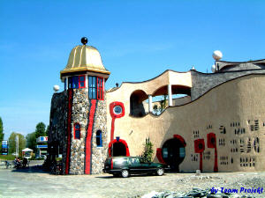
He even designed his own buildings.
This is a market hall.

Slide 27
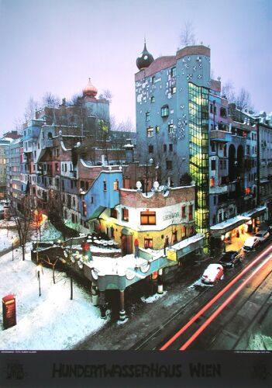
This is a block of flats in Vienna, the capital of Austria.

Slide 28

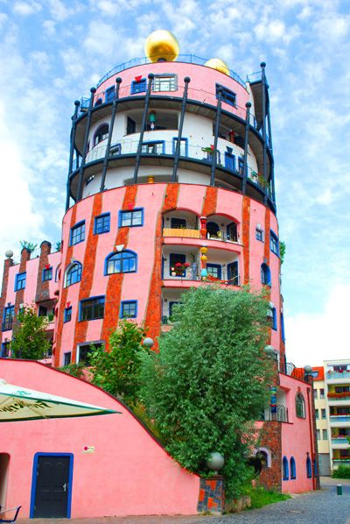
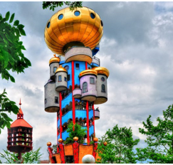
Think about the shapes, patterns and colours of Hundertwassers buildings.
How would you brighten up this block of flats.
Draw a simple version like this black and white image in your books and turn it in to Hundertwasser inspired architecture. You have 10 minutes!

Slide 29
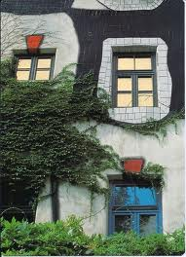
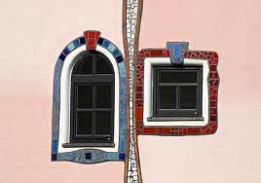
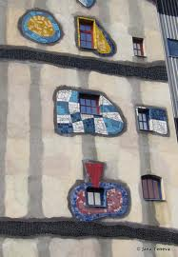
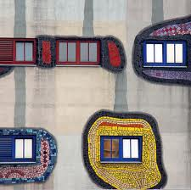
Window
Right
People cannot all afford to build their own houses to their own specification or change a block of flats. Hundertwasser thought it was important though to show that unique people lived behind every window of a property, and demanded that everyone should have the right to design the area around their window themselves.
He called the idea Window Right.
The idea was that as far as your arms reach that is the area round your window which belongs to you as your own private living space, and you should design it exactly as you like.
Paint it, grow flowers, put a frame around it , mosaic it, put chains on it, give it a hat and so on…..

Slide 30
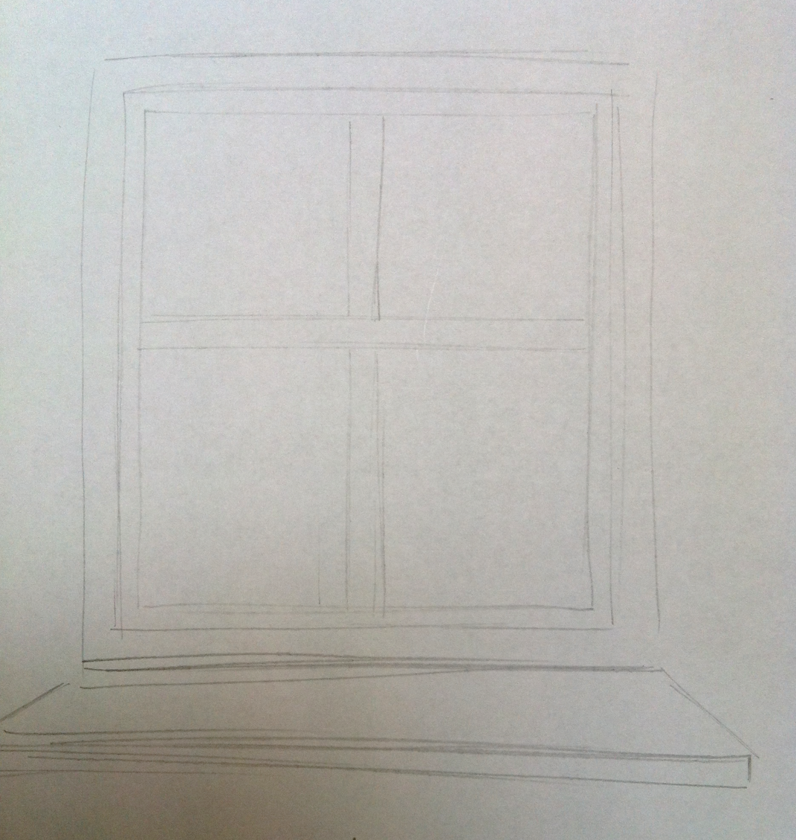
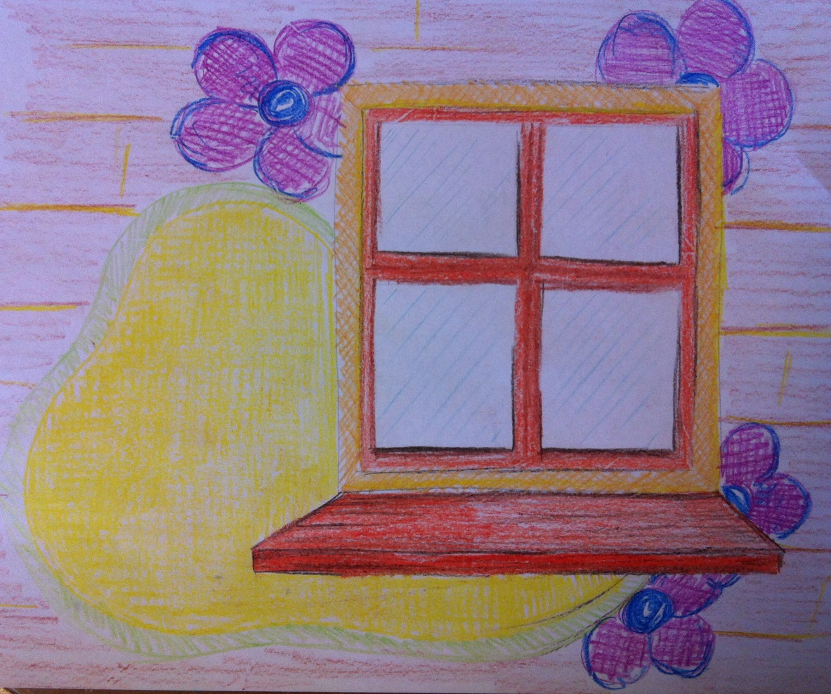
What would your window look like?
Draw a window outline
Now design your window. Be creative and try to show your personality.
Paint it, grow flowers, put a frame around it , mosaic it, put chains on it, give it a hat and so on…..

Slide 31
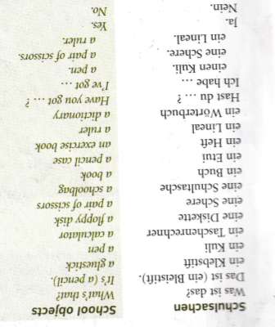
WEEK 5 – w/c 24th Jan

Slide 32
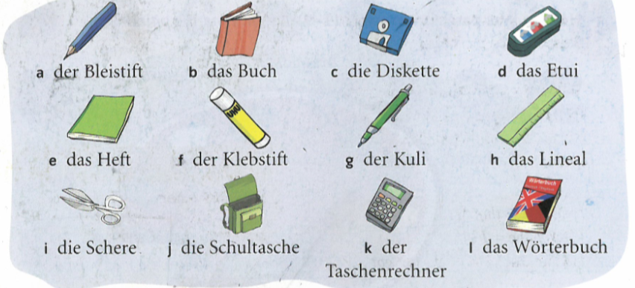
Make a stationery poster. Ignore ‘die Diskette’ as it’s not used any more
Practise your colours and stationery on Linguascope next.

Slide 33
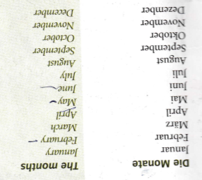
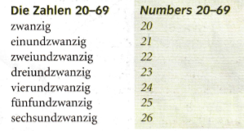
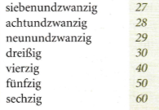
WEEK 6 – w/c 31st Jan
Copy this vocab in to your book and try and learn it.

Slide 34
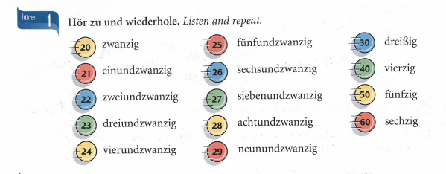

Slide 35
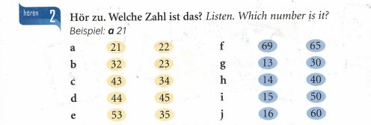

Slide 36
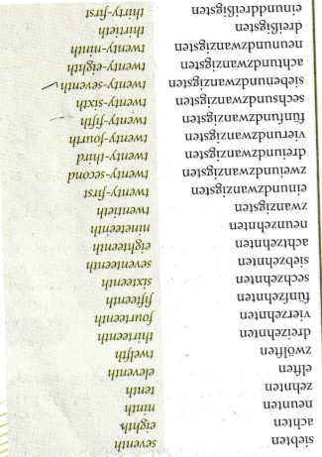
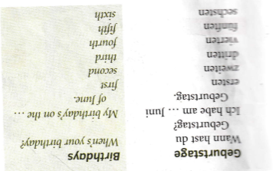
This is how you say your birthday. Can you work out your birthday? Use the list of dates on this slide to help you.

Slide 37
WEEK 7 – w/c 13th Dec
This week is assessment week. Spend some time revising all of the vocab on these slides so far (or use your vocab sheet in your orange book) and then email your teacher for the test papers.

