Slide 1


Year 9 German TERM 3: Echo 2 textbook, chapter 5
If pupils are absent from lessons they should spend time revising and learning vocabulary. All of the vocabulary for this term is on the following slides. First of all, they should recap the vocabulary which they learned the previous week. Then they should start to learn the next section of vocabulary which they have not yet covered in class. This could be done by using the look, cover, write, check method or by making flashcards etc. It should also be copied in to their orange books. There are also a few tasks to complete. A plan for the term is on the next slide.
Pupils can also revise vocabulary on Linguascope-
Username is kingshill password is mfl123*
Any new vocabulary they learn can be written in their orange books or on paper.
If pupils wish to do extension work they can access free MFL lessons on the Oak National Academy website:
https://classroom.thenational.academy/subjects-by-key-stage

Slide 2
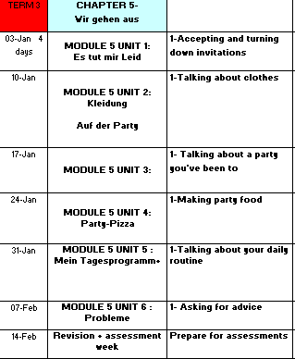

Slide 3
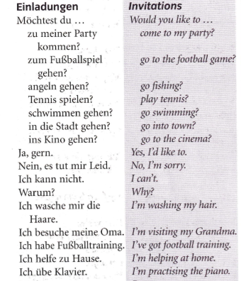
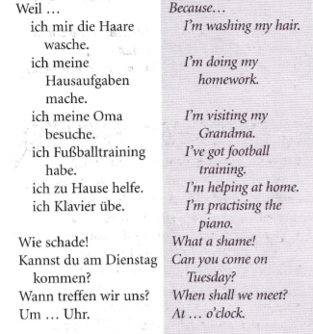
WEEK 1 – w/c 3rd Jan
Copy this vocab in to your book and spend some time trying to learn it.

Slide 4
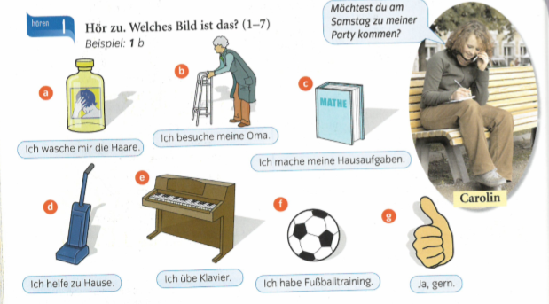

Listen to the recording. Which pictures is it? Example, 1b

Slide 5
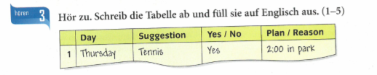
Listen to the recording. Copy out the table and fill it in.

Slide 6
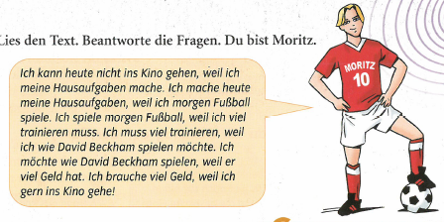
Answer the questions in English
1- Why are you doing your homework today?
2- Why are you playing football tomorrow? (Morgen=tomorrow)
3- Why would you like to play like David Beckham?
4- Why do you need lots of money? (brauchen=to need)
5- Why can’t you go to the cinema today?

Slide 7

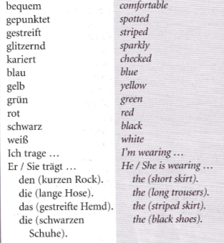
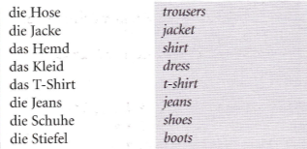
WEEK 2 – w/c 10th Jan
Copy this vocab in to your book and spend some time trying to learn it.

Slide 8







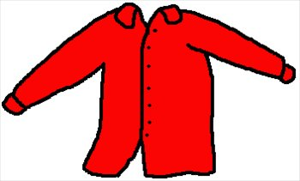

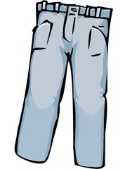
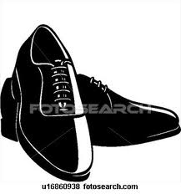

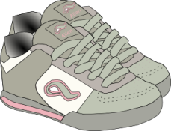
Kleidung- clothing
Make a poster of your favourite outfit or your school uniform and label it.
der Pullover
der Rock
die Baseballmütze
die Hose
die Bluse
die Jacke
das Hemd
das T-Shirt
das Kleid
die Jeans
die Stiefel
die Schuhe
die Sportschuhe

Slide 9
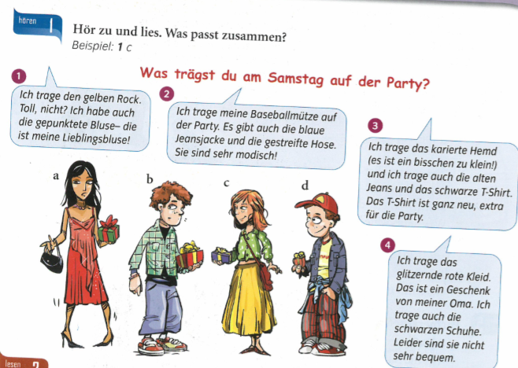
Task 4 p80
Read the
texts.
Match up the
People to the speech
Bubbles e.g. 1c

Slide 10
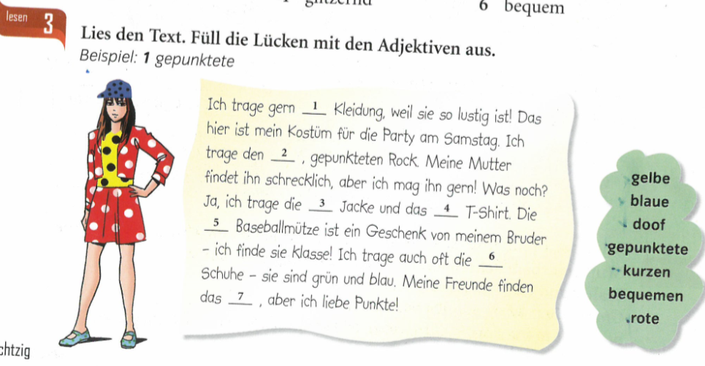
Task
2 p80
Read the text. Which adjectives make sense for the missing numbers 1-7?

Slide 11
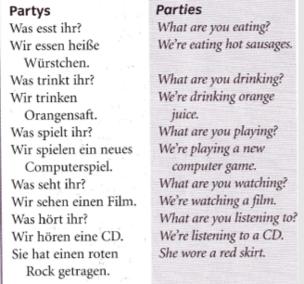
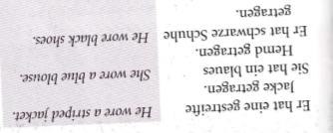
WEEK 3 – w/c 17th Jan
Copy this vocab in to your book and spend some time trying to learn it.

Slide 12
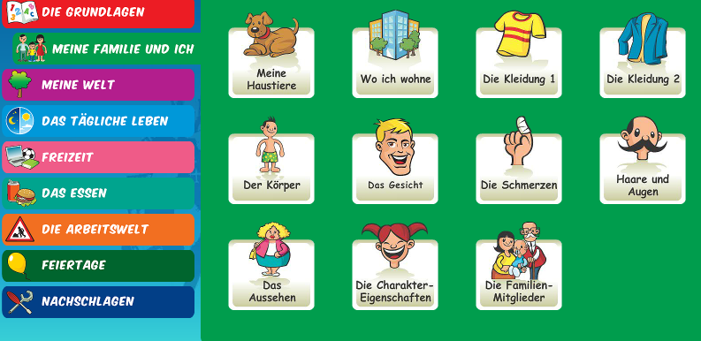
Recap clothing from last week
Log on to www.linguascope.com in the beginner section
Username- kingshill
Password – mfl123*
Then, play some of the games in the green section on Kleidung 1 + 2.

Slide 13
Ich trage – I wear/I am wearing
Ich habe …getragen – I wore
Recap of other past tense-
Ich habe gespielt – I played
Ich habe gegessen – I ate
Ich habe getrunken – I drank
Ich bin gegangen – I went
Ich bin gefahren – I travelled/ went
Remember your past tense – make a note of these phrases

Slide 14
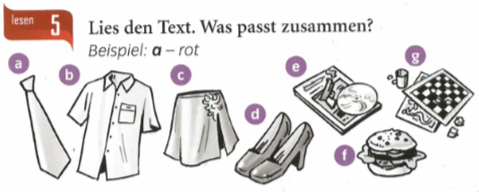
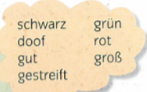
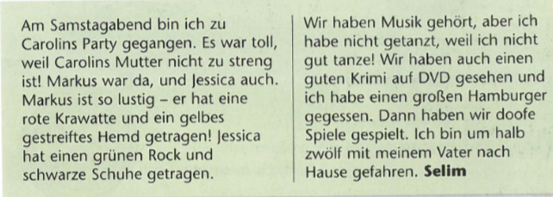
Read text. Choose a word from the cloud for items a-f

Slide 15
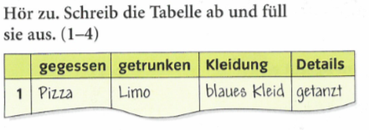
Copy out this table. There are 4 people talking. Allow about 3 lines per person for the answers. Write (in German) what they ate, drank, what they wore and any other details.

Slide 16
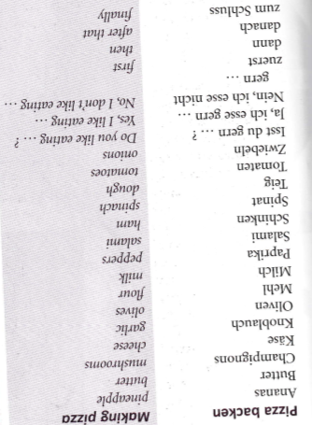
WEEK 4 – w/c 24th Jan
Copy this vocab in to your book
and spend some time trying to learn it.

Slide 17
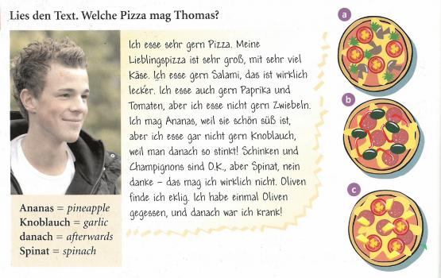
Read the text. Look up any new vocabulary and add it to your orange books. Then look at the 3 pizzas. Which one does Thomas like – a, b or c?
ekelig = disgusting

Slide 18
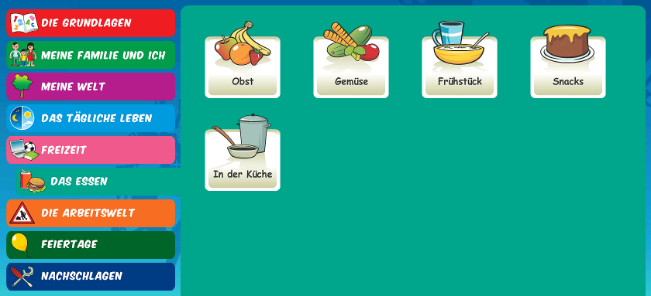
Log in to Linguascope. Make a list of new vocabulary in your orange book. All five of these are good, especially the ‘in der Küche’ (in the kitchen) section
username - kingshill password – mfl123*

Slide 19
Make a poster of all your favourite things to eat and drink. Label the items in German.

Slide 20
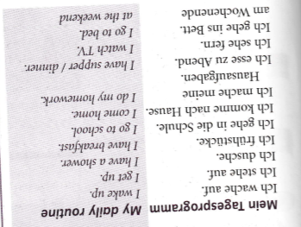

WEEK 5 – w/c 31st Jan
Copy this vocab in to your book
and spend some time trying to learn it.

Slide 21
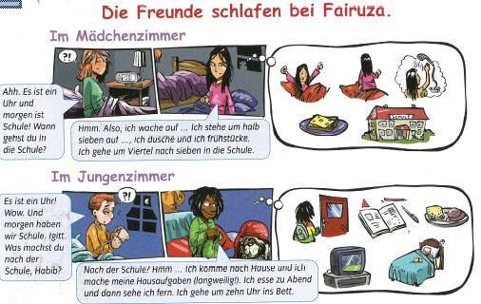
Listen to the text about the sleepover at Fairuza’s house.
p86

Slide 22
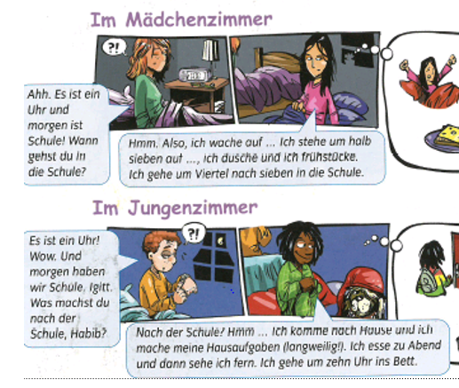
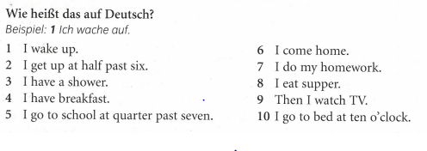
Read the texts again and then find the phrases below in German in the texts.

Slide 23
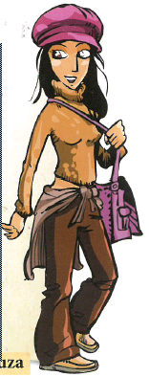
Read the text about Fairuza and her friend Katja and answer the questions in English.
1) What did you do yesterday? (3 things)
2)What did you think of the film and how did Katja find it?
3) What did you eat?
4) What did you and Katja drink?
5) Who was also there?
6) What are you doing next week?

Slide 24
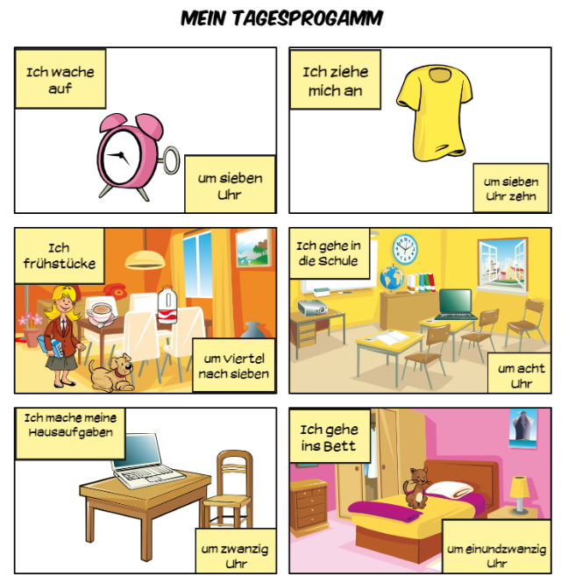
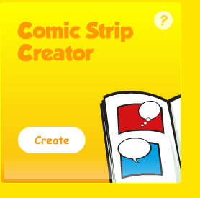
Go to Linguascope-
kingshill
mfl123*
Choose ‘Comic Strip creator’
You will find this below the elementary, beginner and intermediate sections
P95 of textbook will help.
Export your work and email it me at the end of the lesson.

Slide 25
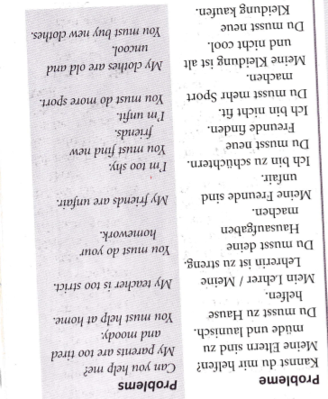
WEEK 6 – w/c 7th Feb
Copy this vocab in to your book
and spend some time trying to learn it.

Slide 26
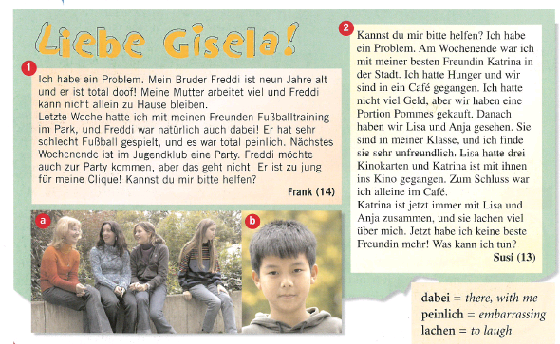
Read the two letters to the problem page ‘Dear Gisela’ from Frank and Susi. Look up any new words and write them in your orange books.
Give 3 details about Frank’s younger brother
Why does he have to look after his brother?
What did frank find embarrassing?
What is Frank doing next weekend?
What did Susi and Katrina do last weekend?
Who is Katrina?
Who did Katrina go to the cinema with?
What is the problem with Katrina, Lisa and Anja now?

Slide 27
WEEK 7 – w/c 14th Feb
This week is assessment week. Spend some time revising all of the vocab on these slides so far and then email your teacher for the test papers. There are also revision activities on the next slide.

Slide 28
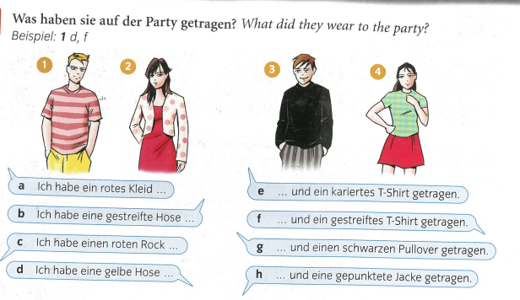

Slide 29
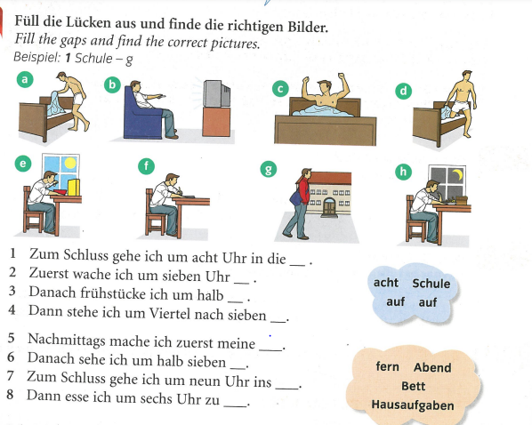

Slide 30
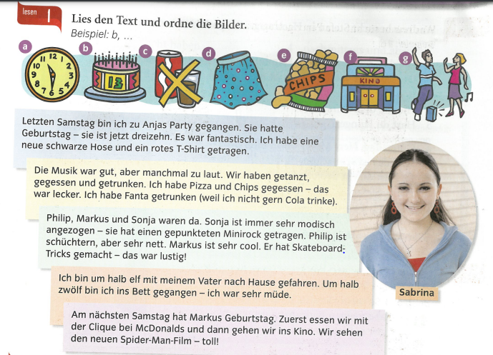
Read the text and put the pictures in order

