Slide 1


Year 9 French TERM 3: Studio 2 textbook, chapter 3
If pupils are absent from lessons they should spend time revising and learning vocabulary. All of the vocabulary for this term is on the following slides. First of all, they should recap the vocabulary which they learned the previous week. Then they should start to learn the next section of vocabulary which they have not yet covered in class. This could be done by using the look, cover, write, check method or by making flashcards etc.
Pupils can also revise vocabulary on Linguascope-
Username is kingshill password is bonjour123
Any new vocabulary they learn can be written in their orange books or on paper.
If pupils wish to do extension work they can access free MFL lessons on the Oak National Academy website:
https://classroom.thenational.academy/subjects-by-key-stage

Slide 2
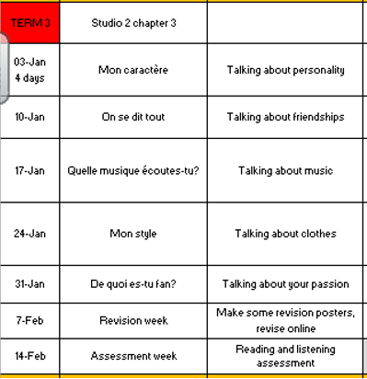

Slide 3
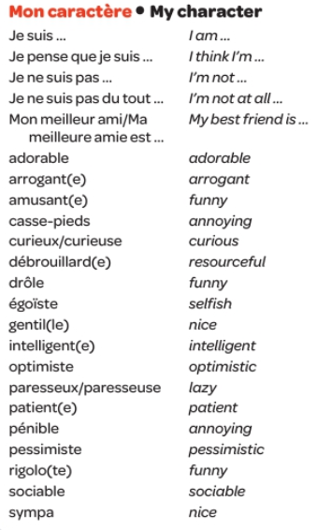
Week 1 vocab

Slide 4

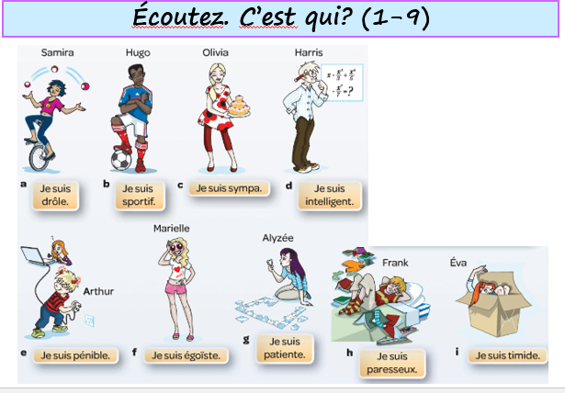
Week 1 w/c 3rd Jan
Copy the vocab into your book and translate it into English. Then do the listening activity, who are they talking about? Write their name in your book.

Slide 5
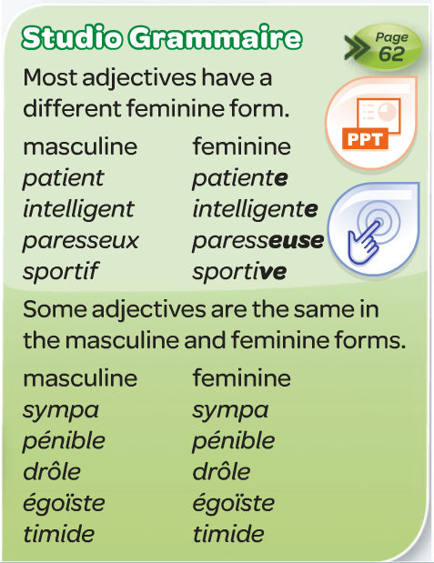
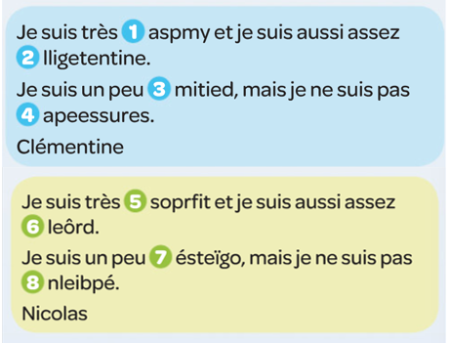
Read the texts and rewrite the jumbled up words. Then copy the green grammar box into your book.

Slide 6
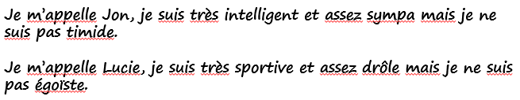
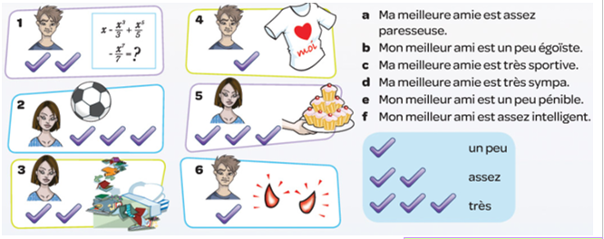
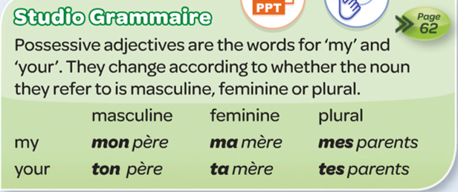
Copy and translate the texts then write one of your own.
Then, match up the pictures with the expressions.
Finally, copy the green grammar box into your book.

Slide 7
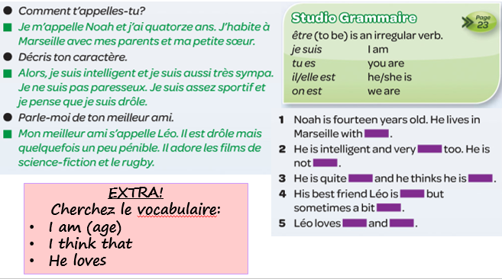
Read the texts and complete the sentences.

Slide 8
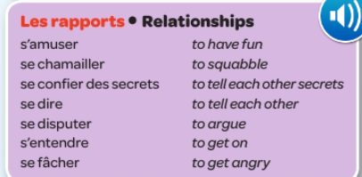
WEEK 2 – w/c 10th Jan
Week 2 vocab

Slide 9
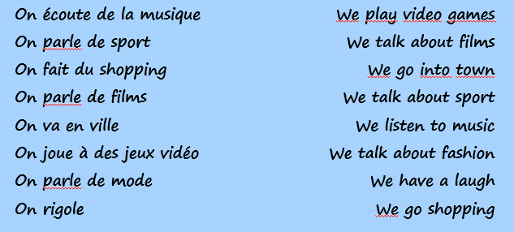
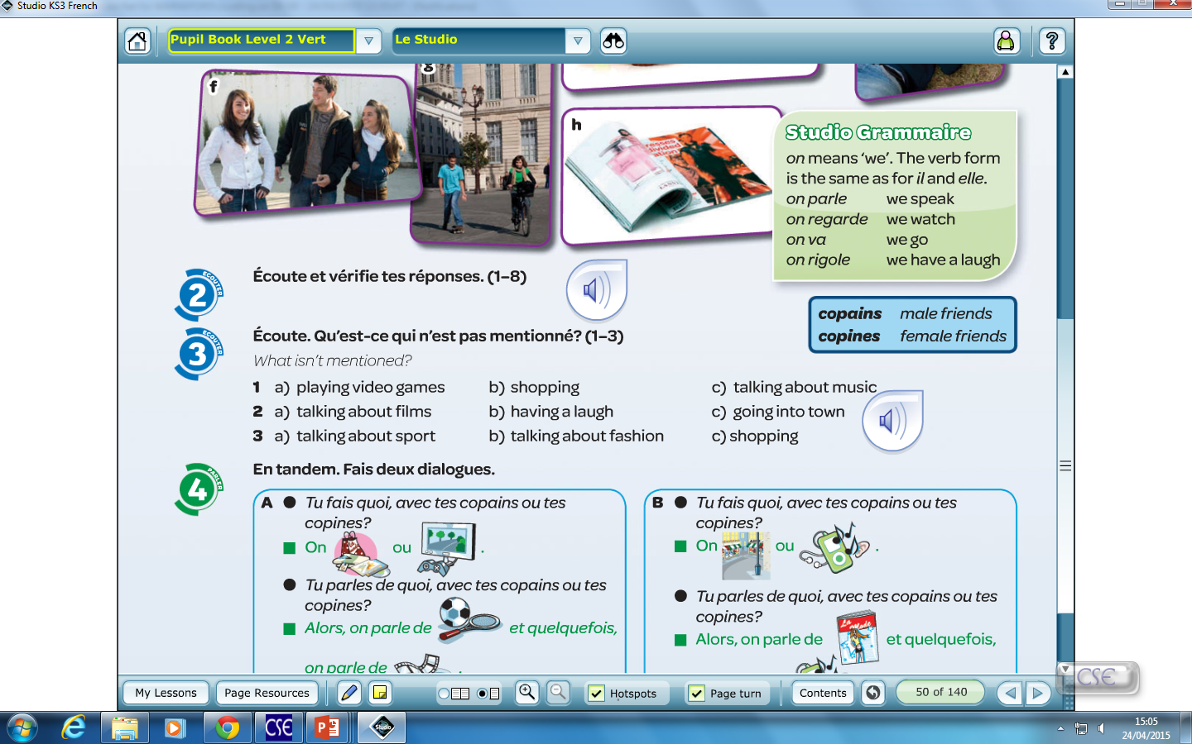
Week 2
Write the sentences in your book and match them up with the correct English.
Then do the listening activity. Which activity is not mentioned?
Then, write the sentences in your book and translate them.
On parle de films et on rigole.
On écoute de la musique. C’est fantastique.
Normalement on parle de sport mais quelquefois on joue au foot, c’est génial.
Tu fais quoi avec tes copains?

Slide 10
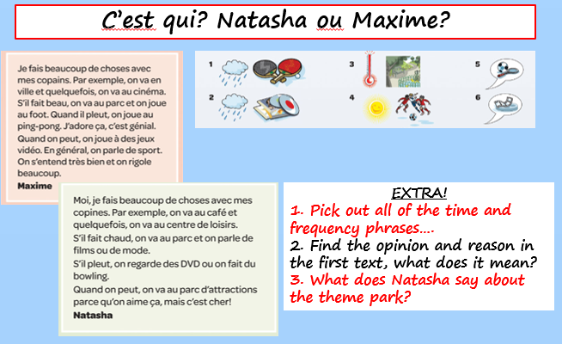
Read the texts and decide if the activities are done my Natasha or Maxime.

Slide 11
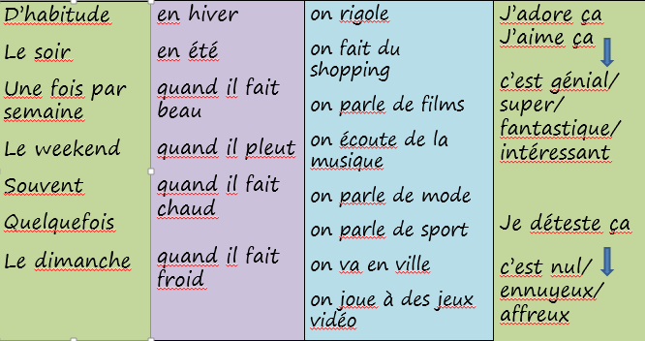
Use the grid to write a paragraph about what you do with your friends. Translate it into English.

Slide 12
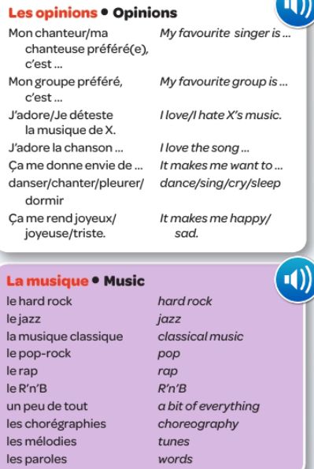
WEEK 3 – w/c 17th Jan
Week 3 vocab

Slide 13
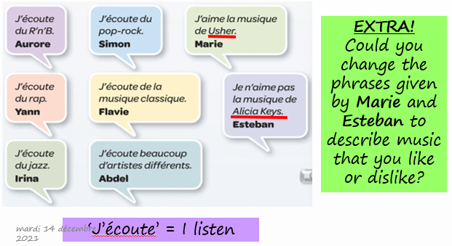
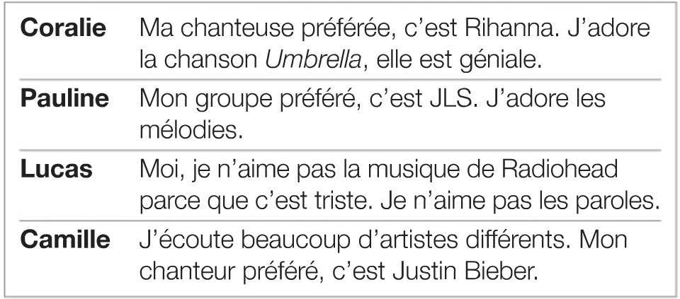
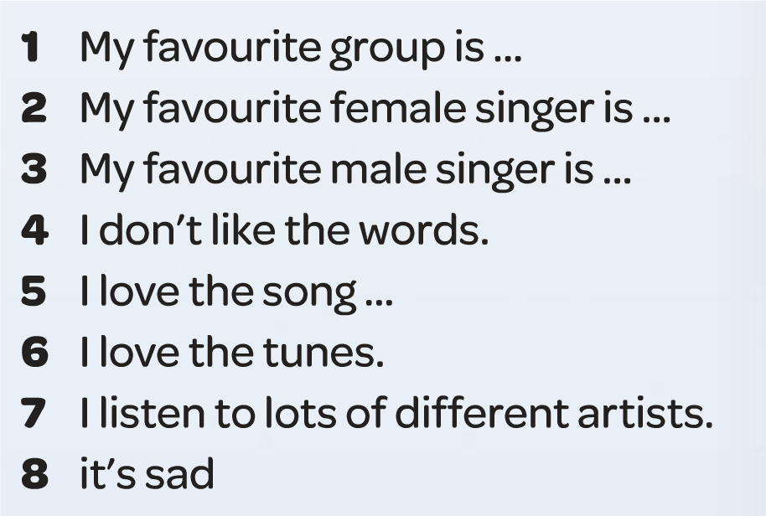
Week 3
Copy and translate the sentences. Adapt them to say what you like and dislike.
Then, fine the expressions in the text and copy them into your book.

Slide 14
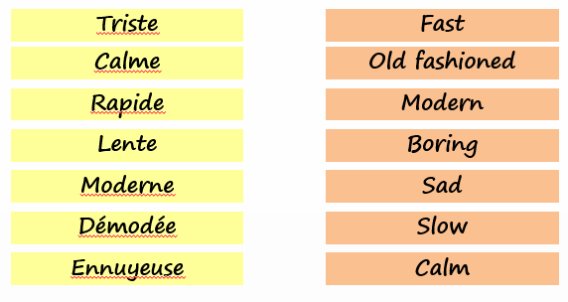
Match up the English and French adjectives.
Then, use the grid to write some sentences about the kind of music you listen to. Translate it into English.
J’aime |  | pop rock |  | rapide / lent
J’adore |  | R’n’B |  | calme
Je n’aime pas | la musique | rap | parce que c’est | triste
Je déteste |  | jazz |  | ennuyeux
J’écoute de… |  | classique |  | moderne /démodé
J’aime… | la chanson… | Hello
 | la musique de… | Ellie Goulding
 | les melodies / les paroles
Mon groupe préféré c’est… | Arctic Monkeys
Mon chanteur préféré c’est… | Ed Sheeran
Ma chanteuse préférée c’est… | Adele

Slide 15
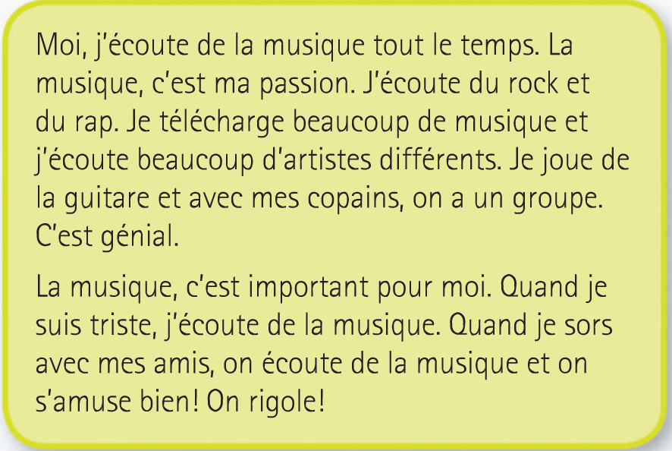
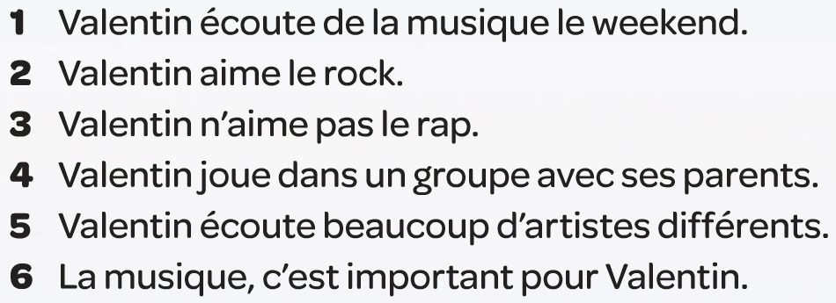
Read the text, which 3 sentences are correct. Translate the text into English.

Slide 16
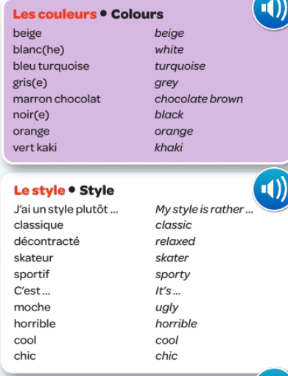
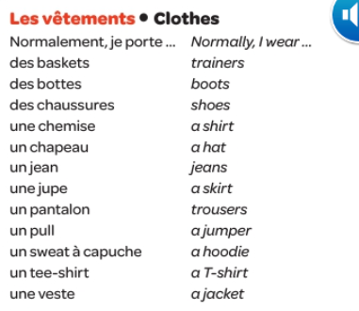
WEEK 4 – w/c 24th Jan
Week 4 vocab

Slide 17
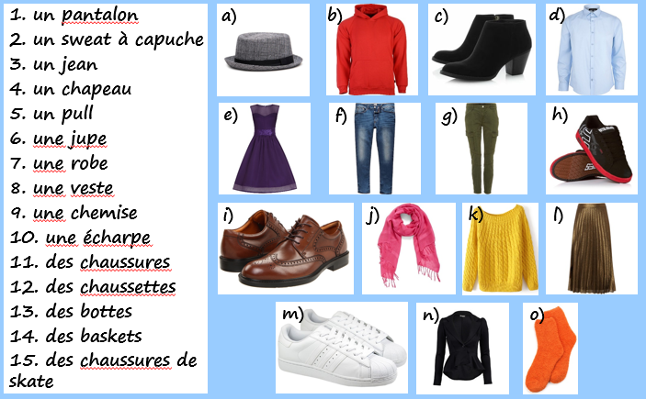
Week 4
Copy the clothes into your book and translate them into English. Draw a picture for each one.
Play some games on quizlet to practice the vocab:
quizlet clothes revision

Slide 18
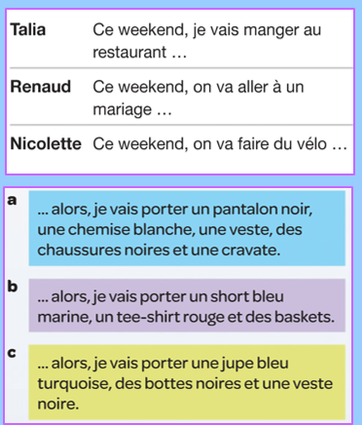
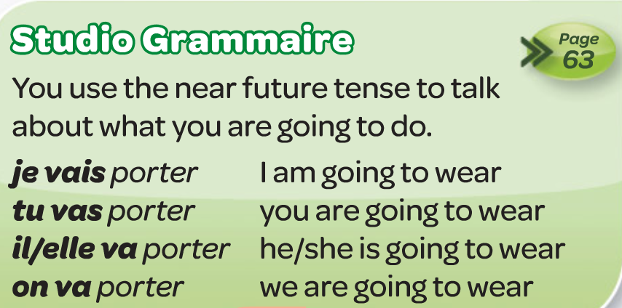
Copy the Studio Grammaire box into your book.
Then, work out who is going to wear what to each event. After you have matched them and copied it into your book, translate it into English.
EXTRA!
Trouvez le vocabulaire:
This weekend
So
A tie
A pair of shorts
Navy blue

Slide 19
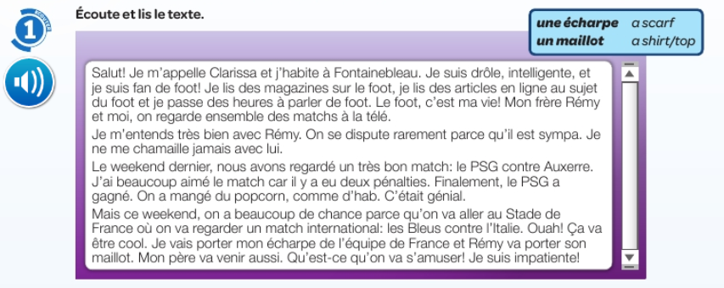
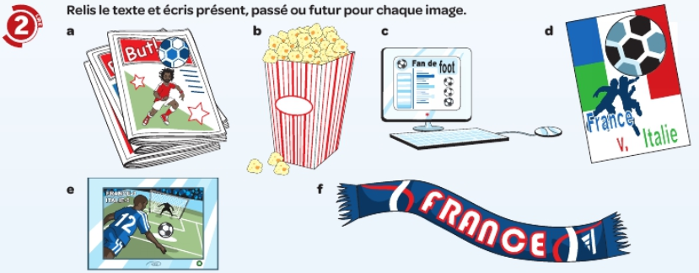
WEEK 5 –
w/c 31st Jan
Read the text, look up any unknown words and say whether each activity is in the past, present or future.

Slide 20
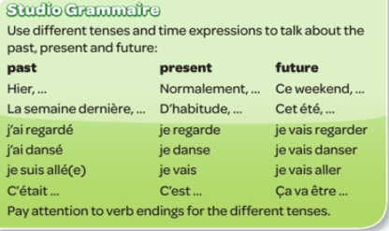
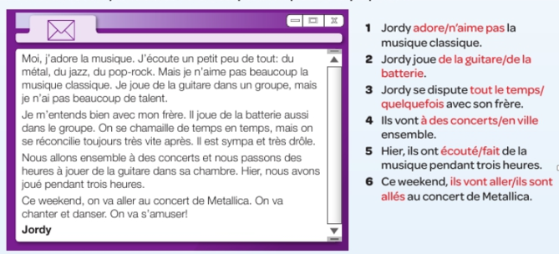
Copy the studio grammaire box and see if you can translate the expressions. If you aren’t sure you can use www.wordreference.com to help you.
Then, read the email and write the 6 sentences choosing the correct word.
If you need more work, learn as many words from the term as you can.

Slide 21
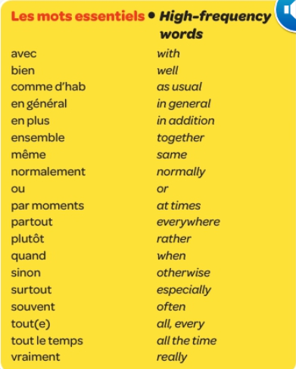
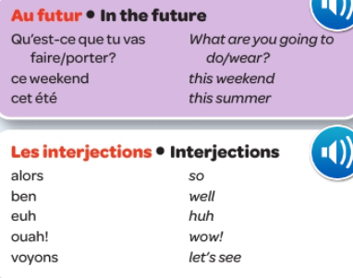
Extra vocab

Slide 22

WEEK 6 – w/c 7th Feb
This week is revision week. You need to revise all of the work that we have done this term, use this presentation for all of the vocab lists.
You can also revise on this quizlet set:
Studio 2 module 3 revision

Slide 23

WEEK 7 – w/c 14th Feb
This week is revision and assessment week. Contact Mrs Millar for the assessment papers. Spend some time revising all of the vocab on these slides.

