Slide 1


Year 8 Spanish TERM 3: Viva 1 textbook, chapter 3
If pupils are absent from lessons they should spend time revising and learning vocabulary. All of the vocabulary for this term is on the following slides. First of all, they should recap the vocabulary which they learned the previous week. Then they should start to learn the next section of vocabulary which they have not yet covered in class. This could be done by using the look, cover, write, check method or by making flashcards etc. It should also be written in their orange book. There are also a few tasks to complete. A plan for the term is on the next slide.
Pupils can also revise vocabulary on Linguascope-
Username is kingshill password is mfl123*
Any new vocabulary they learn can be written in their orange books or on paper.
If pupils wish to do extension work they can access free MFL lessons on the Oak National Academy website:
https://classroom.thenational.academy/subjects-by-key-stage

Slide 2
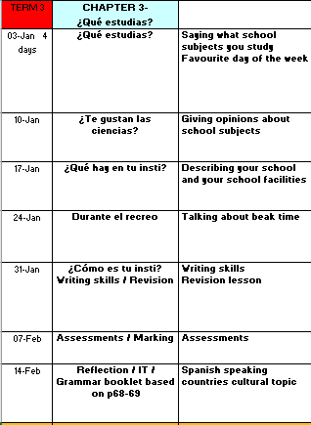

Slide 3
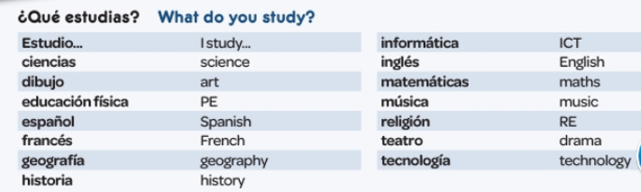
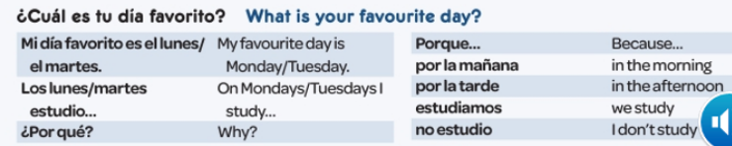
WEEK 1 – w/c 3rd January
Copy this vocab in to your book and spend some time trying to learn it..

Slide 4
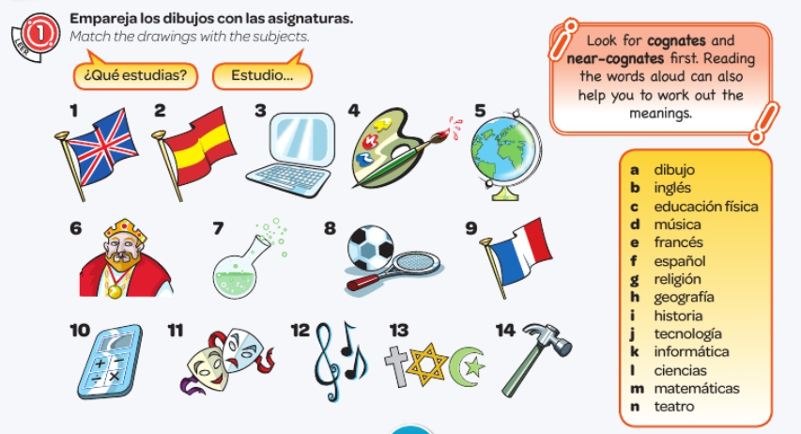
Write down the numbers 1-14 and match each picture with a letter from the yellow box.
  You just need to write the number and the letter, e.g. 1. b

Slide 5
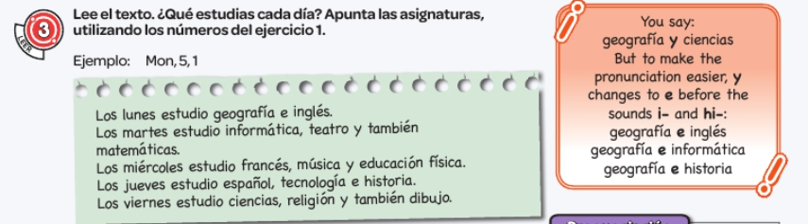
Write down the days of the week (in English) and write down what subjects they say they study on each of the days (just Monday-Friday).
  It says to use the numbers from the previous yellow box, but I think that it is easier just to write down the subject in English. E.g. Monday – Geography and English.

Slide 6
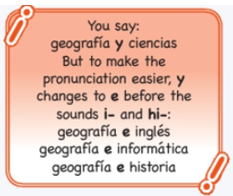
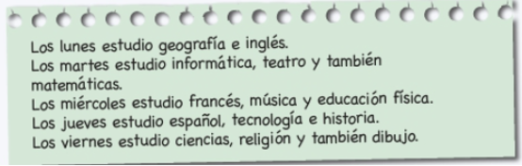
Make a note of this grammar rule:

Slide 7
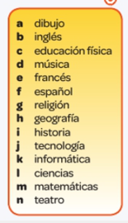
Design your dream timetable (in Spanish!) – Copy this grid down and fill it in.
 | Lunes | Martes | Miércoles | Jueves | Viernes
P1
P2
 | RECREO | RECREO | RECREO | RECREO | RECREO
P3
P4
 | LA HORA DE COMER | LA HORA DE COMER | LA HORA DE COMER | LA HORA DE COMER | LA HORA DE COMER
P5
P6

Slide 8
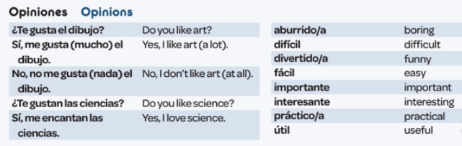
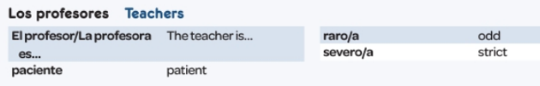
WEEK 2 – w/c 10th January
Copy this vocab in to your book and spend some time trying to learn it..

Slide 9
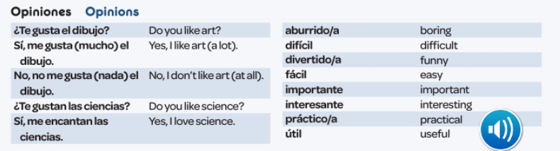
Read the following and make notes: LAS OPINIONES
We use ‘me gusta’ / ‘me encanta’ for singular subjects. i.e. el dibujo / la geografía.
We use ‘me gustan’ / ‘me encantan’ for plural subjects. i.e las ciencias / las matemáticas.
  This is the same when you ask the question ‘do you like?’ – ‘te gusta?’ / ‘te gustan’

Slide 10

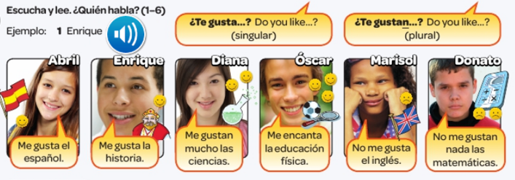
Write 1-6. Listen to the recording. Write the name of who is talking. Example 1) Enrique

Slide 11
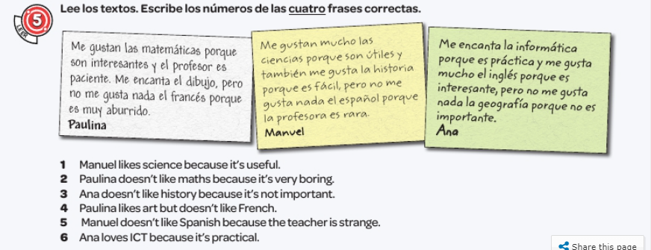
Read the texts. Write the numbers of the 4 correct phrases.

Slide 12
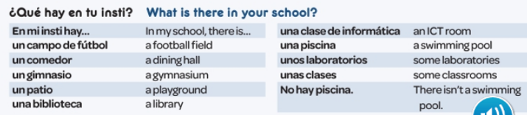
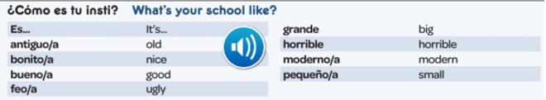
WEEK 3 – w/c 17th January
Copy this vocab in to your book and spend some time trying to learn it..

Slide 13
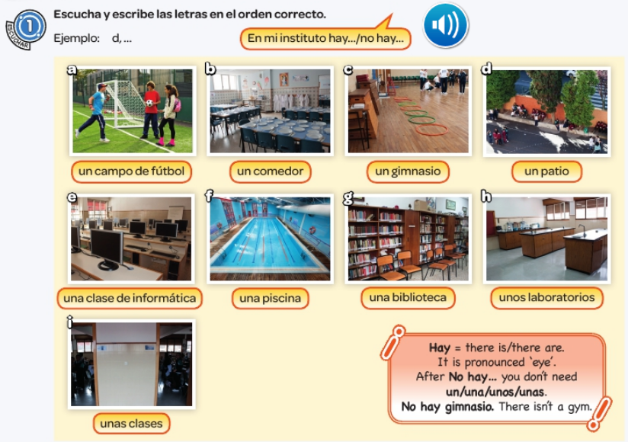
Listen to the recording. But the places in order that you hear them,
Example:
d,….

Slide 14
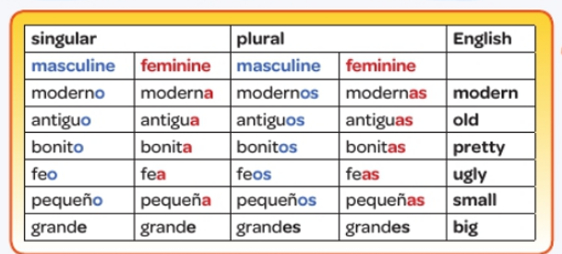
Remember the adjective has to agree with the noun in Spanish.
Have a good look at the table and look at the pattern.

Slide 15
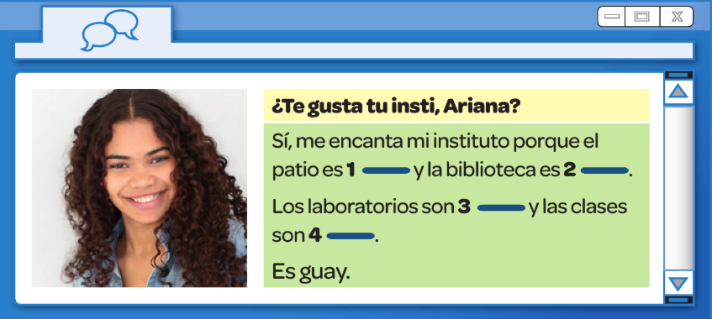
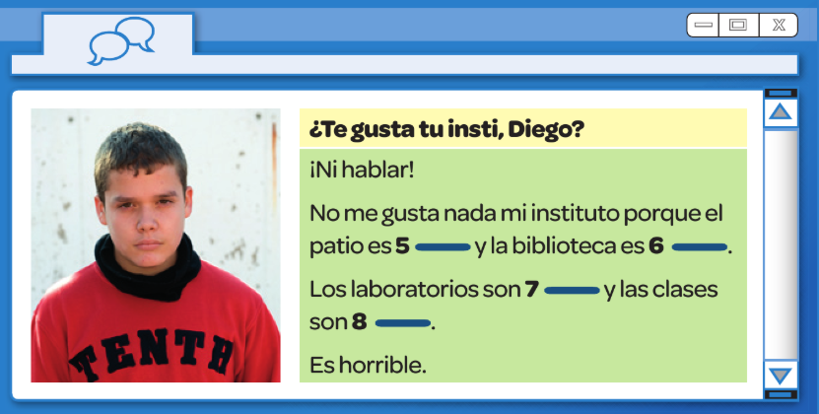
moderna bonitas modernos grande
Fill in the gaps with the words from the boxes. Remember the adjectives need to agree with the noun. Look back at the table on the previous slide if you need a reminder of the endings.
antiguos feas
antigua pequeño

Slide 16
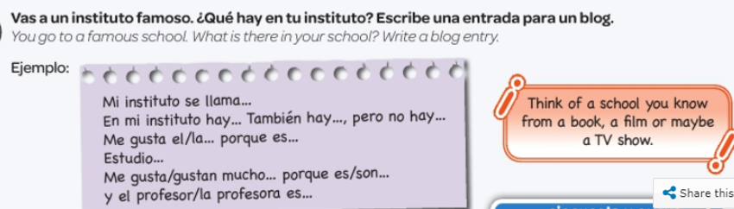

Slide 17
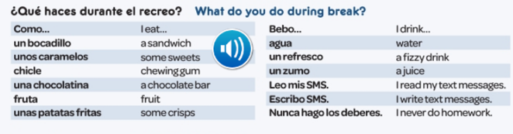

WEEK 4 – w/c 24th January
Copy this vocab in to your book and spend some time trying to learn it..

Slide 18
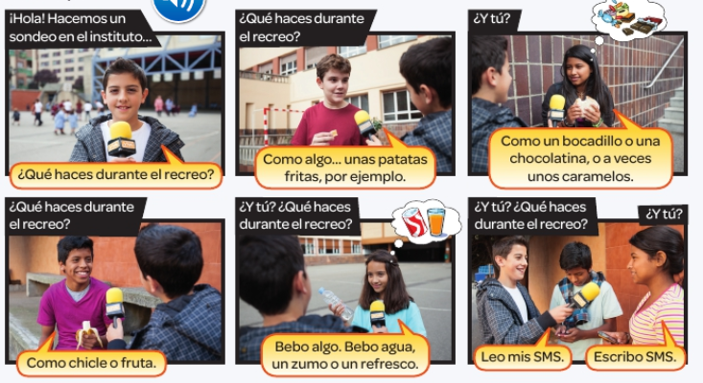
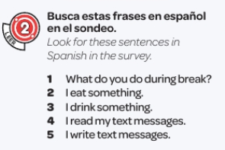

Slide 19
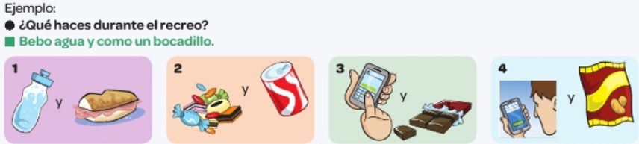
Write sentences about what you do in each picture. Refer back to the vocab slide if you need to.

Slide 20
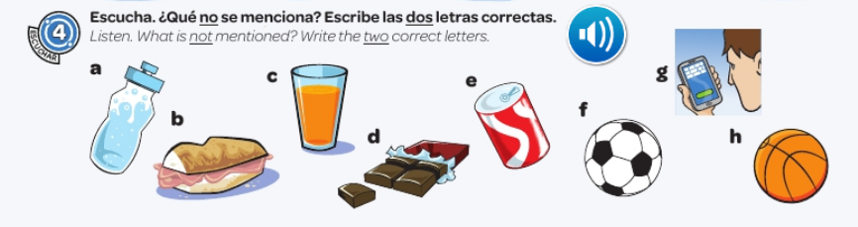

Slide 21
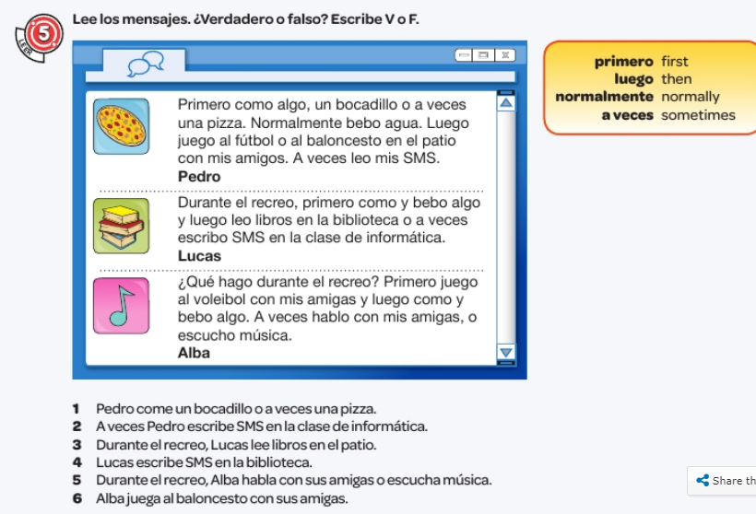
Read the messages. Are these sentences true or false? V = true
F=false

Slide 22
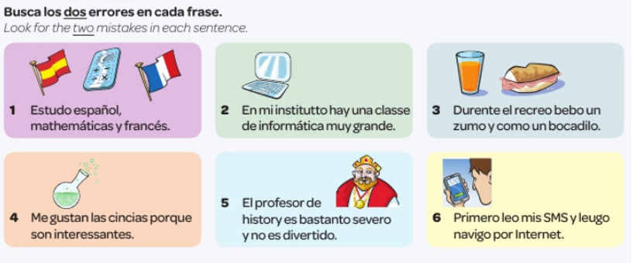
WEEK 5 – w/c 31st January
There is no new vocabulary this week but work through the following tasks please

Slide 23
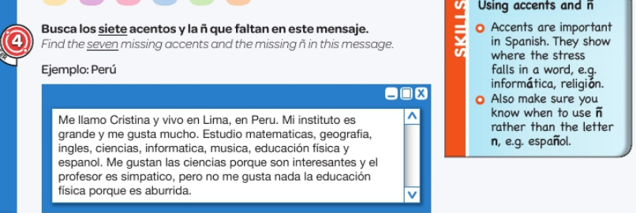

Slide 24
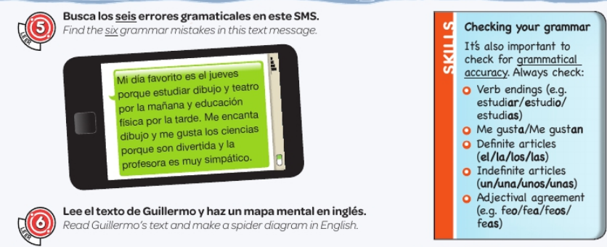

Slide 25
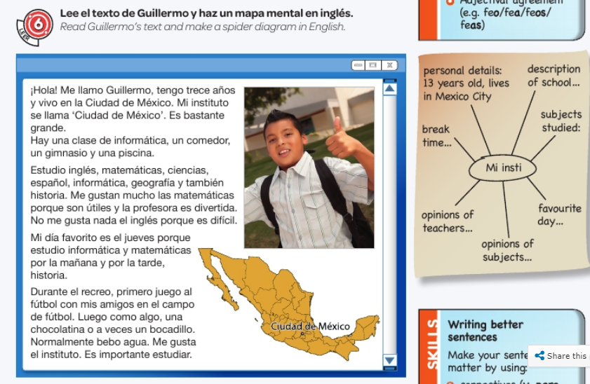

Slide 26
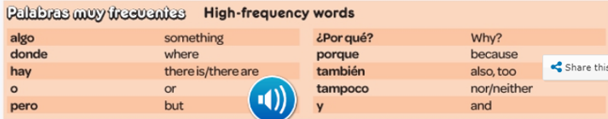
WEEK 6 – w/c 7th February
This week is assessment week. Spend some time revising all of the vocab on these slides so far and the high frequency words below. Then email your teacher for the test papers. There are also revision activities on the next slide.

Slide 27
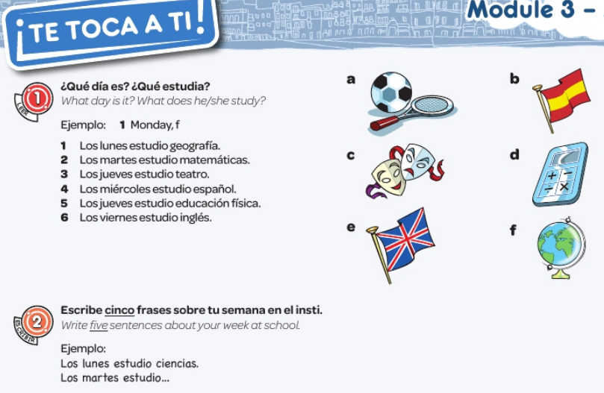

Slide 28
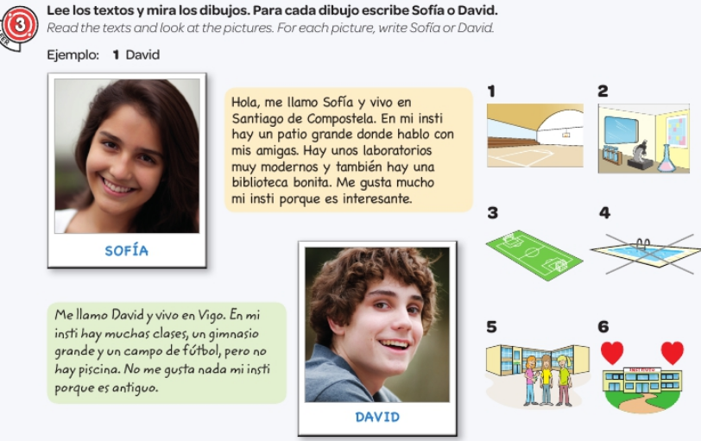

Slide 29
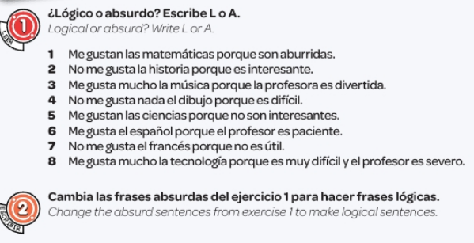

Slide 30
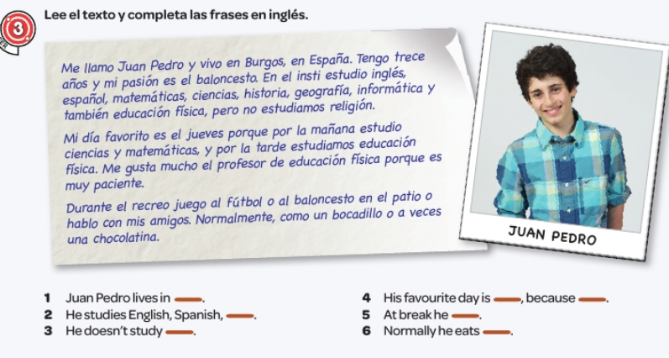

Slide 31
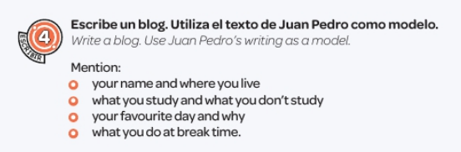

Slide 32
WEEK 7 – w/c 14th Feb
Project week. Research a Spanish speaking country of your choice. You could make a poster or powerpoint and show it to your teacher when you are back in school.

