Slide 1


Year 8 German TERM 3: Echo 1 textbook, chapter 5
If pupils are absent from lessons they should spend time revising and learning vocabulary. All of the vocabulary for this term is on the following slides. First of all, they should recap the vocabulary which they learned the previous week. Then they should start to learn the next section of vocabulary which they have not yet covered in class. This could be done by using the look, cover, write, check method or by making flashcards etc. It should also be written in their orange book. There are also a few tasks to complete. A plan for the term is on the next slide.
Pupils can also revise vocabulary on Linguascope-
Username is kingshill password is mfl123*
Any new vocabulary they learn can be written in their orange books or on paper.
If pupils wish to do extension work they can access free MFL lessons on the Oak National Academy website:
https://classroom.thenational.academy/subjects-by-key-stage

Slide 2
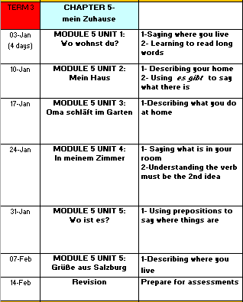

Slide 3
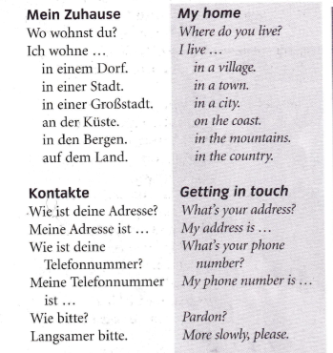
WEEK 1 – w/c 3rd January
Copy this vocab in to your book and spend some time trying to learn it..

Slide 4
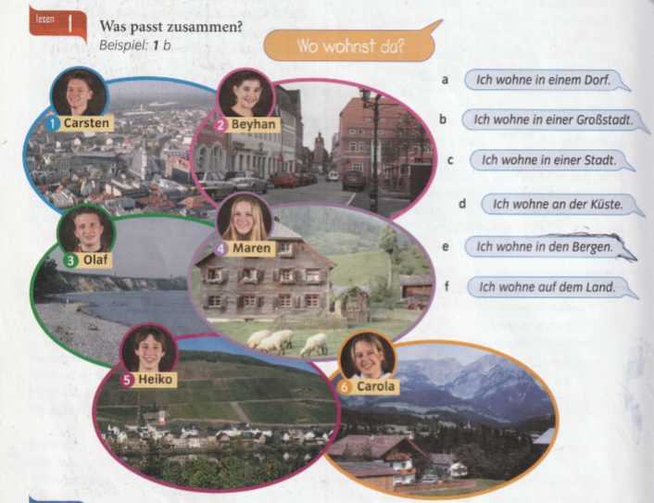
Look at the 6 pictures and match up the pictures with the 6 statements on the right (a-f)

Slide 5
Write sentences about the people. Say what they are called and where they live e.g.
Er heißt Carsten und er wohnt in einer Großstadt.
He is called Carsten and he lives in a city.
Remember sie=she

Slide 6
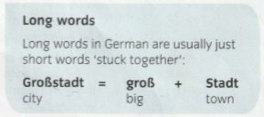

Slide 7
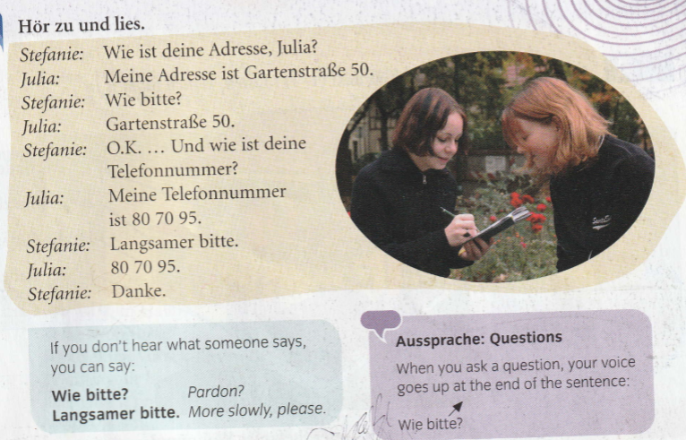
Read the conversation and translate it in to English.

Slide 8
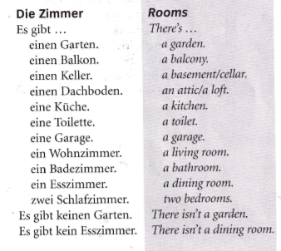
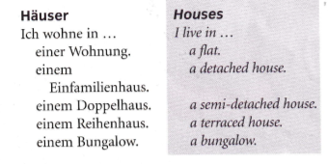
WEEK 2 – w/c 10th January
Copy this vocab in to your book and spend some time trying to learn it..

Slide 9

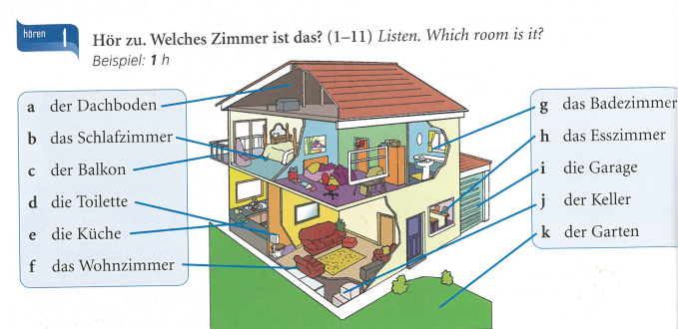
Listen to the recording. Which room do they say. Example 1h

Slide 10
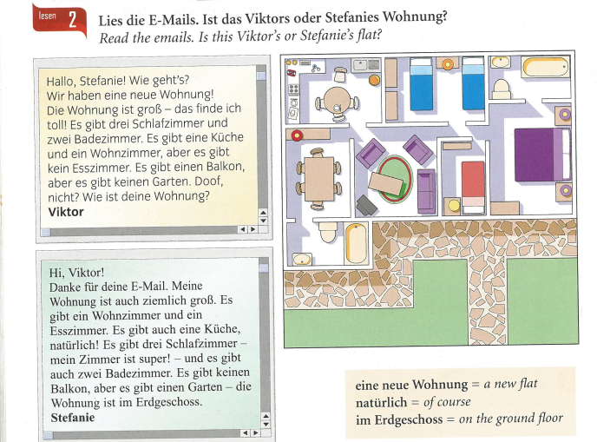
Remember –
keine/keine/kein
Is a negative
Which means they don’t have those things

Slide 11
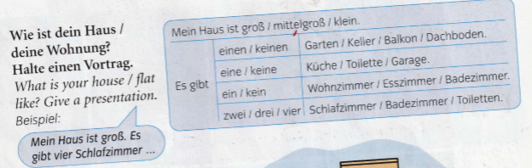
Write a short description about what your house looks like.

Slide 12
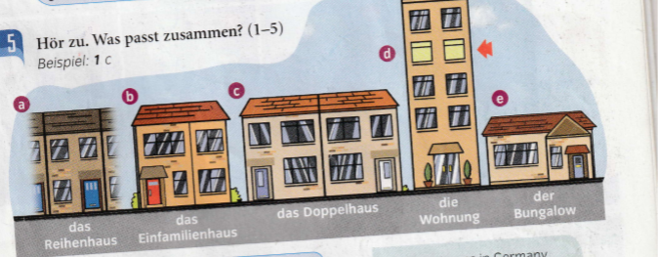
Listen to the recording. Which type of house do the people live in? Write 1-5. Example = 1C

Slide 13
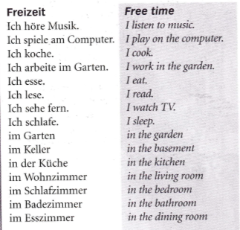
WEEK 3 – w/c 17th January
Copy this vocab in to your book and spend some time trying to learn it..

Slide 14
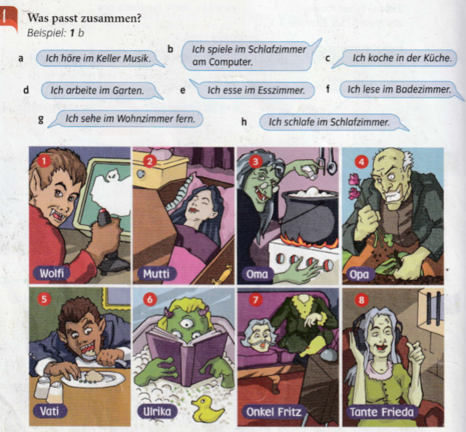
Match up the statements with the pictures. Example, 1b

Slide 15
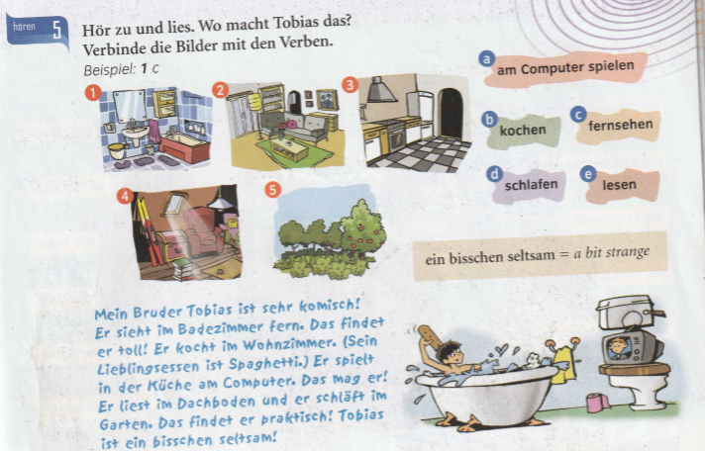
Read about Tobias. Then match up the activities a-e with the rooms he does the activities in (1-5)
Translate the paragraph in to English next

Slide 16
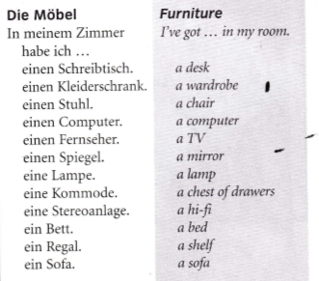
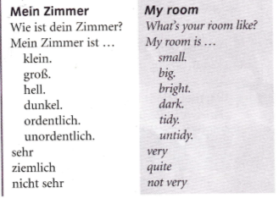
WEEK 4 – w/c 24th January
Copy this vocab in to your book and spend some time trying to learn it..

Slide 17
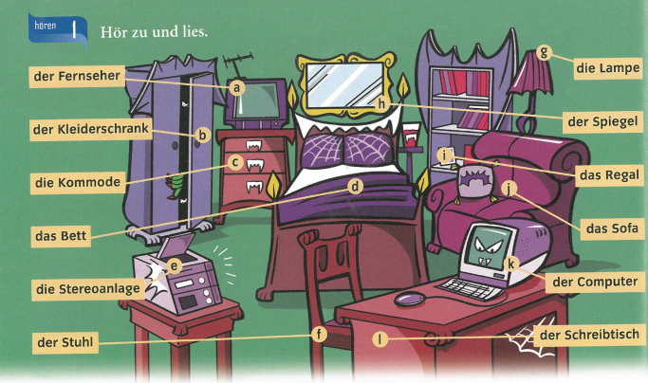
Listen to the recording, which furniture is mentioned. Example, 1d…
You will hear 6 people talk and they will all have more than one item to listen out for

Slide 18
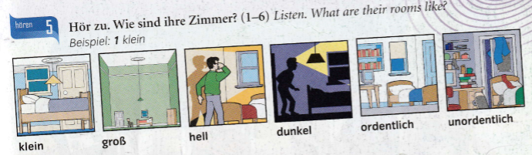
Listen to the recording, what are their rooms like?
Example, 1 klein

Slide 19
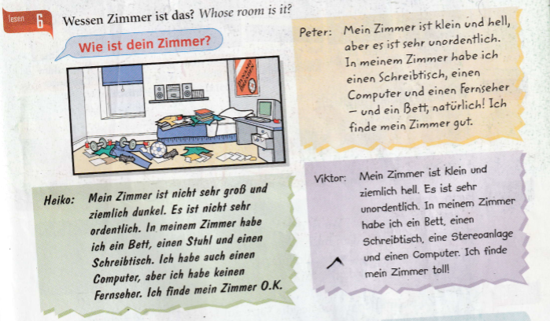
Look at the picture and read the descriptions. Whose room is it? Heiko, Peter or Viktor’s?

Slide 20
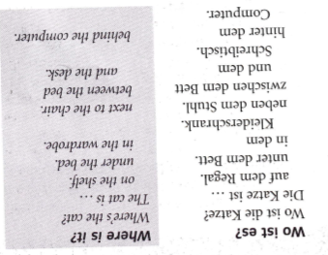
WEEK 5 – w/c 31st January
Copy this vocab in to your book and spend some time trying to learn it..

Slide 21
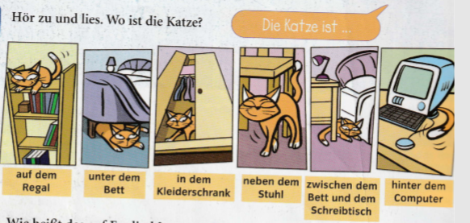
Read the sentences and look at the pictures. Translate the sentences in to English.

Slide 22
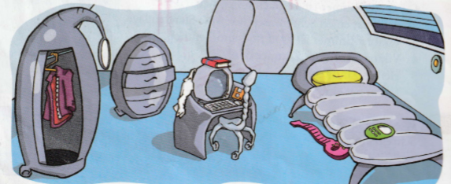
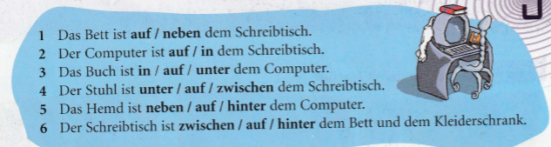
Look at the picture of Zog’s bedroom. Read the sentences describing his room. Choose the correct preposition to make the sentence correct.

Slide 23
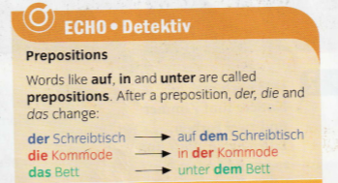
Read the information below and copy it in to your book.

Slide 24
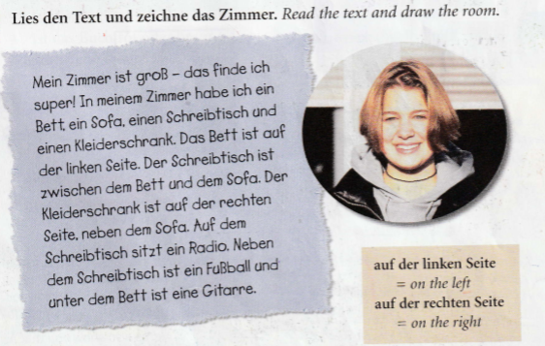
Read the text and draw her bedroom

Slide 25
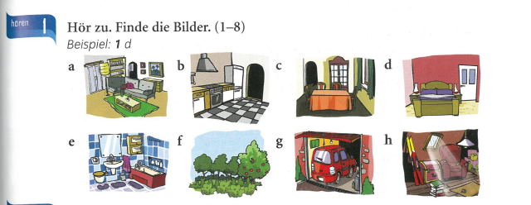
WEEK 6 – w/c 7th February
There is no new vocabulary to learn this week but there are some tasks on the next few slides to practise what you have been doing this term.
Listen to the recording. Which room do they mention?
Example, 1d

Slide 26


Slide 27
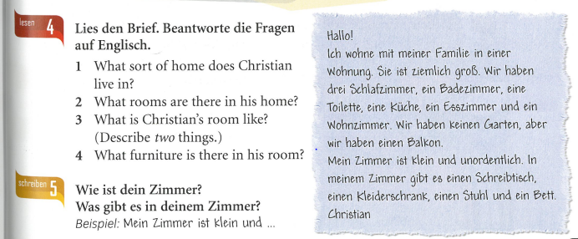
Read the letter and answer the questions in English.
What is your room like? Write a description of it.

Slide 28
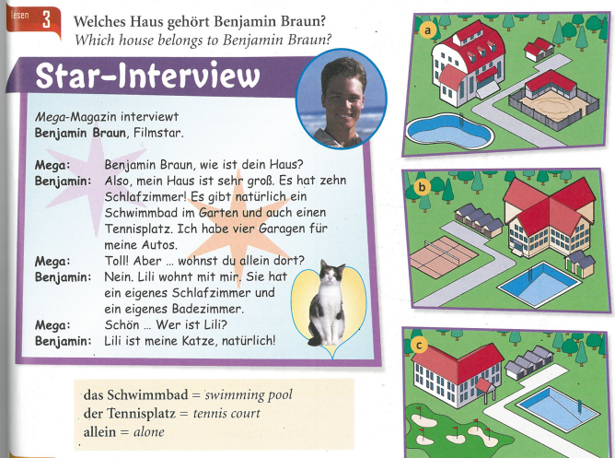

Slide 29
WEEK 7 – w/c 14th Feb
This week is assessment week. Spend some time revising all of the vocab on these slides so far and then email your teacher for the test papers. There are also revision activities on the next slide.

Slide 30
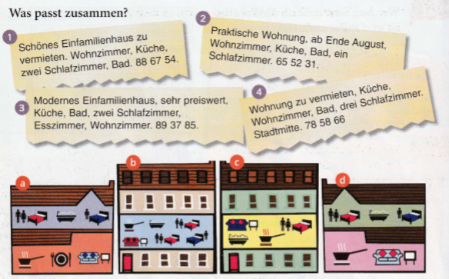
Match up the descriptions of the properties to rent (vermieten) with the pictures

Slide 31
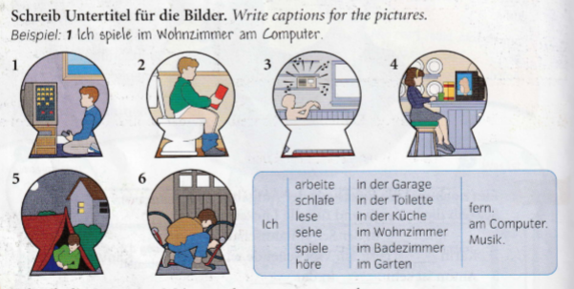

Slide 32
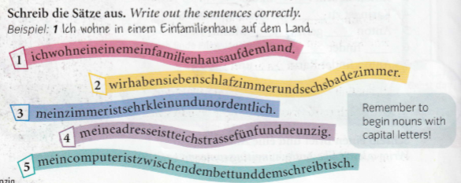

Slide 33
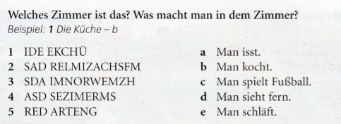
Which room is it? What do you do in each room?
Example 1) die Küche - b

Slide 34
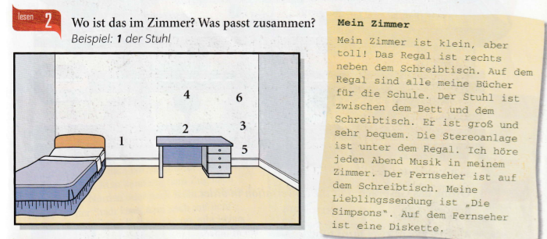
Where are the things in the room? Read the description and look at the picture.
Example 1) der Stuhl

