Slide 1


Year 8 French TERM 3: Studio 1 textbook, chapter 2
If pupils are absent from lessons they should spend time revising and learning vocabulary. All of the vocabulary for this term is on the following slides. First of all, they should recap the vocabulary which they learned the previous week. Then they should start to learn the next section of vocabulary which they have not yet covered in class. This could be done by using the look, cover, write, check method or by making flashcards etc.
Pupils can also revise vocabulary on Linguascope-
Username is kingshill password is bonjour123
Any new vocabulary they learn can be written in their orange books or on paper.
If pupils wish to do extension work they can access free MFL lessons on the Oak National Academy website:
https://classroom.thenational.academy/subjects-by-key-stage

Slide 2
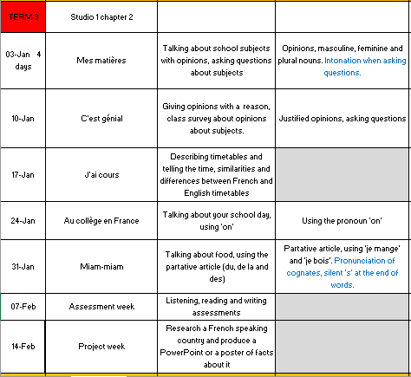

Slide 3
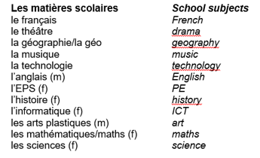
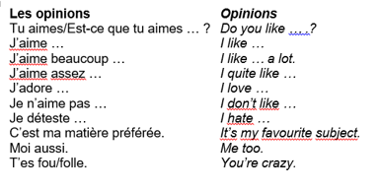
Week 1 – w/c 3rd Jan
vocab

Slide 4
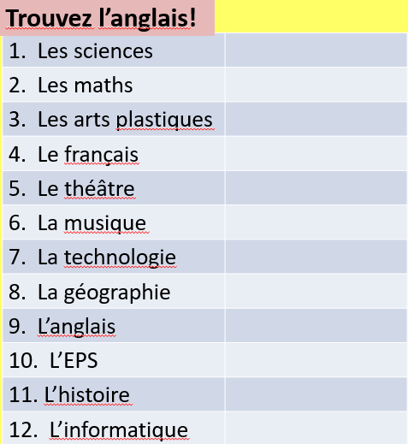
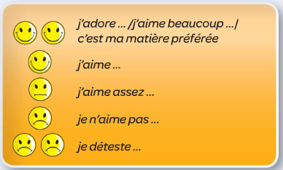
What are the following words in English? Copy them in your book
Week 1
Copy the following expressions and translate them, then use them to write some sentences about your opinions on school subjects.

Slide 5
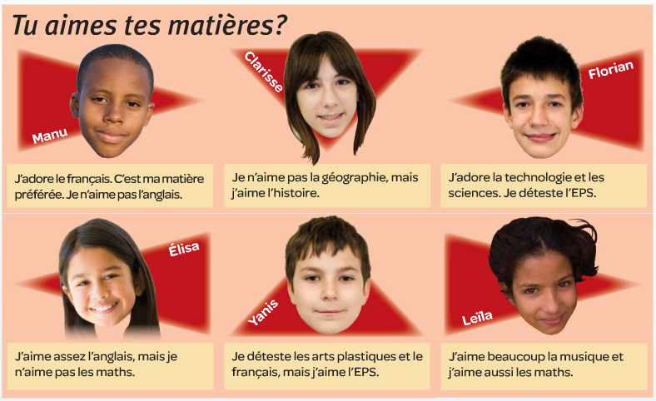

Read the texts and decide who has the opinions below, write their names in your book.

Slide 6
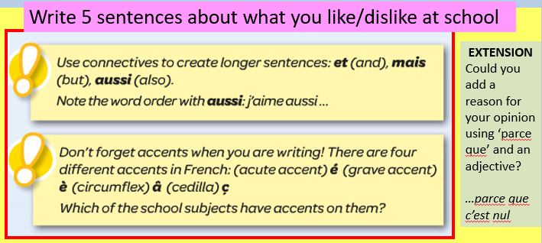

Slide 7
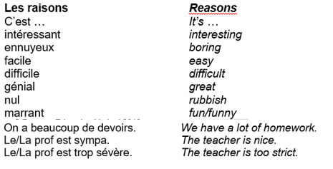
Week 2 – w/c 10th Jan
vocab

Slide 8
Week 2
Positif ☺ ou négatif? ☹
On a beaucoup de devoirs |  | Le prof est trop sévère
C’est difficile |  | C’est intéressant
C’est génial |  | C’est facile
C’est nul |  | Le prof est sympa
C’est marrant |  | C’est ennuyeux
Now try and translate these phrases into English in your book.
EXTENSION: Can you add anymore opinions using ‘c’est + adjective’?

Slide 9

p.31 ex. 4
Do the listening activity and fill out the box.
You are listening for the subject, opinion and reason.
 | matière | opinion | raison
1
2
3
4
5

Slide 10
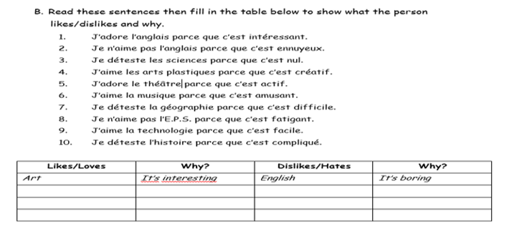

Slide 11
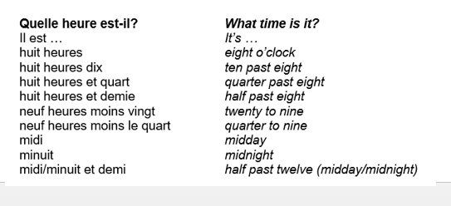
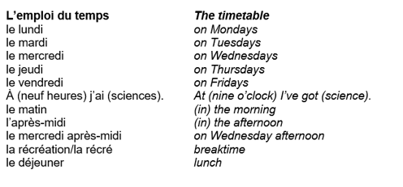
Week 3 – w/c – 17th Jan
vocab

Slide 12
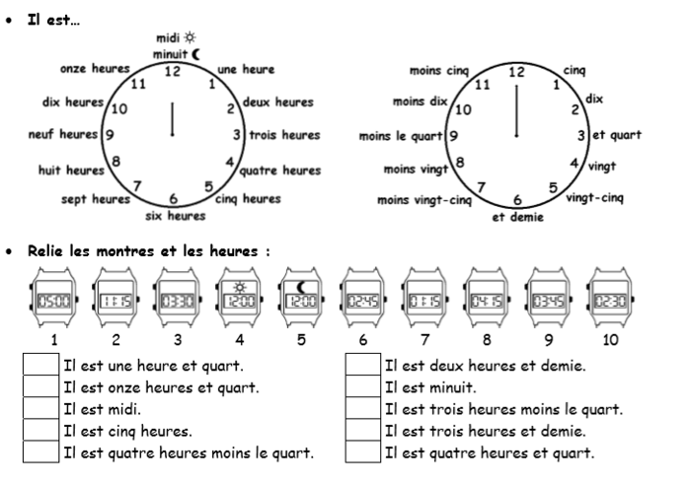
Week 3
The first clock is the hours and the second clock is the minutes, just put them together to make a time. Match up the digital clocks with the times below, then practice writing some of your own times.

Slide 13
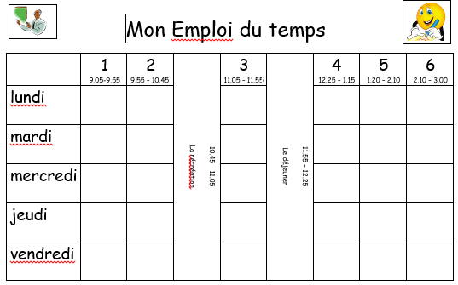
Write a copy of your timetable in French. Try to colour code it, you can include pictures too.

Slide 14
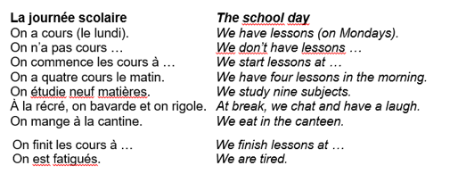
Week 4 – w/c 30th Jan
vocab

Slide 15
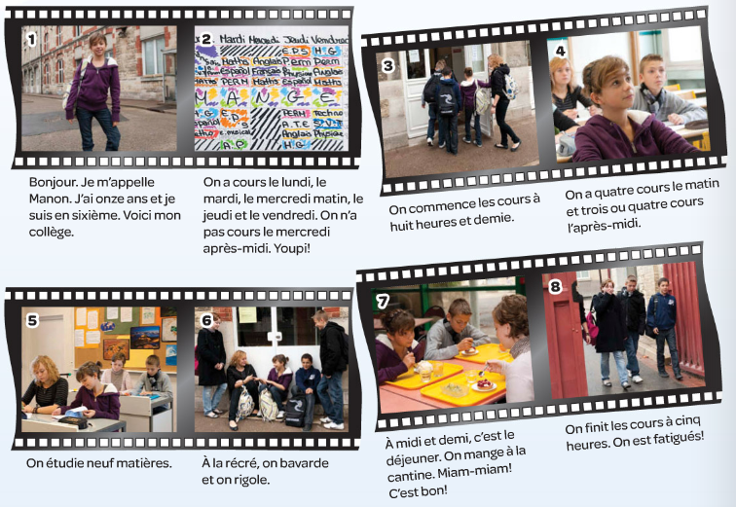
Listen and read the text
Week 4

Slide 16
Use the text to work out the meaning of the following expressions. Write them in your book.
On a cours …
On étudie…
On bavarde
On rigole
On mange
On finit
Le matin
L’après-midi
Je suis en sixième

Slide 17
The French school system
School is compulsory between the ages of 6 and 16 in France.
There are private schools (a bit like Grammar schools) and State schools (like CKS)
Most students go to schools which are closest to their homes so they can either walk or get the bus
The French education system is divided up into Nursery Schools (Ecole Maternelle), Primary Schools (Ecole Primaire) and Secondary Schools commencing with College (Collège) until age 15 when the next step is decided by exams. The top students will be able to go to High School (Lycée) to study for the Baccalauréat. Those who don't get the necessary grades at this stage may follow more vocation educational options.
Children are likely to have more homework than in England. On the other hand many children in Nursery and Primary schools enjoy the benefits of small 'family atmosphere' classes with children of different ages learning and playing together in a supportive environment
Children who fall behind may also be expected to repeat a year in order to catch up, although there is now more flexibility in nursery and primary schools.

Slide 18
Translate this text into French then write your own.
Bonjour! Je m’appelle Sophie et j’ai treize ans. Mon collège s’appelle Ryton Comprehensive School.
On commence à neuf heures moins vingt et finit à quatre heures moins vingt-cinq.
À une heure et demie c’est le déjeuner. On mange à la cantine.

Slide 19
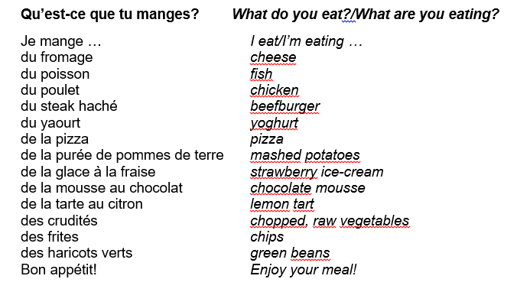
Week 5 – w/c 31st Jan
vocab

Slide 20


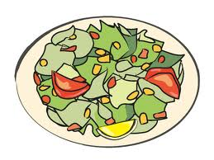










Week 5
Copy the words into your book, translate each one and draw a picture.
du steak
de la pizza
de la salade
de la mousse
au chocolat
des chips
des
crudités
des haricots
verts
des frites
du yaourt
du poulet
de la glace
à la fraise
du fromage
du poisson

Slide 21
Make a canteen menu given the vocab provided, and see if you can add some of your own items too. Make sure you illustrate your menu and add prices.

Slide 22

Week 6 – w/c 7th Feb
This week is revision and assessment week. Contact Mrs Millar for the assessment papers. Spend some time revising all of the vocab on these slides from week 1 and the high frequency words on the following slide.

Slide 23
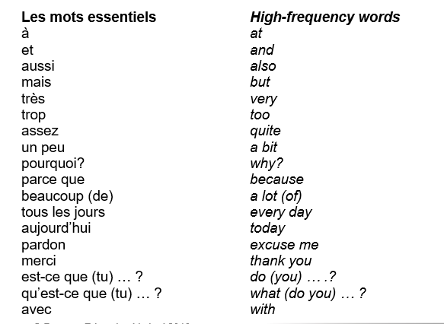

Slide 24
WEEK 7 – w/c 14th Feb
Project week. Research a French speaking country of your choice. You could make a poster or powerpoint and show it to your teacher when you are back in school.

