Slide 1
Who were the Tudors?
Objectives
To create a family tree of the Tudors
To find out more about key Tudor Monarchs

Slide 2
Who were the Tudors?
What do we already know about the Tudors?
Can we name any monarchs in the Tudor family?
How could we describe the Tudor family?
The Tudors

Slide 3
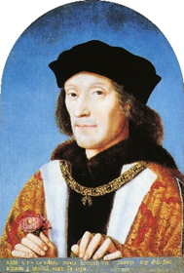
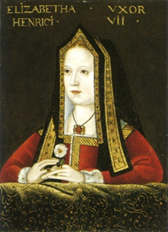
Tudor Family Tree
You have pictures of most of the Tudors.
Cut out the first two and stick them at the top of a new page under the title.
Add their relationship and Henry VII’s dates
Married. (m.)
Henry VII (Tudor) 1485-1509
Elizabeth of York

Slide 4
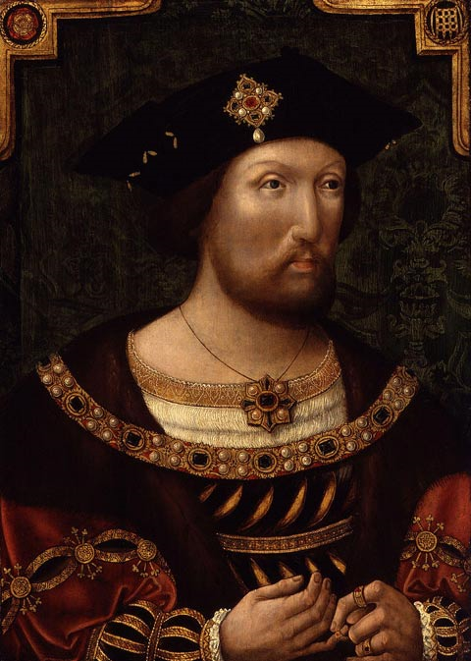
Tudor Family Tree
Married. (m.)
Henry VIII 1509-1547

Slide 5
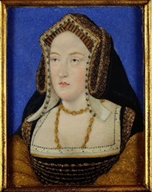
Tudor Family Tree
Married. (m.)
Catherine of Aragon (until 1533)

Slide 6
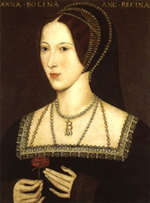
Tudor Family Tree
Married. (m.)
Anne Boleyn (d. 1536)

Slide 7
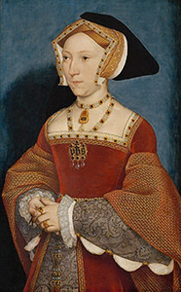
Tudor Family Tree
Married. (m.)
Jane Seymour (d. 1537)

Slide 8
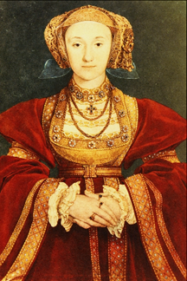
Tudor Family Tree
Married. (m.)
Anne of Cleves (until 1540)

Slide 9
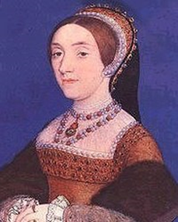
Tudor Family Tree
Married. (m.)
Catherine Howard (d.1542)

Slide 10
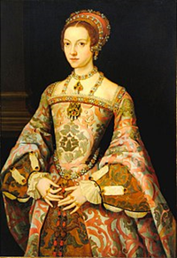
Tudor Family Tree
Married. (m.)
Katherine Parr

Slide 11
Tudor Family Tree
Married. (m.)

Slide 12
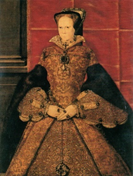
Tudor Family Tree
Mary I 1553-1558

Slide 13
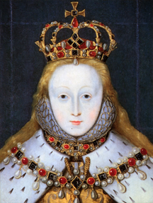
Tudor Family Tree
Elizabeth I 1558 - 1603

Slide 14
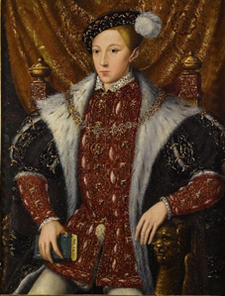
Tudor Family Tree
Edward VI 1547-1553

Slide 15
Who were the Tudors?
Use the fact files on pages 31-32 to annotate your family tree with some information about each of the Tudor monarchs.

