Slide 1
Aerobic and Anaerobic Exercise
Lesson Objectives:
At the end of the lesson you will know:
The immediate, short and long term effects of exercise.
The difference and definitions of aerobic and anaerobic exercise.

Slide 2
Aerobic Training
The aerobic respiratory system is responsible for producing the majority of our energy while our bodies are at rest or taking part in low-intensity to moderate exercise
Aerobic exercise involves using oxygen to break down food (mainly glucose) to use for energy
This energy is supplied to muscle contractions
Glucose + oxygen → energy + water + carbon dioxide
Cannot perform for a long duration due to lactic acid build up over this sharp burst of energy.
What are some examples of aerobic exercise?

Slide 3
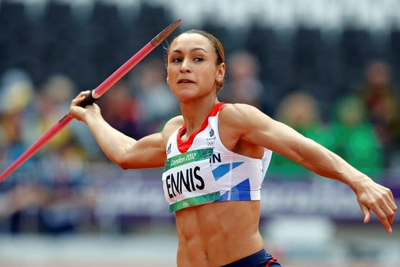
Anaerobic Training
No oxygen is used
The energy needed for exercise is provided without oxygen
Because no oxygen is used, glucose cannot be fully broken down into carbon dioxide and water.
Involve very high intensity actions that can only be continued over a short period of time
Supplies energy rapidly
What are some sporting examples of this?
Glucose → energy + lactic acid

Slide 4
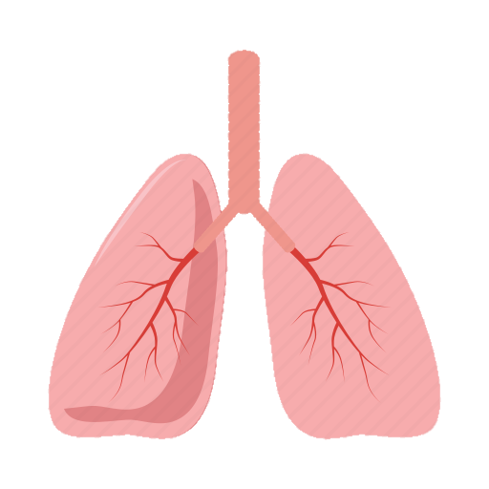
Immediate Effects on our Respiratory System
When we exercise our lungs must work harder and faster as our muscles require more oxygen. With the lungs working harder the body is supplied with oxygen and to also breathe out carbon dioxide that is produced. Hence why exercise makes us out of breath as our lungs are working rapidly.
Aerobic Exercise | Anaerobic Exercise
During anaerobic exercise, the lungs are able to work fast enough to supply the muscles with oxygen | However during anaerobic exercise, the lungs cant supply enough oxygen . Referring back to oxygen debt, the breathing remains fast and intense when exercise is over

Slide 5
Oxygen Debt (EPOC)
EPOC: Excess post-exercise oxygen consumption
When you exercise your muscles demand more oxygen
This means that the lungs have to work harder and faster in order to meet the demand of oxygen, but also to exhale the carbon dioxide that is produced
This causes you to get out of breath
When you stop exercising you may still be breathing heavily, during this time you will take in more oxygen to ‘repay’ the oxygen debt
During recovery from anaerobic exercise, the oxygen is used to remove lactic acid
Can take several hours to completely remove all the lactic acid produced during very intense exercise

Slide 6
Immediate effects of exercise
1. Increase in HR
RHR is usually around 70-80bpm
Exercise can easily raise HR to around 100-150bpm
2. Increase in stroke volume
Heart contracts more powerfully during exercise
3. Increase in breathing rate
Depth of breathing increases also, causing an increase in tidal volume
This allows for greater gaseous exchange at the lungs
During exercise glucose and other substances are needed by the muscles are transported to the blood alongside oxygen. Additionally by-products of respiration: carbon dioxide and lactic acid are carried away from the muscles.

Slide 7
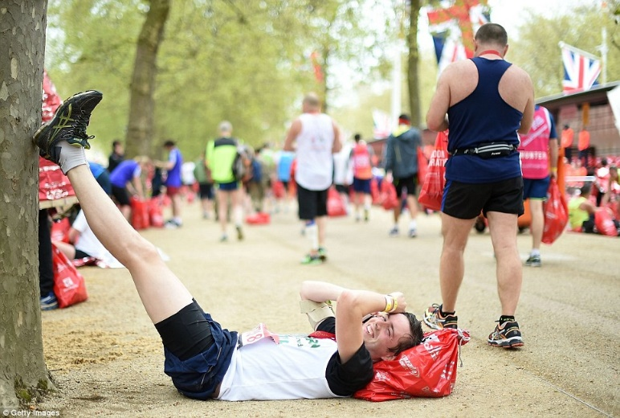
Lactic Acid
Lactic acid is produced during anaerobic respiration. This happens when there is not enough oxygen for normal aerobic respiration to take place.
Lactic acid is responsible for the pain you feel in your muscles when they get tired.
When too much of it builds up in a muscle, it can prevent the muscle contracting. At this point, the performer’s muscles will cramp and they will be forced to stop.

Slide 8
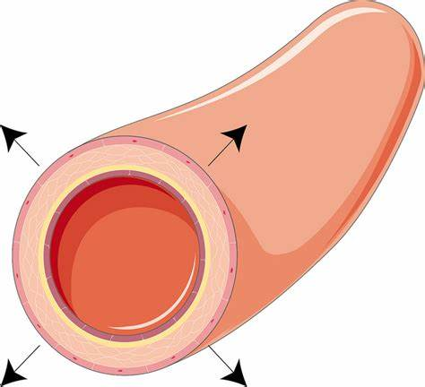
Immediate Effects : Heat Loss
Vasodilation
Capillaries near to the surface of the skin dilate, allowing more blood to flow through them. This means more heat is lost to the environment.
Sweating
Sweat glands excrete sweat, which takes away heat with it as it evaporates.

Slide 9
Water loss
When we sweat, water is lost from out body.
Water is vital for our body to maintain their key functions!
To compensate for this the body produces less urine, however is longer exercises or hotter weather this is not enough to compensate for.
We don’t only lose water but also important salts called electrolytes. These are very vital in the nervous system. However these salts can be replaces in exercise by drinking isotonic drinks
Severe salt depletion can lead to cramps, fainant and in extreme cases death

Slide 10
Recovery Rates
Your recovery rate is how quickly your body returns to normal following a period of time of exercise.
Therefore this is a good indicator of fitness, the fitter you recover, the fitter you are.
You can measure this with a heart rate monitor or simply using a RPE scale
As you recover from exercise the following changes happen in these areas:
Lactic acid levels in the blood
Glycogen stores
Heart rate

Slide 11
Short term effects of exercise (24-36 hours after exercise)
1. Tiredness
Individuals may suffer from fatigue the day after exercise due to the muscles of the body having worked very hard
2. Nausea
Feeling sick or vomiting during/after exercise
Can be caused by over exertion or a sudden abrupt end to exercise
Heavy exercise causes the blood flow to be redirected away from the digestive system and to the working muscles

Slide 12
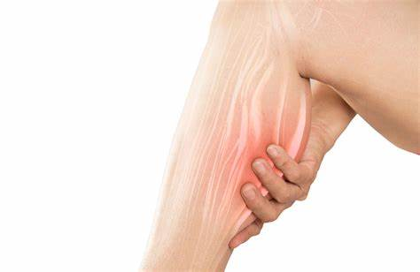
Short term effects of exercise (24-36 hours after exercise)
3. Dizziness
Performers may feel dizzy and light headed following exercise
Caused by low blood sugar or a drop in blood pressure
4. DOMS (Delayed onset muscle soreness)
Real name for aching, painful and stiff muscles following intense exercise
Caused by eccentric muscle contractions which cause tiny tears in muscle fibres
Muscles repair stronger after tearing
5. Cramp
Not the same as DOMS
Painful involuntary contraction of a muscle that is typically caused by fatigue or strain
Links to dehydration
How to prevent cramp | Pro level training – YouTube – Video on training cramps

Slide 13
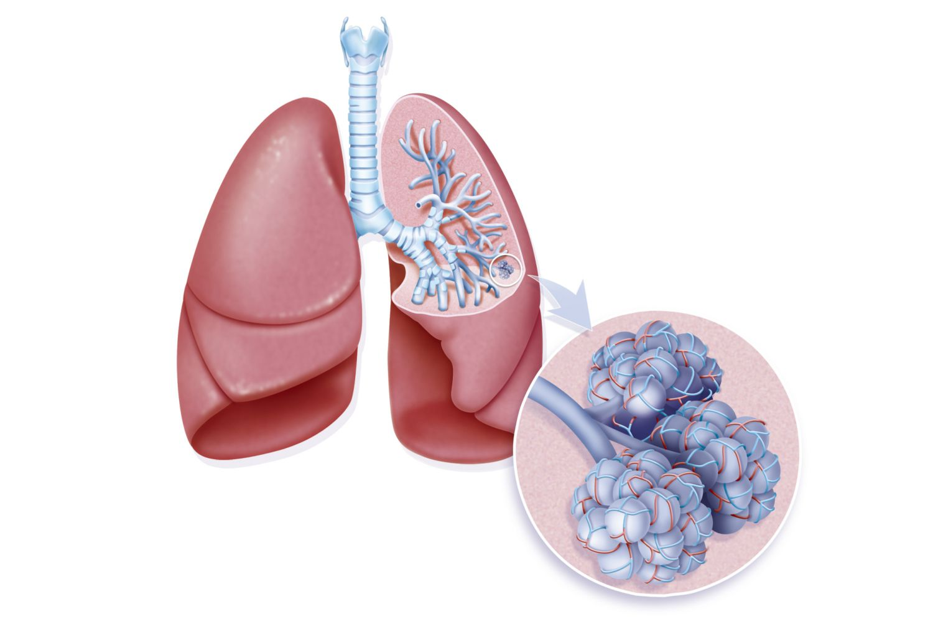
Long term effects of exercise (months and years)
The Lungs
Training makes the lungs more effective with supplying the body with oxygen as it becomes more effective.
New blood vessels grow around the alveoli, making gas exchange more efficient,
The muscles involved in breathing such as our intercostal muscles become a lot stronger and can work for longer

Slide 14
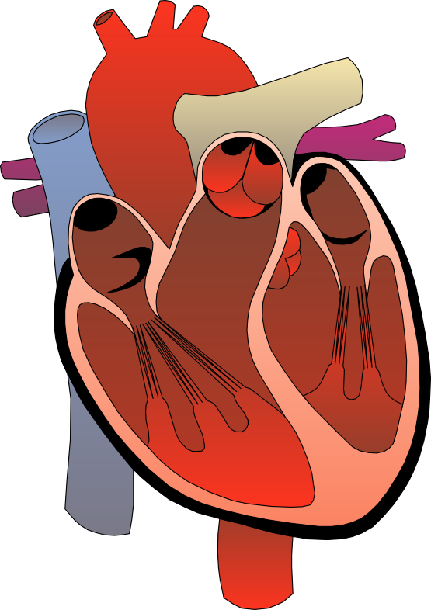
Long term effects of exercise (months and years)
The Heart
Increase in the size of the heart (hypertrophy)
Increased size of the heart means it can contract at a greater force and pump out more blood with each beat (increase in stroke volume)
The heart becomes a more efficient pump

Slide 15
Other long term effects of exercise (months and years)
Regular exercise reduces body weight and muscle mass.
01
Muscle, tendons and ligaments around joints get stronger to prevent injury
02
Aerobic energy system will improve through training which means you will build up a stronger stamina.
03
Cardiac output will increase
04

Slide 16
Exam Question
Explain long term effects to our cardiovascular system of exercise (3 marks)
Explain and describe a short term effect of exercise? (2 marks)

Slide 17
Lastly…
Can we now match up our cards the correct way?
Work in pairs and use your notes!

Slide 18
Homework

