Slide 1
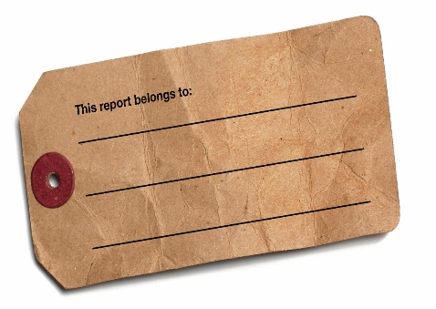
Learning Outcome: To explore a range of Frantic Assembly’s socially distanced devising techniques in preparation for C1!
OUTCOMES!
Learning Goals!
To evaluate the movement produced – what are the themes communicated or the characters and story that emerge?
To develop your knowledge of and experiment with a range of Frantic Assembly’s distanced devising techniques.
To discuss Frantic Assembly – Recap who are they and their style.

Slide 2
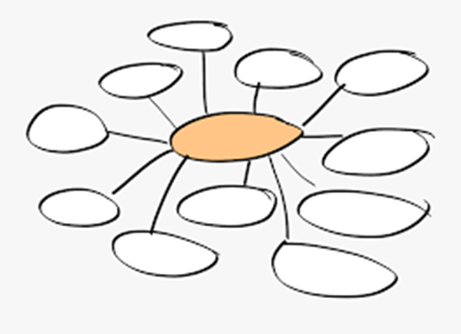
ENGAGE
2.) Write down everything you know about Frantic Assembly on your mind map considering the 3 questions below:
https://www.youtube.com/watch?v=PSP5NhBpIhM
Challenge 1 | Challenge 2 | Challenge 3
Tell me what you know about Frantic Assembly Or What questions do you have about Frantic Assembly. | Explain what you know about their style. Features, skills required etc. | Reflect on how you might use some of their techniques/ideas in a socially distanced way for C1.
Notes:
Select one or two students to share

Slide 3
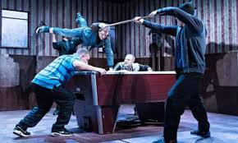
Frantic Assembly
ENGAGE
Frantic Assembly are a British theatre company co-founded by Artistic Director, Scott Graham, 25 years ago.
“Our ambition is that we continue to learn and remain committed to making brave and bold theatre. At times it is physically dynamic and brutal. At others it's proudly tender and fragile.”
“It is about the ethos of collaboration, of empowerment, of that constant desire to improve. It is about telling stories in a voice we don't always hear and about finding talent in places we don't always look.”
Their approach to creating theatre is distinctly creative and has movement at the foreground of all of their work.
They have worked in over 40 countries world-wide and regularly collaborate on other productions (for example, ‘Humans’ – Channel 4, and the National Theatre’s ‘The Curious Incident of the Dog in the Night-Time’).
SMSC Question: Frantic Assembly are hugely popular globally today. Why do you think this might be?
Would they have been as popular 10, 20, 30 or more years ago?

Slide 4
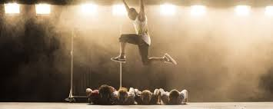
Frantic Assembly - Quads
EXPLORE
The exercise (and variations of it) are a regular part of Frantic’s rehearsal process:
https://www.youtube.com/watch?v=gdiXOOa9TdI
1.) Stand in 4 rows all facing the same way.
2.) Row 1 jump on the spot 8 times. On count 8 they front row turn to face the back. Repeat till everyone is facing the back.
3.) Then on count 6 the back line turn to face the font. Repeat till everyone is facing the front.
4.) Repeat 4, 2, 1
1 =
2 =
3 =
4 =
5 =
6 =
7 =
8 =
Extension: Let’s think of some moves we can add to different numbers e.g. clap on every ‘5’.
Notes:
Suggested Song – black skin head instrumental https://www.youtube.com/watch?v=RuxOHxkrKk4

Slide 5
Quads Reflection
EVALUATE
Consider the questions below:
Share your ideas with the rest of the class!
Question 1 | Question 2 | Question 3
List the skills you had to use to be successful in the warm up. | Explain how you used those skills. | Reflect on the importance of those skills when working in Frantic’s style.

Slide 6
REFLECTION…
EVALUATE
In you’re a different coloured pen:
1.) Write the time in the key and colour in the second box.
2.) Write down anything new you have learnt about Frantic Assembly in the first part of the lesson.
Challenge 1 | Tell me what you know about Frantic Assembly Or What questions do you have about Frantic Assembly.
Challenge 2 | Explain what you know about their style. Features, skills required etc.
Challenge 3 | Reflect on how you might use some of their techniques/ideas in a socially distanced way for C1.
Notes:
Select one or two students to share

Slide 7
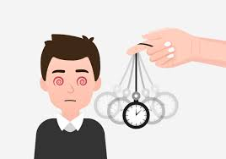
Mirroring 1 –
Columbian Hypnosis
EXTEND
1.) Working in pairs, label yourselves A and B.
2.) A lead your partner around the room by making them follow your hand. Consider different levels. Your aim is to lead your partner around the room maintaining a 2m distance between your hand and their face not to catch them out!
4.) Swap!
Notes:
Suggest the start on the spot then experiment with speed, levels and moving around the space

Slide 8
Mirroring 2 – Group Task
EXTEND
1.) Stand in a diamond formation.
2.) The person at the front is the leader and must explore a range of movements (actions, levels, dynamics, moving). The rest of the group must follow.
3.) If the leader turns to face a different direction, the person who is now at the front is the new leader!
4.) Explore this to the length of one song. Ensure everyone has at least one opportunity to lead.
REFLECTION:
1.) What skills did you use in these exercises?
2.) Explain how.
3.) Reflect on how you could use this technique (mirroring) in your devised piece. What story might it tell?
Notes:
Ensure all students have a chance to lead the group. This may mean changing the formation slightly through the task.
Suggested song: Intriguing Possibilities – from the Social Network Soundtrack

Slide 9
REFLECTION…
EVALUATE
In you’re a different coloured pen:
1.) Write the time in the key and colour in the third box.
2.) Write down anything new you have learnt about Frantic Assembly in this part of the lesson.
Challenge 1 | Tell me what you know about Frantic Assembly Or What questions do you have about Frantic Assembly.
Challenge 2 | Explain what you know about their style. Features, skills required etc.
Challenge 3 | Reflect on how you might use some of their techniques/ideas in a socially distanced way for C1.
Notes:
Select one or two students to share

Slide 10
Devising Technique –
Phone Numbers
EXTEND
Part 1:
1.) Find a space by yourself facing a wall.
2.) Imagine there is a giant phone pad in front of you. Using your right hand only press the numbers on the phone pad – Reach for the numbers!
3.) Repeat but use only your eyes and head to press the numbers.
4.) Repeat but swaying to the numbers. Return to a neutral centred position in between each number.
Part 2: Group Challenge!
1.) Create a phone number.
2.) Sway to the numbers in unison – can you do
this in
sync with each other?
3.) Move your head and eyes to the numbers.
4.) Press the numbers using your right hand only.
5.) Rehearse until this is fluid and you make no mistakes!
Develop the movement further considering:
Canon
dynamics
Levels
Focus
Retrograde
/Reverse
Repetition
Notes:
Suggested Song – Angel – Massive Attack - https://www.youtube.com/watch?v=HLrqNhgdiC0

Slide 11
Share Your Work!
EXPLAIN
Perform your piece to me!
Can you meet the success criteria…
Complete focus.
Remain in sync with the rest of your group.
A thoroughly rehearsed string of choreography.
Reflection:
1.) Tell me what went well?
2.) Identify what you could do to improve.
3.) Reflect on the story / theme / characters that have emerged from the movement.
EVALUATE

Slide 12
REFLECTION…
EVALUATE
In you’re a different coloured pen:
1.) Write the time in the key and colour in the fourth box.
2.) Write down anything new you have learnt about Frantic Assembly in this part of the lesson.
Challenge 1 | Tell me what you know about Frantic Assembly Or What questions do you have about Frantic Assembly.
Challenge 2 | Explain what you know about their style. Features, skills required etc.
Challenge 3 | Reflect on how you might use some of their techniques/ideas in a socially distanced way for C1.
Notes:
Select one or two students to share

Slide 13
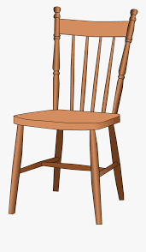
Socially Distant Chair Duets
EVALUATE
Recap: What are chair duets?
Chair Duets are one of Frantic Assembly’s most famous devising techniques!
https://www.youtube.com/watch?v=nLrabSNRHhg
1.) Start sitting facing forward. One person begins by placing one hand on ‘their partner’ and creates four moves: touch, push, pull, turn etc.
2.) The second person does the same.
3.) Continue till you have a string of approximately 15 moves.
4.) Find a move that joins the last move to the first.
5.) Rehearse until fluid and you can both perform with your focus outwards.
Socially distant formation:
Partner A
Partner B
The action/reaction still needs to happen but you need to imagine your partner is sat next to you and moving you!
Extra Challenge: Develop this further considering: focus, dynamics, repetition,
Notes:
Music needs to be upbeat and quick Students should work towards being in time with the music.
Suggested songs: Lucky Star – Basement Jaxx feat. Dizzee Rascal, or Banquet – Bloc Party

Slide 14
Share Your Work!
EXPLAIN
Perform your piece to the other pair!
Can you meet the success criteria…
Complete focus.
A confident and energetic performance.
A thoroughly rehearsed string of choreography.
Reflection:
1.) Tell me what went well?
2.) Identify what they could do to improve.
3.) Reflect on the story / theme / characters that have emerged from the movement.
EVALUATE

Slide 15
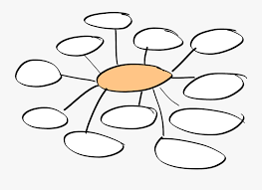
REFLECTION…
EVALUATE
In you’re a different coloured pen:
1.) Write the time in the key and colour in the fifth box.
2.) Write down anything new you have learnt about Frantic Assembly in this part of the lesson.
Challenge 1 | Tell me what you know about Frantic Assembly Or What questions do you have about Frantic Assembly.
Challenge 2 | Explain what you know about their style. Features, skills required etc.
Challenge 3 | Reflect on how you might use some of their techniques/ideas in a socially distanced way for C1.
Notes:
Select one or two students to share

