Slide 1
Can we educate the mind without educating the heart?

Slide 2
Stephen Lawrence
Discuss with a partner.
Who is he?
Why do you think he is the focus of our studies?
What do you know about him?

Slide 3
To use a historic event to create a sensitive piece of drama.
Learning Outcome

Slide 4
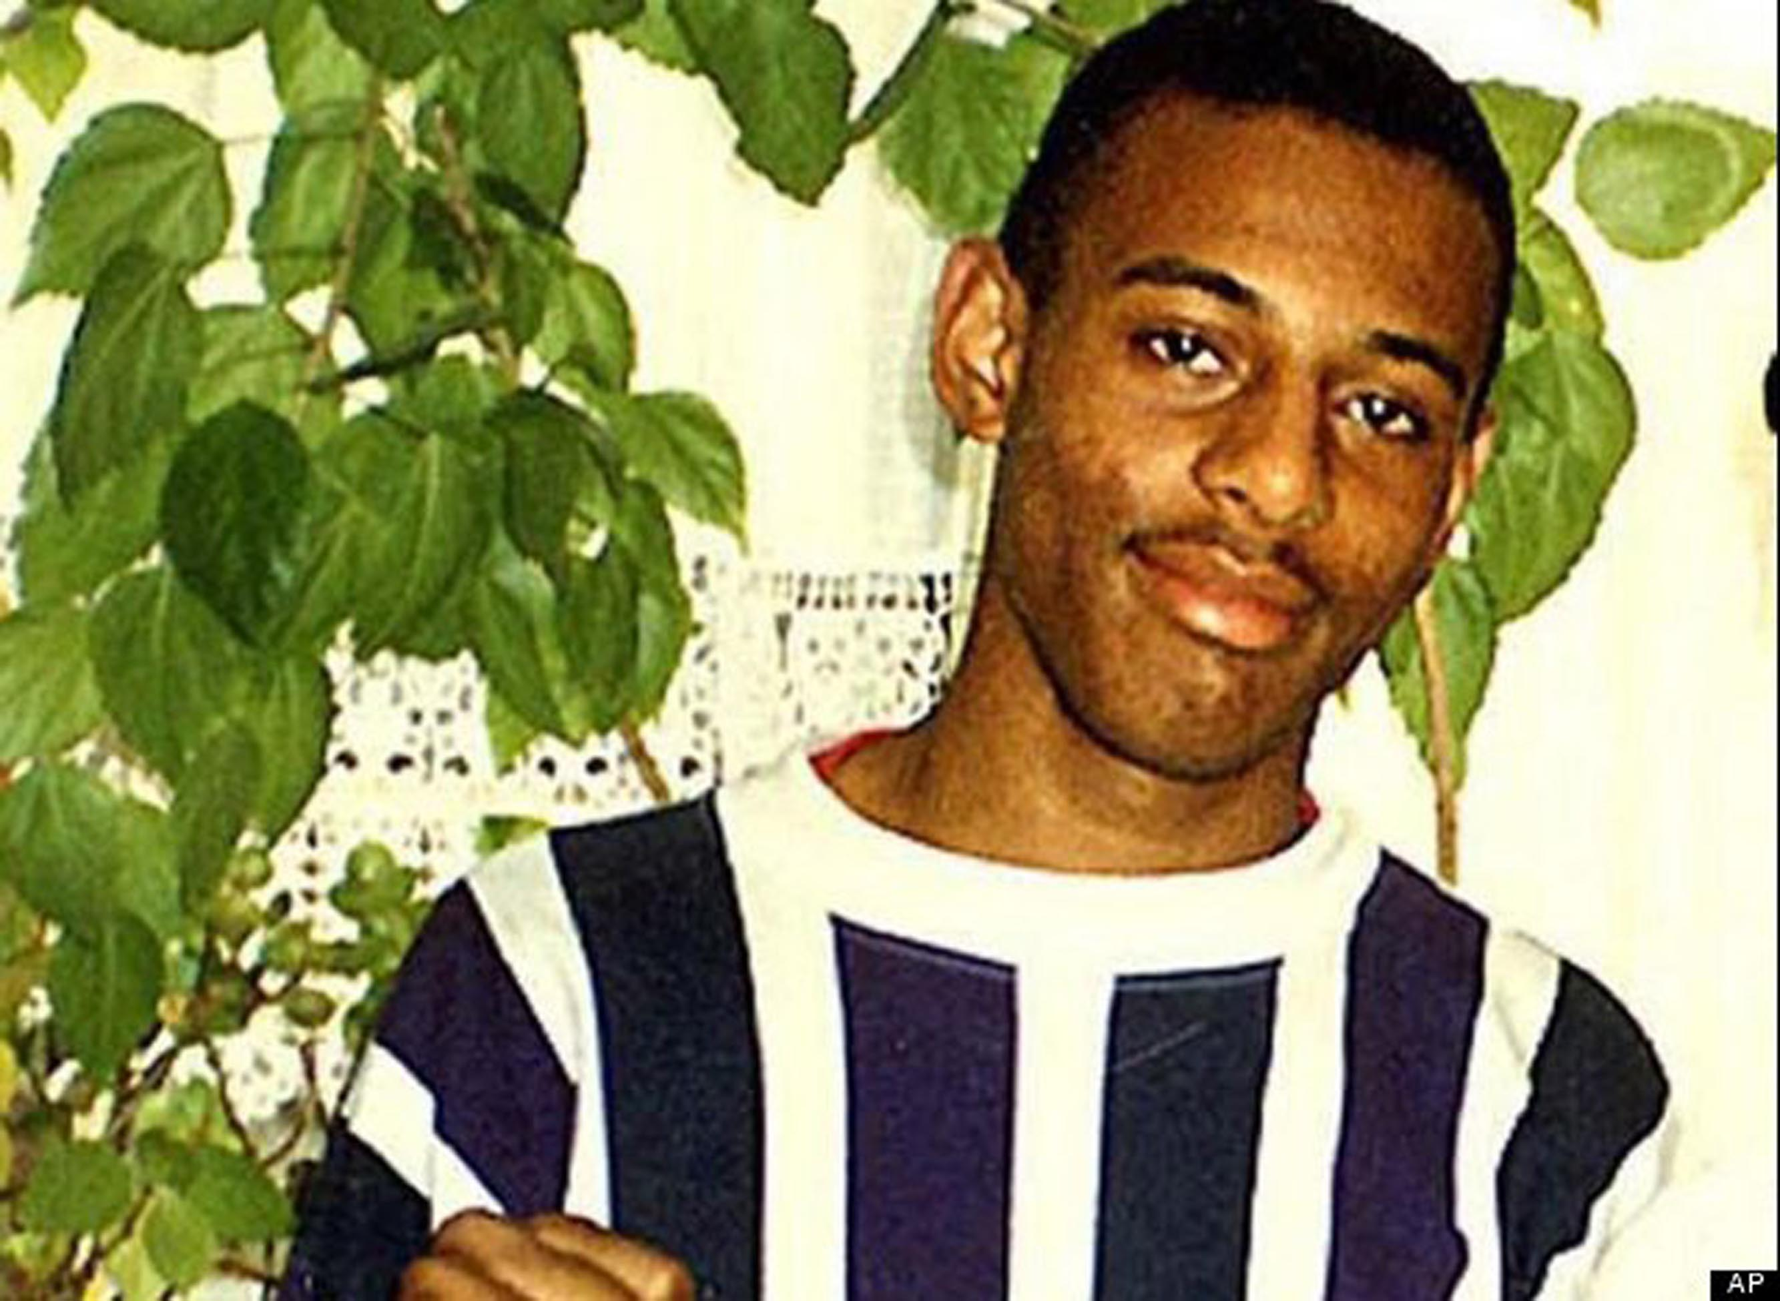
Stephen Lawrence
How can a challenging historical event to help us create a sensitive piece of drama?

Slide 5
Learning Outcomes
By the end of the lesson:
ALL of you will be able to give and accept direction during the rehearsal process.
MOST of you will be able to devise a sensitive piece of drama based on a challenging issues and theme.
SOME of you will be able to use symbols or abstract ideas/techniques easily to aid your work.

Slide 6
Murder
The murder of Stephen Lawrence is a notable murder case surrounding the killing of an 18 year old sixth form student in South East London
Stephen was stabbed to death whilst waiting for a bus on the evening of 22nd April 1993

Slide 7
Racist
This case is extremely important in British legal history as the Metropolitan Police were deemed to be
Institutionally Racist
They did not save Stephen’s life as he was BLACK

Slide 8
Still Images
You will be divided into groups of 5 and given a series of descriptions
Create a still image for each description (you may not all be needed for each image)
YOU WILL HAVE ONE MINUTE TO CREATE EACH STILL IMAGE!!!
Personal Learning & Thinking Skills
You will need to become a Creative Thinker & a
Team Worker to complete this task successfully

Slide 9
Groups
Get into groups of 5.
Each group must have a mix of boys and girls.
Pick your group responsibly – do not choose to work with people who you think may be a distraction.
Stand in a space with your group.

Slide 10
#1
End
1
2
3
4
5
6
7
8
9
10
11
12
13
14
15
16
17
18
19
20
21
22
23
24
25
26
27
28
29
30
31
32
33
34
35
36
37
38
39
40
41
42
43
44
45
46
47
48
49
50
51
52
53
54
55
56
57
58
59
60
A teenager is at his uncle’s
house, playing computer
games with his best friend.
The uncle tells them it is
getting late and time they were
going home.
Notes:
Click on the ’60’ button in powerpoint mode to trigger the timer.

Slide 11
#2
End
1
2
3
4
5
6
7
8
9
10
11
12
13
14
15
16
17
18
19
20
21
22
23
24
25
26
27
28
29
30
31
32
33
34
35
36
37
38
39
40
41
42
43
44
45
46
47
48
49
50
51
52
53
54
55
56
57
58
59
60
The friends leave the uncle’s house and make their way home. On the way they decide to get something to eat and stop off at a takeaway. They purchase their food.
Notes:
Click on the ’60’ button in powerpoint mode to trigger the timer.

Slide 12
#3
End
1
2
3
4
5
6
7
8
9
10
11
12
13
14
15
16
17
18
19
20
21
22
23
24
25
26
27
28
29
30
31
32
33
34
35
36
37
38
39
40
41
42
43
44
45
46
47
48
49
50
51
52
53
54
55
56
57
58
59
60
The boys leave the shop with their food and make their way to the bus stop. There are other people at the stop, but no sign of a bus. They continue to wait…it is getting late.
Notes:
Click on the ’60’ button in powerpoint mode to trigger the timer.

Slide 13
#4
End
1
2
3
4
5
6
7
8
9
10
11
12
13
14
15
16
17
18
19
20
21
22
23
24
25
26
27
28
29
30
31
32
33
34
35
36
37
38
39
40
41
42
43
44
45
46
47
48
49
50
51
52
53
54
55
56
57
58
59
60
As there is no sign of a bus, one of the boys decides to walk home and tries to convince his friend to do the same. Then a bus arrives and they both get on it.
Notes:
Click on the ’60’ button in powerpoint mode to trigger the timer.

Slide 14
#5
End
1
2
3
4
5
6
7
8
9
10
11
12
13
14
15
16
17
18
19
20
21
22
23
24
25
26
27
28
29
30
31
32
33
34
35
36
37
38
39
40
41
42
43
44
45
46
47
48
49
50
51
52
53
54
55
56
57
58
59
60
Before long the boys realise that they are on the wrong bus and going away from their homes. They quickly get off and find themselves in an unknown and rougher area. They begin to argue.
Notes:
Click on the ’60’ button in powerpoint mode to trigger the timer.

Slide 15
#6
End
1
2
3
4
5
6
7
8
9
10
11
12
13
14
15
16
17
18
19
20
21
22
23
24
25
26
27
28
29
30
31
32
33
34
35
36
37
38
39
40
41
42
43
44
45
46
47
48
49
50
51
52
53
54
55
56
57
58
59
60
One of the boys storms off, the other stays where he is while he decides what to do. A gang of other boys are watching this from across the road. They begin to walk towards the boy who has been left alone
Notes:
Click on the ’60’ button in powerpoint mode to trigger the timer.

Slide 16
#7
End
1
2
3
4
5
6
7
8
9
10
11
12
13
14
15
16
17
18
19
20
21
22
23
24
25
26
27
28
29
30
31
32
33
34
35
36
37
38
39
40
41
42
43
44
45
46
47
48
49
50
51
52
53
54
55
56
57
58
59
60
The gang of boys begin to shout racist abuse at the first boy and then catch him up and assault him. His friend watches from a distance and then runs to help. His friend has been stabbed and is lying on the ground.
Notes:
Click on the ’60’ button in powerpoint mode to trigger the timer.

Slide 17
#8
End
1
2
3
4
5
6
7
8
9
10
11
12
13
14
15
16
17
18
19
20
21
22
23
24
25
26
27
28
29
30
31
32
33
34
35
36
37
38
39
40
41
42
43
44
45
46
47
48
49
50
51
52
53
54
55
56
57
58
59
60
The gang of boys run away and leave the boy they have stabbed lying on the ground. His friend is very distressed and runs to a phone box to call for an Ambulance
Notes:
Click on the ’60’ button in powerpoint mode to trigger the timer.

Slide 18
The Suspects
Gary Dobson
Neil Acourt
Jamie Acourt
Luke Knight
David Norris
In 2012, Dobson and Norris were convicted of murdering Stephen, 19 years after he died.

Slide 19
Task Two - Skills
For the next set of tasks, you will need to be an
Effective Participator
Actively involved with the work
Negotiate with the group
Identify areas for improvement and refine during rehearsal

Slide 20
Role Play
Create a scene where the gang is discussing the murder.
ALL - give and accept direction during the rehearsal process.
MOST - devise a sensitive piece of drama based on a challenging issues.
SOME - use symbols or abstract ideas/techniques easily to aid your work.
Choose from one of the
following scenarios:
Outside near the bus stop, spot Stephen & Duwayne waiting for the bus;
At home planning the killing as an initiation test.
CHALLENGE
Discuss: What are the most significant moments in your piece and why?

Slide 21
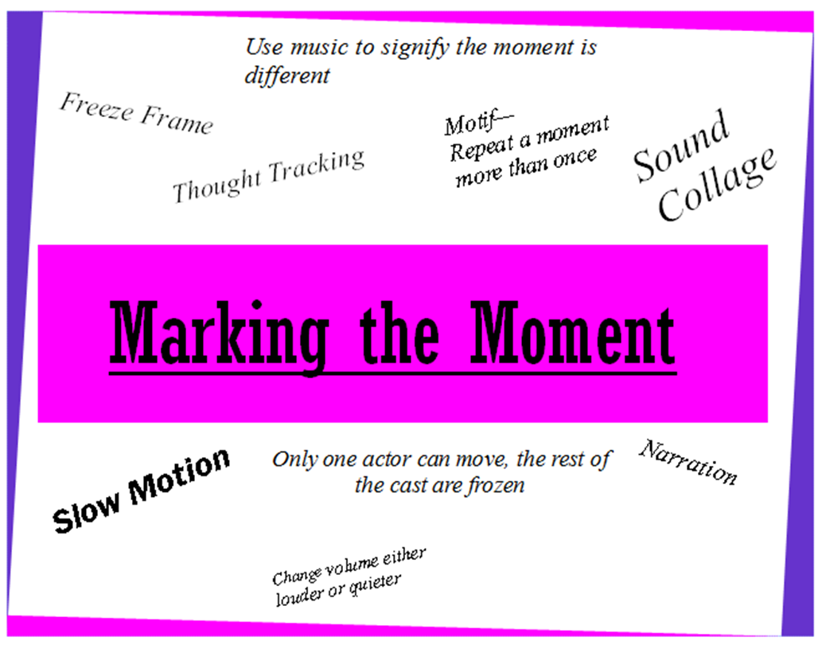
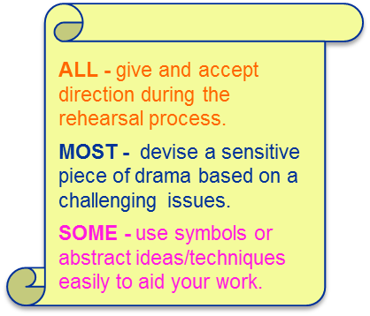
Marking the Moment What is it?
CHALLENGE:
Experiment with multiple techniques to mark the moment. Pick the one which works best.
Think - Pair - Share
Pick one moment in your piece to stand out as different from the rest.
An opportunity for you to create
an ABSTRACT moment

Slide 22
Crosscutting
Now run the end of you piece and crosscut forward to your final still Image from earlier in the lesson…
The gang of boys run away and leave the boy they have stabbed lying on the ground. His friend is very distressed and runs to a phone box to call for an Ambulance
How did the crosscut back to the final image enable us to create a sensitive piece of drama?

Slide 23
Did you meet the Learning Objective?
Using a historic event to create a sensitive piece of drama.
ALL of you will be able to give and accept direction during the rehearsal process.
MOST of you will be able to devise a sensitive piece of drama based on a challenging issues and theme.
SOME of you will be able to use symbols or abstract ideas/techniques easily to aid your work.
Notes:
Pupils position themselves in the room to indicate the extent to which they feel they’ve met the LO.

Slide 24
Review
How was todays lesson
like a jam doughnut?

Slide 25
Feel Good Plenary…
“Put your hands on the shoulders of…”
Notes:
Pupils move around the space. Read out some of the following statements one at a time. Pupils then put their hand / hands on the shoulders of people who they feel did the best:
“…someone who demonstrated a high level of creativity”
“…someone who made a good contribution to whole class discussions”
“…someone who’s done themselves proud this lesson”
“…someone who used brilliant drama vocabulary”

