Slide 1
A Computer System
(Complete)
Input Devices
Processing Devices
Output Devices
Storage Devices
Software

Slide 2
Software
Another name for software is programmes.
Programmes are lists of instructions that control what a computer does. They can be many millions of instructions long! (Programmers work in teams to write them, often code is reusable)
Programmes are executed (carried out) by a processor (hardware).
There are different types of software. A common classification calls all software that makes the computer function systems software, and any software written to do a particular job beyond that applications software.

Slide 3
Applications Software
Examples are word-processors, spreadsheets, databases, games, smart phone/tablet apps, drawing packages, photo-editing software, browsers, e-mail apps etc. All these examples are general purpose so are called generic.
Some applications software can be very special purpose e.g. controlling power stations, hospital scanners, aircraft flight decks etc. This type of software is very costly to write.

Slide 4
Systems Software
There is some very basic systems software built into a computer to actually get it started every time you switch it on!
Then on top of this you need an operating system like Windows 10, Android, Unix, Linux or Mac OS. This has to be installed and then loaded into memory every time the computer starts up.
Only when the OS is loaded can you run applications software and get some work done!

Slide 5
Embedded Systems
PCs, games consoles, tablets and smart phones are examples of multi purpose machines. i.e. they are constructed to be able to run many different apps and so do many different things.
Embedded systems, on the contrary, are limited in what they can do. Examples of embedded systems include things like TVs, washing machines and DVD recorders.
Typically, the programmes that embedded systems use are stored on ROM chips and cannot be changed. Because there is limited need for RAM or complex processing they are cheaper to mass produce and manufacture.

Slide 6

Software layers
Communication between layers
Operating System
Applications Software
Applications Software
BIOS
Hardware
Applications Software

Slide 7
Operating System Tasks
All operating systems perform the following essential tasks for any computer system:
Memory Management. Allocates memory to programmes and makes sure that one programme does not interfere with memory allocated to another.
Handle communication between the different parts of the computer system so that they work together
Data Transfer. Moving data between the different parts of the system – e.g. transfer of data from hard drive to memory. Handling input and output operations.
Processor management. Deciding which program should be given processor time and for how long.
Security. Detecting, handling and reporting error situations to minimise loss of data. Handling log-in for password protected systems
They provide the user interface. Graphical user interfaces include menus, windows, icons and mouse pointer.

Slide 8
What is Multi-tasking?
here, the OS appears to allow several programmes to run at the same time. In reality, only one programme at a time can have access to the CPU – what the OS does, is frequently switch between the programmes accessing the processor, giving the illusion that they are all running simultaneously. All modern PCs and phones run multi-tasking OSs.

Slide 9
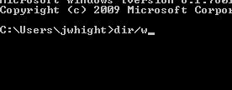
Types of user interface
Command line:
This is the earliest interface, developed before the mouse was invented!
It requires the user to key in special command words in order to tell the computer what to do.
A negative is that the user needs to know quite a lot about computers in order to use this interface. However, it does allow complete control over the computer system and is tremendously powerful. For this reason, the command line is still built into modern computers and is often used by experienced users.

Slide 10
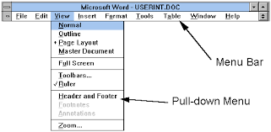
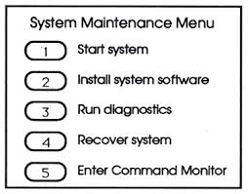
Types of user interface
2) Menu driven:
Because the command line was so difficult for most ordinary users to use menu driven systems were developed. Often the computer would start up with the command line and then run a particular programme to get the menu system running on top.
The idea with a menu driven system is to offer the user all the most likely choices of what they might want to do. Menus can be organised in to sub-menus if necessary.
Menu driven systems do not always require a mouse (think Sky TV). However, because they cannot provide all possible choices, the command line is still needed.

Slide 11
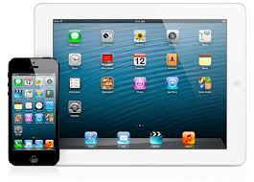
Types of user interface
3) Graphical User Interface (GUI):
The biggest leap forward in usability was with the GUI. Developed by Apple, it required a mouse and used an on screen pointer to select objects. Icons were invented to represent files, folders and programs, and commands could be given by various combinations of clicking the mouse buttons. Modern GUIs use touch screens instead of a mouse.

Slide 12
Proprietary vs open source software
Proprietary (or the property of…) software is the term given to software developed by businesses like Microsoft. Customers buy an object code copy of the software which they can run on their computer. The software is copyrighted and licensed to prevent illegal distribution.
Open source software gives users access to the source code as well as the object code version. Users have permission to modify, customise and develop the programmes further! The philosophy of open source is to resist the dominance of big businesses with computer use. Open source developers believe that computer usage should be free (or at least as cheap as possible) and available to everyone. For that reason, open source software is usually cheaper than proprietary software and is sometimes free to customers.
Linux is an example of an open source OS; Openoffice is a direct competitor to the MS-Office programmes; and Python is an open source programming language.
Take a read of this link and take a look at the “donate” link on the Open Office home page.

Slide 13
Standards
Standards are essential in computing to ensure that hardware and software work together correctly. Different types of standards include:
Proprietary – these are owned by a company. For example, anyone writing software to run on Windows must follow the standards laid down my Microsoft.
Industry – often many companies come together to plan and agree standards that they can all use. For example, the USB standards came about like this.
De facto – sometimes standards just come about because of common usage; e.g the use of HTML to code webpages came about in this way.
Open standards – these are developed and made publically available. Software developed in this way can be modified by others, e.g. open source.

