Slide 1
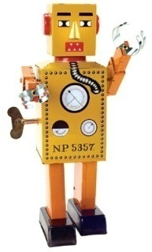
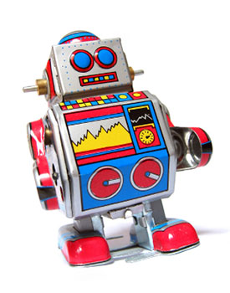
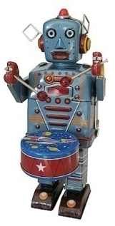
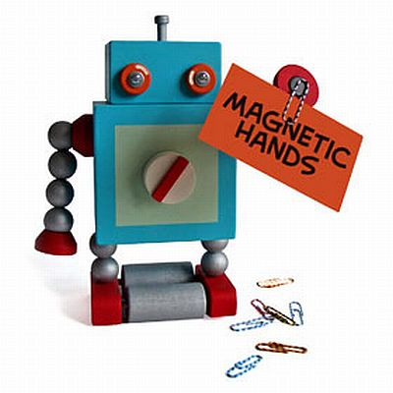
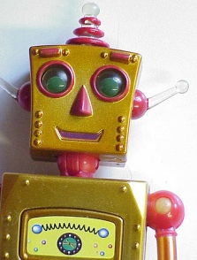
Year 7 Art lessons 1-3
2022
New Topic - ROBOTS

Slide 2
Look at the following pictures of robots.
What shapes are they made up of?

Slide 3
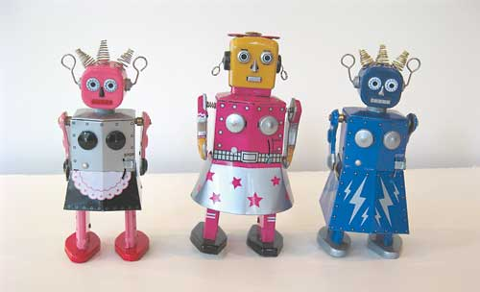

Slide 4
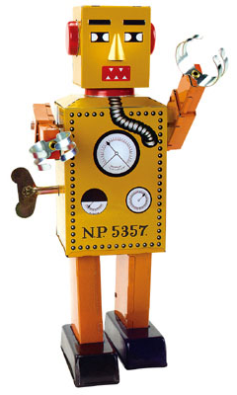

Slide 5
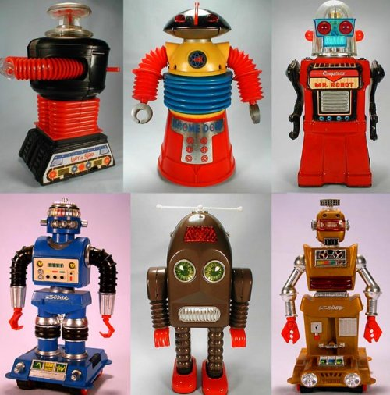

Slide 6
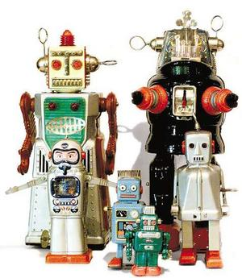

Slide 7


Slide 9

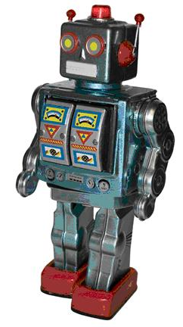

Slide 10
What basic shapes did you identify in the pictures of robots?
Square
Rectangle
Trapezoid
Circle
Triangle

Slide 11
Task 1:To draw a Robot
Objectives
You will draw a robot for your title page on paper.
You should complete the drawing of a robot in pencil using shade and tone.
You could use the aid of a grid to assist with the drawing.
We expect you to spend time on this drawing. If you were doing this in school we would work on it for about 3 lessons. Please complete this task over 2 weeks.

Slide 12
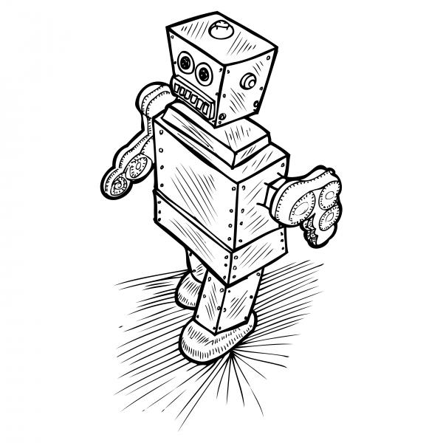
How to use a grid to help you copy an image

Slide 13


Place the enlarged grid under your page and hold in place with paper clips.
Now draw your robot onto your page using the grid as a guide.

Slide 14






Select a robot from the images provided on the powerpoint
2. Work on A4 paper
3. Use a 2B pencil to copy the robot.
4. Try to fill the page with the drawing.
5. Use the aid of a grid if required

Slide 15
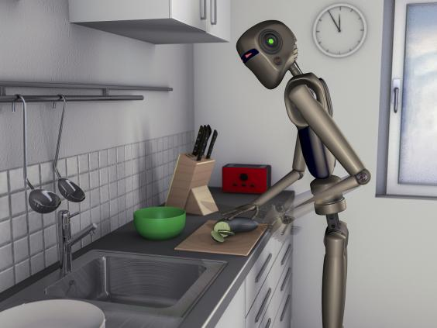
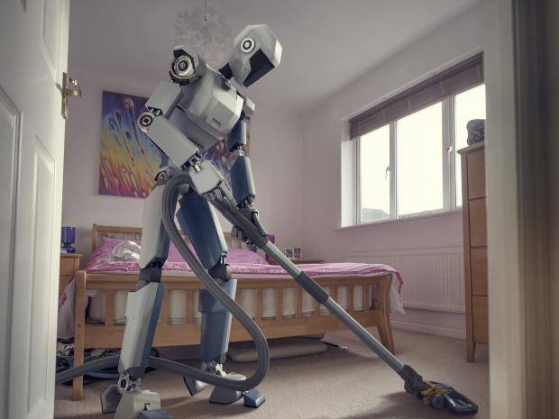
Task 2
Design a robot to complete tasks that you don’t like doing.
Fill your A4 page. Add colour and annotation describing it’s functions.

