Slide 1
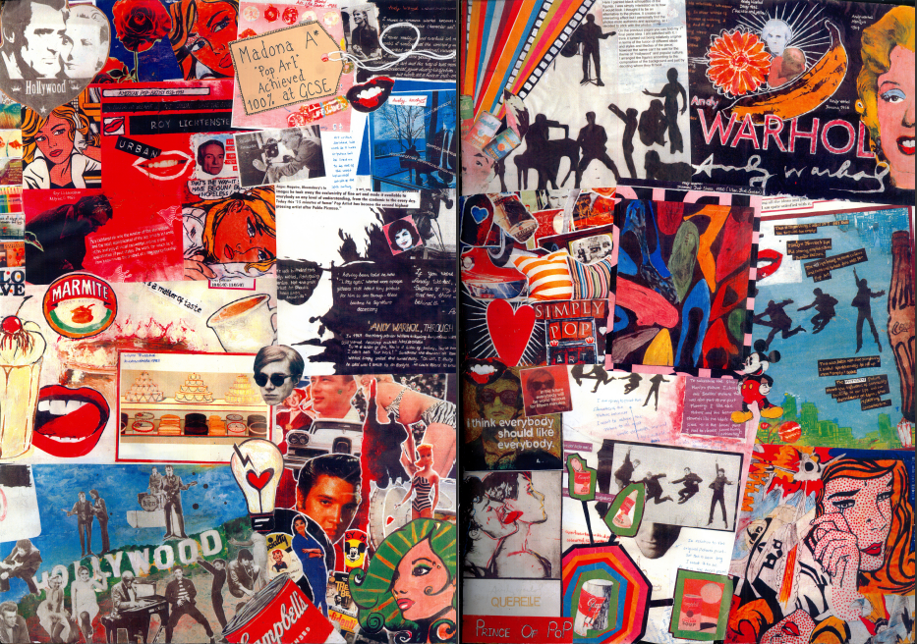
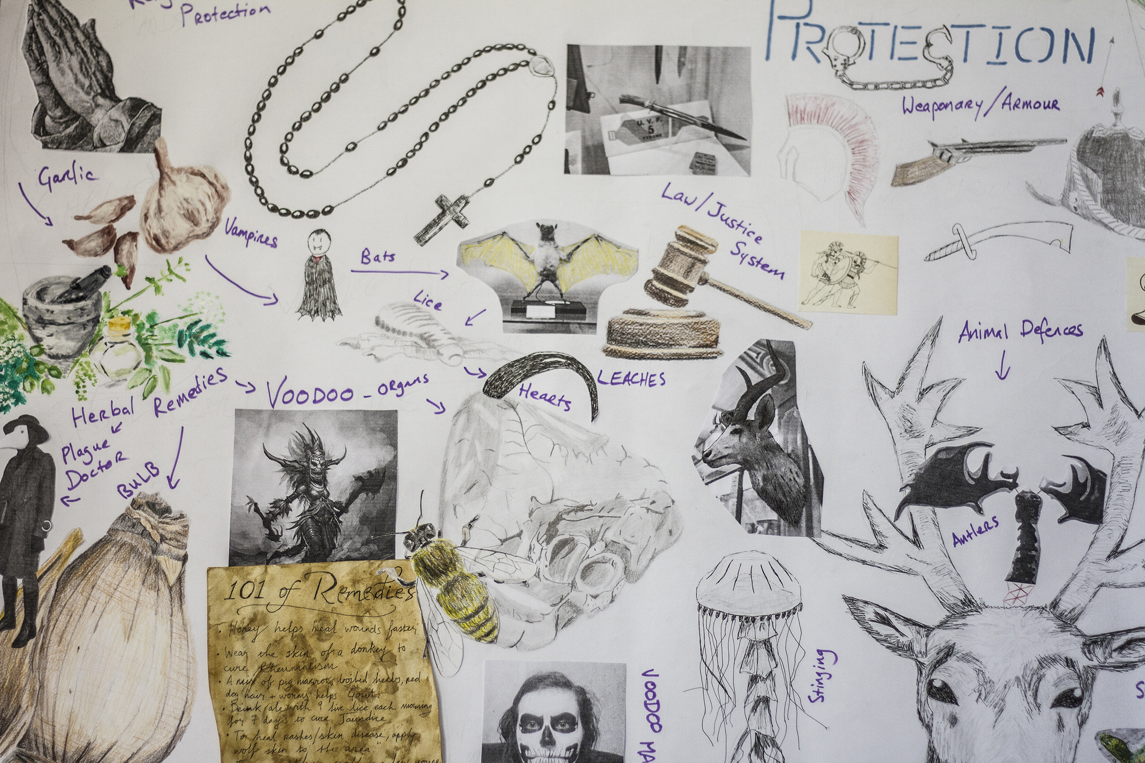
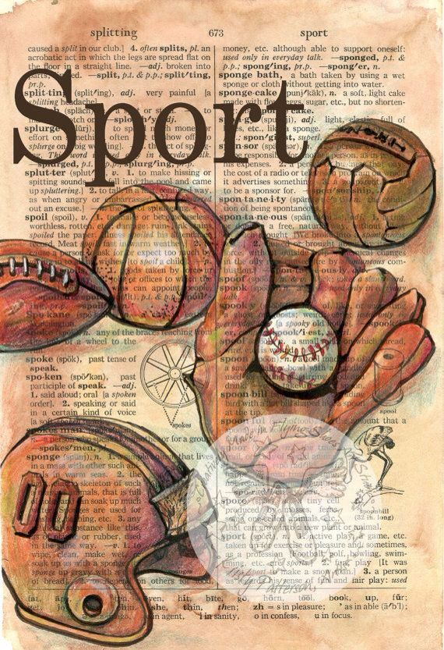
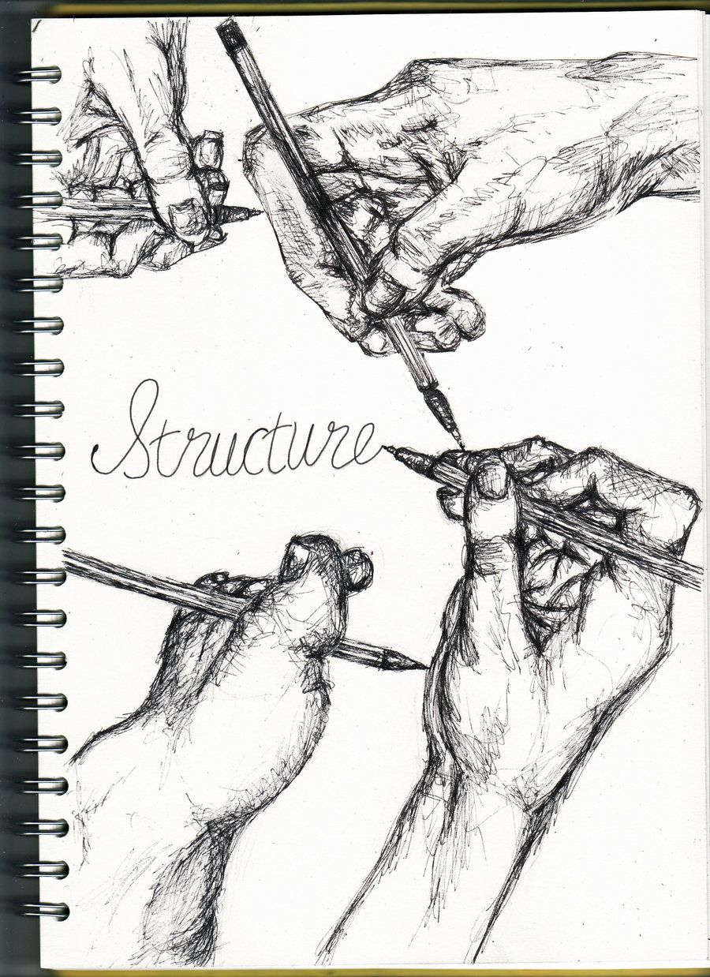

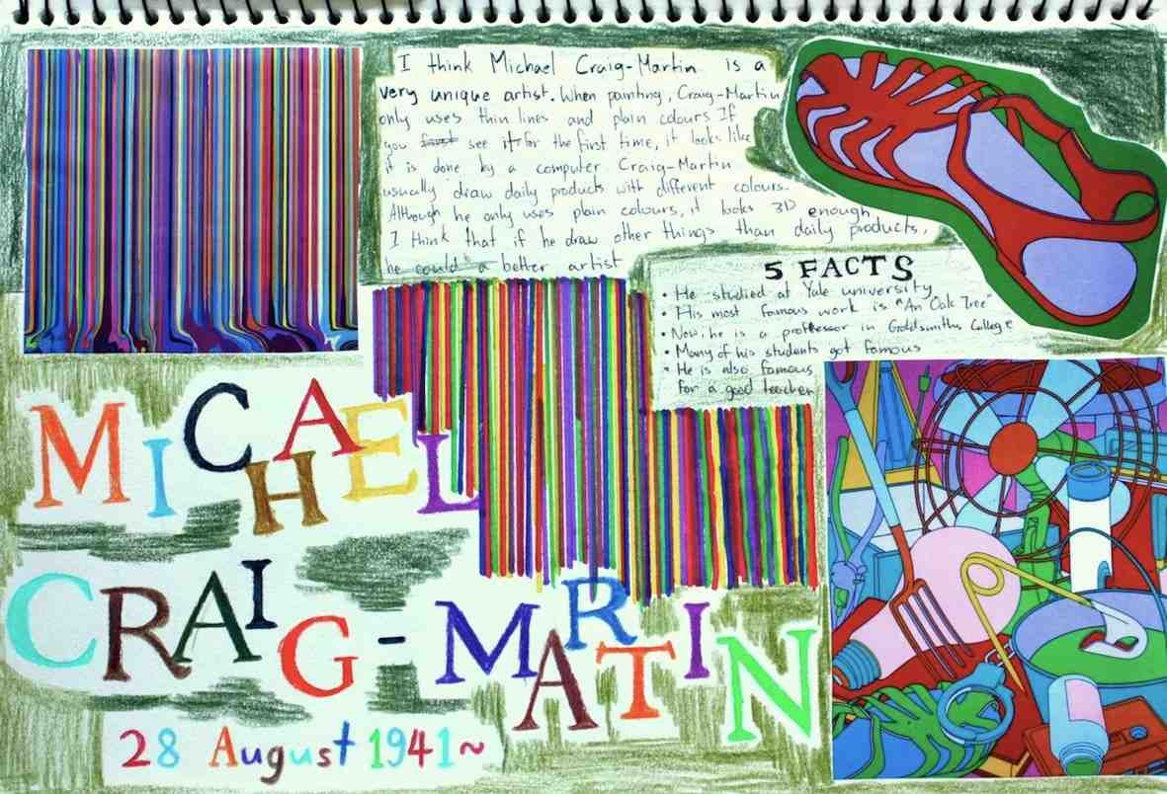

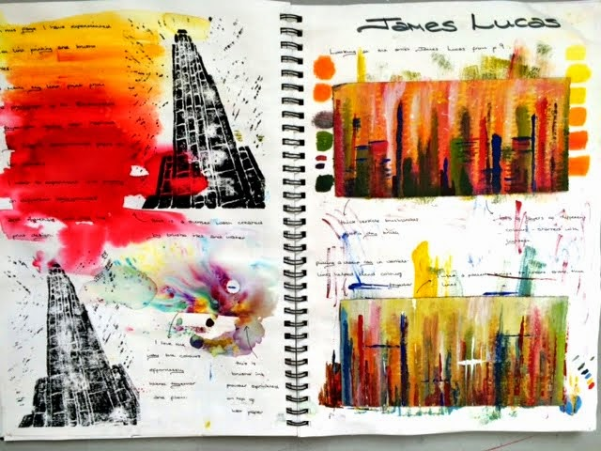
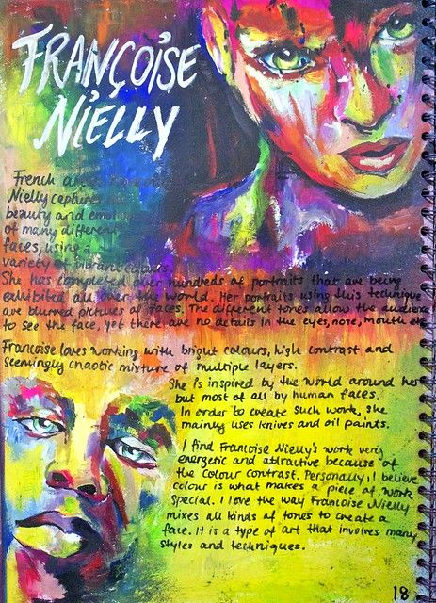
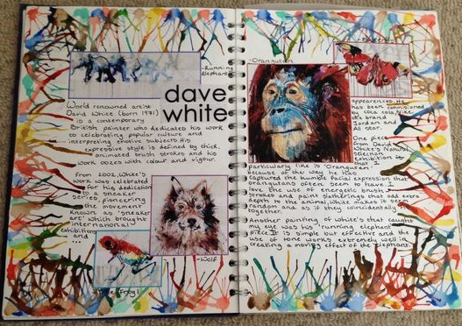
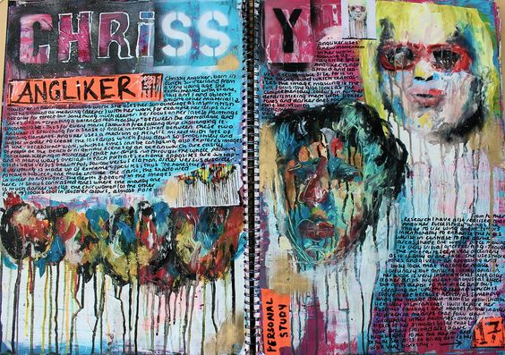
Flow chart for producing Preparation work for Final piece/Exam piece
MOOD BOARD
A double page filled with a wide range of inspirational images collected from the internet/Pinterest etc. Images should be annotated explaining their relevance and how they link with the question you have chosen. Images could include work by the artists mentioned in your question but also others that you have found yourself.
BRIEF
Type or write out the question you have chosen to study. If it gives you different options identify the approach that you will be taking.
ARTIST RESEARCH
You should be aiming to produce 4 double page spreads on 4 very different artists that you are going to use to inspire your ideas for your final piece. Each page should include the artist’s name as the title, images of their work, a brief paragraph about their art work, media and techniques, your opinion of their work and your copy/reproduction of a piece of their work. All this should be presented in a thoughtful, well planned manner using appropriate colours, backgrounds, patterns, textures influenced by the artist’s work.

Slide 2
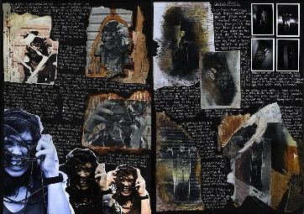
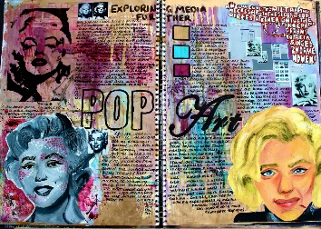

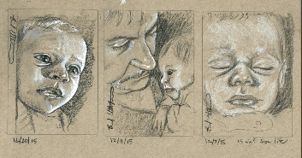
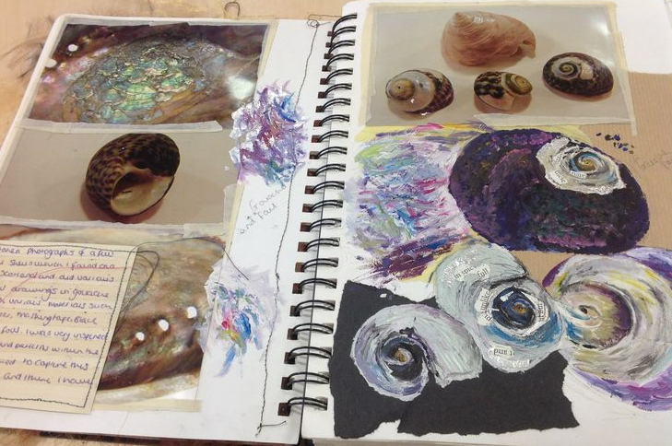
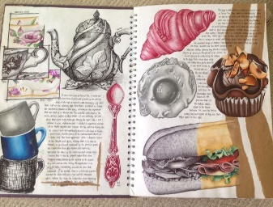
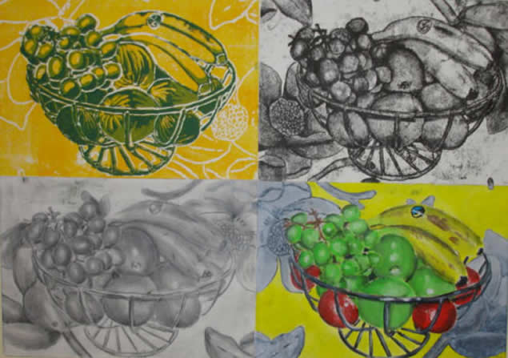
PHOTOGRAPHS
To achieve the top marks you must include your own photographs. This can be difficult with some questions and you may need to really think about what you can include. Discuss this with me, I will be able to help you come up with some ideas. For example one student studying super heroes photographed “nerf” guns and used these images in his final piece in a pop art style.
DRAWINGS/PAINTINGS/COLLAGE/PRINTS
You will need to produce a wide range of images from life, your photos and images collected from the internet. You need to use a wide range of media, techniques and scale. You may do some quite rough sketchy drawings and some more detailed meticulous ones. You should be aiming to produce several double pages of images.
DEVELOPMENT OF IDEAS/EXPERIMENTATION
Initial ideas for your final piece should be numerous (at least 3). These can be rough, annotated sketches explaining your idea and should connect with the artists that you have been studying (it’s a good idea to put a small picture of the piece of work you have been inspired by to remind the examiner what you were aiming for). Don’t settle for the first idea that comes to you, push yourself to try different compositions, consider different materials & techniques, scale and layout.
Experiment with a wide range of media. You want to show that you have tried using a variety and have settled on a particular technique through careful consideration.
ANNOTATION
You need to annotate everything you do, explain your thought process and why you are doing what you’re doing. The examiner does not know you and unless you make it clear to them may not understand what you are doing and why….
FINAL PIECE
Your design and plan for your final piece should be sketched out clearly, annotated detailing & explaining the materials, scale, colour scheme etc that you are going to use. Remember if you run out of time and don’t manage to complete your final piece we should be able to see in your prep work how you wanted it to look. Also make reference to your initial source of inspiration again.

Slide 3
