Slide 1
YEAR 9
GRAFFITI

Slide 2
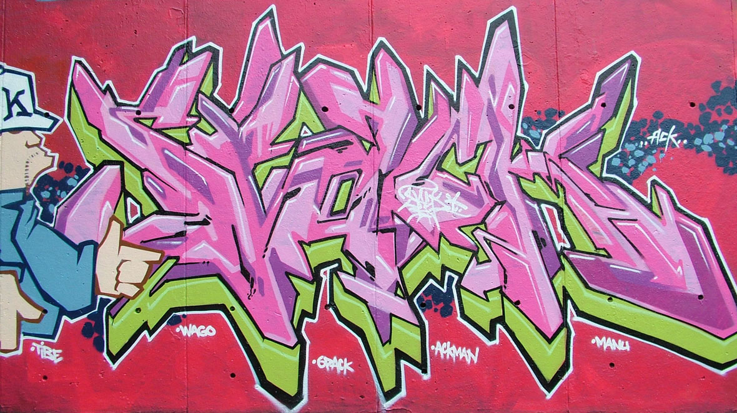
STREET ART?

Slide 3
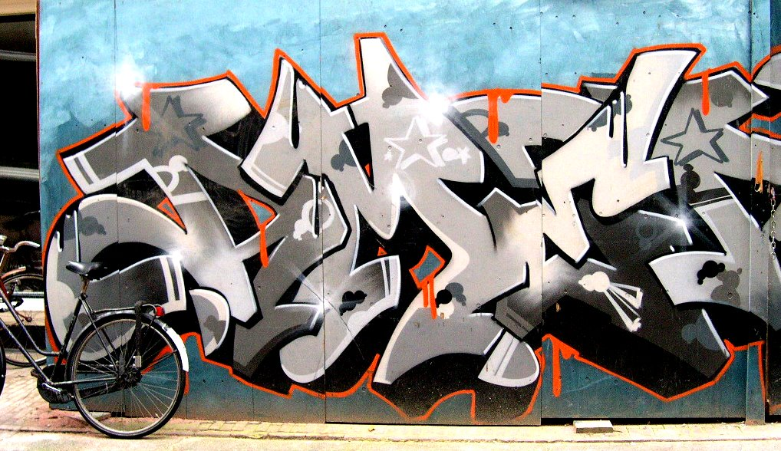

Slide 4
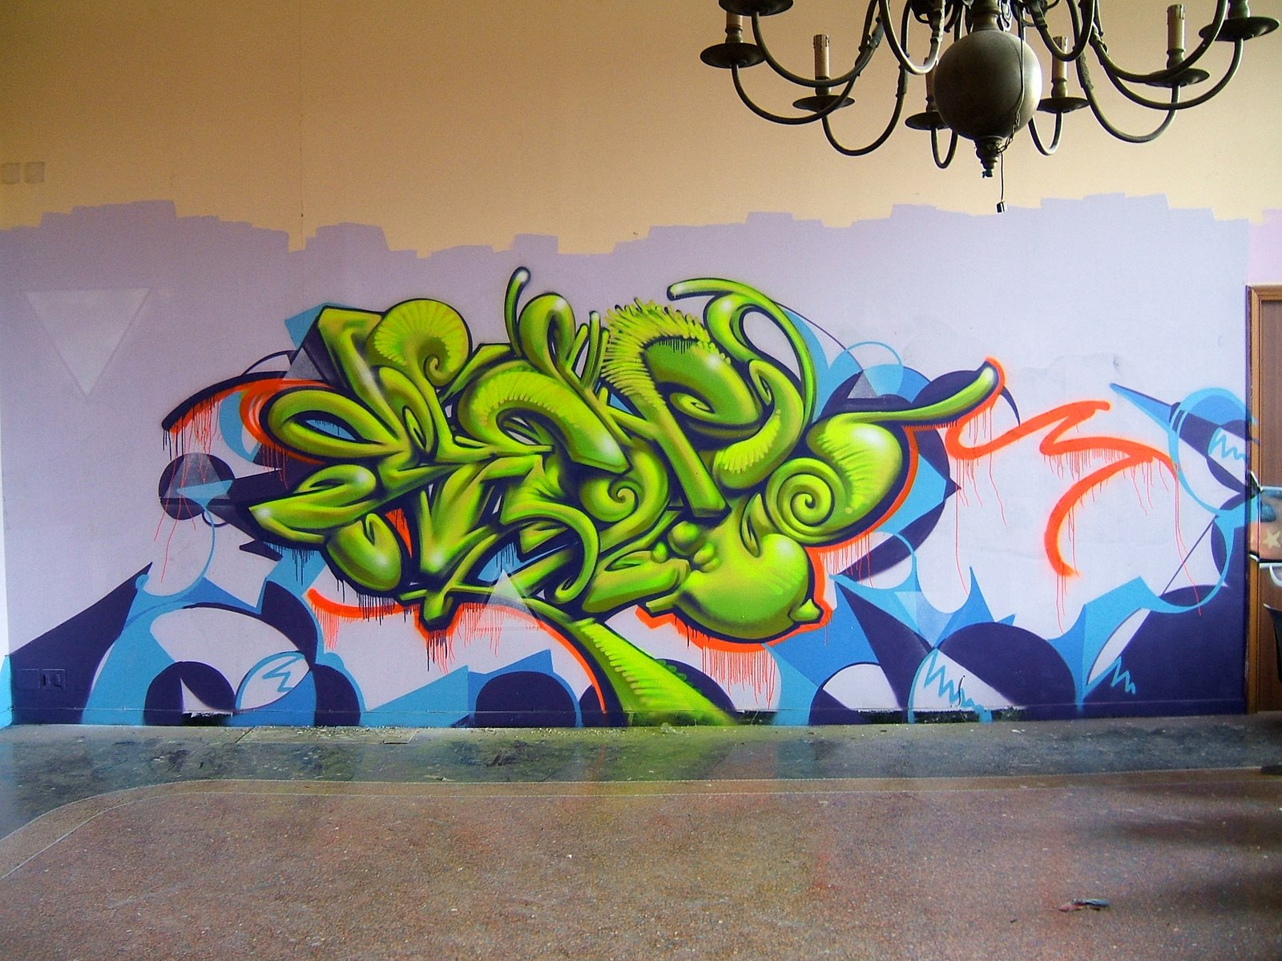

Slide 5
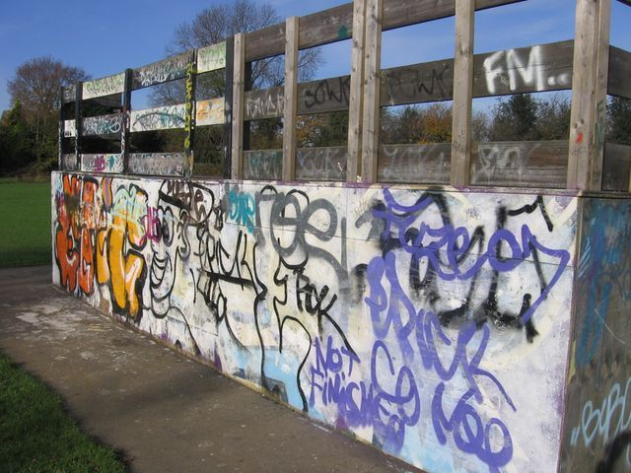
STREET ART?

Slide 6
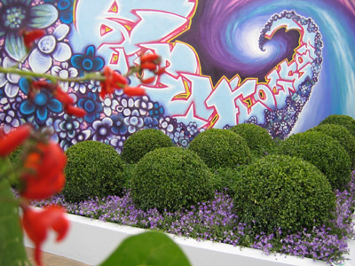
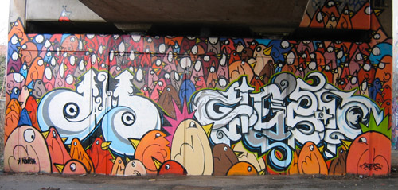
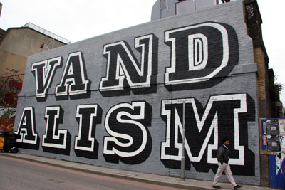
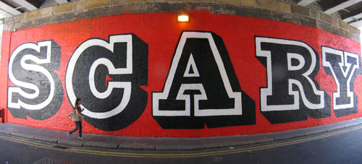

Slide 7
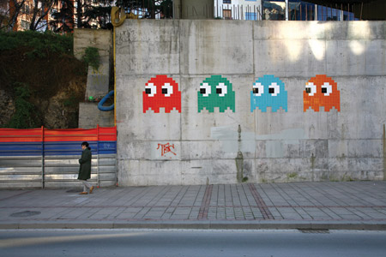
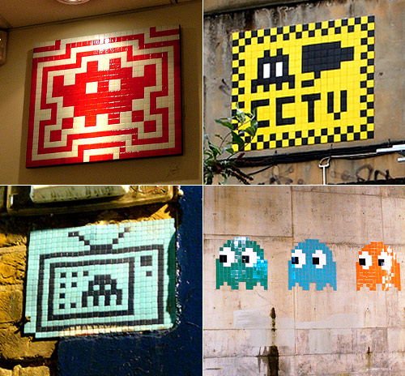
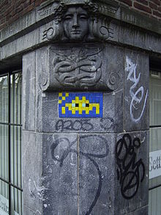
INVADER/SPACE INVADER

Slide 8
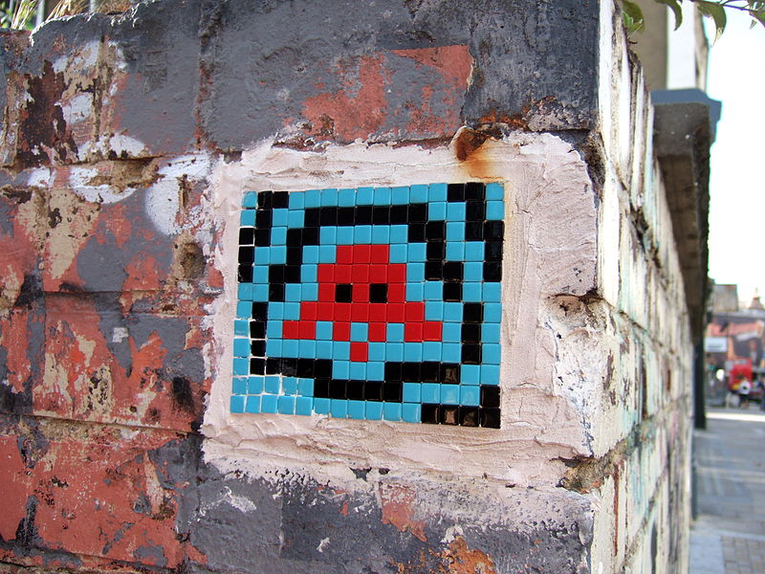

Slide 9
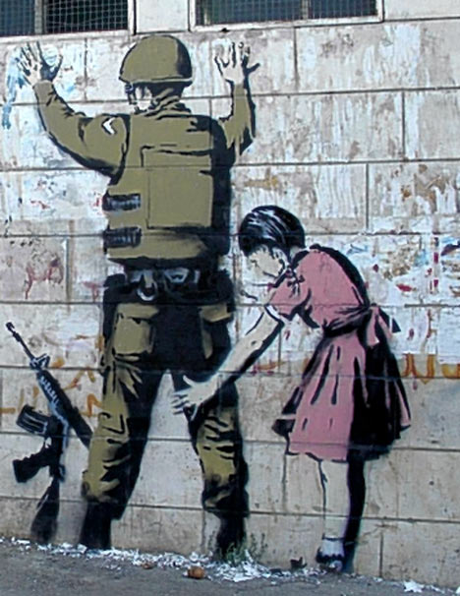
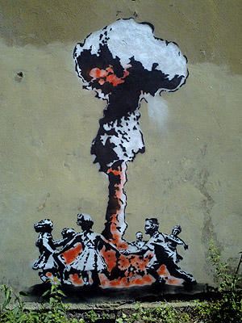
GUERILLA ART?

Slide 10
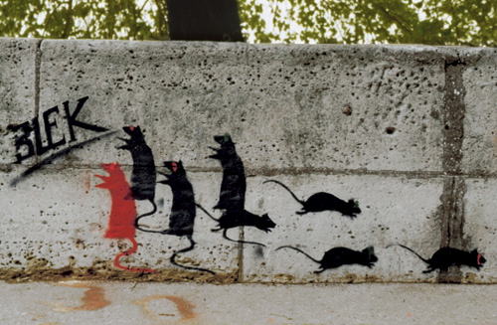
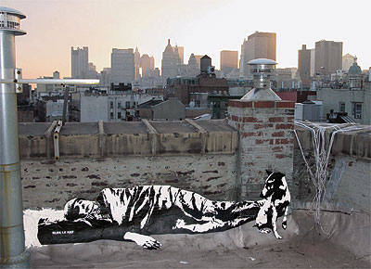
BLEK LE RAT
FOUNDER OF THE POPULAR “STENCIL” TECHNIQUE
PARIS-BASED ARTIST
HAD A STRONG INFLUENCE ON BANKSY

Slide 11
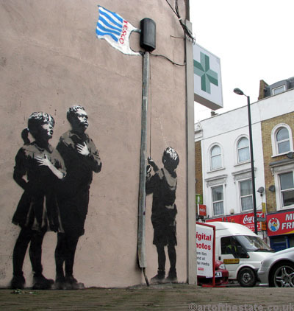
BANKSY
HUMOUR
POLITICAL SATIRE
ANONYMITY
MEDIA SAVVY
BRITAIN’S MOST NOTORIOUS VANDAL?

Slide 12
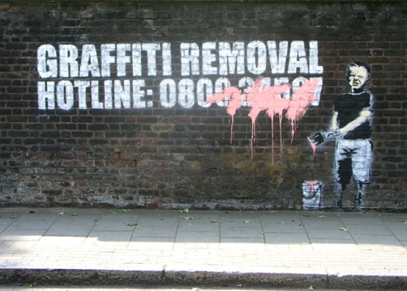
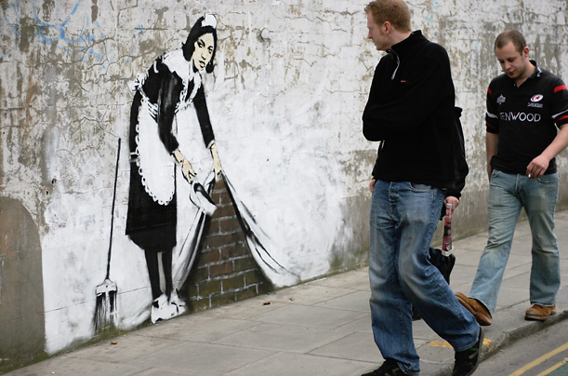

Slide 13
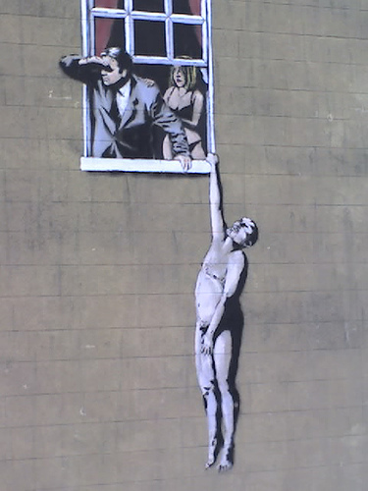
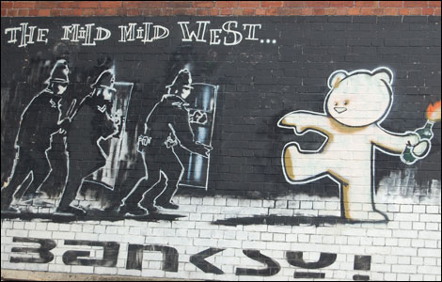

Slide 14
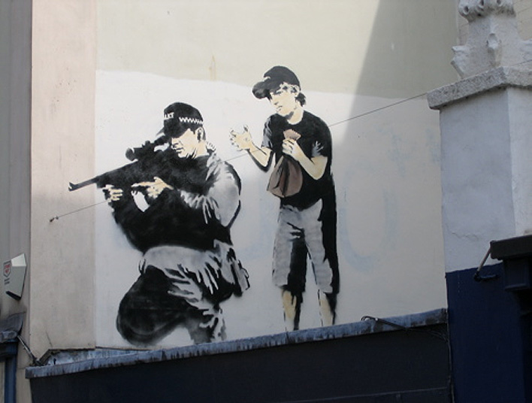

Slide 15
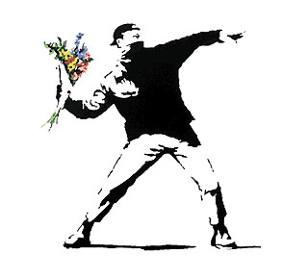
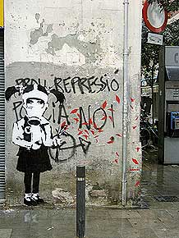
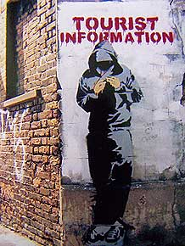
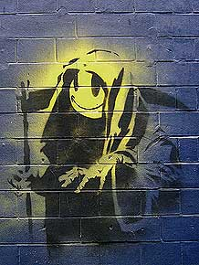
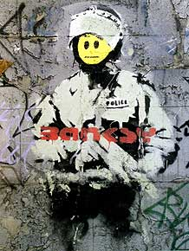
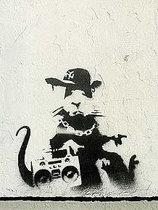

Slide 16
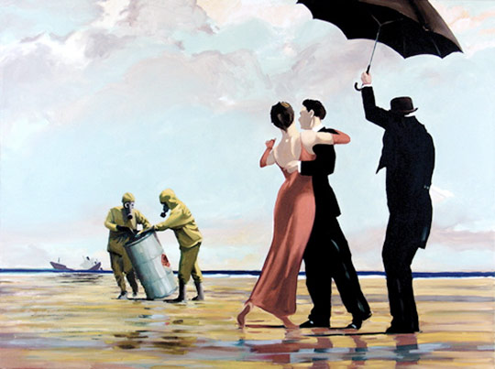
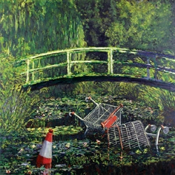
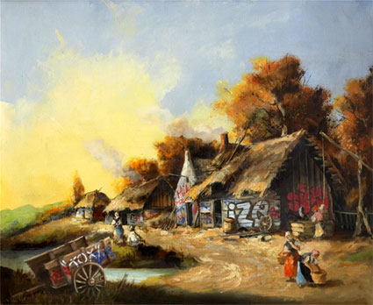

Slide 17
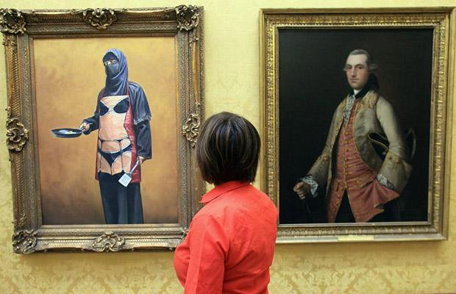

Slide 18
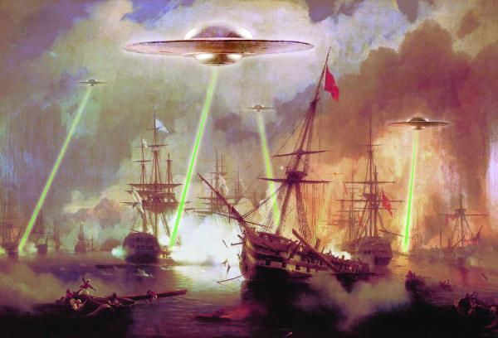

Slide 19
Year 9 Lesson 1
Print out pictures from the internet (in colour if possible) of different graffiti styles. Try to find ones with interesting backgrounds eg clouds/explosions.

Slide 20
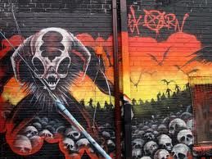
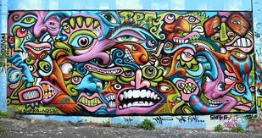
Using ‘Google’ find at least 6 images of interesting Graffiti backgrounds, print them off onto an A4 sheet to stick in your art book for next lesson.

Slide 21
Graffiti Tag
Black & White
Lesson 1-2

Slide 22
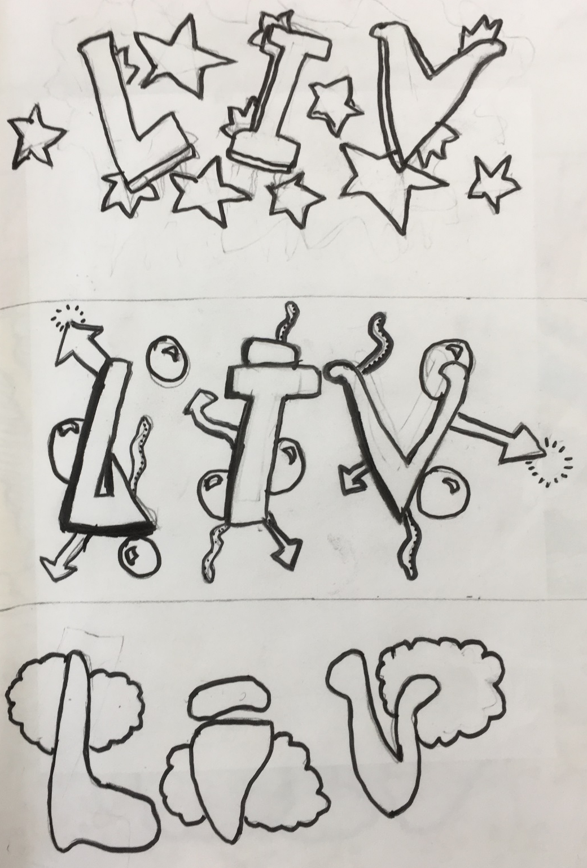
Divide your A4 paper into 3 equal sections approx. 10cm

Slide 23
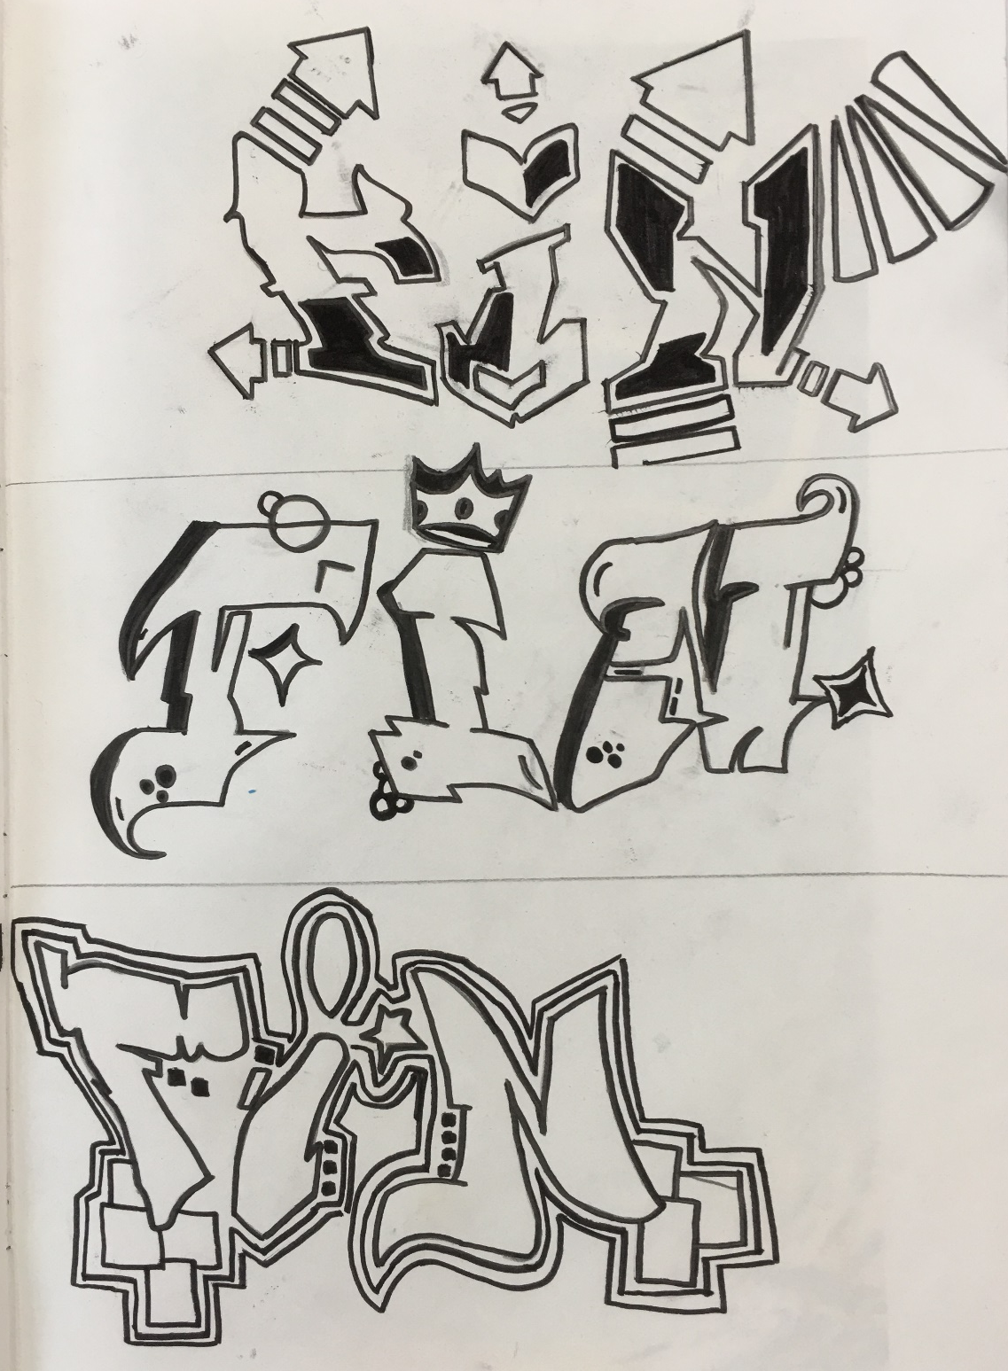
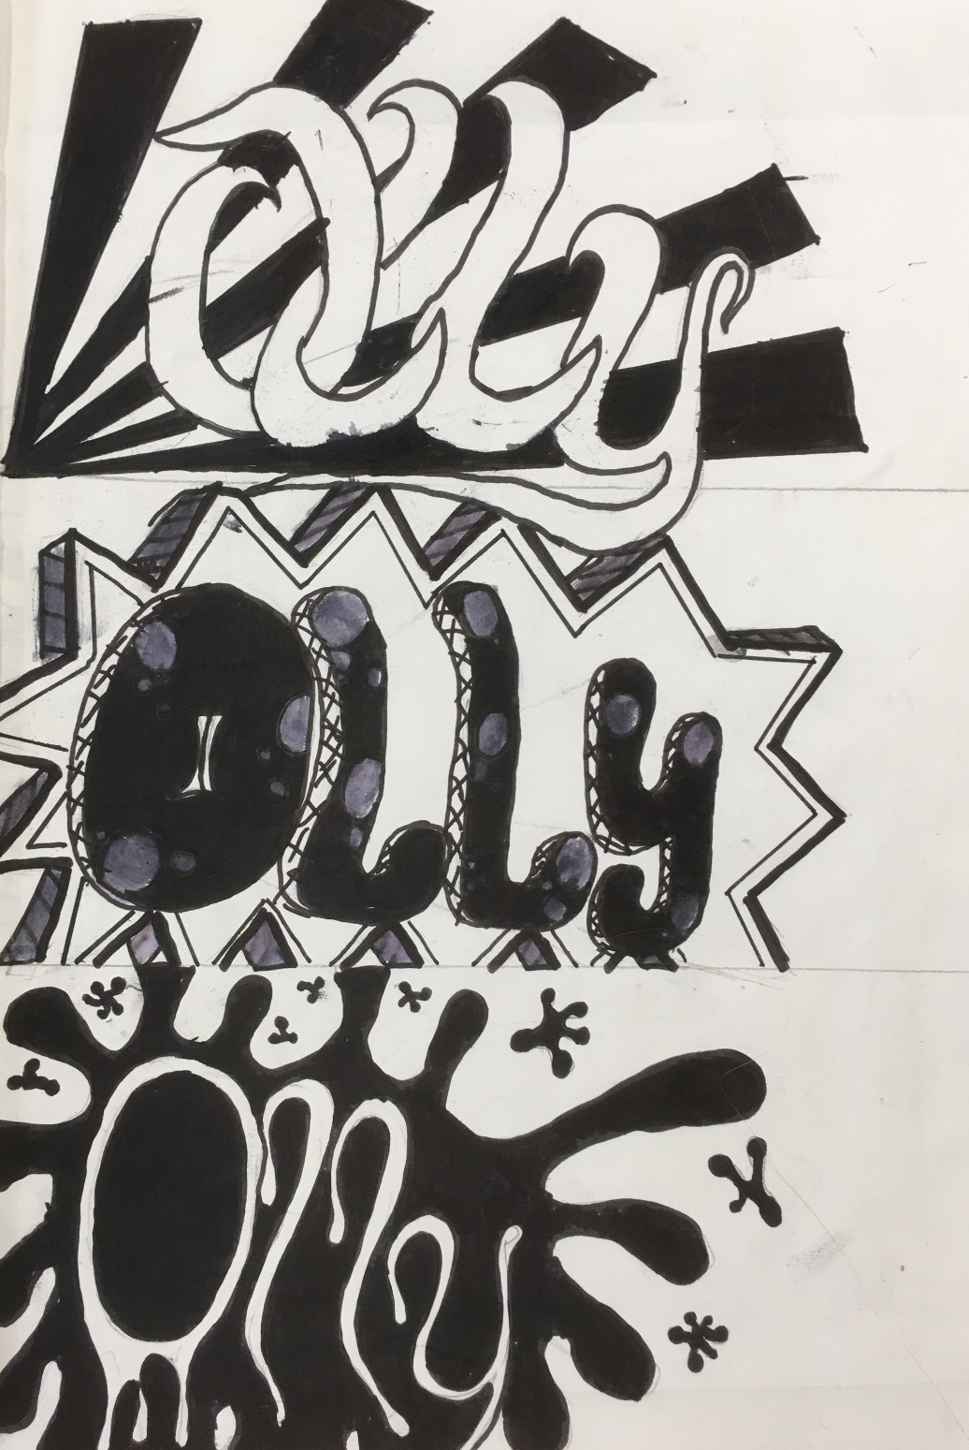

Slide 24
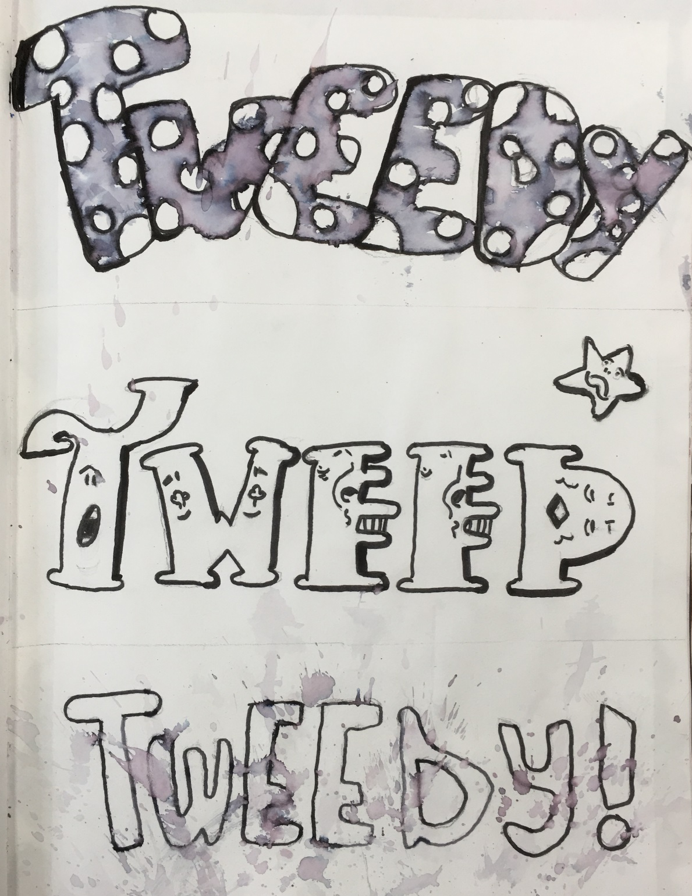
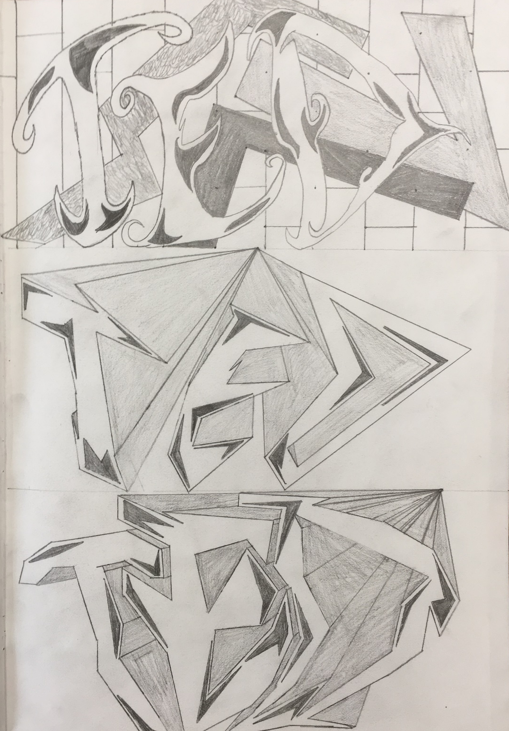

Slide 25
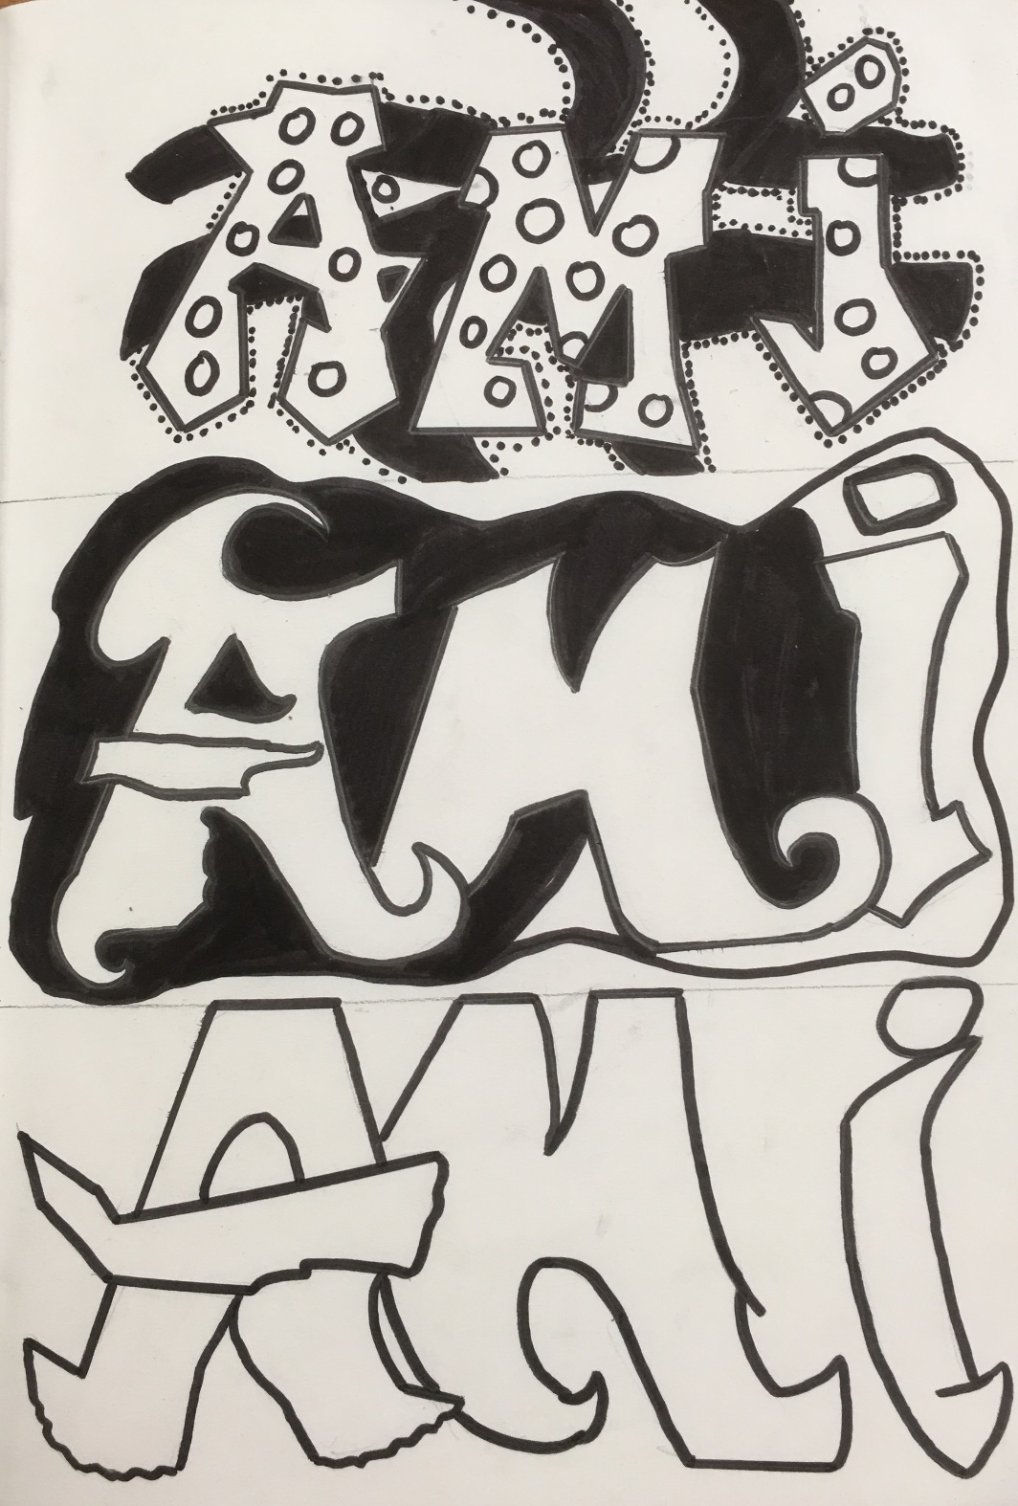
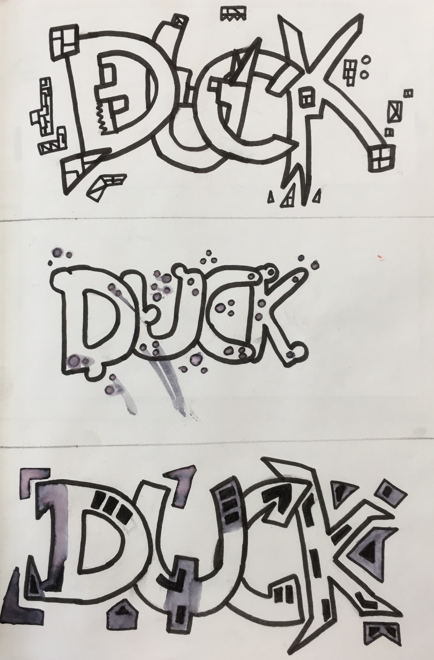

Slide 26
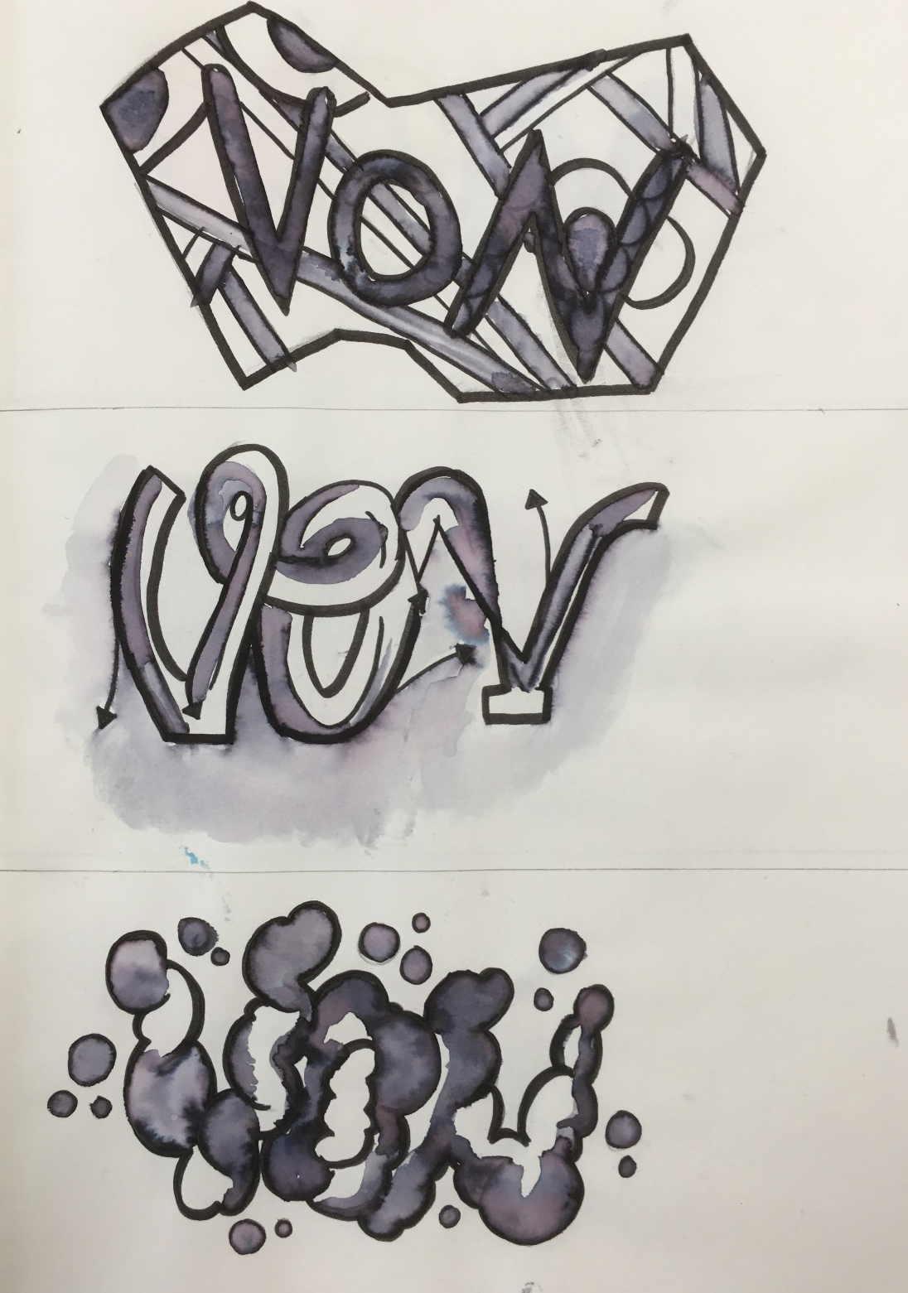
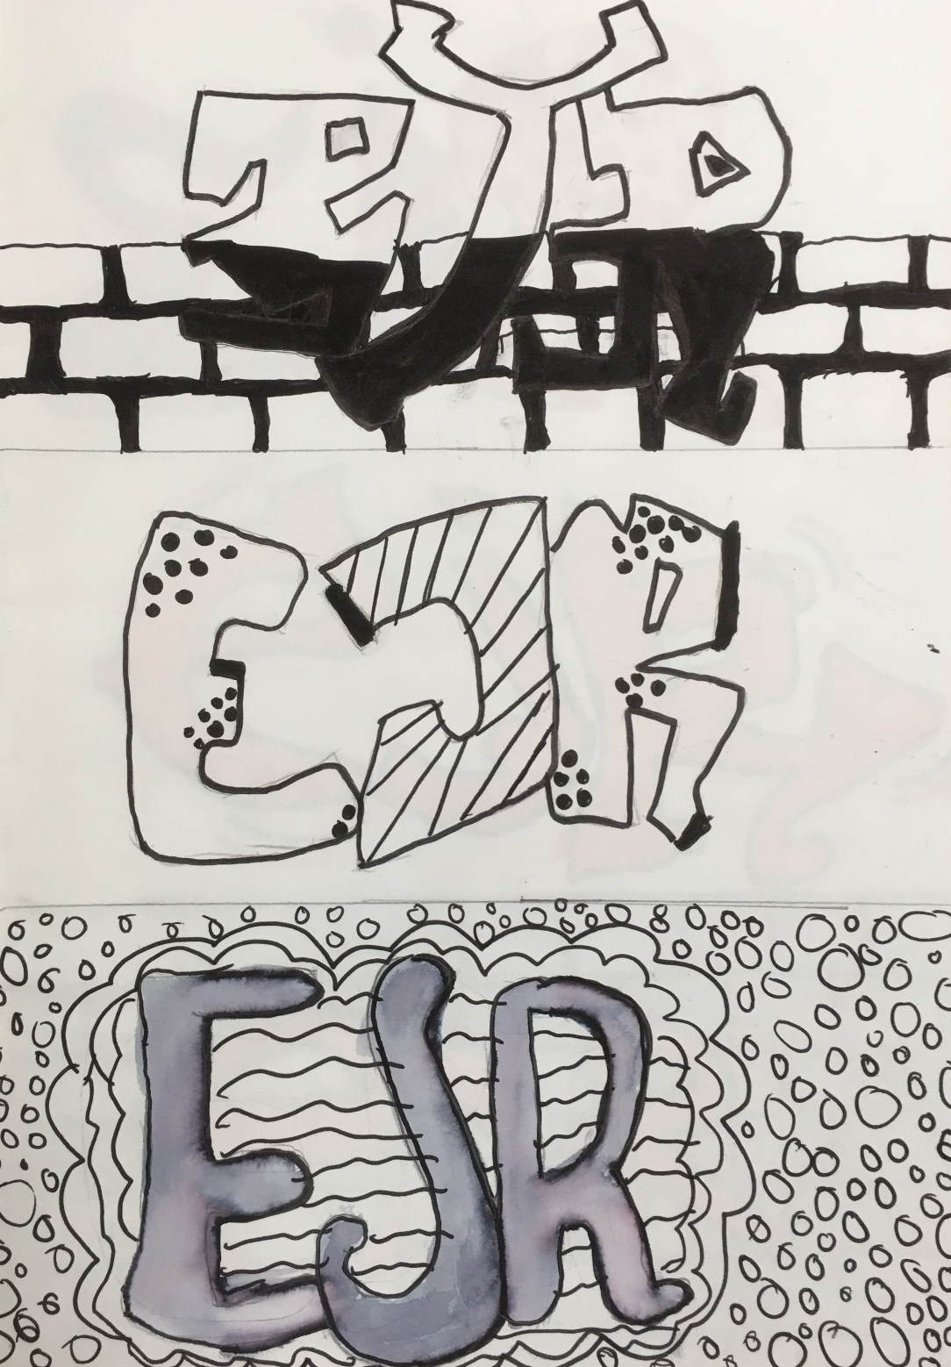

Slide 27
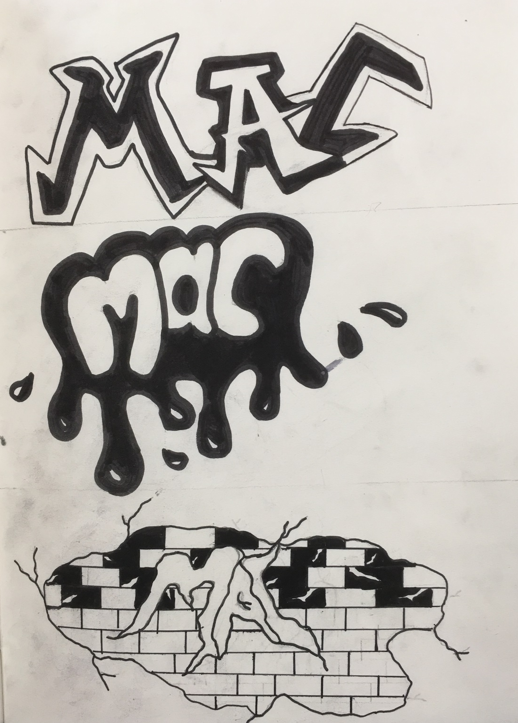
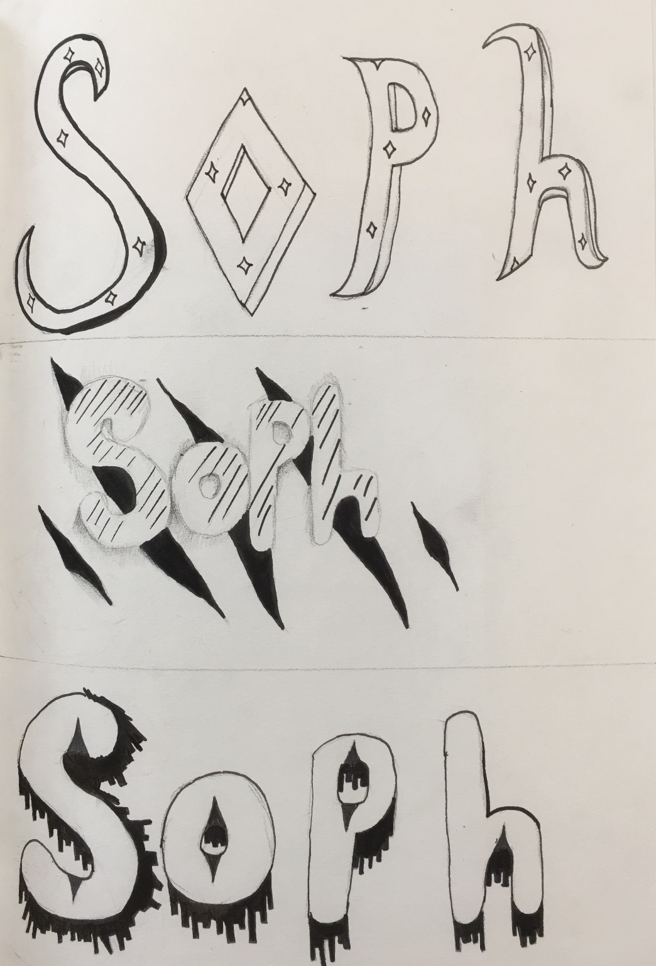

Slide 28
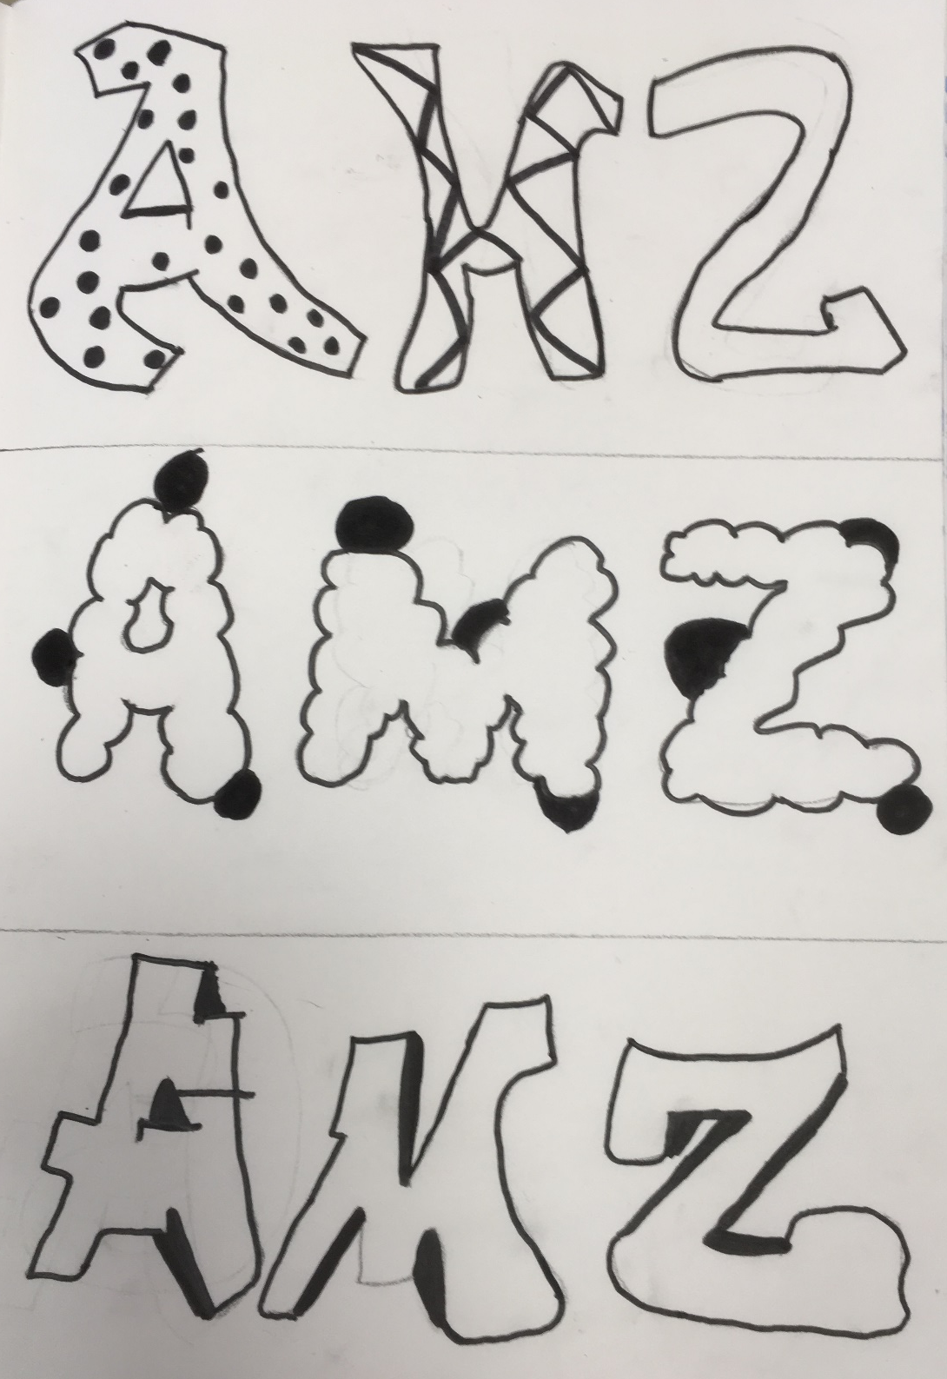
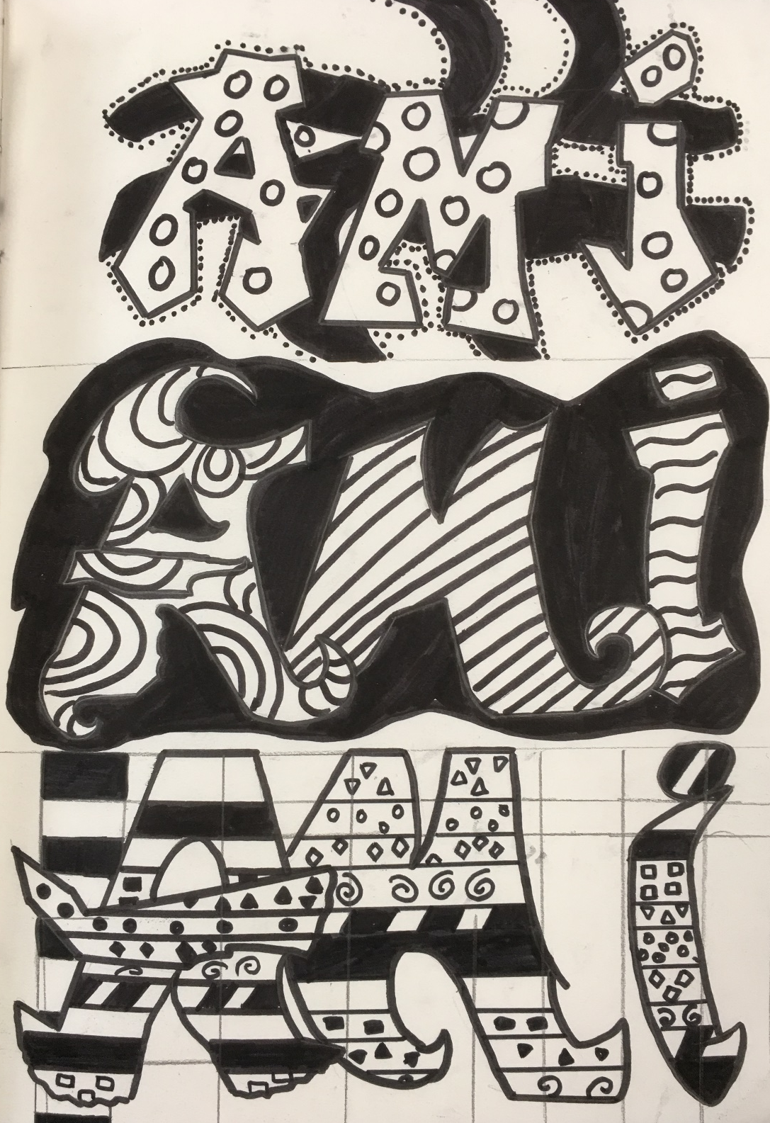

Slide 29
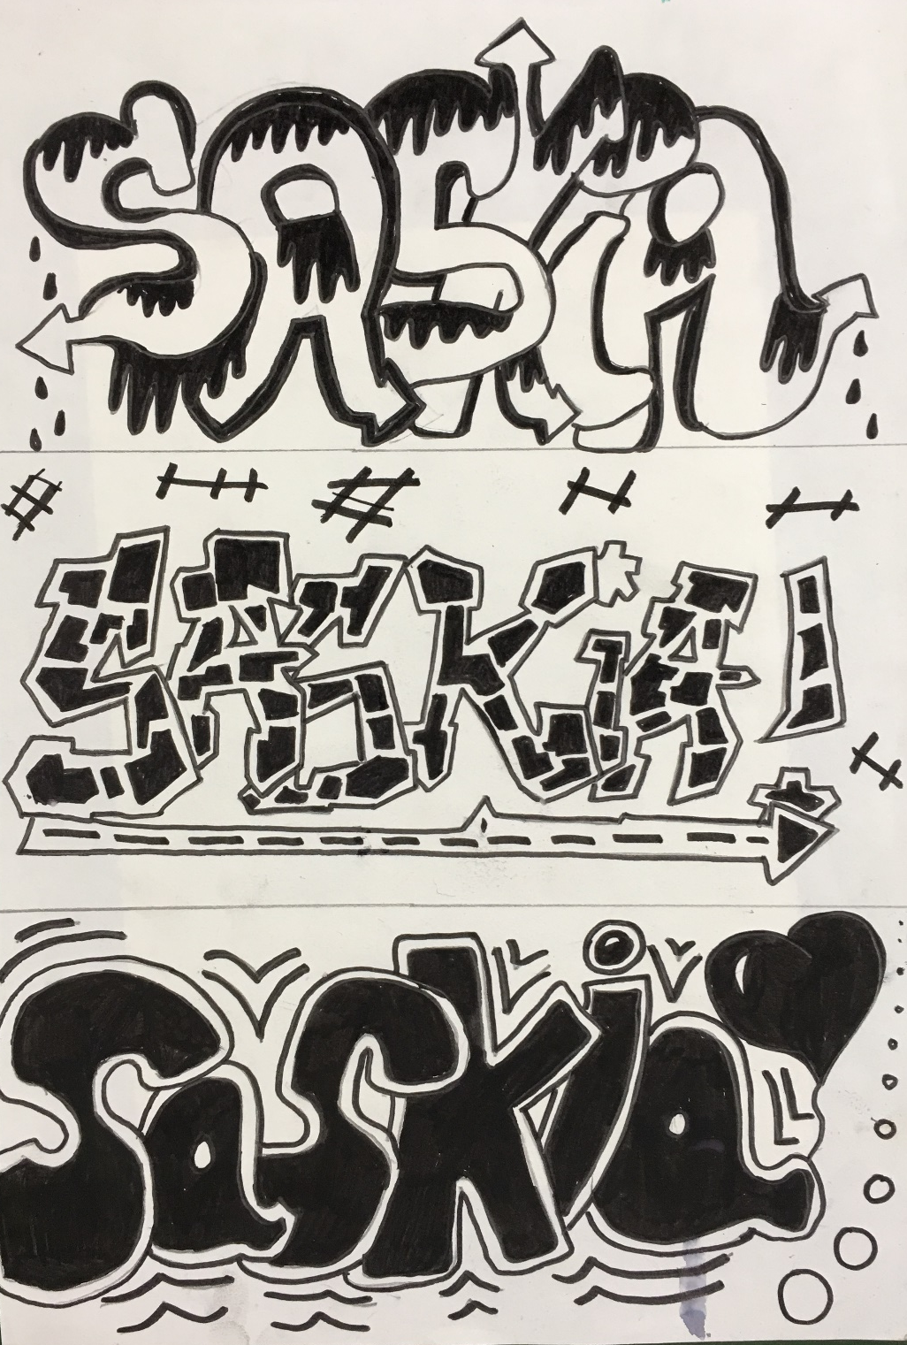
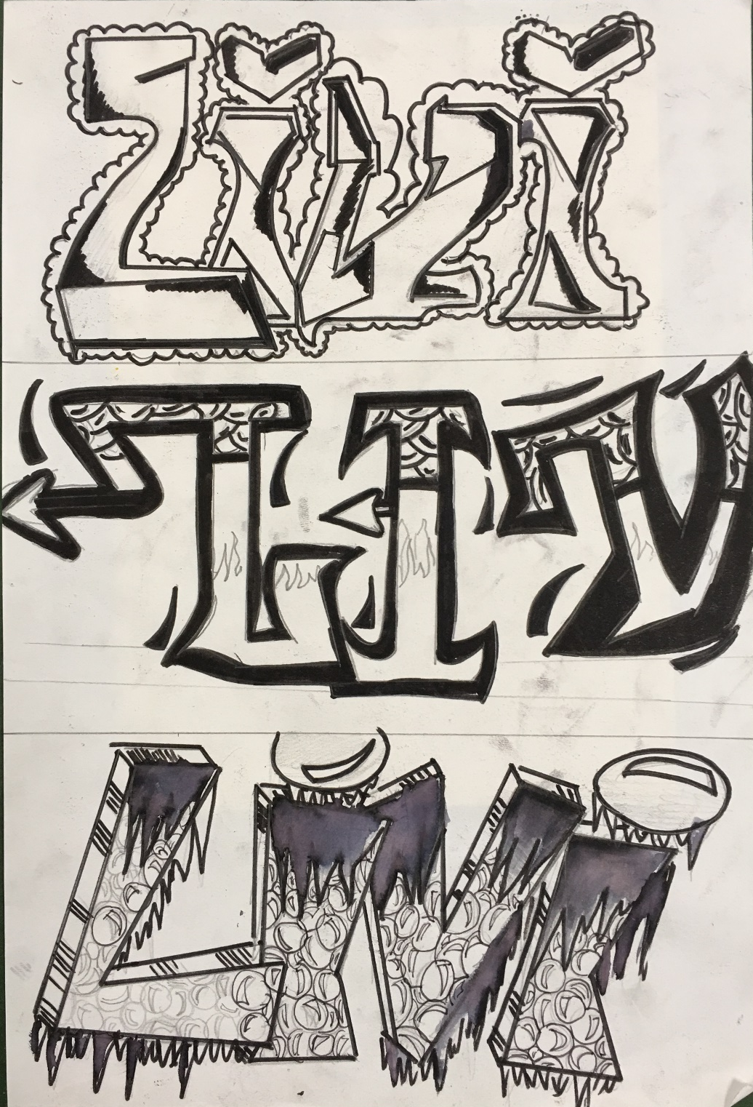

Slide 30
Graffiti Tag
Colour
Lessons 3-4

Slide 31
Divide your next right hand page into 3 equal sections approx. 10cm
You now need to consider the different types of colour medium that you can use to produce your tags.
Colour pencil
Felt pen
Felt pen & water
Brusho powders
Ink
Water colour
Oil pastel
Collage

Slide 34
Year 9 lesson 5
Produce a collage of a brick wall.
Use colour papers/newspaper/or “brick” colours cut out of magazines.

Slide 35
Final outcome- Tag on Brick wall

Slide 37
Year 9 lesson 6
Using the internet, produce a page on “Banksy”. I would like to see several pictures of his work and some basic information that you have learnt about him

