Slide 1
Week 2
Day of the Dead
You will need a ruler, A4 white paper, a pencil and possibly a black pen. Make your border design attractive with lots of detailed drawings of skulls.

Slide 2
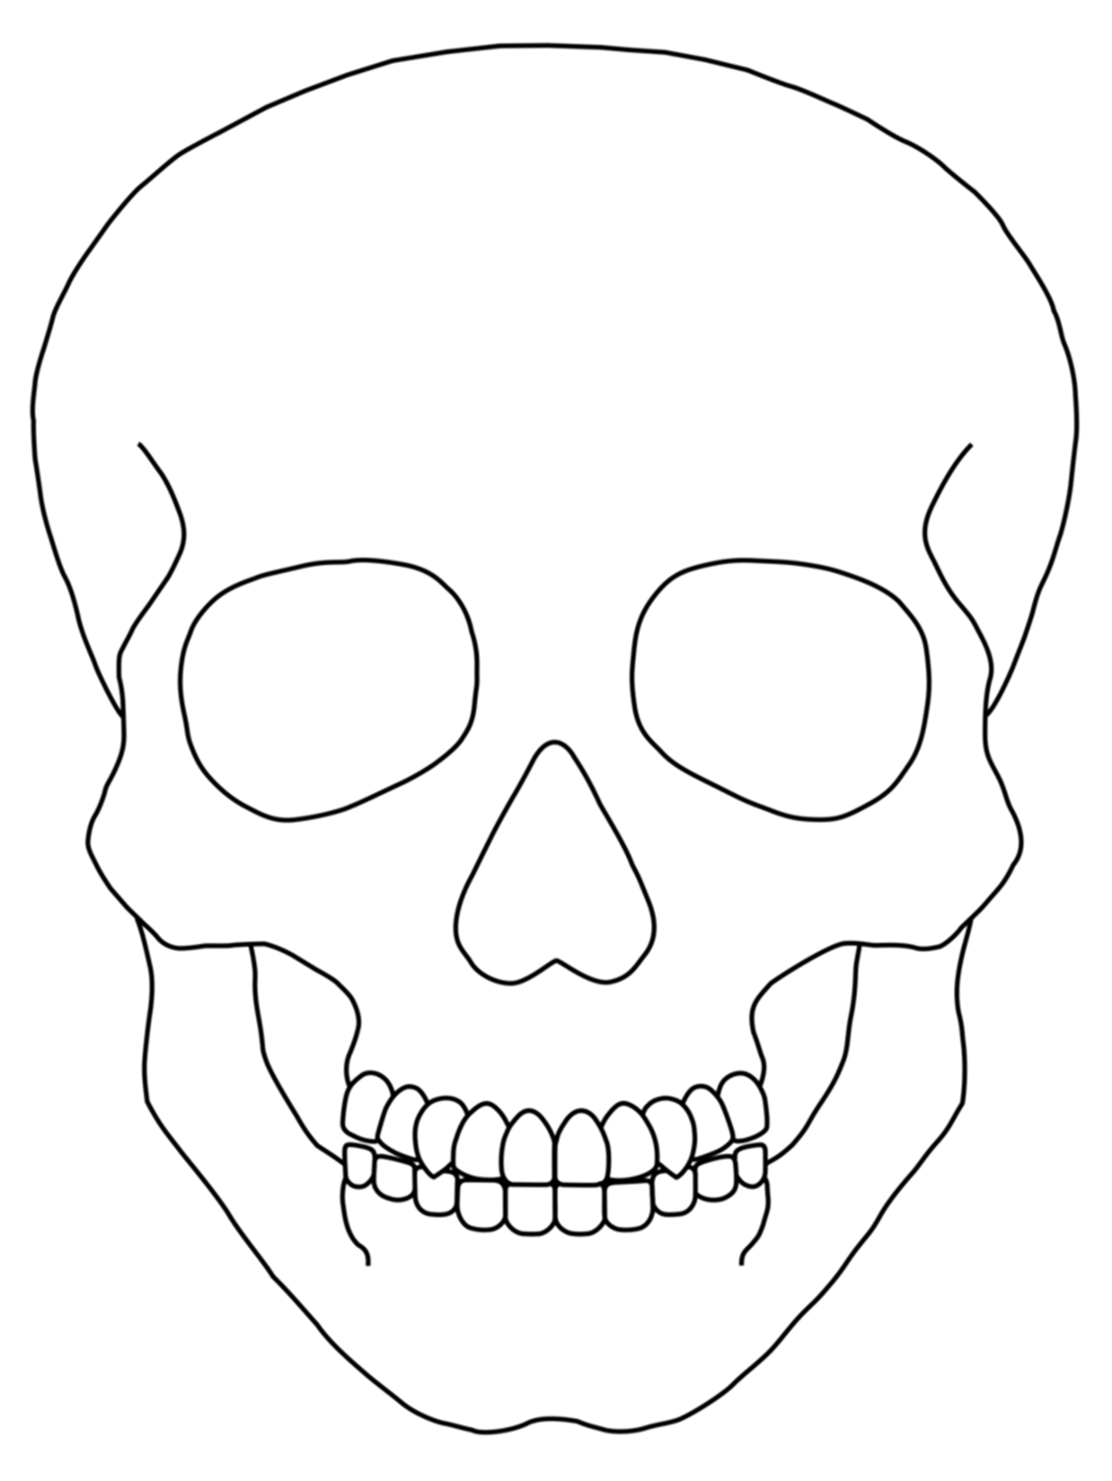
Task 1
Complete your A4 Skull design from last week – remember it should be bright and colourful!

Slide 3
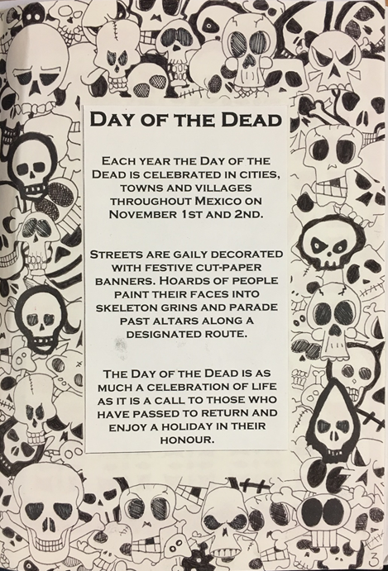
Task 2 – Black & White Skull Border
5cm
Leave this area blank
5cm
Measure a 5cm border all the way round an A4 sheet of paper.
Decorate the border with BLACK & WHITE skull images
The final look will be your brightly coloured skull on top of your B&W border of skulls

