Slide 1
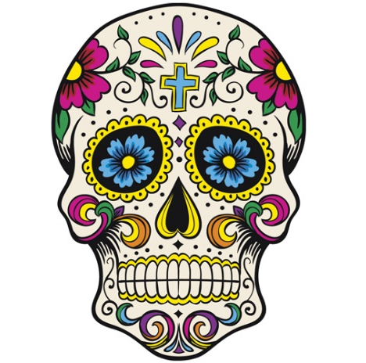
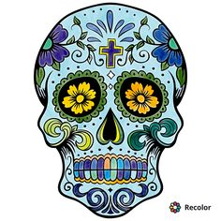
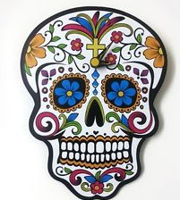
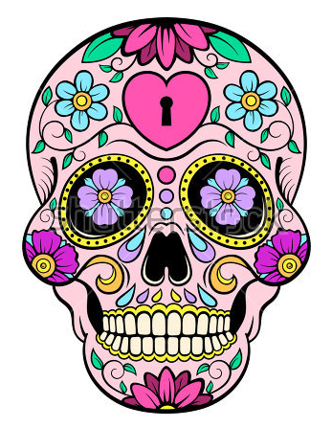
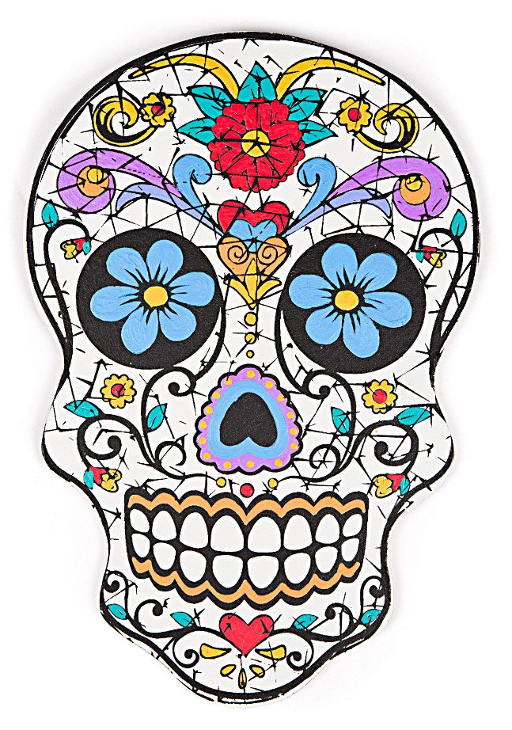
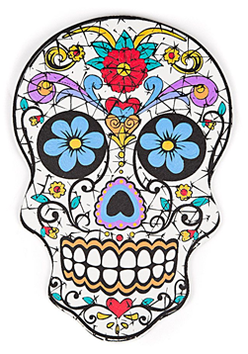
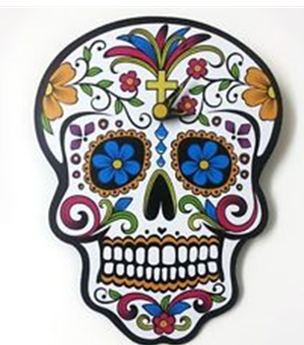
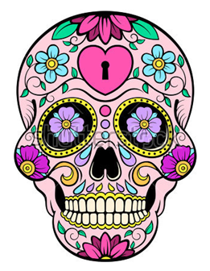
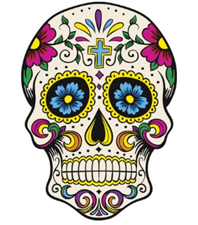
DIA DE LOS MUERTOS
(MEXICAN DAY OF THE DEAD)

Slide 2
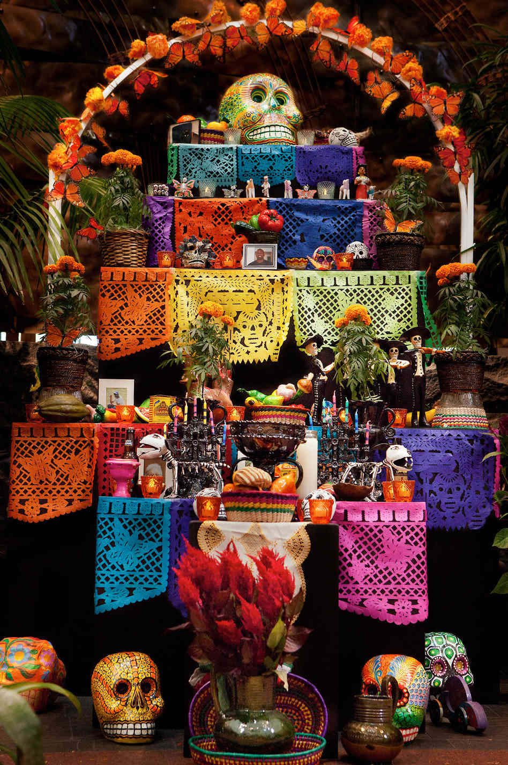
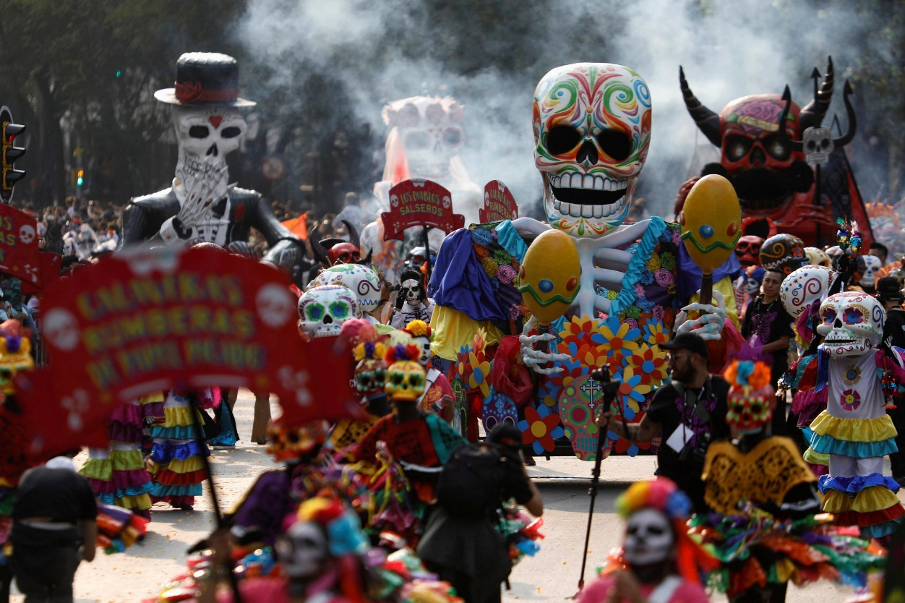
The Day of the Dead (Spanish: Día de Muertos) is a Mexican holiday celebrated throughout Mexico, in particular the Central and South regions, and by people of Mexican heritage elsewhere. The multi-day holiday focuses on gatherings of family and friends to pray for and remember friends and family members who have died, and help support their spiritual journey.

Slide 3
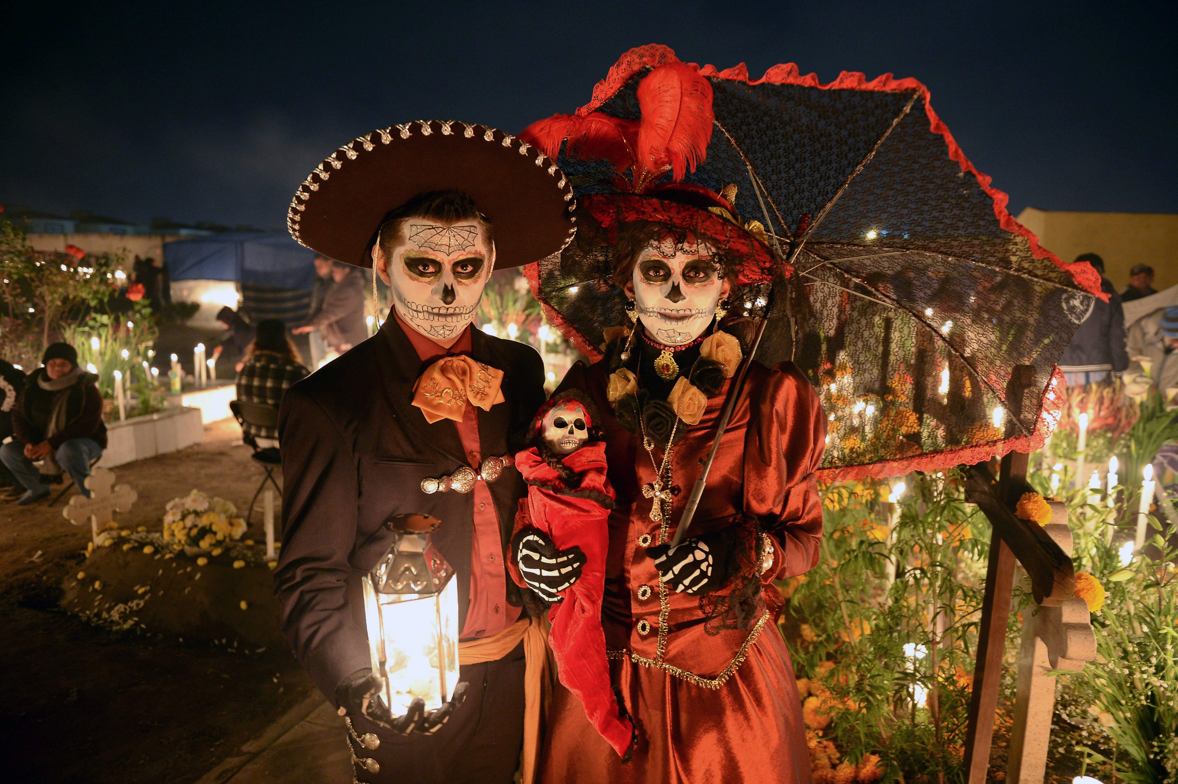
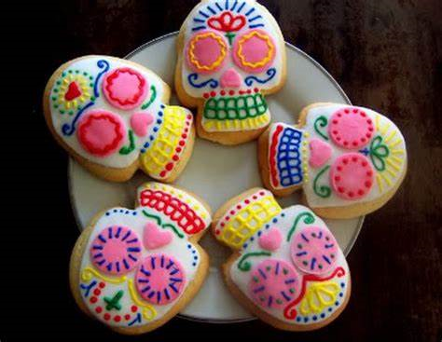
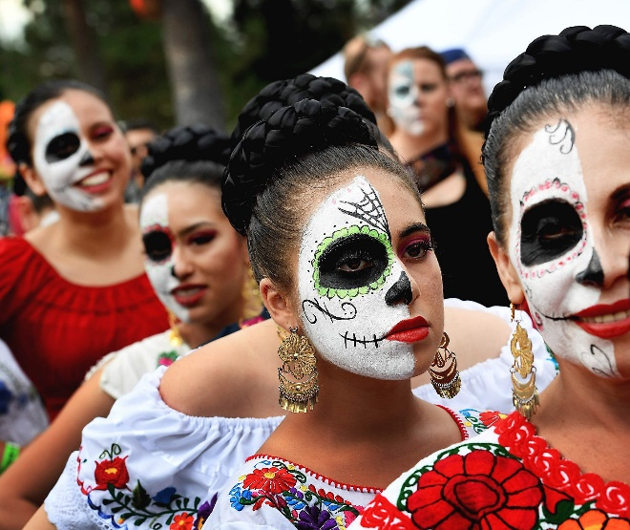
Traditions connected with the holiday include building private altars called ofrendas, honoring the deceased using calaveras, aztec marigolds, and the favourite foods and beverages of the departed, and visiting graves with these as gifts. Visitors also leave possessions of the deceased at the graves.

Slide 4
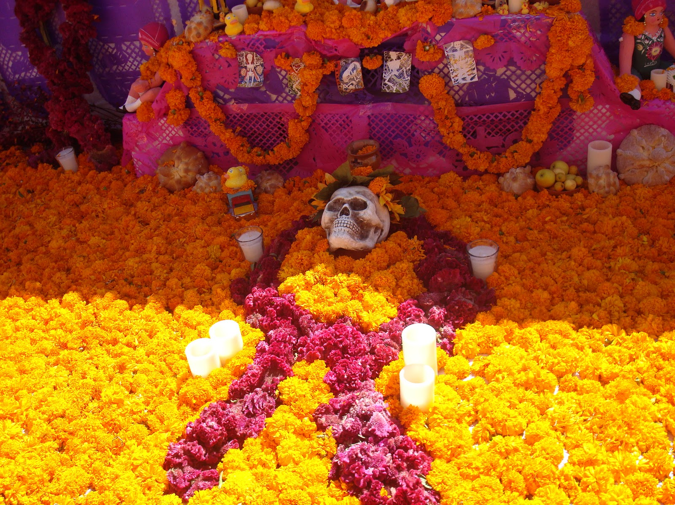
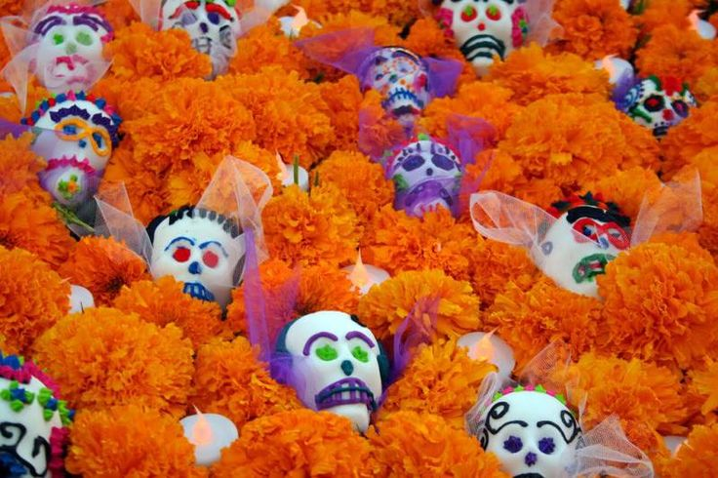
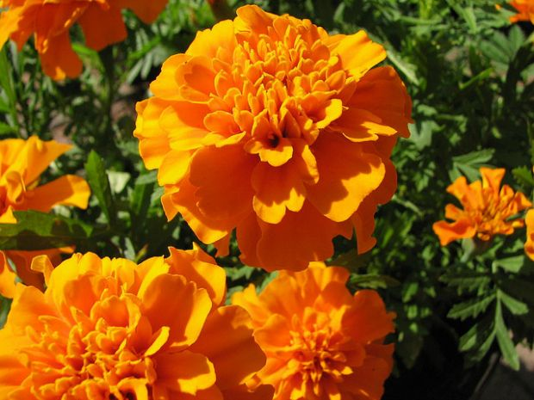
Plans for the day are made throughout the year, including gathering the goods to be offered to the dead. During the three-day period families usually clean and decorate graves; most visit the cemeteries where their loved ones are buried and decorate their graves with ofrendas (altars), which often include orange Mexican marigolds. In modern Mexico the marigold is sometimes called Flor de Muerto (Flower of Dead). These flowers are thought to attract souls of the dead to the offerings. It is also believed the bright petals with a strong scent can guide the souls from cemeteries to their family homes.

Slide 5
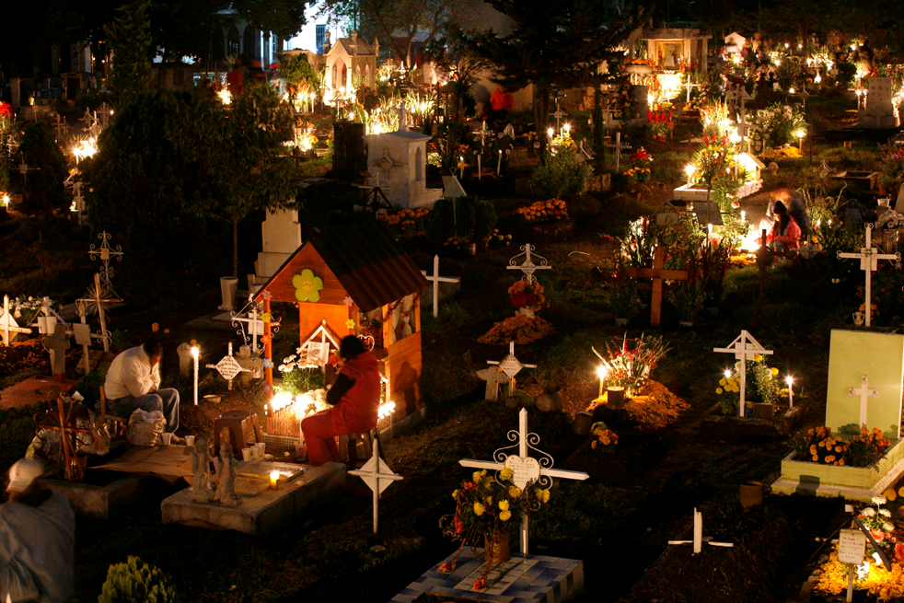

Slide 6
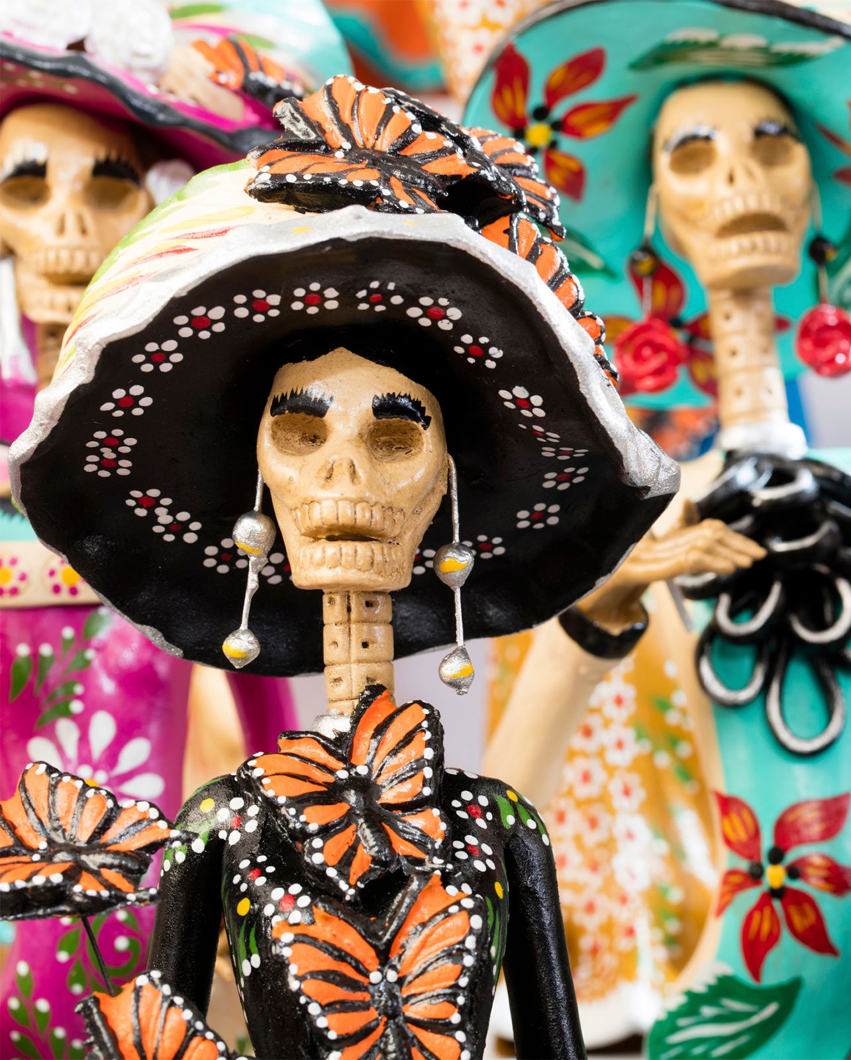
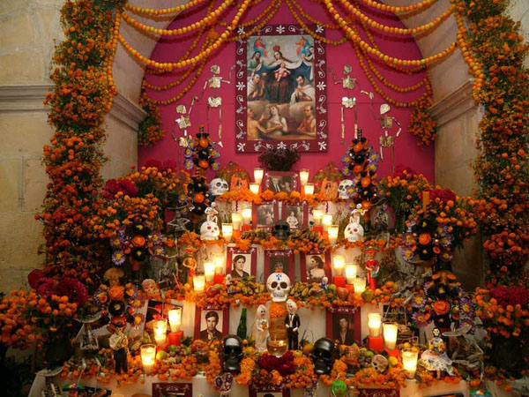
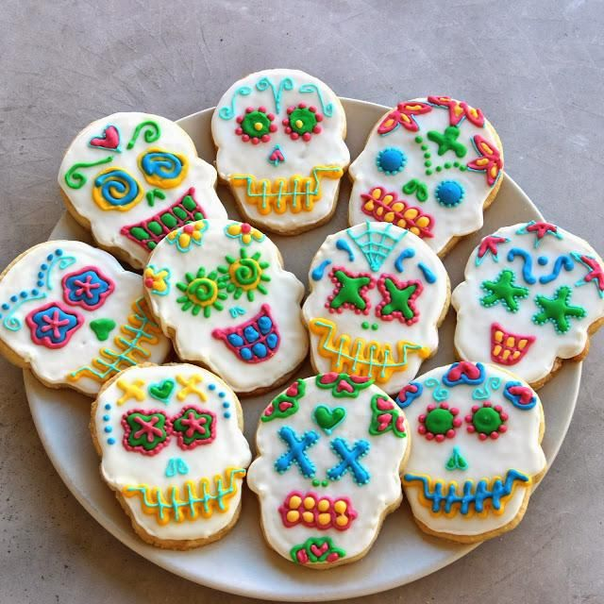
Toys are brought for dead children (los angelitos, or "the little angels"), and bottles of tequila for adults. Families will also offer trinkets or the deceased's favourite sweets on the grave. Some families have ofrendas in homes, usually with foods such as candied pumpkin, pan de muerto ("bread of dead"), and sugar skulls.
The ofrendas are left out in the homes as a welcoming gesture for the deceased. Some people believe the spirits of the dead eat the "spiritual essence" of the ofrendas food, so though the celebrators eat the food after the festivities, they believe it lacks nutritional value.
Pillows and blankets are left out so the deceased can rest after their long journey. In some parts of Mexico people spend all night beside the graves of their relatives. In many places, people have picnics at the grave site, as well.

Slide 7
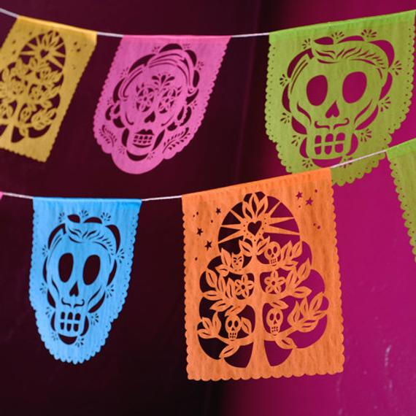
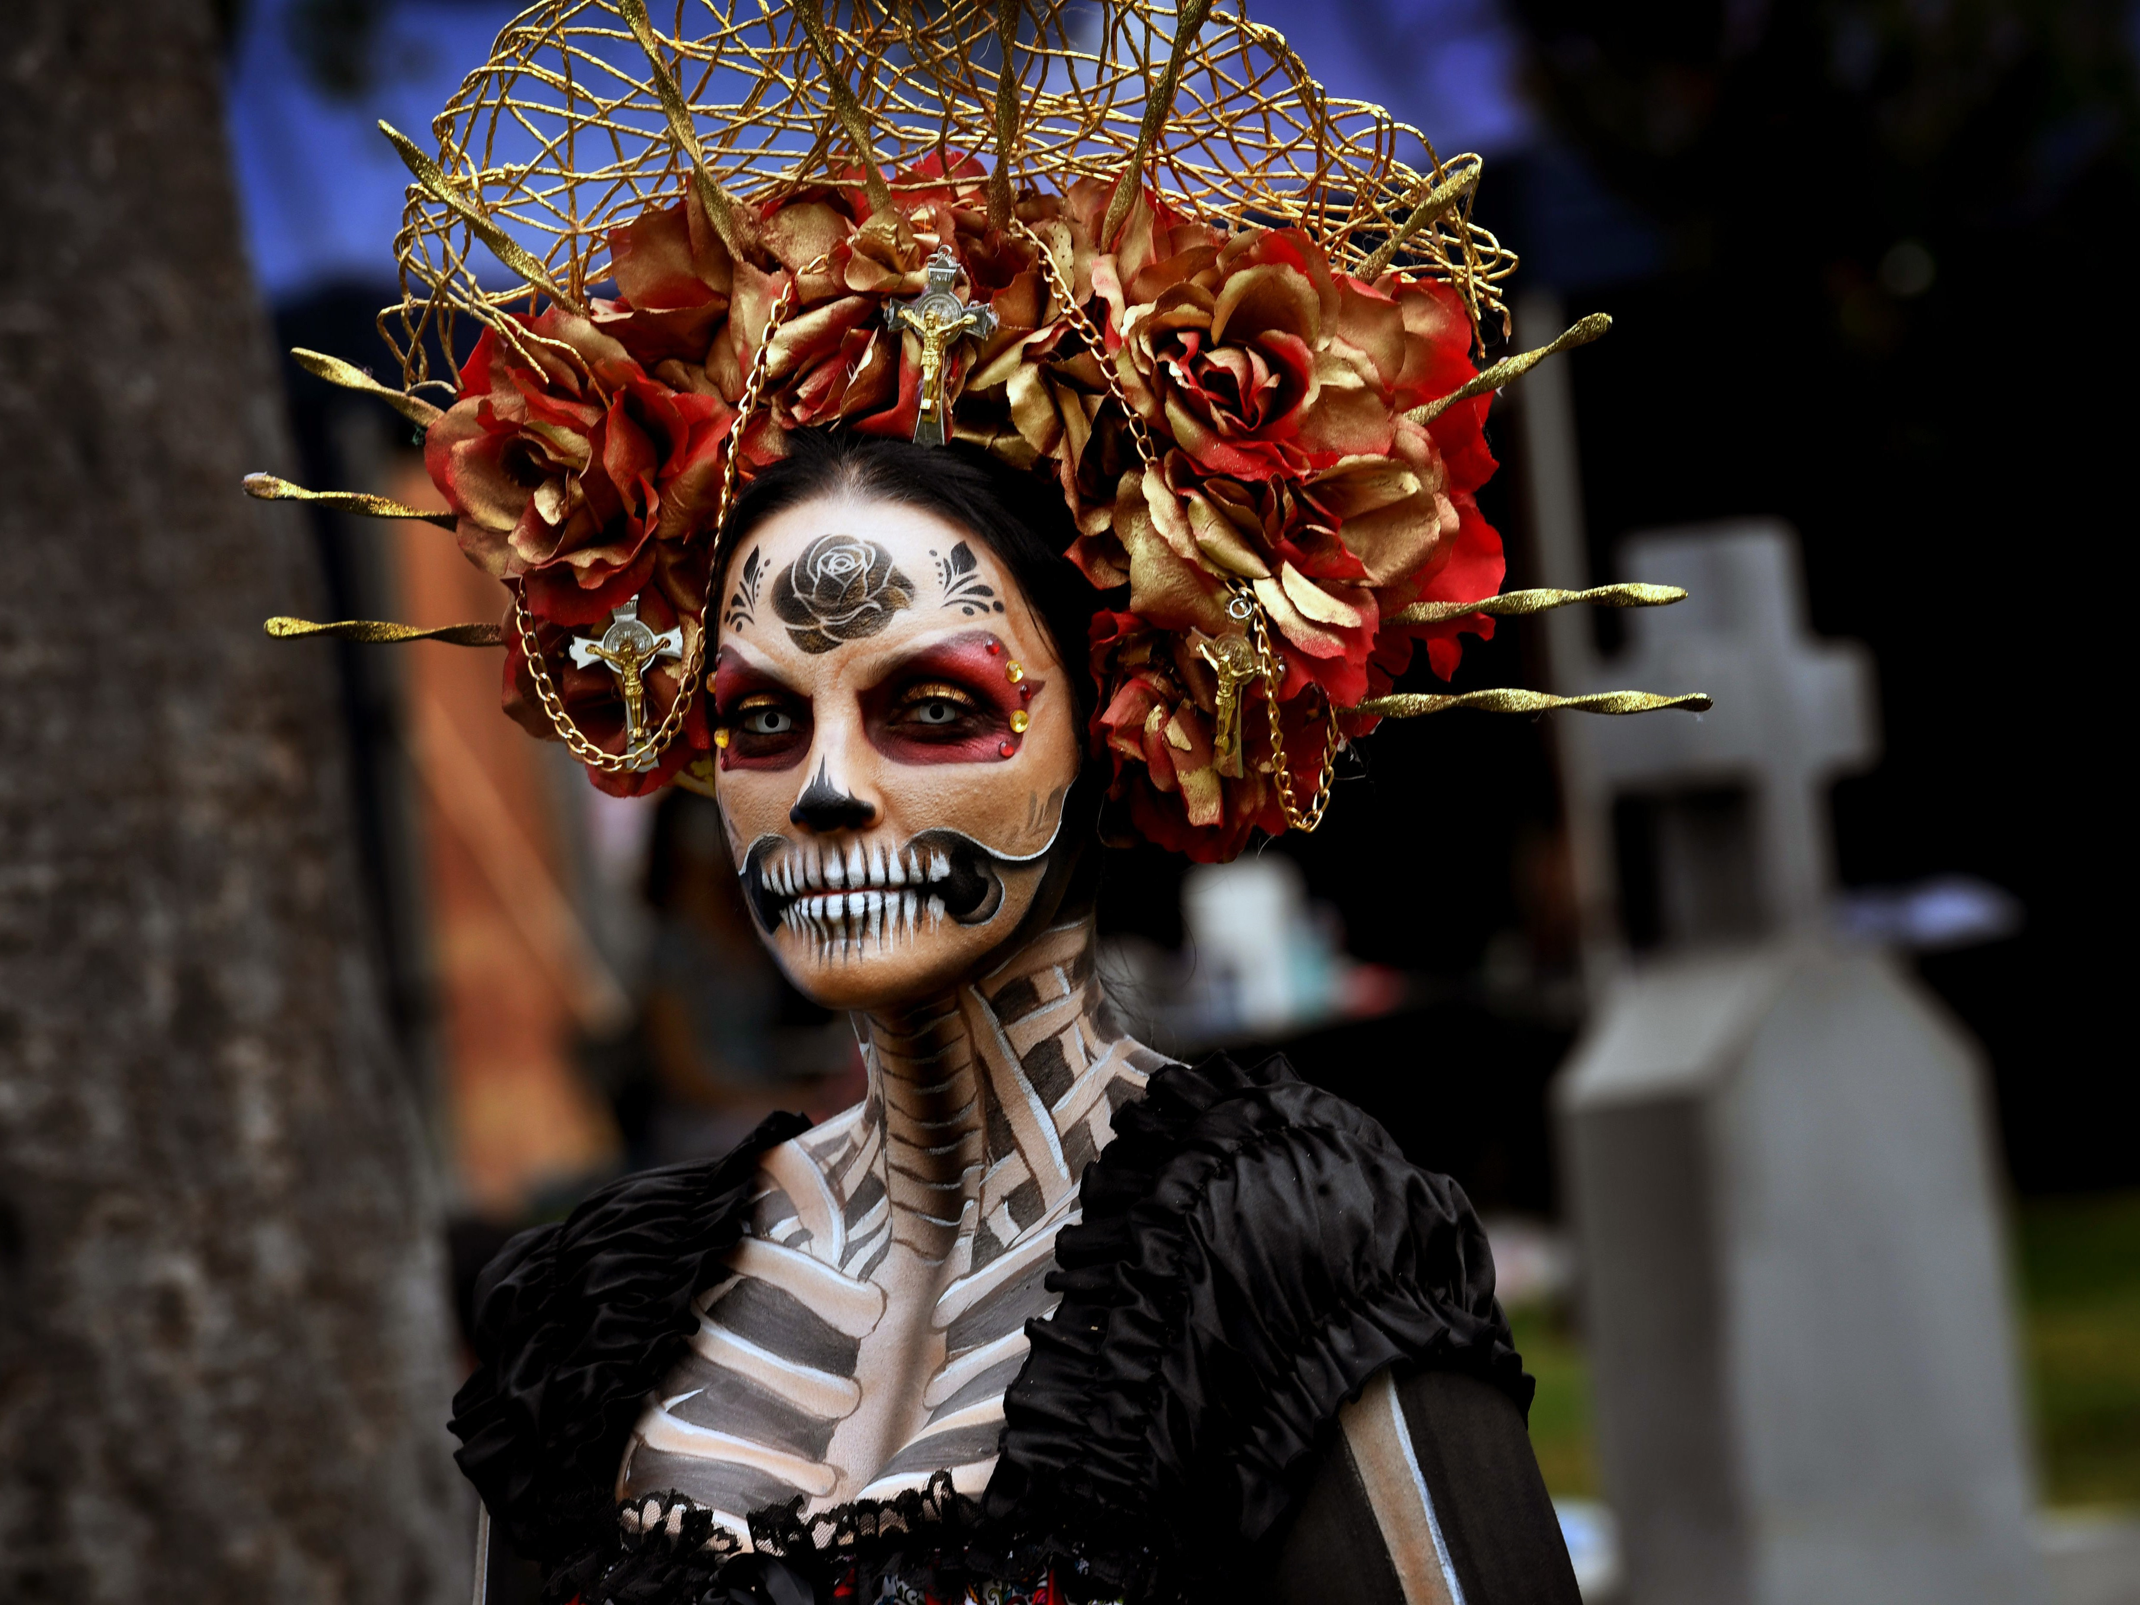
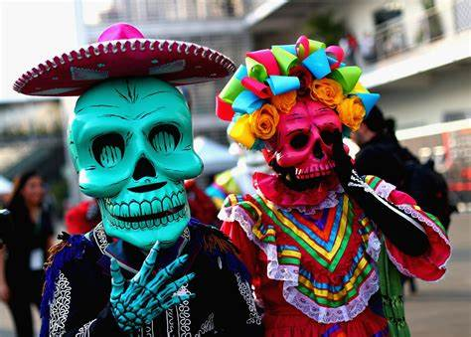
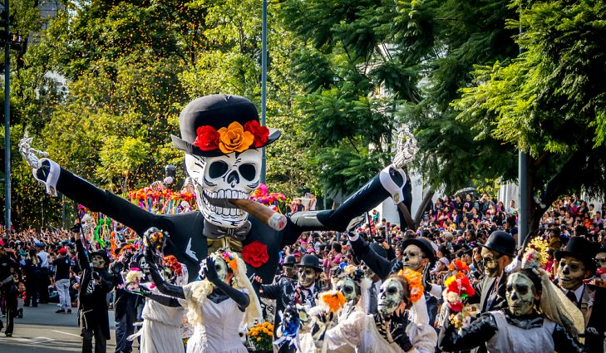

Slide 8
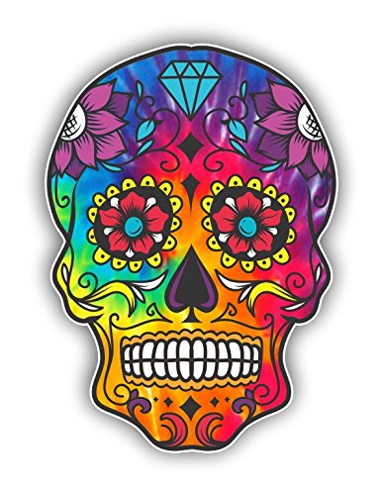
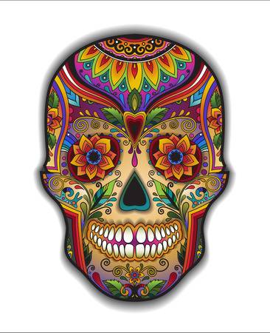
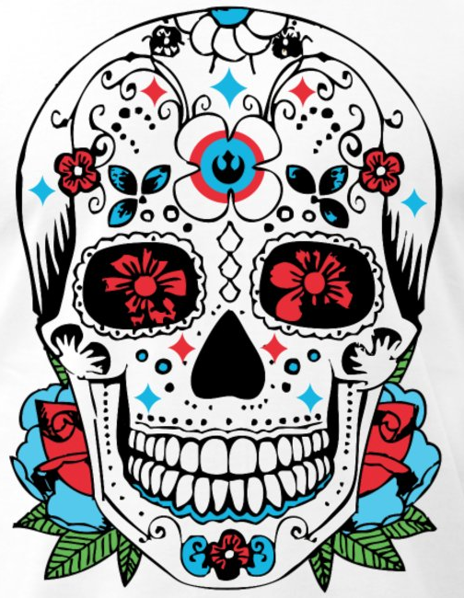
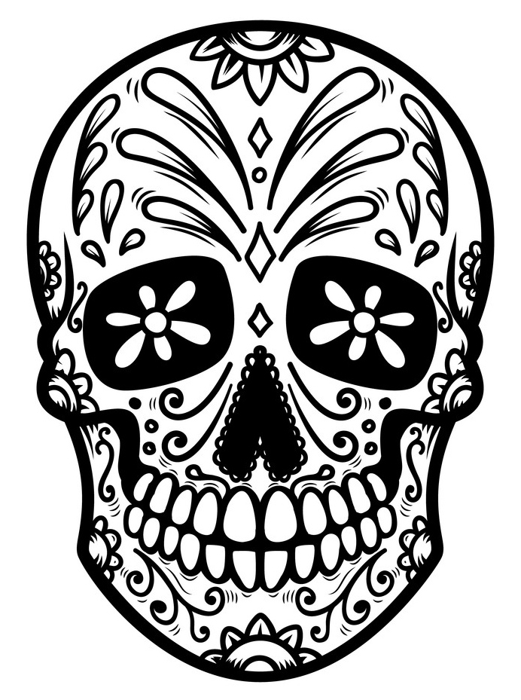
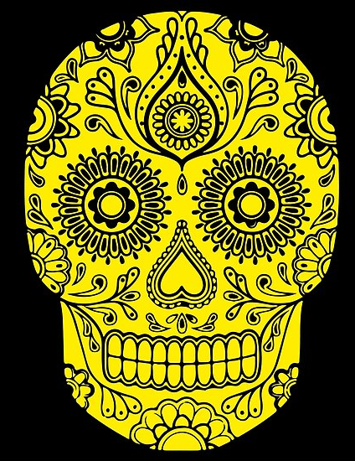

Slide 9
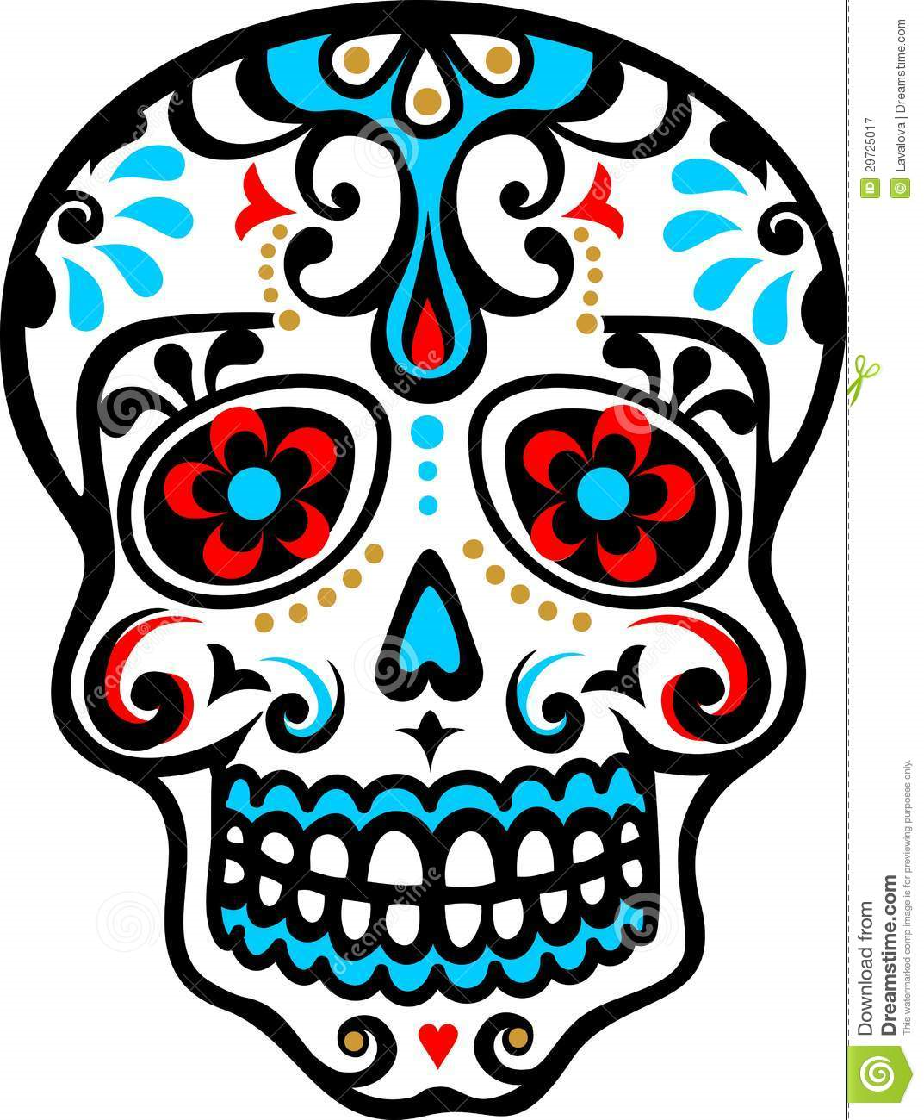
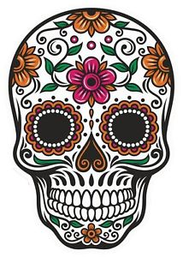
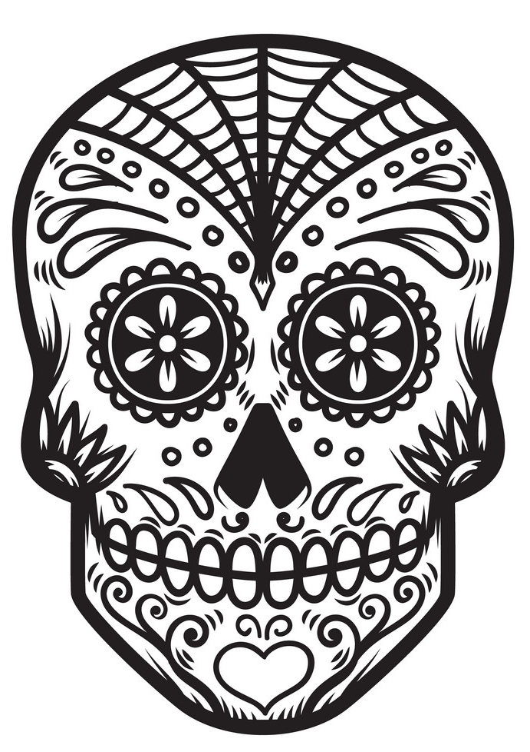
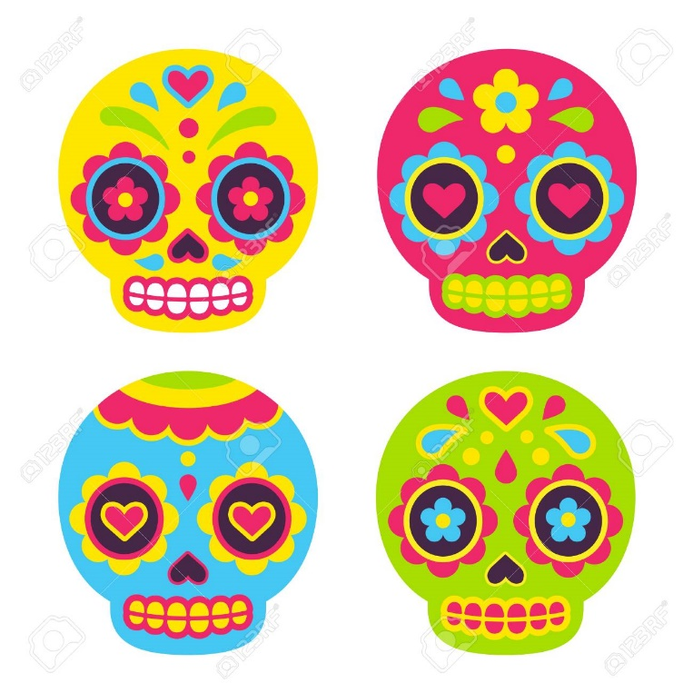
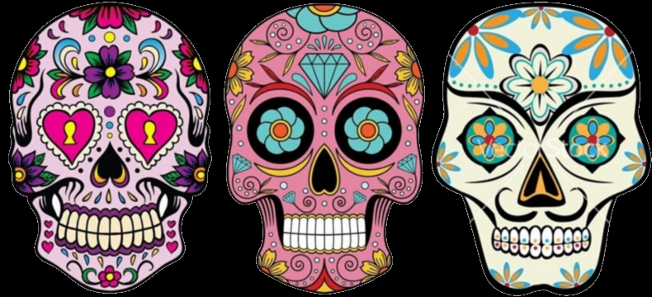

Slide 10
Lesson 1-2
Print off the skull template
Decorate the skull using any colour media you have at home felt tip pens are particularly effective.

Slide 11
