Slide 1
Year 11 Art Workshops week 1-2
Watch the attached youtube clips about collage. Produce a collage of any image related to your chosen theme. I have included some suggestions for artists you could work in the style of

Slide 2
Week 1 : Collage
https://www.youtube.com/watch?v=-HB3IrP_jRQ&safe=true
https://www.youtube.com/watch?v=M6ujlhcZV_8&safe=true

Slide 3
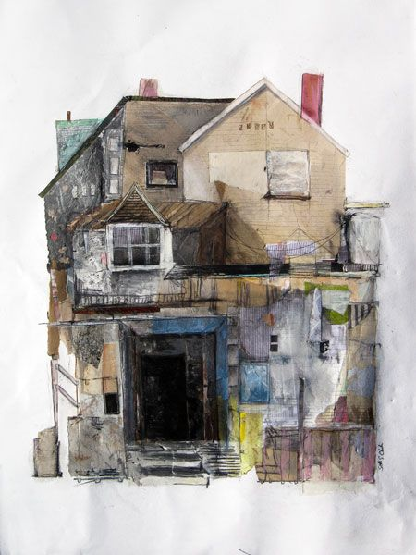
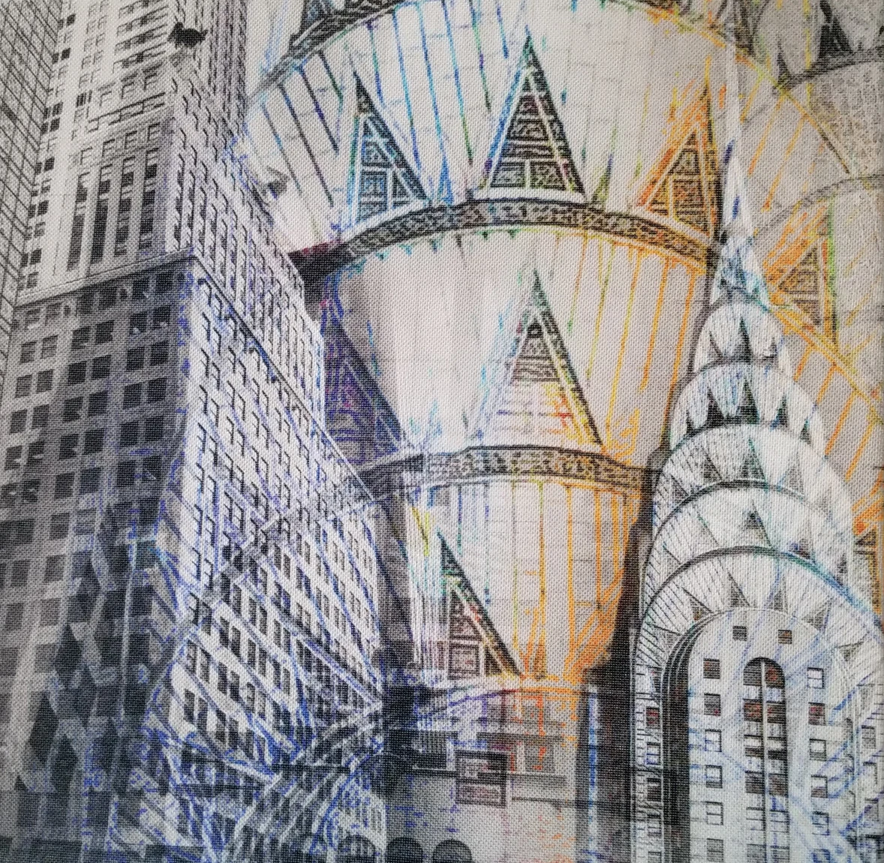
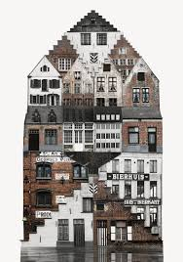
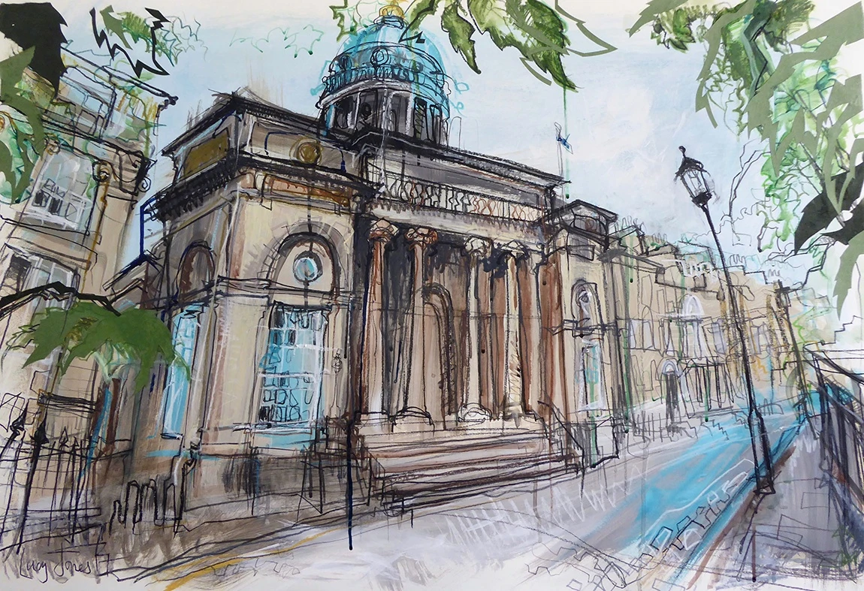
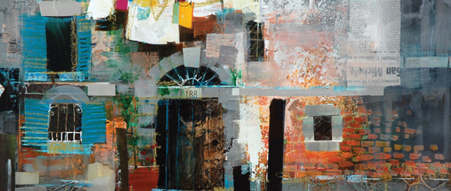
ARCHITECTURE
Artists
Lucy Jones
Ian Murphy
Mike Bernard
Anastasia Savinova

Slide 4
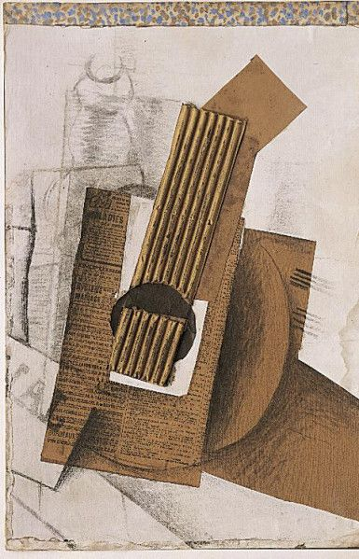
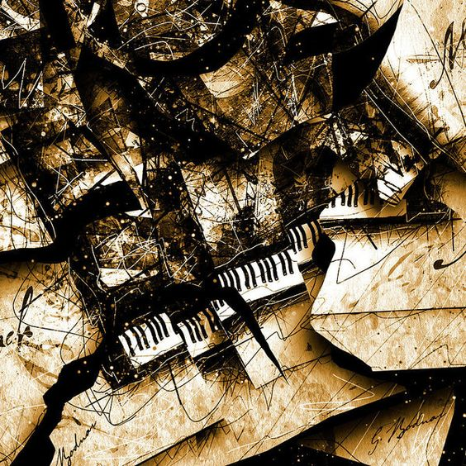
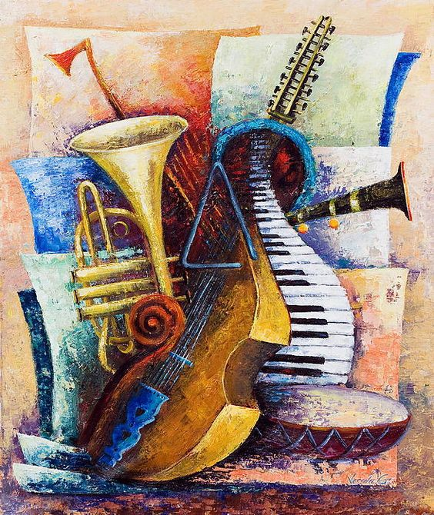
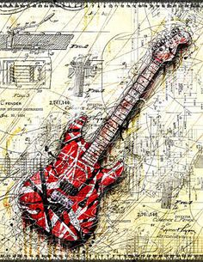
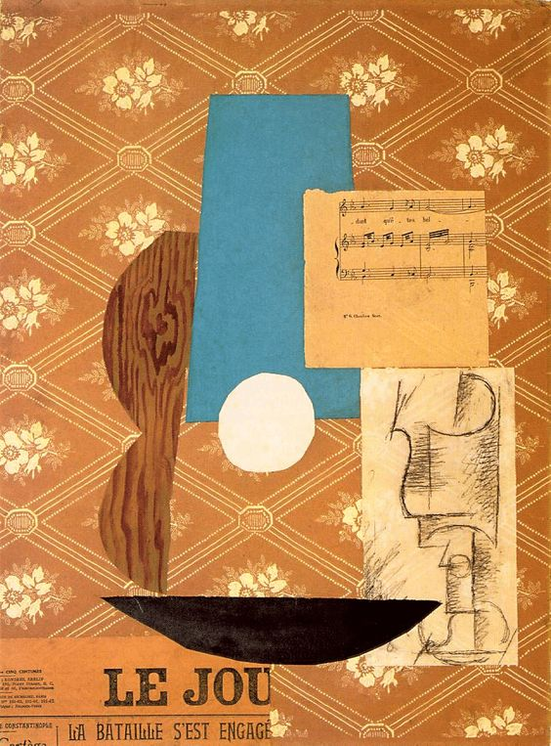
MUSICAL INSTRUMENTS
Artists:
Georges Braque
Pablo Picasso
Vessela Kolibarova
Gary Bodnar

Slide 5
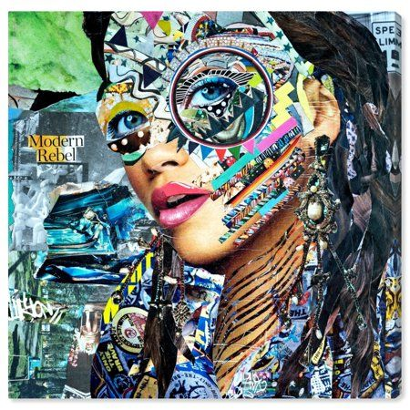
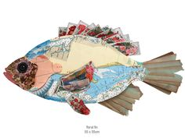
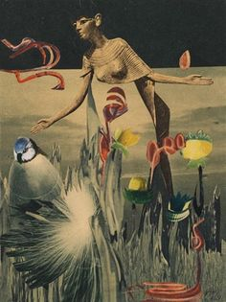
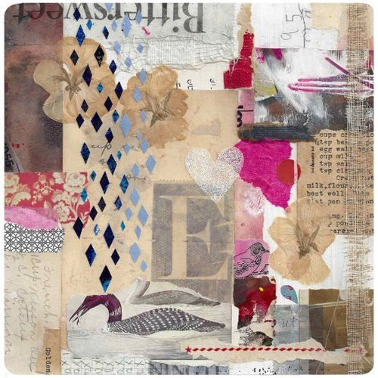
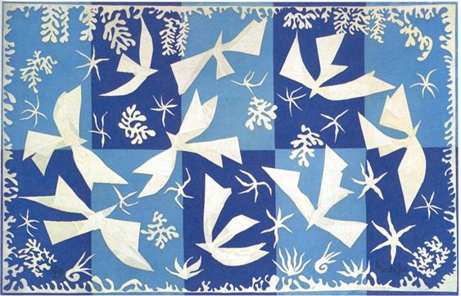
ARRANGEMENTS
Artists
Katy Hirschfeld
Shelley Kommers
Hannah Hoch
Henri Matisse
Peter Clark

Slide 6
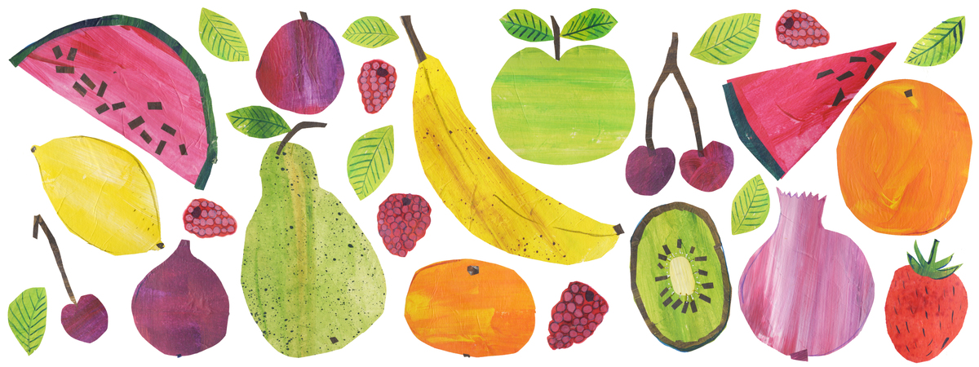
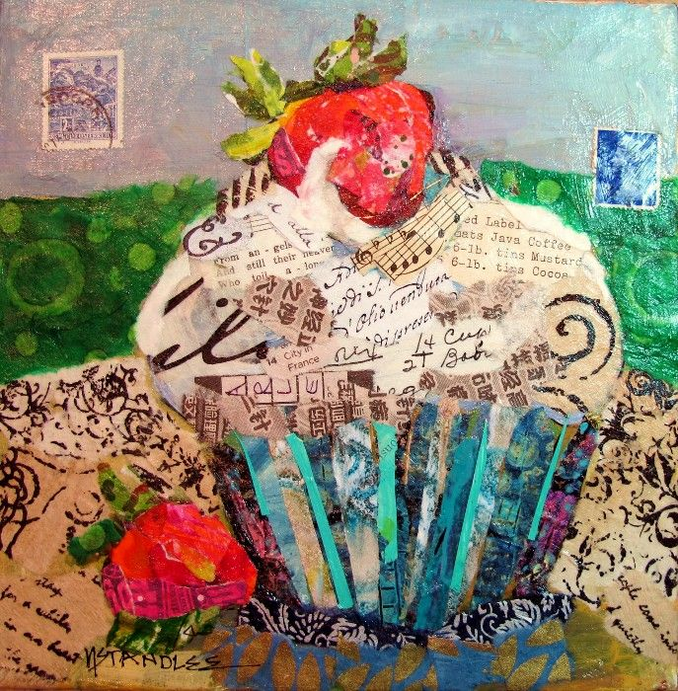
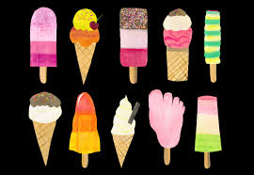
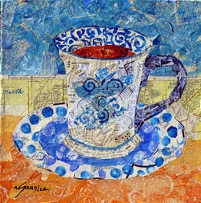
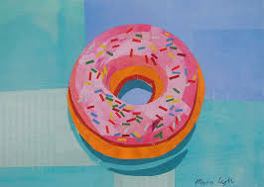
FOOD
ARTISTS
Tracey English
Nancy Standle
Megan Coyle

Slide 7
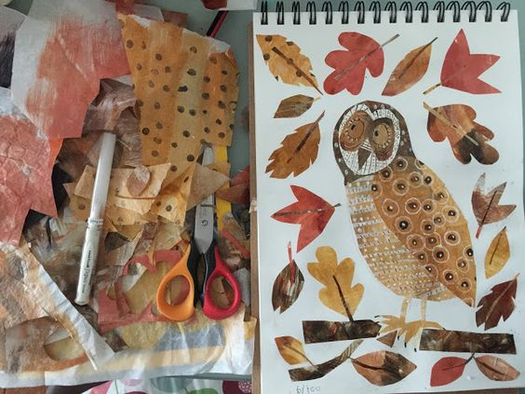
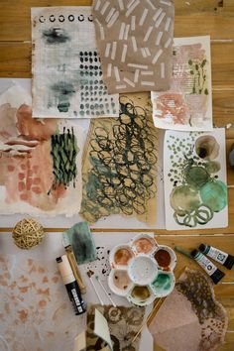
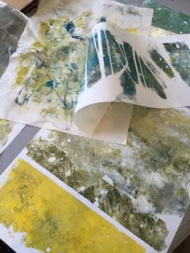
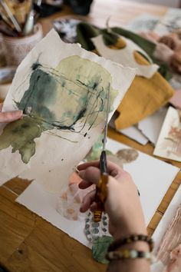

Slide 8
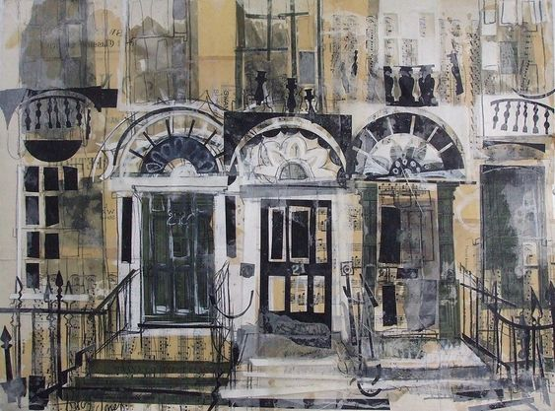

Slide 9
