Slide 1
Week 4: watercolour painting from a photograph
This week you will watch a tutorial on how to use watercolour to create colour transparencies. You will be painting wet on dry ( wet paint onto dry paper).
You will use only one colour but will paint 4 layers of that colour.
I have selected 4 images for you to work from which you need to print off if you can…..if you can’t don’t worry you can try and trace it off your computer screen or draw it free hand.

Slide 2
Instructions.
Watch the recorded clip from the teams lesson for a second time.
Print off your image (A4) which relates to your chosen theme.
Trace your image very lightly with a hard pencil if you have one (2H) or a HB if you don’t.
Mix up a good amount of your chosen colour. I suggest brown for the architectural detail, blue for the pears, grey for the chess pieces and blue for the eye. You need to mix up enough paint to complete the painting.
Make sure that you allow the paint to dry in between layers, you can wait for it to dry naturally or gently use a hairdryer.
Only use ONE colour, you are not trying to produce a photographically realistic piece.
If you do not have watercolour paint, mix up a light solution of granulated coffee.

Slide 3
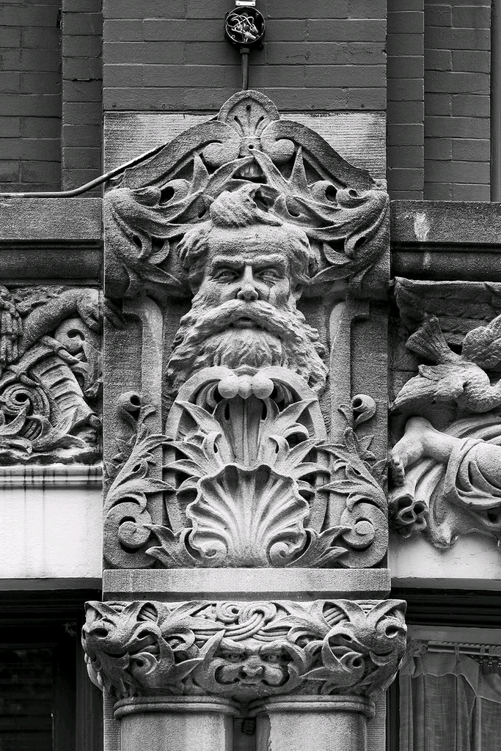
Architecture

Slide 4
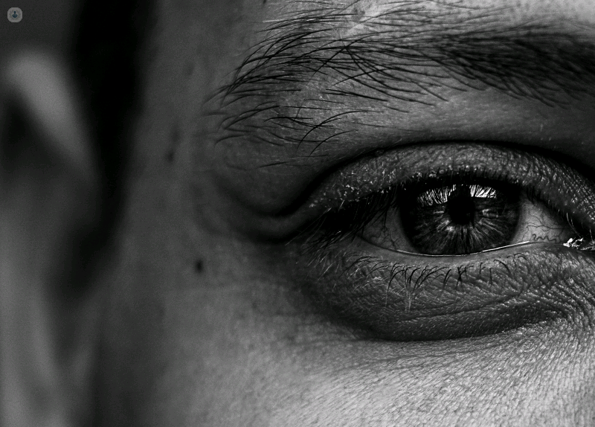
Arrangements ?

Slide 5
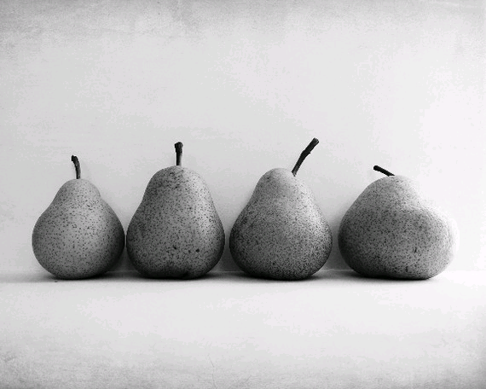
Food

Slide 6
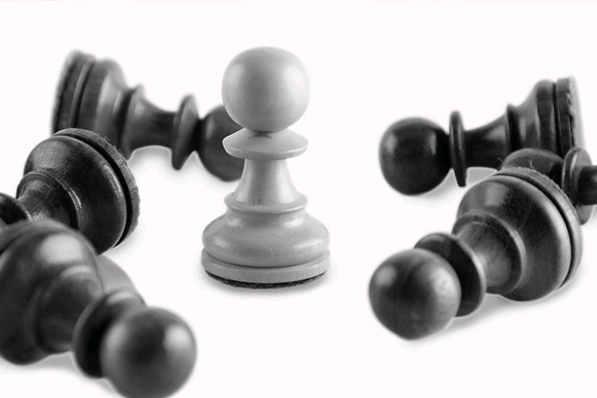
Arrangements

Slide 7
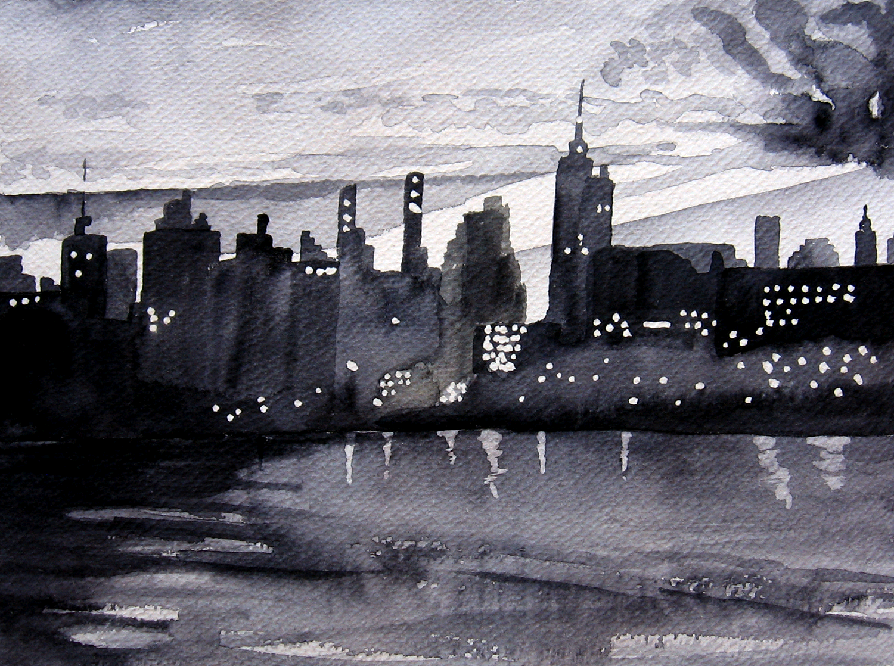
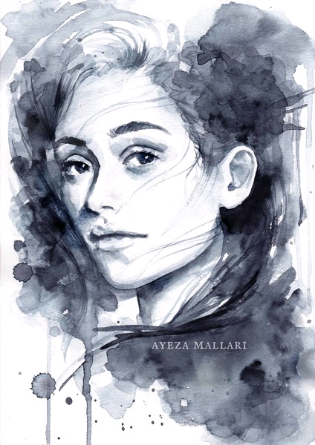
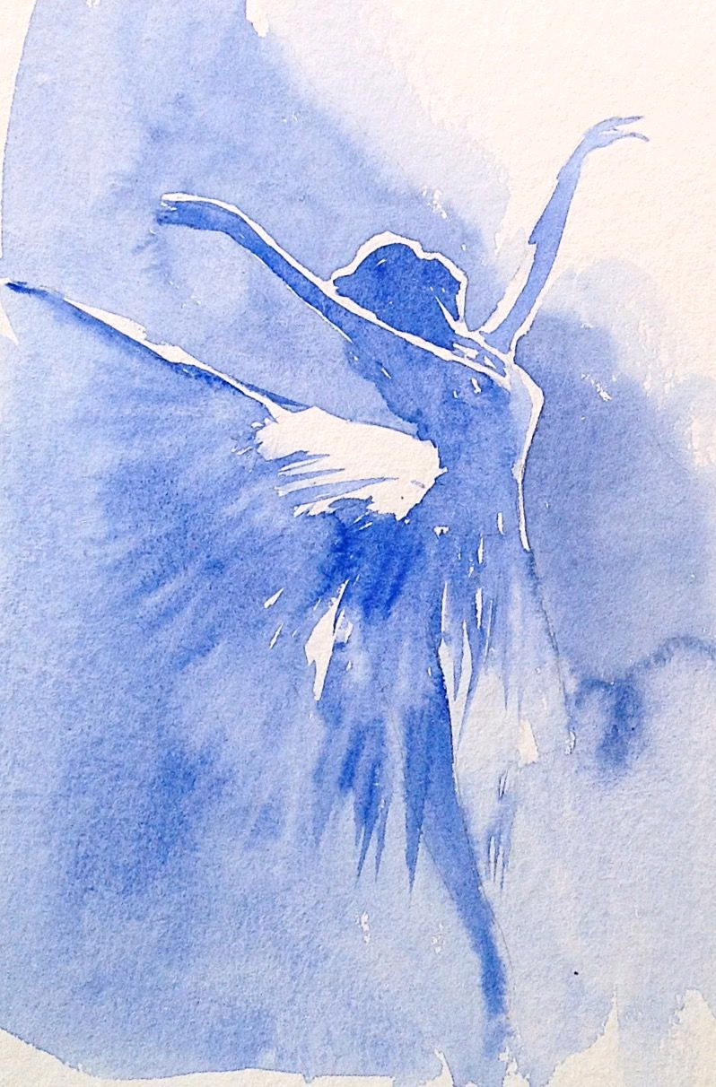
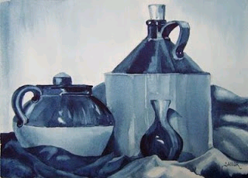
Examples of this technique ( also known as monochromatic painting)

Slide 8
