Slide 1
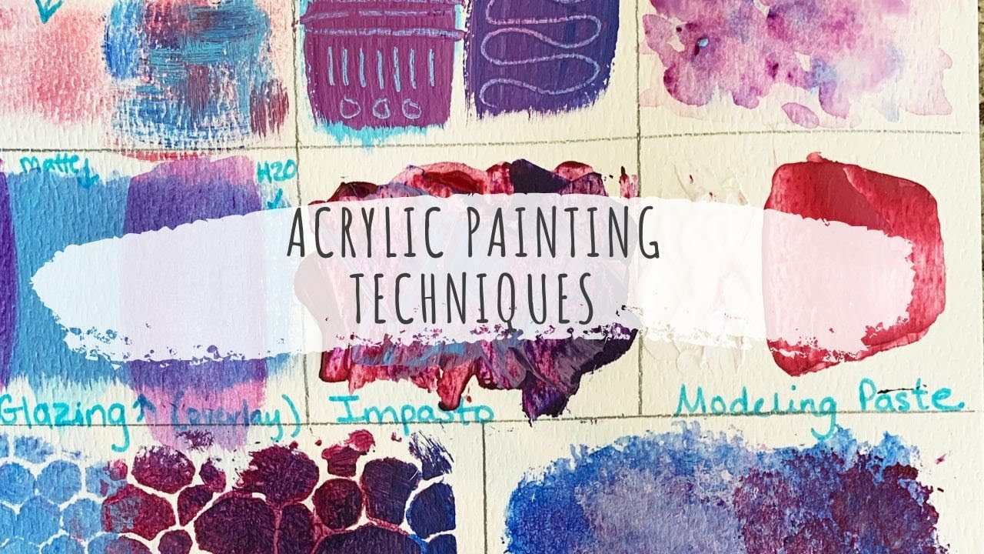
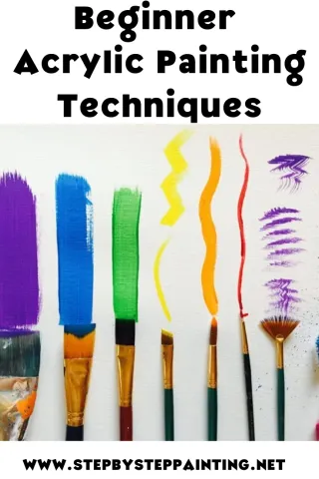
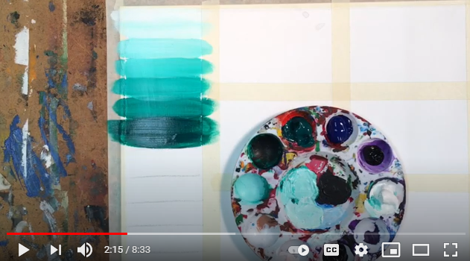
Week 3
Acrylic painting techniques
Watch the clip and complete the exercise
https://www.youtube.com/watch?v=Yag1mjm4RtA&safe=true

