Slide 1
RESPECT TERM 2 Enquiry: How powerful is the media?

Slide 2
Lesson 1: “Why does media run the world?” Objectives 1. To define what is the media 2. To explain the purpose of different platforms 3. To discuss how the media runs the world

Slide 3
Media Runs the World!!
‘Media' refers to the different channels we use to communicate information in the everyday world. Media is the plural of medium (meaning of communication).
Task 1 - What are the main forms of media? List them in your book.
Television
Magazines
Film
Radio
Advertising
Music
News
Internet

Slide 4
Media Runs the World!!
These main forms of Media are known as ‘platforms’ for distribution, meaning that they are like ‘subheadings’ for other types and genres of media.
For Example: Radio (being a main platform) includes:
Music
Talk Radio
Radio Drama
Sport Coverage (although sport isn’t a form of media)
News
Task 2 – With your partner, look at the other main Media platforms and mind map all the elements that each one includes. Use the radio example to help you.

Slide 5
Watch
Task: list how many ways social media influences us.
Write a paragraph answering: Does social media run the world?

Slide 6
Extension Watch:
Can storytelling through the media create stereotypes?

Slide 7
Lesson 2: Does the newspapers we read influence how we vote? Objectives 1. To list main the ideologies of the two main political parties 2. To evaluate the extent of media influence on elections.

Slide 8
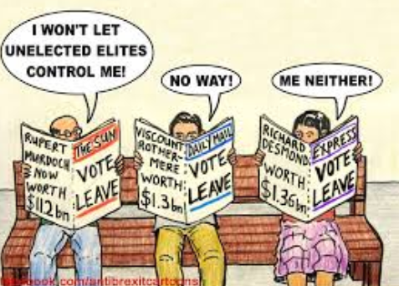
Does the newspapers we read influence how we vote?
Starter:
Is the press in the UK independent or neutral?
British media is independent but not neutral.

Slide 9
What is the main ideologies of the UK’s two main political parties?
Labour
Conservatives
Task 1: List what each party stands for the clips may help.

Slide 10
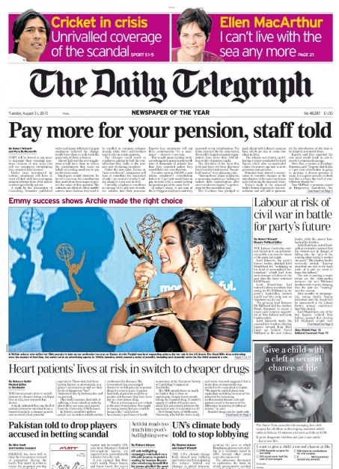
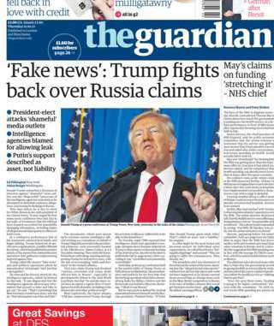
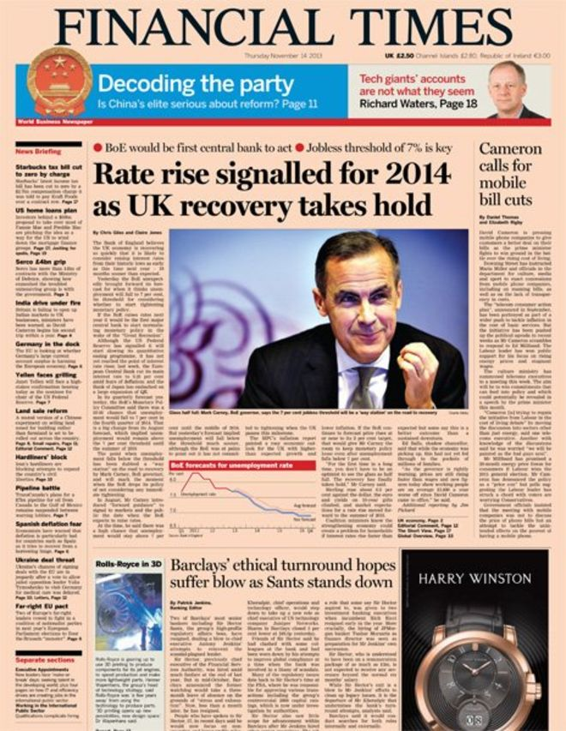
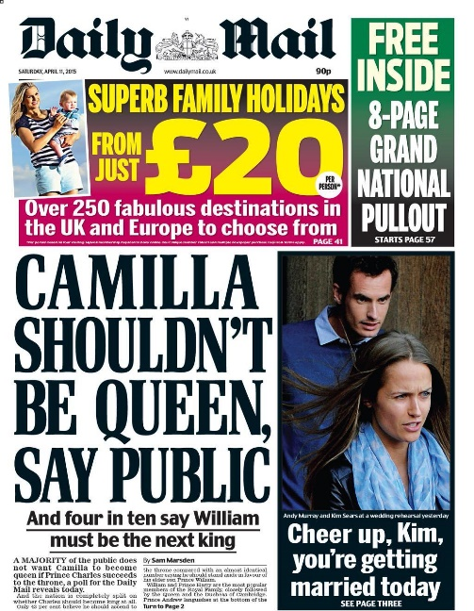
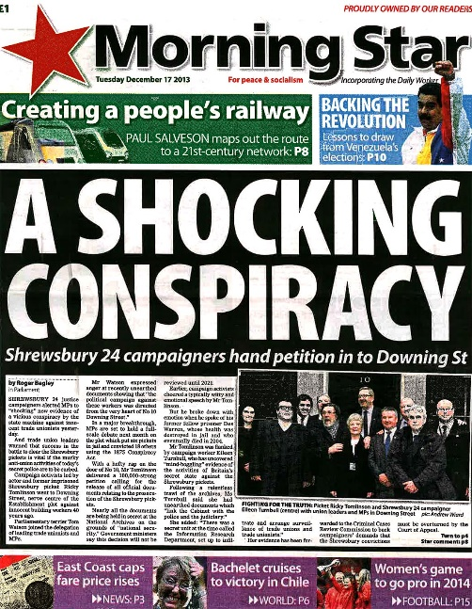
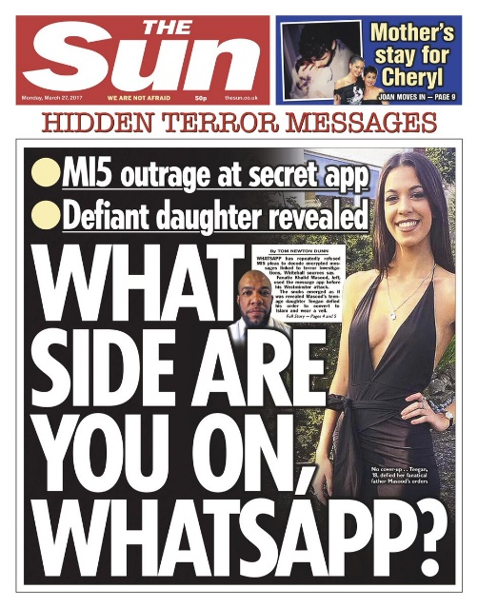
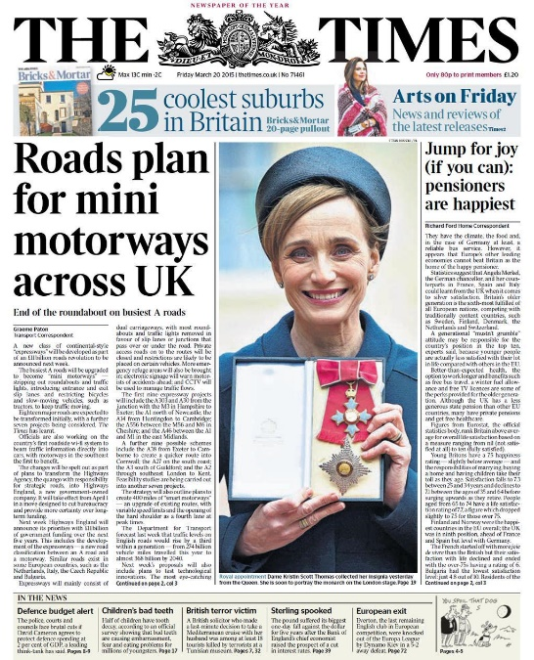
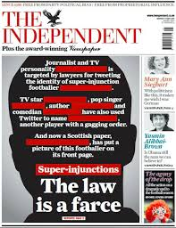
David & Frederick
Barclay
The Scott Trust
Pearson PLC
Lord Rothermere
The People’s Press Printing Society
Trinity Mirror PLC
Rupert Murdoch
Rupert Murdoch
Richard Desmond
A & E Lebedev
Notes:
Discuss newspapers. Which are the group familiar with? How many of their parents/families take a newspaper, which ones? Conduct a survey to find out which are the most popular newspapers in the class. Then ask them about newspaper ownership, who do they think owns/runs each newspaper? What should the rules regarding newspaper ownership be?

Slide 11
Political Allegiances
CONS
LAB
UKIP
NONE
Daily Mail The Sun Daily Telegraph Financial Times The Times
The Guardian The Mirror The Morning Star
Daily Express
The Independent
Notes:
Which newspapers backed which political party in the 2015 general election? See if the pupils can guess. What implications does this have with regard to the newspapers most popular in the class? Which way are they likely to vote?

Slide 12
How influential is the media?
Notes:
How did this election turn out~?

Slide 13
Social media a powerful political weapon
List all the Brexit party use Social Media to influence us in this case study in wales.

Slide 14
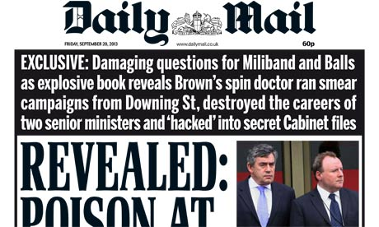
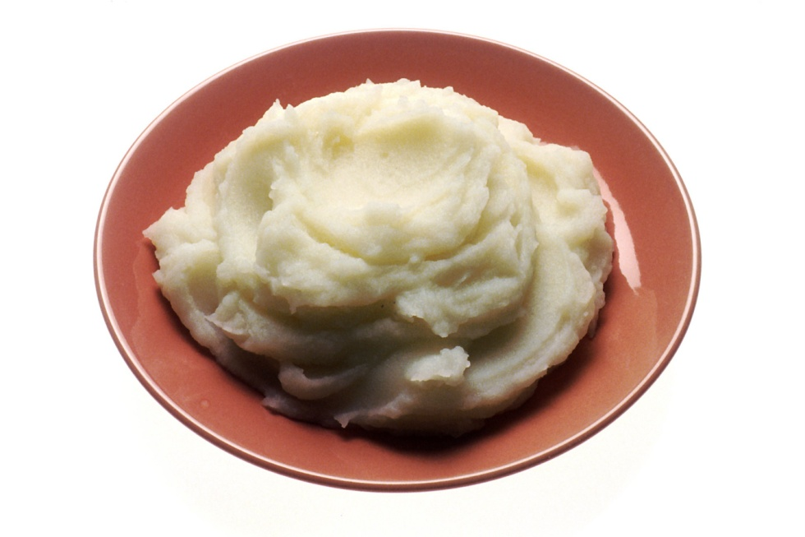
MAIL
OR
MASH?
Notes:
Fake News

Slide 15
Pubs to trial professional lanes
Is there no one left in Britain who can make a sandwich?
EU WANTS MIGRANTS TO TAKE OUR JOBS
UK thanks Russell Brand
Married gays to tour drought-hit countries
GREEN SPIES WILL SNOOP IN YOUR HOME.
Meet the bassist who ruptured his scrotum on a glitter cannon.
Harry Styles reacts to gay rumours
by creating more gay rumours.
Middle-aged man 'was wearing non-Superdry clothing'
Independent Scotland will not be
allowed to use British oxygen
Sewer was blocked by large Pooh.
Nice girls pretending to
look forward to Glastonbury
£14 million Viagra conman hit with stiff sentence.
Britain to be hit by entirely typical weather
Wales gone

Slide 16
Does the newspapers we read influence how we vote?
Exit Poll:
On your way out vote
Yes - it does influence how we vote
No - it does not
Place your votes in the Ballot Box

Slide 17
Lesson 3: “Is the media creating culture wars to sell papers?”

Slide 18
Are we really in the middle of a ‘Culture War’?
Learning Outcomes:
Define key media terms
Create a nuanced perspective from divisive media
2. Explain the things you find most alarming about the idea of a ‘culture-war’, outrage culture and whether we are in fact in a culture war at all.

Slide 19
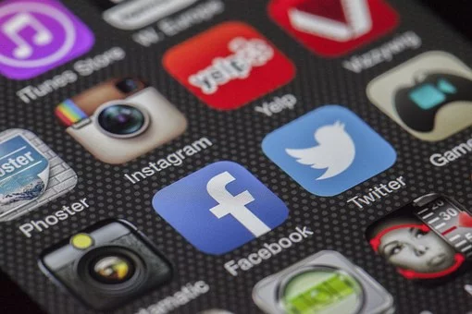
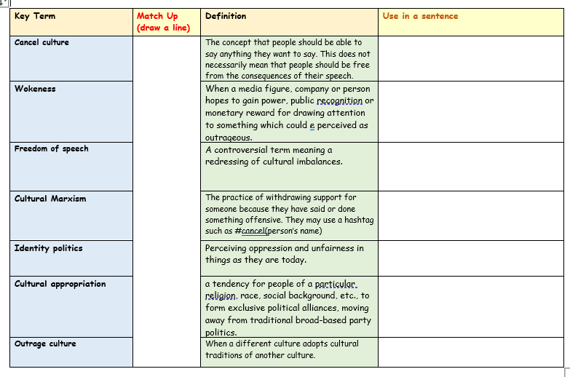
Task One:
We have a lot of new key terms we’ll be looking at today.
You may know some already, but some you will probably
not have heard of before.
Let’s explore these now. You have a copy
each but you can help each other in pairs too.
Don’t forget to complete the final column!
We will go through the answers together in ten minutes.

Slide 20
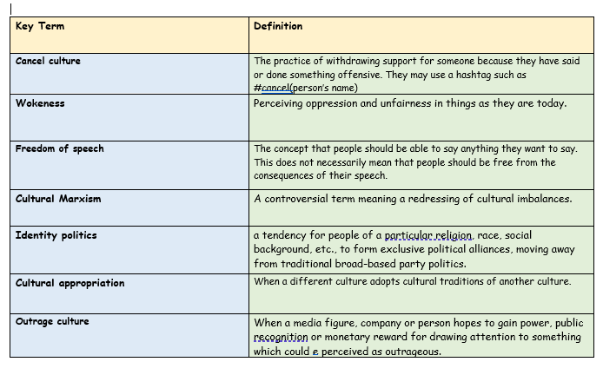
Task One Review: Let’s have someone share their final column ideas…

Slide 21
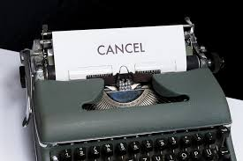
Task Two:
We will now find out more
about the different factors
contributing towards what
Some refer to in the media
as a culture war.
POPCORN READING!
We will take it in turns to read.
When you have finished reading a
paragraph, say the name of the
next person in the class you
would like to read.
Listen carefully, in case your
name is next.

Slide 22
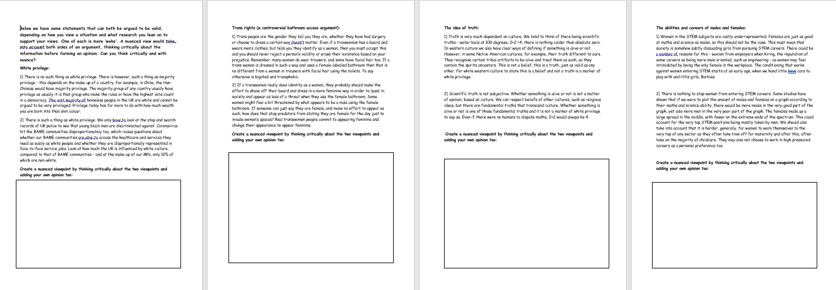
Task 3 : How can we think critically and with nuance?
You have been given some statements. Both on each page can be argued to be valid, depending on how you view a situation and what research you lean on to support your views. One of each is more ‘woke’ one is more right wing. A nuanced view would take into account both sides of an argument, thinking critically about the information before forming an opinion.
Can you think critically and with nuance? Discuss the statements with a partner before summarising your own views in the boxes.

Slide 23
Alarmed Llama Plenary:
Use your alarmed Llama plenary sheet to note down anything you have found alarming about the content and information we’ve covered today.
Learning Outcomes:
Define key media terms.
Create a nuanced perspective from divisive media
Explain the things you find most alarming about the idea of a ‘culture-war’, outrage culture and whether we are in fact in a culture war at all.

Slide 24
Lesson 4: Does the media have responsibilities?

Slide 25
The Role Of The Media In A Democratic Society
What does this mean?
Why is it important?
Informing and influencing public opinion.
Exchanging ideas and opinions.
Holding those in power to account.

Slide 26
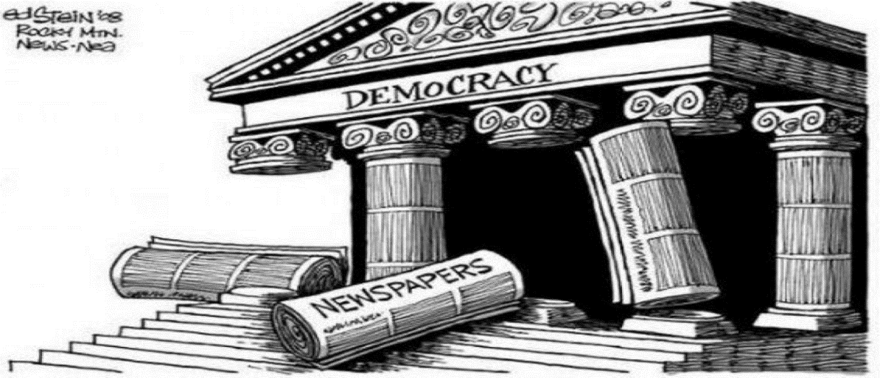
MEDIA RIGHTS AND RESPONSIBILITIES
LEGAL RIGHTS
LEGAL RESPONSIBILITIES
Article 10 Of The Human Rights Act 1998 states… Everyone has the right to freedom of expression. This right shall include freedom to hold opinions and to receive and impart information and ideas without interference by public authority and regardless of frontiers. The exercise of these freedoms mays be subject to restrictions that are necessary in a democratic society – in the interests of national security, territorial disorder or crime, for the protection of health or morals, for the protection of the reputation or rights of others, for preventing the disclosure of information received in confidence, or for maintaining the authority and impartiality of the judiciary.

Slide 27
What Is “In The Public Interest”?
The public interest includes:
Detecting or exposing crime or a serious misdemeanor;
Protecting public health and safety;
Preventing the public from being misled by some statement or action of an individual or organisation;
Exposing misuse of public funds or other forms of corruption by public bodies;
e) Revealing potential conflicts of interest by those in positions of power and influence;
f) Exposing corporate greed;
g) Exposing hypocritical behavior by those holding high office.
Notes:
Prior to showing the text box, discuss the notion of being “in the public interest”. What would the group say is in the public interest to know? Use current real life examples if possible (in the booklet the image of Cliff Richard and a police helicopter is shown) Show the box. How are their ideas similar or different to the points in the definition? They should write this definition down. Then they should check the news link. How are the current stories linked to this definition of public interest? Watch the clips. When do journalists go too far?

Slide 28
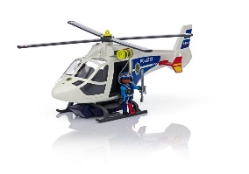
https://www.standard.co.uk/news/uk/sir-cliff-richard-successfully-sues-bbc-for-invasion-of-privacy-a3889976.html

Slide 29
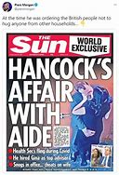
(142) BREAKING: Labour demand PM sacks Matt Hancock over affair scandal 'blatant abuse of power' - YouTube

Slide 30
Watch these clips: How are the current stories linked to this definition of public interest? When do journalists go too far?
https://news.sky.com/entertainment
https://www.ibtimes.co.uk/topless-photos-kate-middleton-six-journalists-face-trial-invasion-privacy-1588234
https://www.youtube.com/watch?v=jtdLW1WcUxg&safe=true

Slide 31
Lesson 5: How do we ensure that the press is both free and responsible?

Slide 32
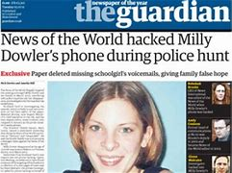
Case Study: The News of the World and Milly Dowler.
Task 1: Complete the guided reading to find out what happened.

Slide 33
How do we ensure that the press is both free and responsible? In 2011, following the discovery of widespread “phone-hacking” by journalists at the News of the World and other newspapers, David Cameron set up a public inquiry under the chairmanship of Lord Justice Leveson.

Slide 34
How do we ensure that the press is both free and responsible? Leveson found that the existing Press Complaints Commission (PCC) – the main industry regulator of the press in the UK since 1990 – was not fit for purpose. His report recommended creating a new independent body and said that it should take an active role in promoting high standards, including having the power to investigate serious breaches and sanction newspapers. It should be backed by legislation designed to assess whether it was doing its job properly. The legislation would enshrine, for the first time, a legal duty on the Government to protect the freedom of the press. An arbitration system should be created through which people who say they have been victims of the press could seek redress without having to go through the courts.

Slide 35
How do we ensure that the press is both free and responsible? Did it work?
https://www.youtube.com/watch?v=_aqr3cw2gpY&safe=true

Slide 36
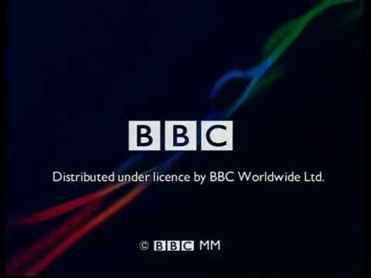

Slide 37
Extract From The BBC Royal Charter
The public purposes of the BBC are as follows:
Sustaining citizenship and civil society
Promoting education and learning
Stimulating creativity and cultural excellence
Representing the UK, its nations, regions and communities
Bringing the UK to the world and world to the UK
How is the BBC achieving this?
https://www.bbc.co.uk/iplayer
BBC iPlayer - Points of View - 2021: Episode 16

Slide 38
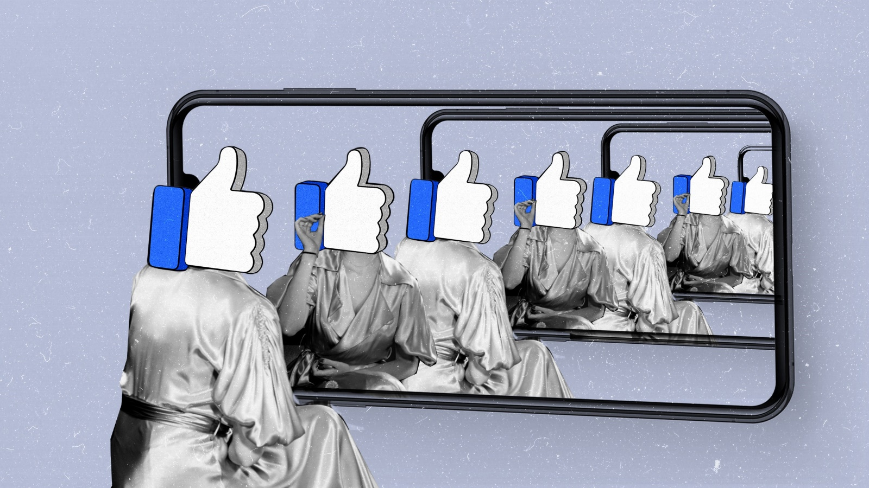
Plenary: Is Media just our echo chamber?
Notes:
Discuss…

