Slide 1


Year 9 French TERM 2: Studio 2 textbook, chapter 2
If pupils are absent from lessons they should spend time doing the ctivities on the following slides then they should revise and learn vocabulary. All of the vocabulary for this term is on the following slides. First of all, they should recap the vocabulary which they learned the previous week. Then they should start to learn the next section of vocabulary which they have not yet covered in class. This could be done by using the look, cover, write, check method or by making flashcards etc. There are also a few tasks to complete. A plan for the term is on the next slide.
Pupils can also revise vocabulary on Linguascope-
Any new vocabulary they learn can be written in their orange books or on paper.
If pupils wish to do extension work they can access free MFL lessons on the Oak National Academy website:
https://classroom.thenational.academy/subjects-by-key-stage

Slide 2
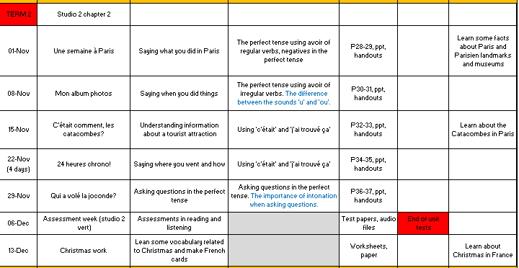

Slide 3
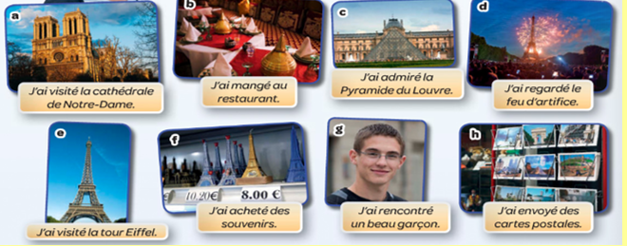
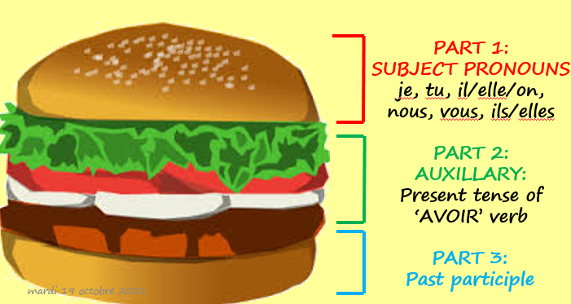
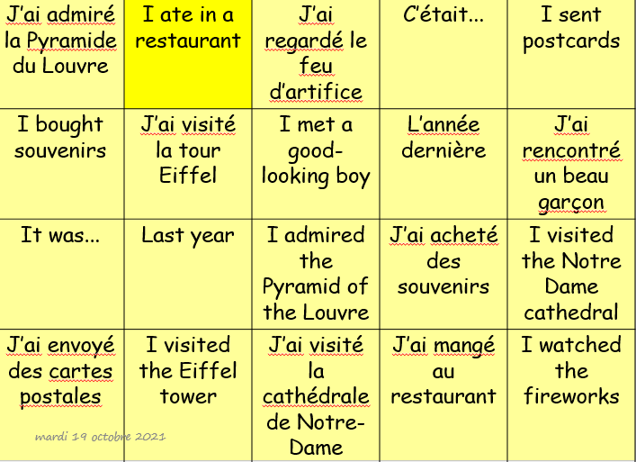
Week 1 – copy the vocab and translate it into English. Then copy the ‘verb burger’ about how to make the perfect tense (past tense). Match the English and French in the grid below.

Slide 4
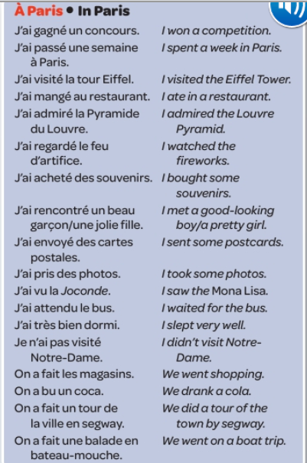
Practice this vocabulary and learn as much of it as possible (especially the verbs).

Slide 5
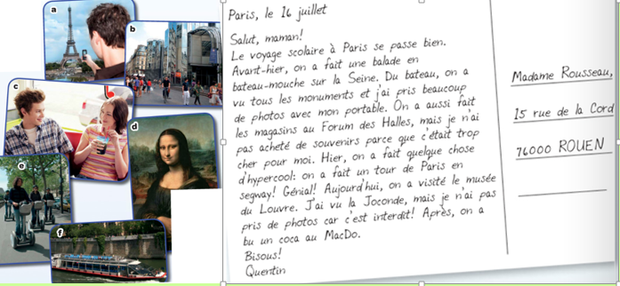
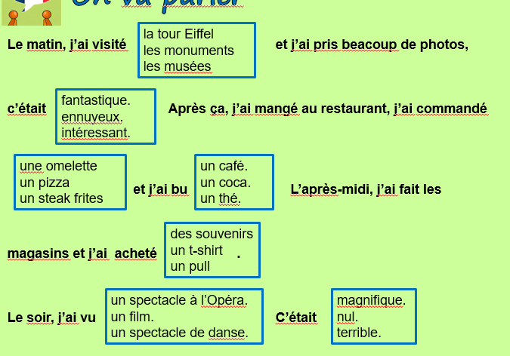
Week 2 – Read the postcard and put the photos in the correct order. Then write a paragraph using the trapdoor template. Translate it into English.

Slide 6
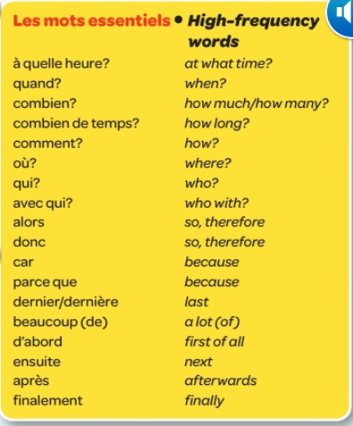
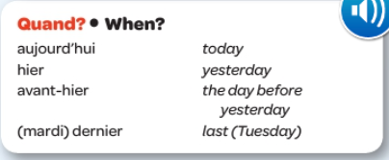
Practice this vocabulary and learn as much of it as possible.

Slide 7
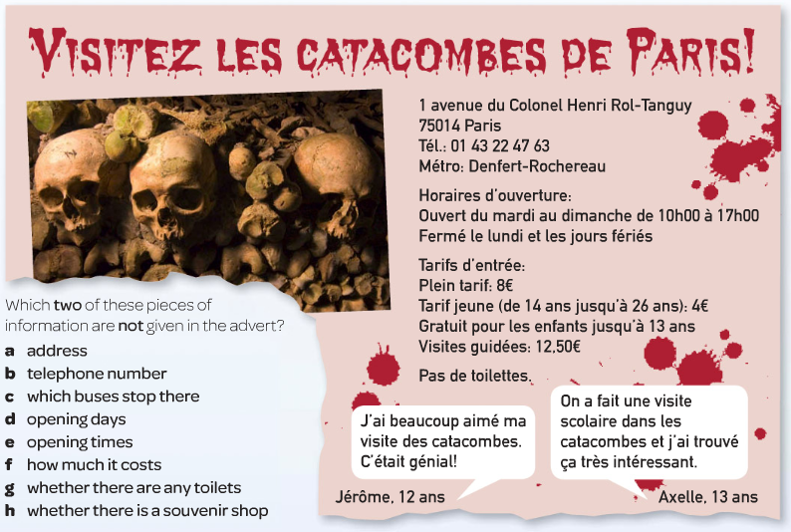
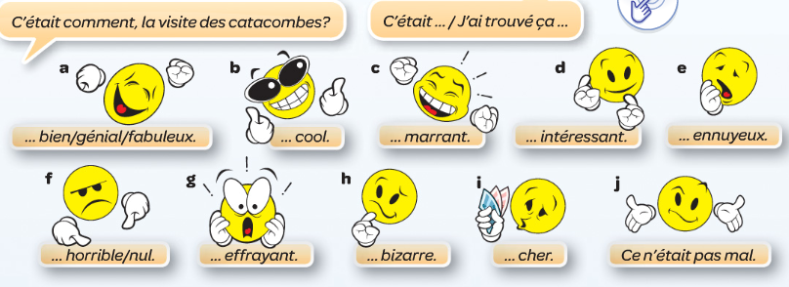

Week 3 – read the advert for the Catacombes and find the French to the 6 expressions below. Then copy the opinion vocab (c’était – it was).

Slide 8
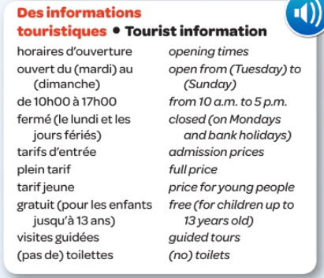
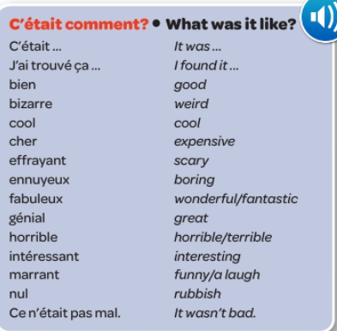
Learn the new vocab for this week.

Slide 9
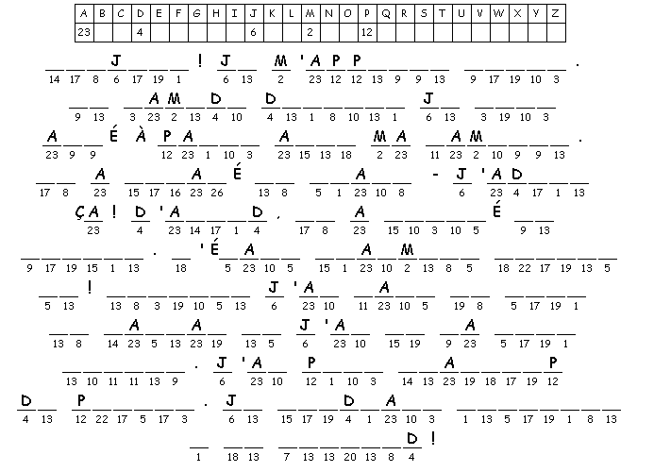
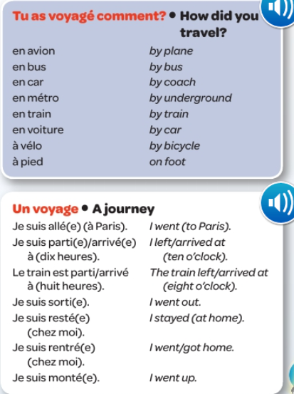
Week 4 – complete the code breaker. Then, make a poster out of the new vocab below and learn as much of it as you can.

Slide 10
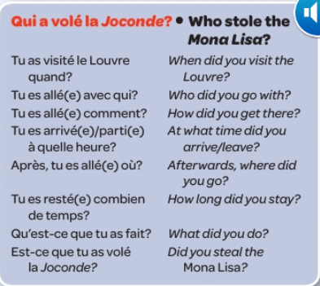
Week 5 – Practice asking questions in the perfect tense. Write these down in your book and write an example answer for each question. Learn some of these questions and adapt them to ask different things (eg, when did you visit Paris?).

Slide 11
Week 6 – revision week. Make a revision poster about the topics we have covered this term.
Do some revision activities on this quizlet page:
Studio 2 module 2 revision
Then contact Mrs Brown for the assessment paper.

Slide 12
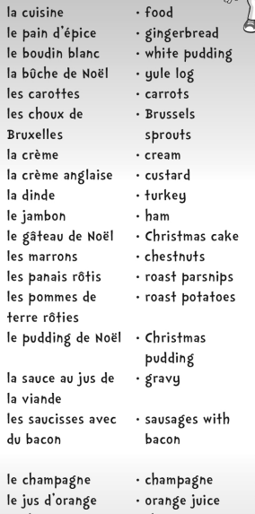
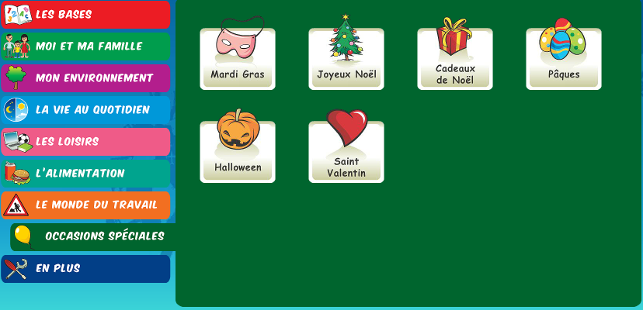
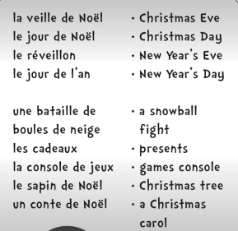
Week 7 – Contact Mrs Brown for the assessment paper. You can also do some Christmas activities on Linguascope or make a French Christmas card.

