Slide 1


Year 8 German TERM 2: Echo 1 textbook, chapter 4
If pupils are absent from lessons they should spend time revising and learning vocabulary. All of the vocabulary for this term is on the following slides. First of all, they should recap the vocabulary which they learned the previous week. Then they should start to learn the next section of vocabulary which they have not yet covered in class. This could be done by using the look, cover, write, check method or by making flashcards etc. It should also be written in their orange book. There are also a few tasks to complete. A plan for the term is on the next slide.
Pupils can also revise vocabulary on Linguascope-
Any new vocabulary they learn can be written in their orange books or on paper.
If pupils wish to do extension work they can access free MFL lessons on the Oak National Academy website:
https://classroom.thenational.academy/subjects-by-key-stage

Slide 2
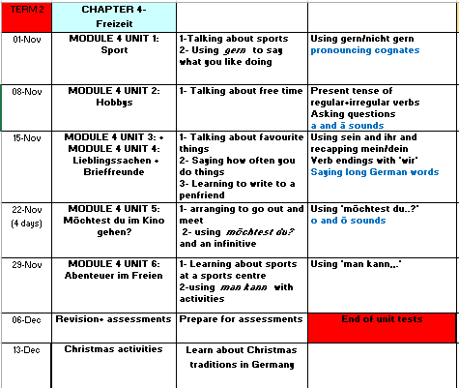

Slide 3
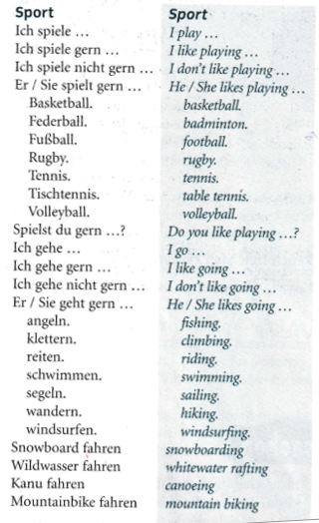
WEEK 1 – w/c 1st Nov
Copy this vocab in to your book and try and learn it.

Slide 4
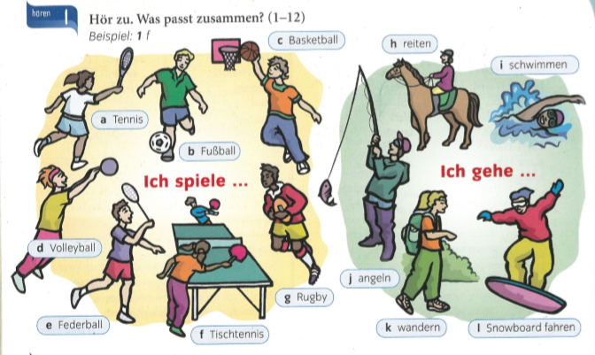

Write down 1-12. What activities do they mention?

Slide 5
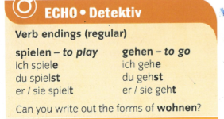
Copy this information in to your book.
Remember ich = I du= you er/sie = he/she
(Therefore I play, you play, he/she plays I go, you go, he/she goes)

Slide 6
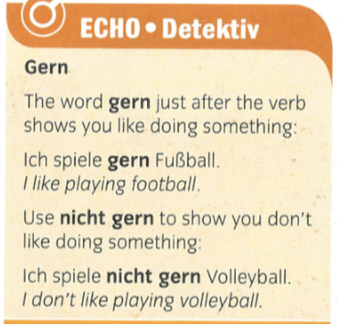
Copy this information in to your book.

Slide 7
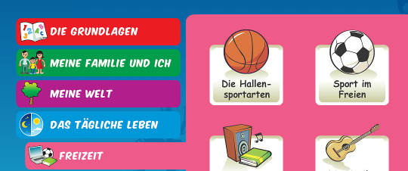
Now, either make a poster of the sports phrases from the vocab slide or play on Linguascope at the sports sections in the beginner area.

Slide 8
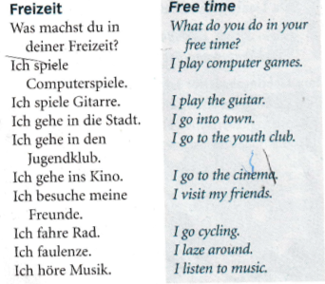
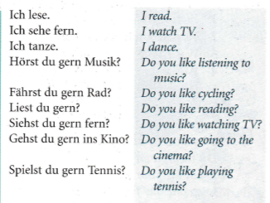
WEEK 2 – w/c 8th Nov
Copy this vocab in to your book and try and learn it.
You could also make a poster

Slide 9
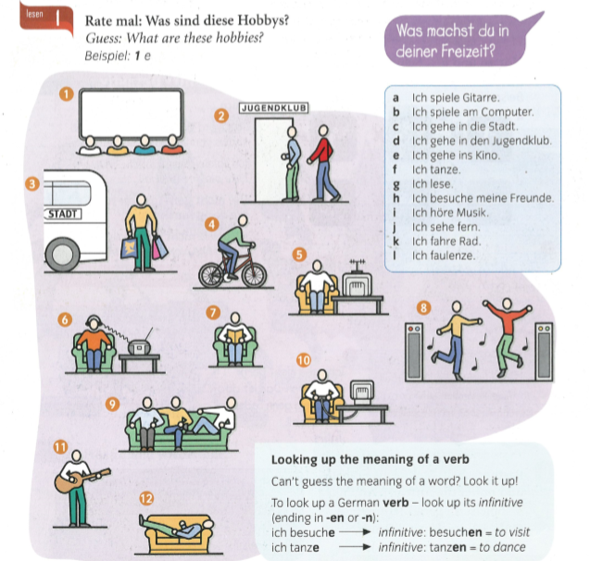
Match up the pictures 1-12 with the phrases a-l

Slide 10

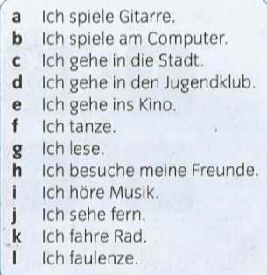
Listen to the recording. What do they do? You can write the answer in English or just write the letter a-l from the list at the side.

Slide 11
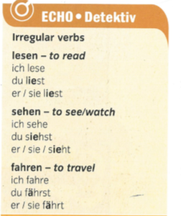
These verbs are irregular which means they don’t follow the normal pattern. Look at how these change for du (you) and er/sie (he/she). Sometimes an I is added and sometimes umlauts.
I read
You read
He/she reads
I see/watch
You see/watch
He/she sees/ watches
I travel
You travel
He/she travels

Slide 12
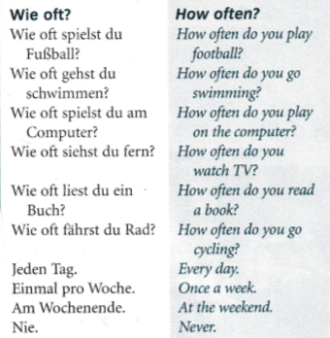
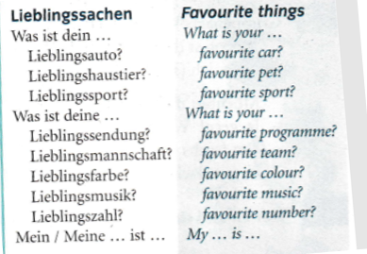
WEEK 3 – w/c 15th Nov
Copy this vocab in to your book and try and learn it.

Slide 13
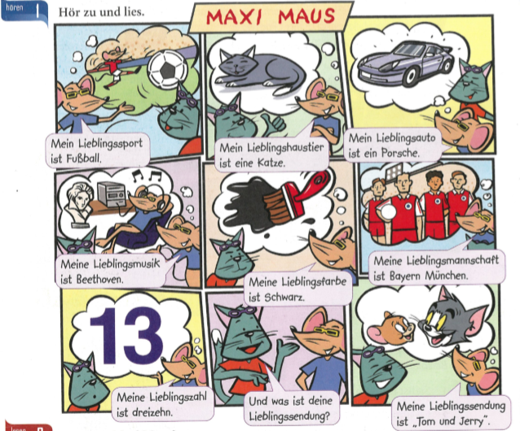
Listen and read along to Maxi Maus telling you his favourite things.
Then make a poster in German of your favourite things. This could be in your book or on a powerpoint.

Slide 14
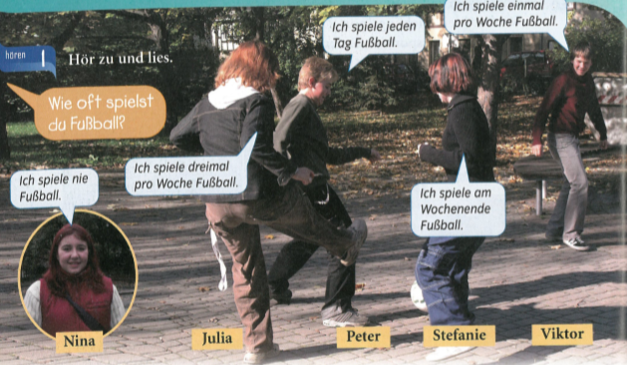
Listen to the recording and read along - How often do the children play football? Try and translate the sentences in to English. Use the vocab slide to help you.

Slide 15

Listen to the recording. Write down what activity they do and how often. You can do this in German or in English.

Slide 16
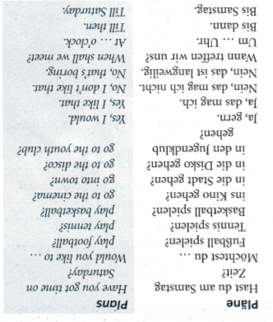
WEEK 4 – w/c 22nd Nov
Copy this vocab in to your book and try and learn it.

Slide 17
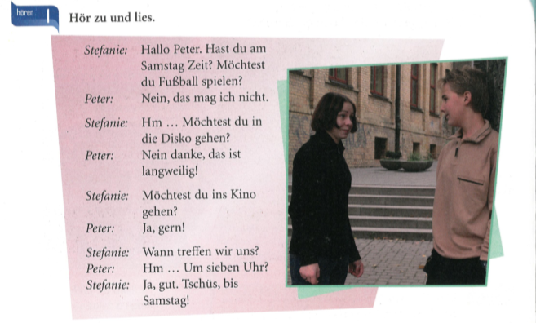
Listen to the conversation. Try and work out what it means by looking back at the vocab slide for this week.

Slide 18
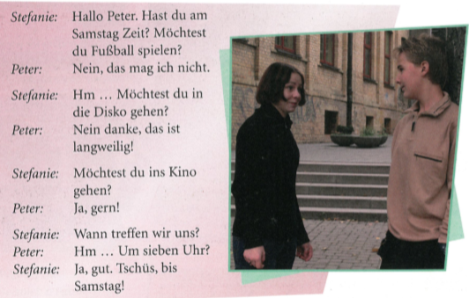
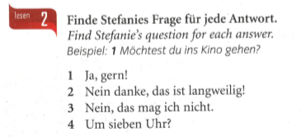

Slide 19
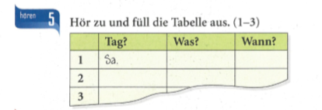
Listen to the recording. Copy the table. What day are they meeting? What will they do? What time are they meeting? You can do this in German or English

Slide 20
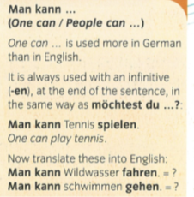
WEEK 5 – w/c 29th Nov
Copy these notes in to your orange book.

Slide 21
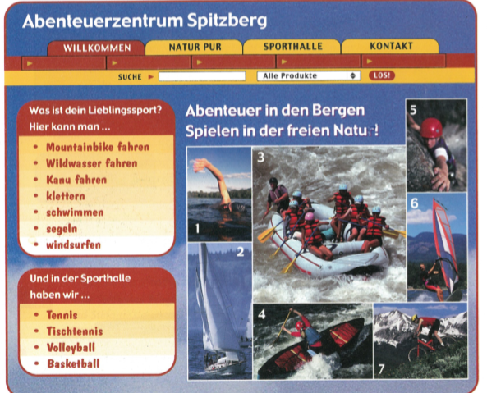
Look at this brochure for the Abenteuerzentrum (adventure centre). See how many sports/ activities you can recognise from the list. Use an online dictionary to help you if you are unsure of any words. Then, find a word for each picture,
e.g. 1 = schwimmen

Slide 22
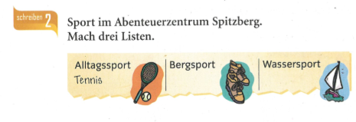
Try and categorise the sports from the holiday brochure on the previous slide in to 3 categories – every day sports, mountain sports and water sports

Slide 23


Log in to Linguascope
Choose the Lingua League section (not beginner or elementary this time). There are 6 things to have a go at – click on the 6 buttons at the top to move between activity. Make sure you look at activity 1 first though as it teaches you the new words. Um fit zu bleiben means in order to stay fit.

Slide 24
WEEK 6 – w/c 6th Dec
This week is assessment week. Spend some time revising all of the vocab on these slides so far and then email your teacher for the test papers. There are also revision activities on the next slide.

Slide 25
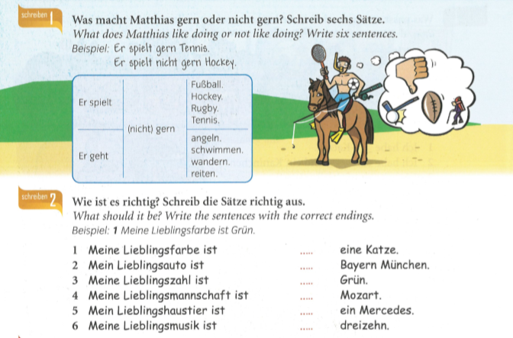

Slide 26
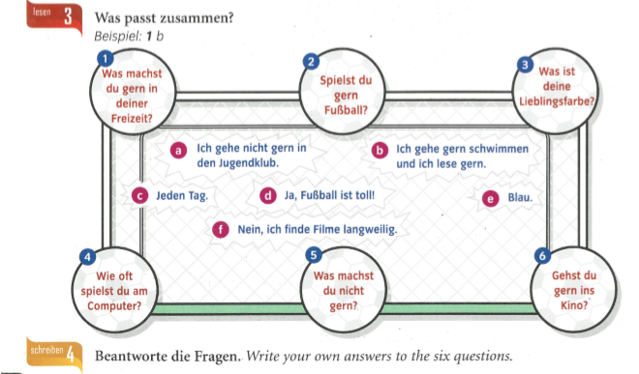
Match up the questions to the answers.

Slide 27
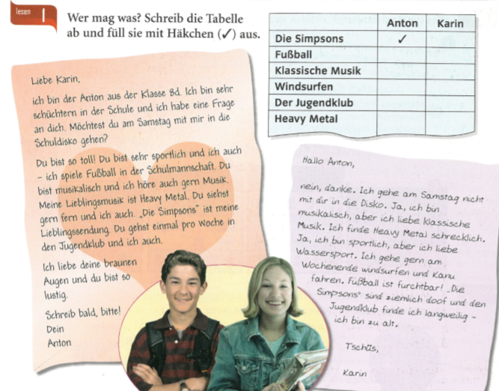
Who likes what? Copy out the table and tick if the people (Anton or Karin) like those activities.

Slide 28
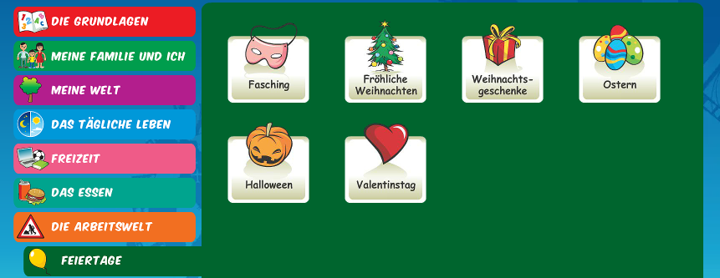
WEEK 7 – w/c 13th Dec
Learn about Christmas in Germany by reading the following slides. Then make your own poster or Powerpoint about Christmas in Germany or do some of the Linguascope Christmas activities in the beginner section.

Slide 29


Weihnachten in Deutschland
A traditional German
Christmas

Slide 30
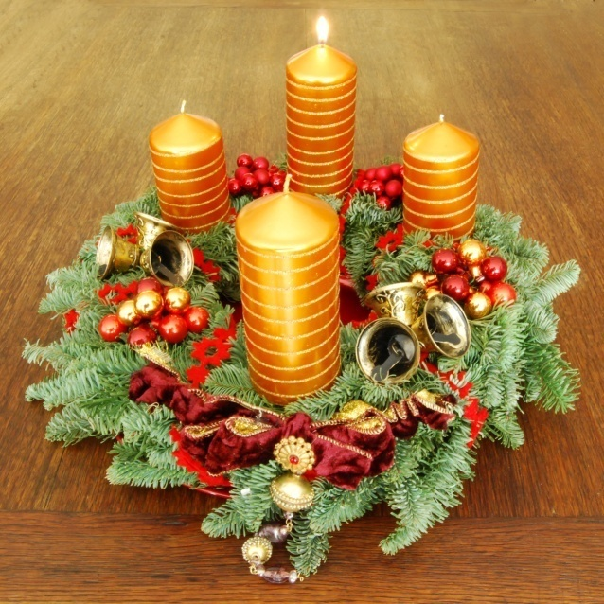
Beginning
At the end of November, families either make or buy an Adventkranz.
The Adventkranz is made of fir twigs and contains 4 candles.
A candle is lit every Sunday leading up to Christmas Eve.

Slide 31
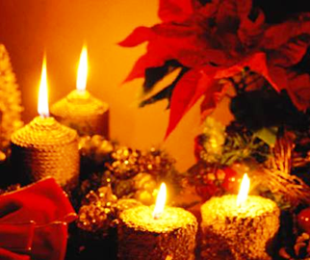
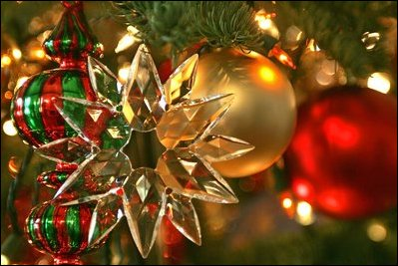
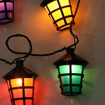
Pre-Christmas
Christmas celebrations start earlier in Germany than in England. About four weeks before Christmas, German families decorate their homes with small lights, lanterns and wreaths.

Slide 32
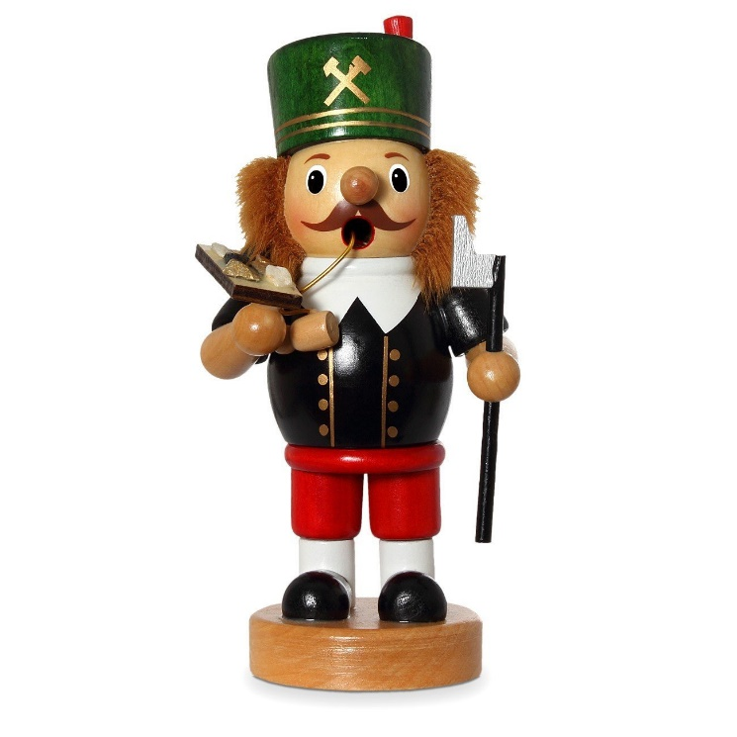
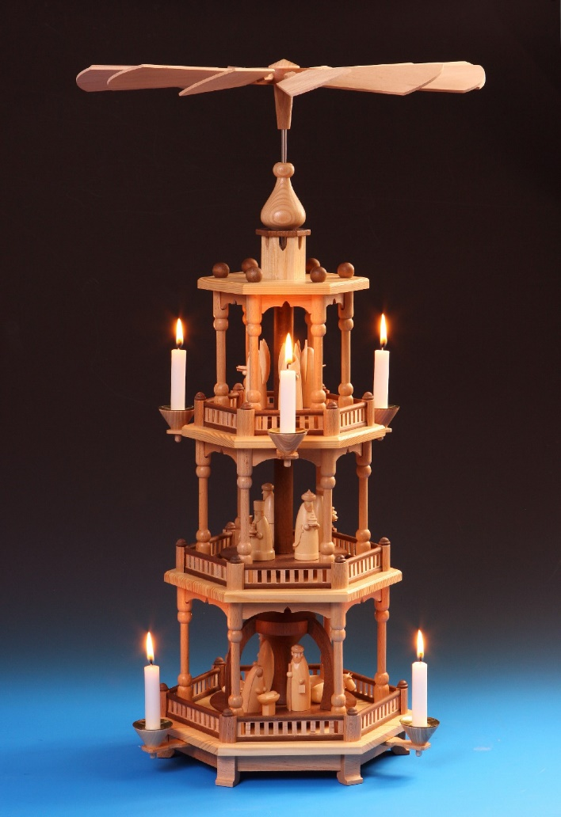
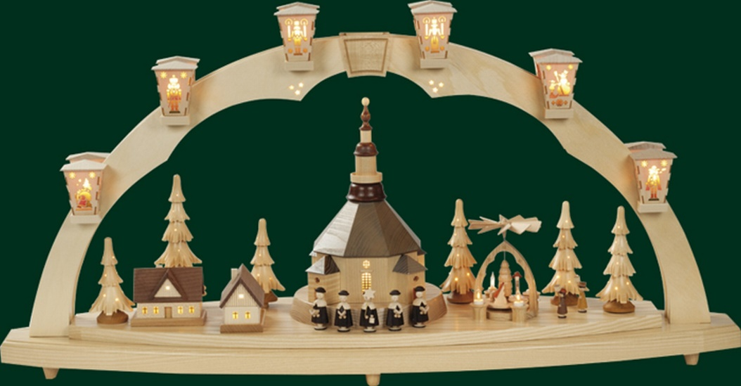
Decorating the home…

Slide 33
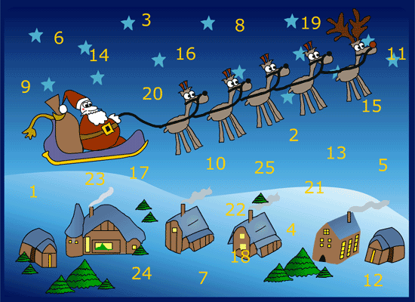
Most German children also have an Adventskalender. These are also popular in England now. For each day up to Christmas, there is a door to be opened. Sometimes behind this door you will find a picture, poem or sometimes a piece of chocolate.

Slide 34
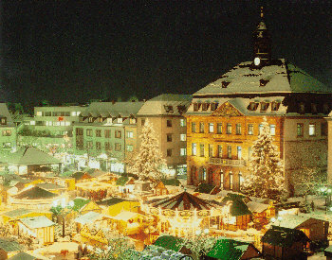
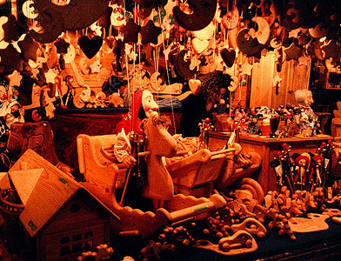
Between the December 6th and 23rd it is the tradition in Germany to visit the Weihnachtsmärkte
  You can buy;
  Food: Bratwurst (sausages), Waffeln (waffles), Glühwein (mulled wine), Crêpes etc.
  Clothes: Scarves, caps, gloves, jumpers etc.
  Christmas decorations.

Slide 35
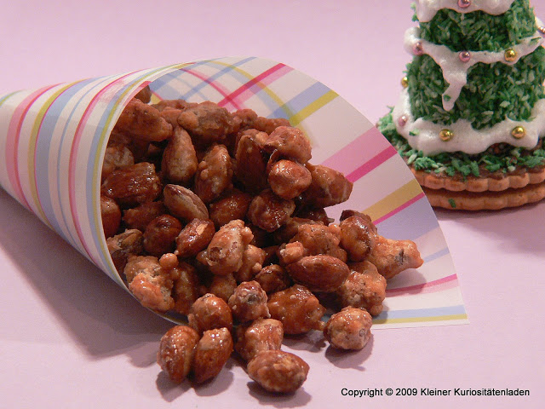
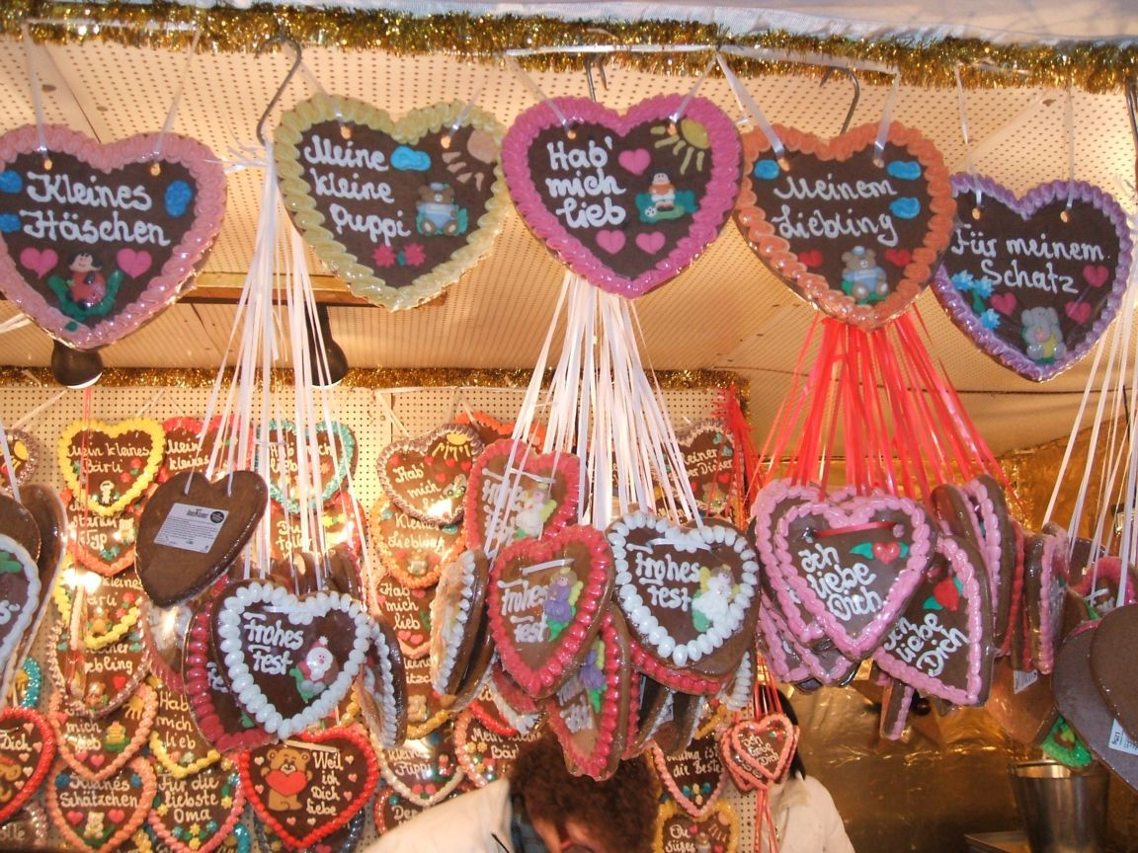
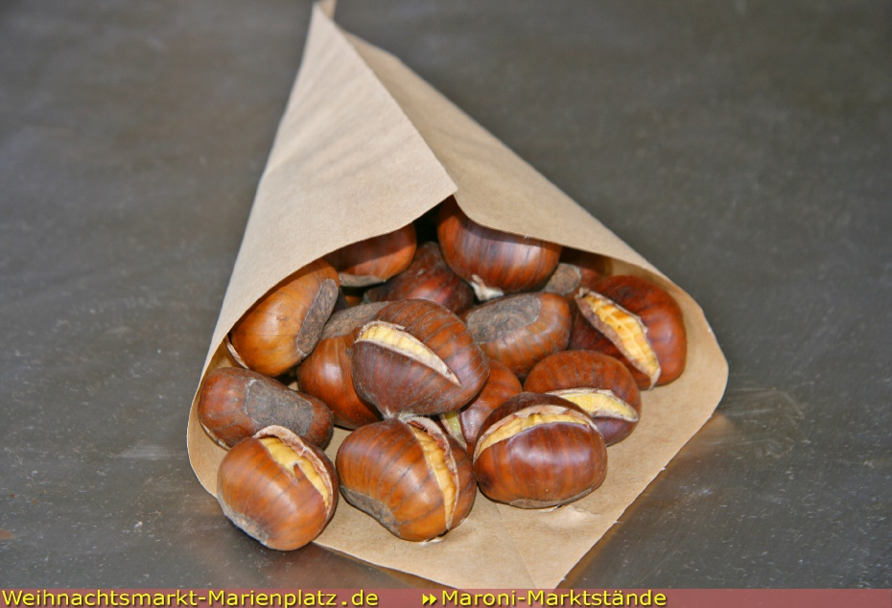
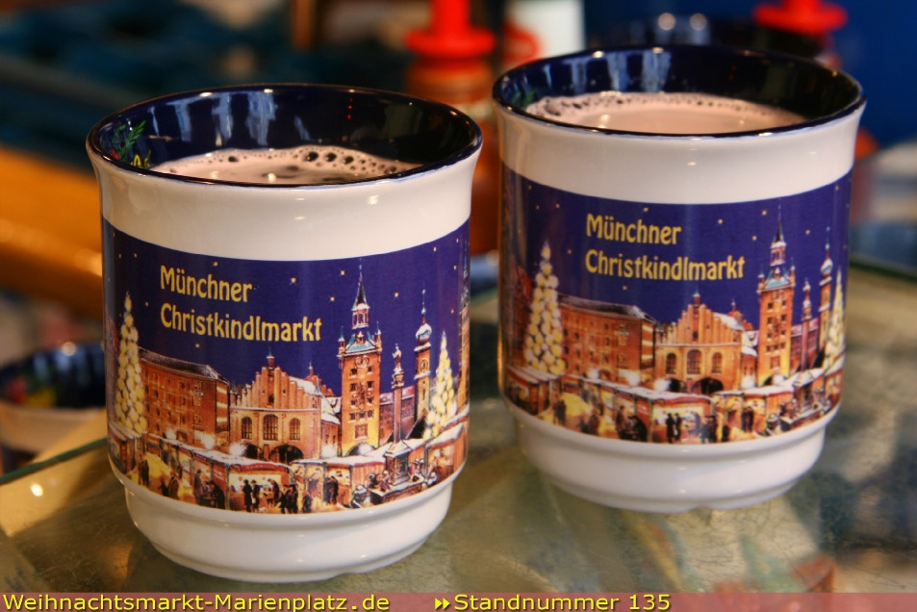
Auf dem Weihnachtsmarkt…
gebrannte Mandeln
Lebkuchen
Maroni
Glühwein

Slide 36
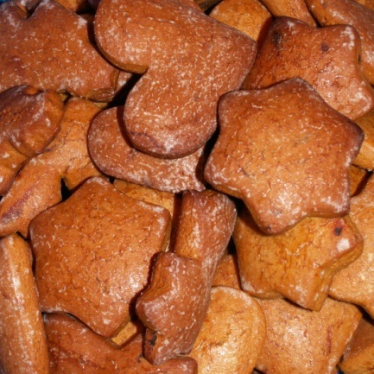
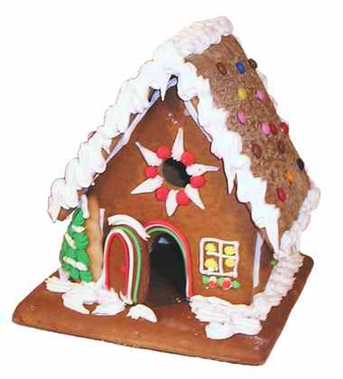
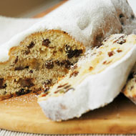
Families often set aside special evenings for baking spiced cakes, cookies and gingerbread houses.
Families also make gifts & decorations. Little dolls of fruit are traditional Christmas toys.
Stollen
Lebkuchen

Slide 37
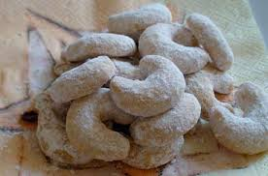
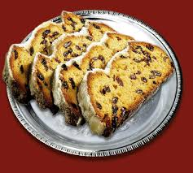
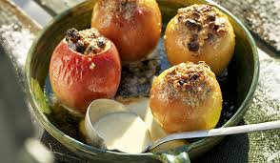
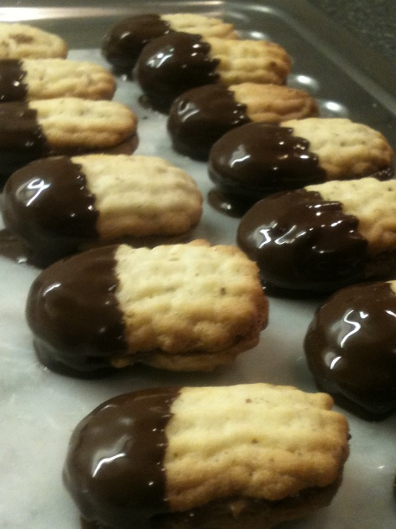
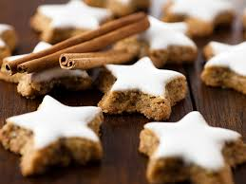
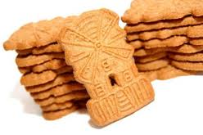
Weihnachtsbäckerei
Vanillekipferl
Stollen
Bratäpfel
Zimtsterne
Bärentatzen
Spekulatius

Slide 38


On the evening of December 5th children leave their shoes or boots outside the front door.
That night, St. Nikolaus visits and fills the shoes with chocolates, fruit, nuts & sweets.

Slide 39





German families celebrate Christmas on the morning of Christmas Eve (Heiligabend).
The family decorates the tree with apples, sometimes with real candles, baubles (Kugeln) and with (Engelshaar) (‘angel’s hair’ – tinsel).
At the top of the tree is a star (Stern) and at the foot of the tree the crib (Krippe).

