Slide 1


Year 7 German rotation 1: Echo 1 textbook, chapter 1
If pupils are absent from lessons they should spend time revising and learning vocabulary. All of the vocabulary for this term is on the following slides. First of all, they should recap the vocabulary which they learned the previous week. Then they should start to learn the next section of vocabulary which they have not yet covered in class. This could be done by using the look, cover, write, check method or by making flashcards etc. It should also be copied in to their orange books. There are also a few tasks to complete. A plan for the term is on the next slide.
Pupils can also revise vocabulary on Linguascope-
Any new vocabulary they learn can be written in their orange books or on paper.
If pupils wish to do extension work they can access free MFL lessons on the Oak National Academy website:
https://classroom.thenational.academy/subjects-by-key-stage

Slide 2
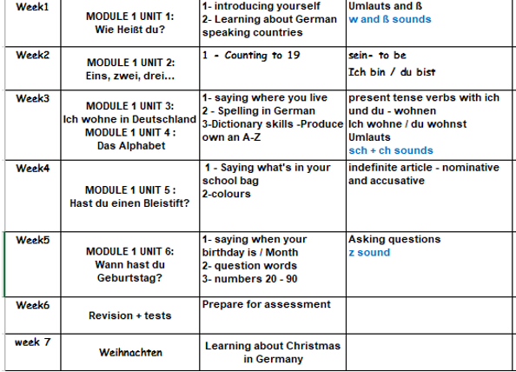


Slide 3
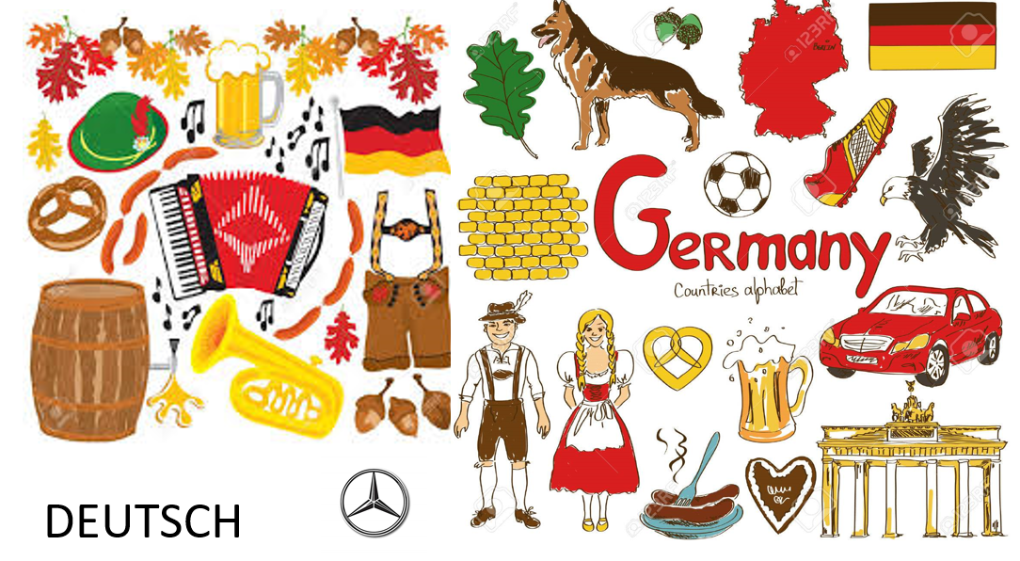
WEEK 1 – w/c 1st Nov
This term you will study German. Make a German title page in your orange book. Ideas for the design are below (Do not do anything to do with Nazi Germany please):

Slide 4
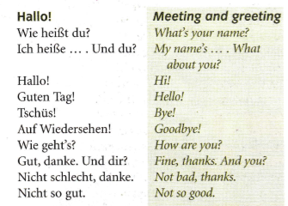
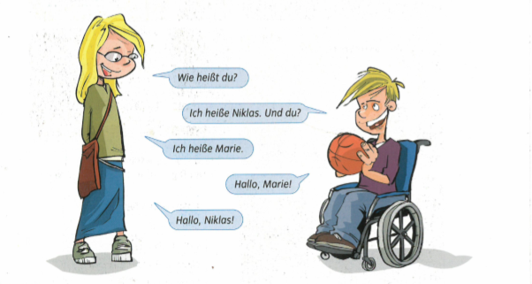
Copy this vocab in to your book and learn it.
Read the conversation. Translate it in to English

Slide 5



Slide 6
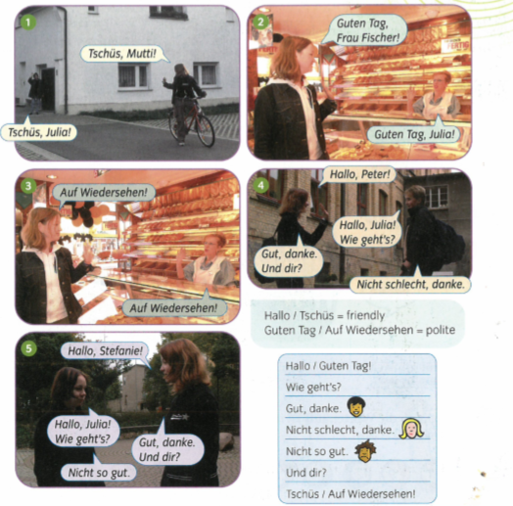
Listen to the conversation and read along. Work out what it means in English.

Slide 7
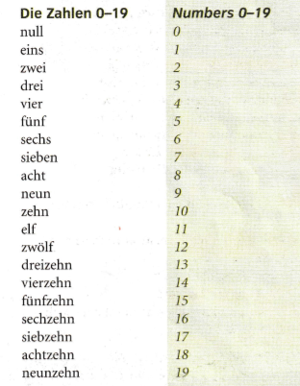

WEEK 2 – w/c 8th Nov
Copy this vocab in to your book and learn it.

Slide 8
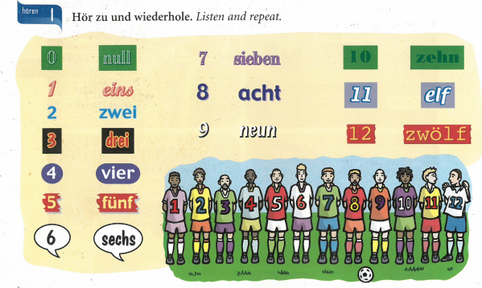

Slide 9

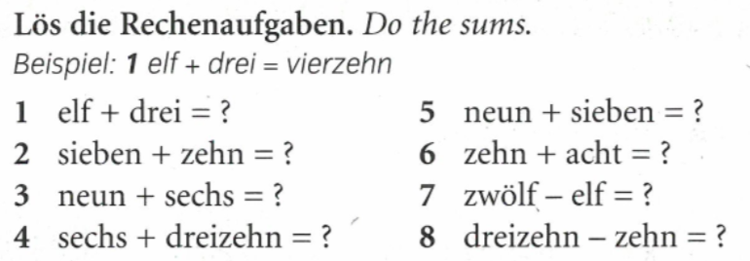
Practise your numbers on Linguascope next.

Slide 10
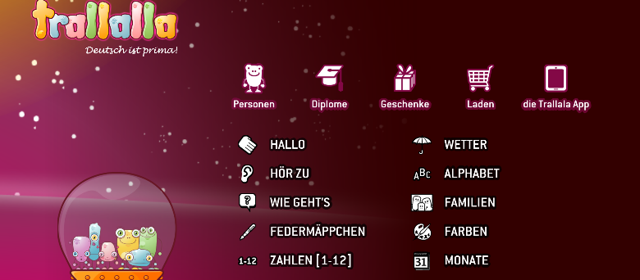
Practise the numbers 1-12 on the elementary section of Linguascope.

Slide 11
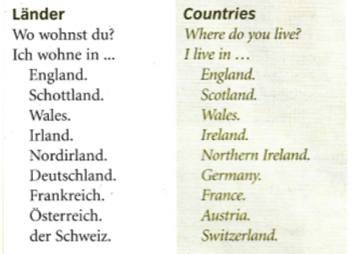
WEEK 3 – w/c 15th Nov
Copy this vocab in to your book and learn it.

Slide 12
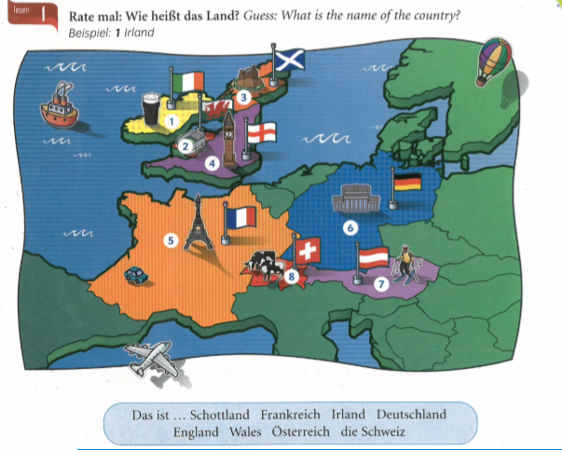

Slide 13


Slide 14
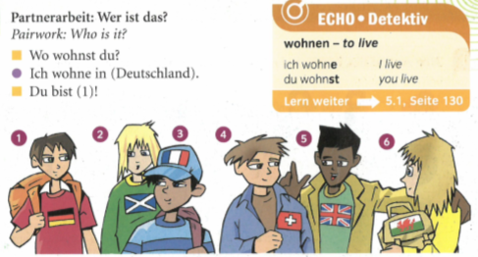
Write a sentence for each person as though you are them, e.g.
1. Ich wohne in Deutschland

Slide 15
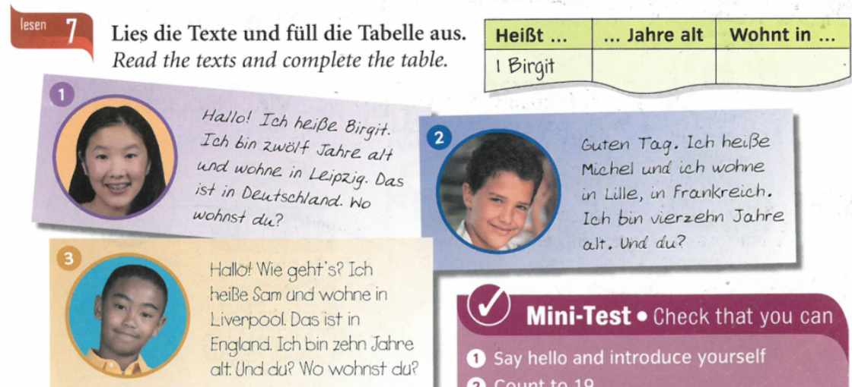
Practise your countries on Linguascope next.

Slide 16
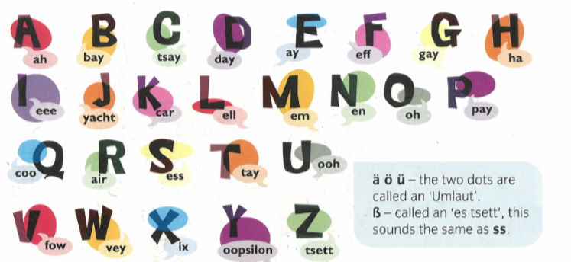
Listen and repeat

Slide 17
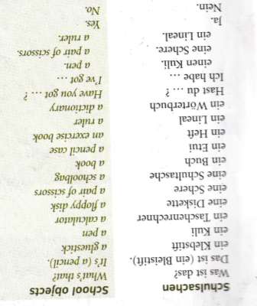
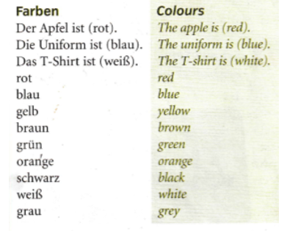
WEEK 4 – w/c 22nd Nov
Copy this vocab in to your book and try and learn it.

Slide 18
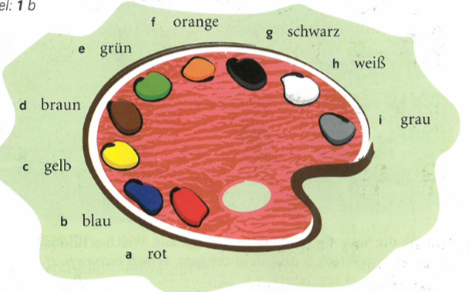
Make a colours poster in your book

Slide 19
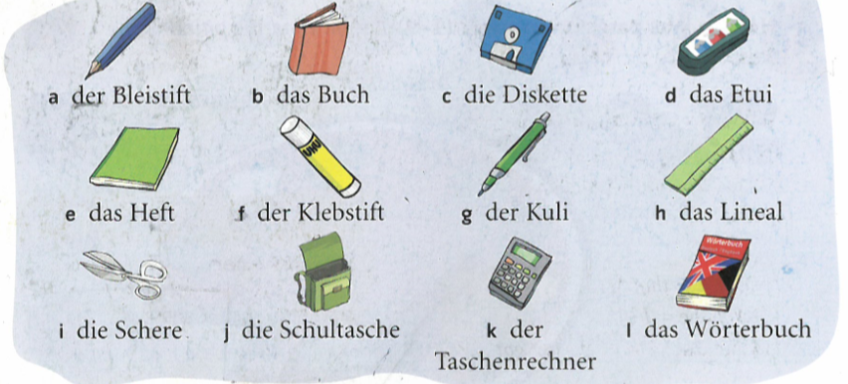
Make a stationery poster. Ignore ‘die Diskette’ as it’s not used any more
Practise your colours and stationery on Linguascope next.

Slide 20
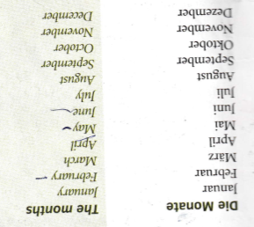
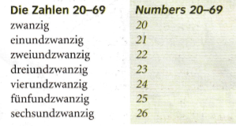
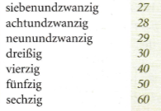
WEEK 5 – w/c 29th Nov
Copy this vocab in to your book and try and learn it.

Slide 21
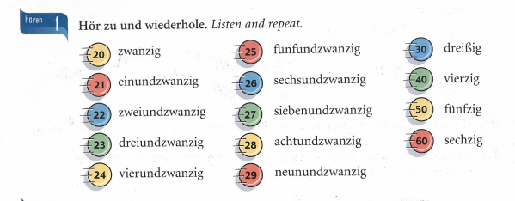

Slide 22
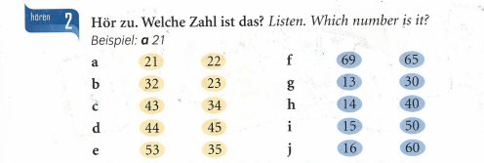

Slide 23
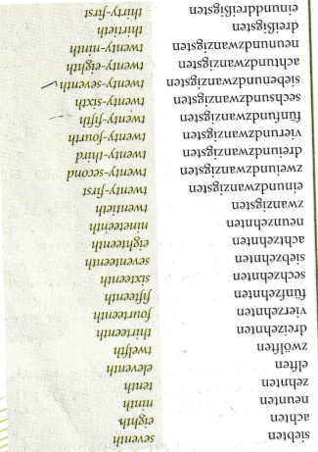
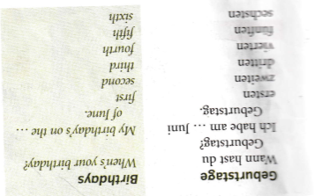

Slide 24
WEEK 6 – w/c 6th Dec
This week is assessment week. Spend some time revising all of the vocab on these slides so far and then email your teacher for the test papers.

Slide 25
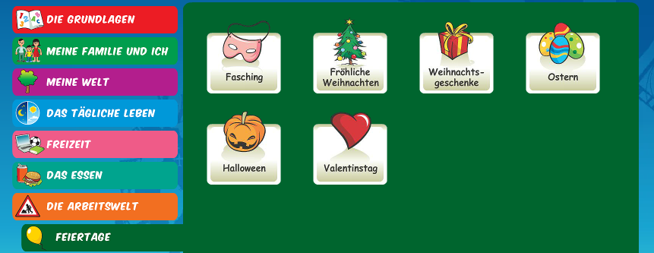
WEEK 7 – w/c 13th Dec
Learn about Christmas in Germany by reading the following slides. Then make your own poster or Powerpoint about Christmas in Germany or do some of the Linguascope Christmas activities in the beginner section.

Slide 26


Weihnachten in Deutschland
A traditional German
Christmas

Slide 27
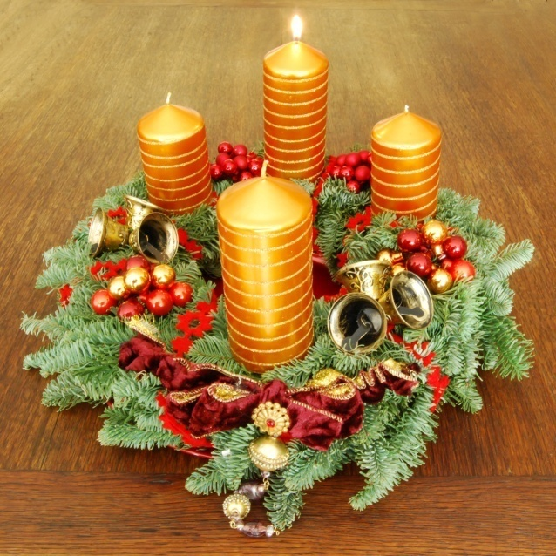
Beginning
At the end of November, families either make or buy an Adventkranz.
The Adventkranz is made of fir twigs and contains 4 candles.
A candle is lit every Sunday leading up to Christmas Eve.

Slide 28
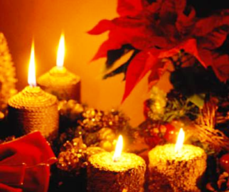
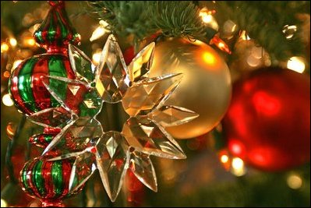
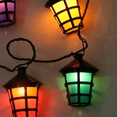
Pre-Christmas
Christmas celebrations start earlier in Germany than in England. About four weeks before Christmas, German families decorate their homes with small lights, lanterns and wreaths.

Slide 29
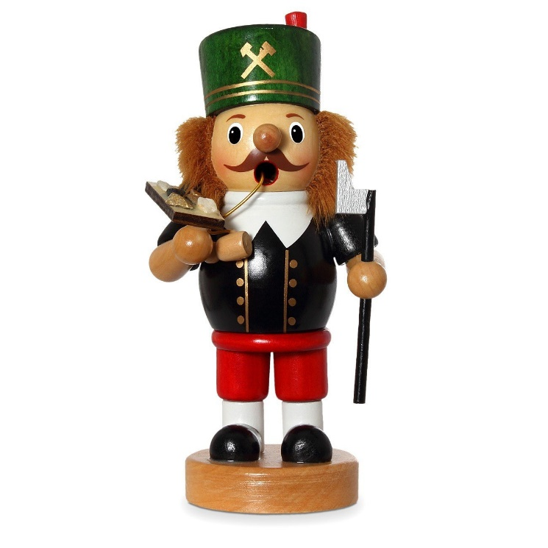
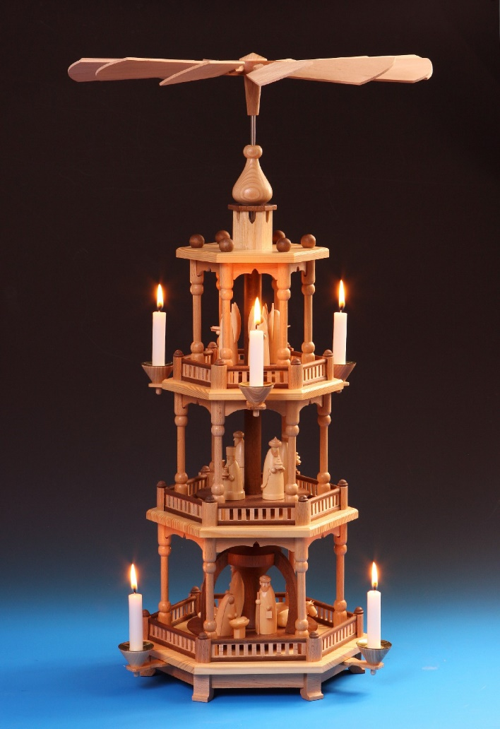
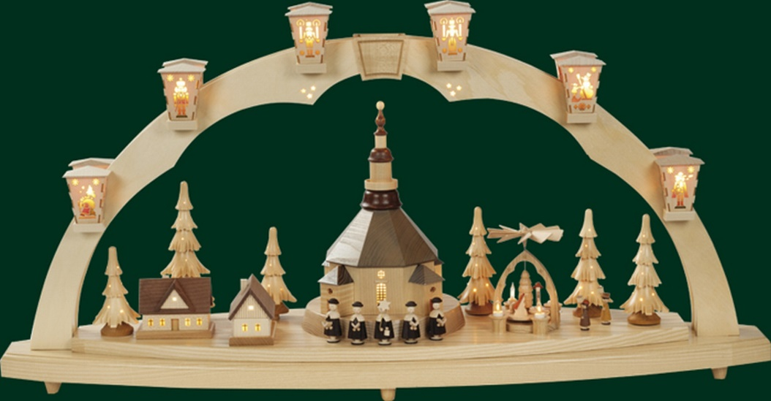
Decorating the home…

Slide 30
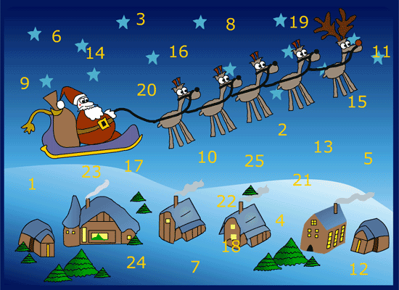
Most German children also have an Adventskalender. These are also popular in England now. For each day up to Christmas, there is a door to be opened. Sometimes behind this door you will find a picture, poem or sometimes a piece of chocolate.

Slide 31
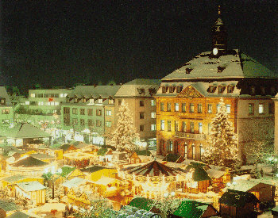
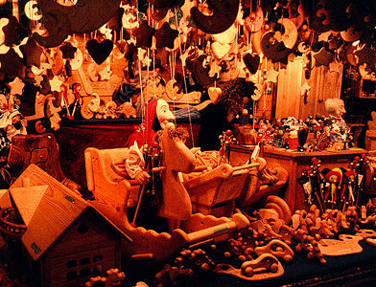
Between the December 6th and 23rd it is the tradition in Germany to visit the Weihnachtsmärkte
  You can buy;
  Food: Bratwurst (sausages), Waffeln (waffles), Glühwein (mulled wine), Crêpes etc.
  Clothes: Scarves, caps, gloves, jumpers etc.
  Christmas decorations.

Slide 32
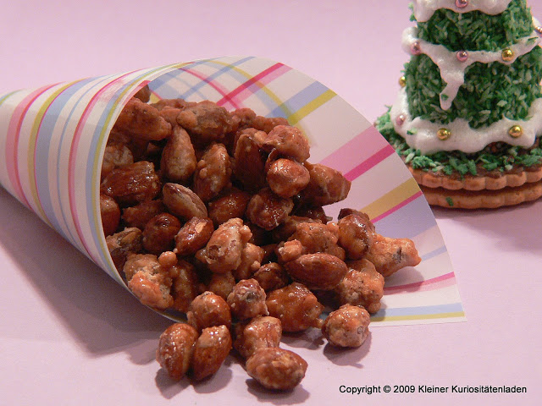
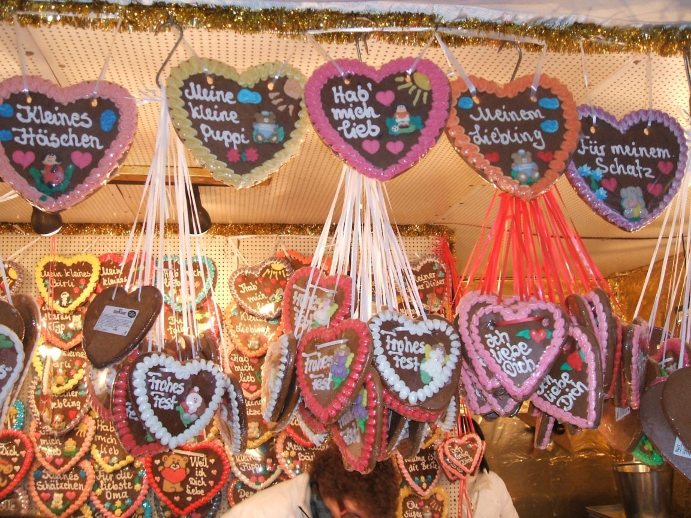
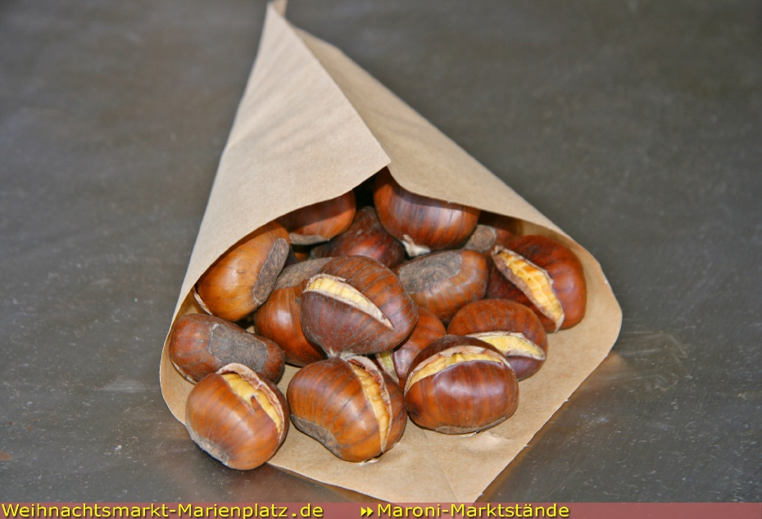
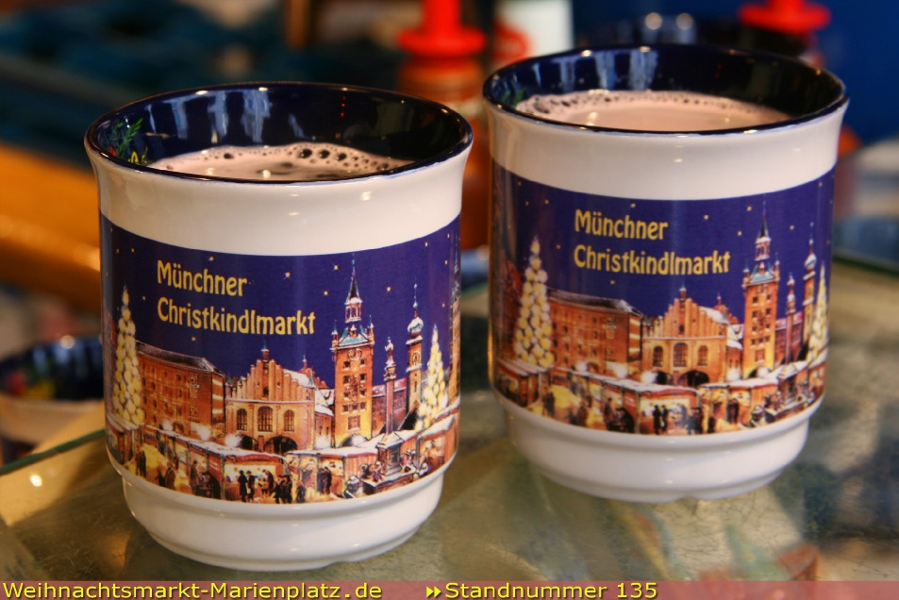
Auf dem Weihnachtsmarkt…
gebrannte Mandeln
Lebkuchen
Maroni
Glühwein

Slide 33
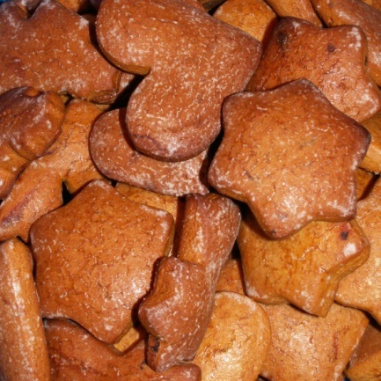
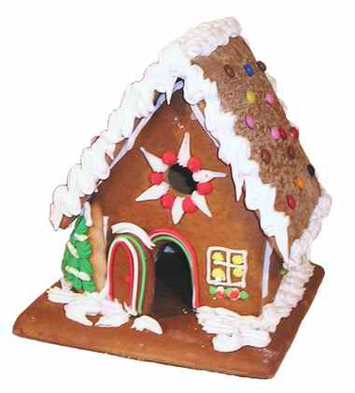
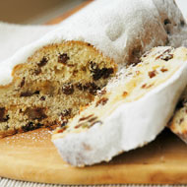
Families often set aside special evenings for baking spiced cakes, cookies and gingerbread houses.
Families also make gifts & decorations. Little dolls of fruit are traditional Christmas toys.
Stollen
Lebkuchen

Slide 34
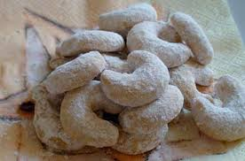
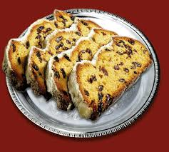
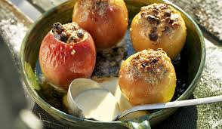
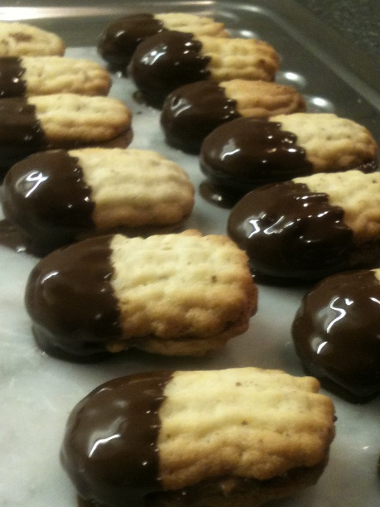
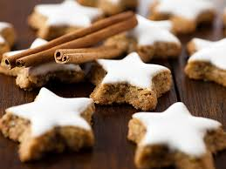
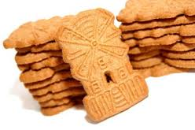
Weihnachtsbäckerei
Vanillekipferl
Stollen
Bratäpfel
Zimtsterne
Bärentatzen
Spekulatius

Slide 35
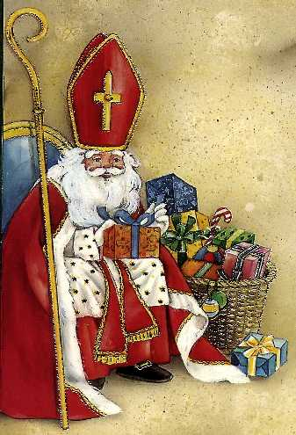

On the evening of December 5th children leave their shoes or boots outside the front door.
That night, St. Nikolaus visits and fills the shoes with chocolates, fruit, nuts & sweets.

Slide 36





German families celebrate Christmas on the morning of Christmas Eve (Heiligabend).
The family decorates the tree with apples, sometimes with real candles, baubles (Kugeln) and with (Engelshaar) (‘angel’s hair’ – tinsel).
At the top of the tree is a star (Stern) and at the foot of the tree the crib (Krippe).

