Slide 1
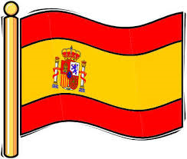

Year 7 Spanish rotation 1: Mira 1 textbook, chapter 1
If pupils are absent from lessons they should spend time revising and learning vocabulary. All of the vocabulary for this term is on the following slides. First of all, they should recap the vocabulary which they learned the previous week. Then they should start to learn the next section of vocabulary which they have not yet covered in class. This could be done by using the look, cover, write, check method or by making flashcards etc. It should also be copied in to their orange books. There are also a few tasks to complete. A plan for the term is on the next slide.
Pupils can also revise vocabulary on Linguascope-
Any new vocabulary they learn can be written in their orange books or on paper.
If pupils wish to do extension work they can access free MFL lessons on the Oak National Academy website:
https://classroom.thenational.academy/subjects-by-key-stage

Slide 2
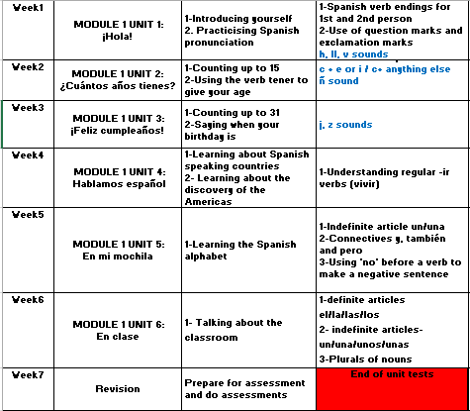

Slide 3
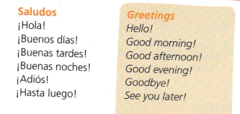
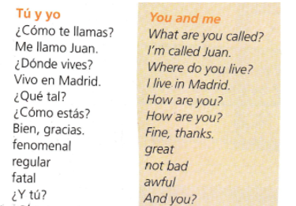
WEEK 1 – w/c 1st Nov
Copy this vocab in to your book and try and learn it.

Slide 4
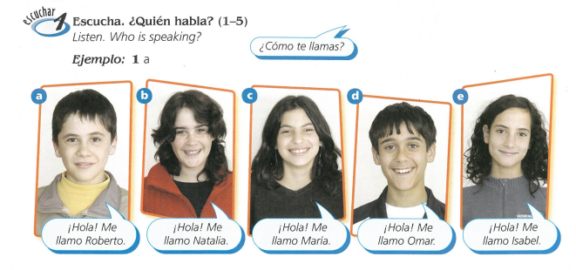


Slide 5
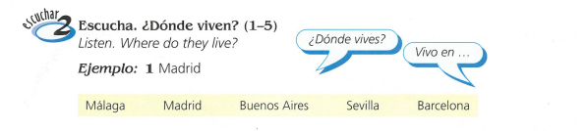

Slide 6
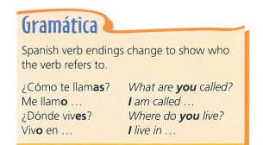
Copy this in to your book.

Slide 7
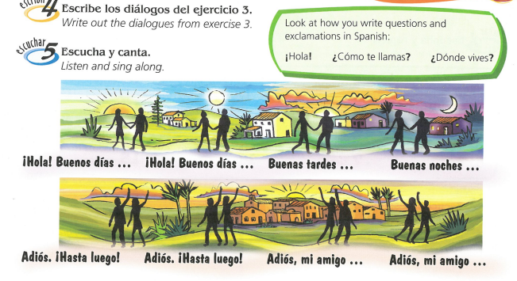

Slide 8
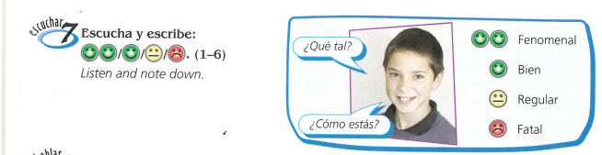
How are they feeling? Listen to the recording

Slide 9
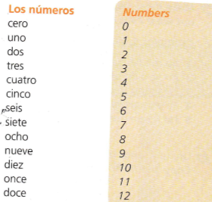


WEEK 2 – w/c 8th Nov
Copy this vocab in to your book and try and learn it.
Practise counting to 10.

Slide 10
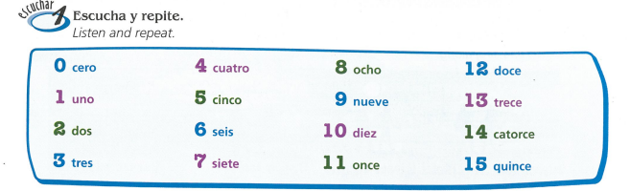
Learn to count to 15

Slide 11
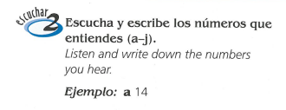
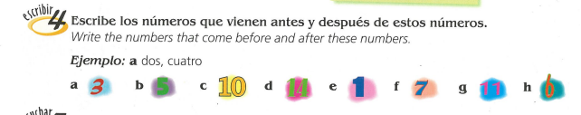

Slide 12
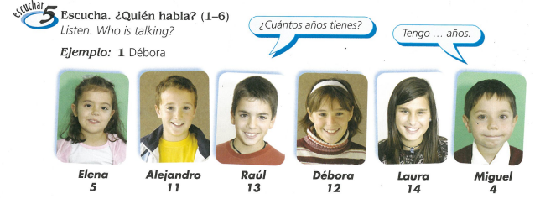

Slide 13
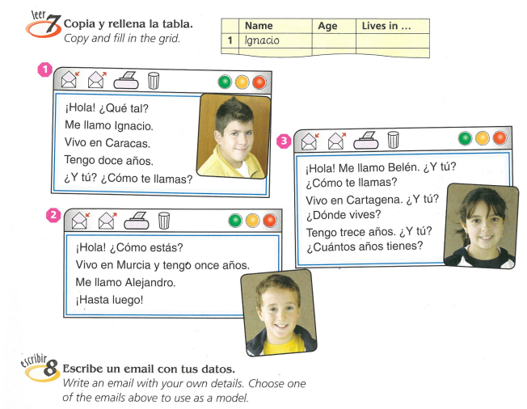

Slide 14
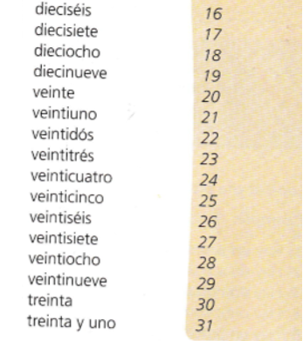
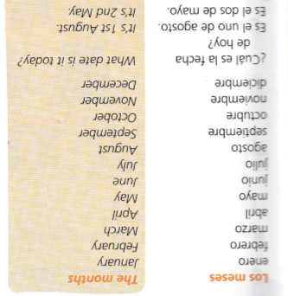
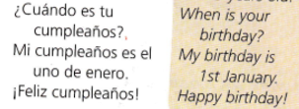
WEEK 3 – w/c 15th Nov
Copy this vocab in to your book and try and learn it.

Slide 15
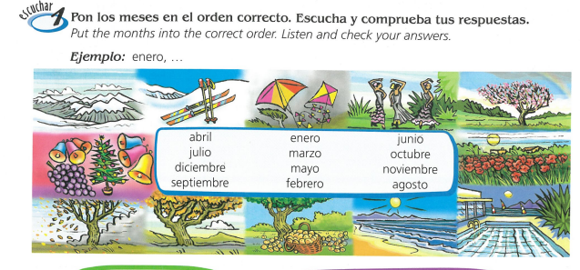

Slide 16
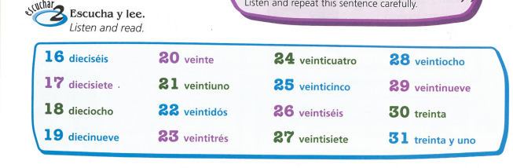

Slide 17
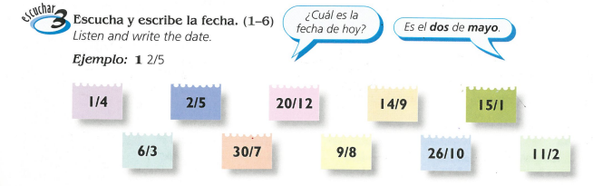

Slide 18
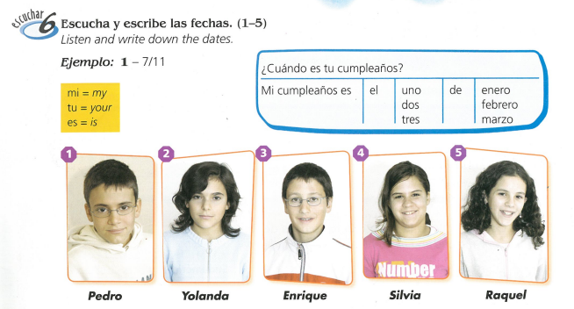

Slide 19
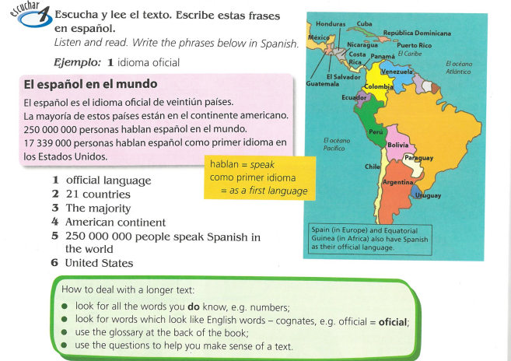
WEEK 4 – w/c 22nd Nov
This week we are learning about some other Spanish speaking countries. Look at the map below and try and copy it. You will also learn about the discovery of the Americas on the next slides.

Slide 20
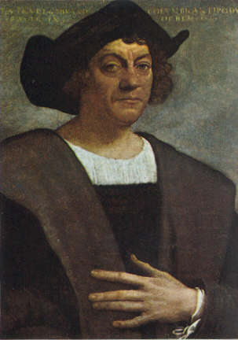
The discovery of the Americas
Today we are going to be looking at a cultural topic. We have looked at Spanish speaking countries in class and this week you are going to learn about the discovery of the Americas by Christopher Columbus.

Slide 21
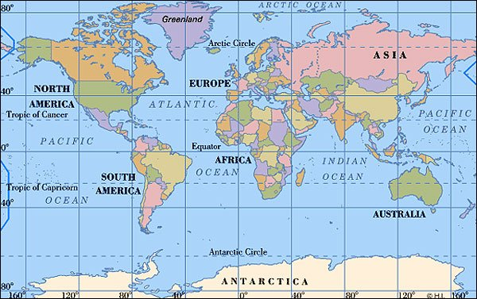
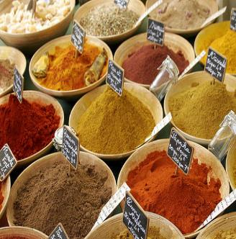
Christopher Columbus was born in 1451. He was Italian. When he grew up he became a great explorer who sailed across the Atlantic Ocean, hoping to find a route to India. He moved to Spain in 1491.
Italy
U.S.A
India was very important because many of the spices that people in Europe wanted grew there. They used these spices in cooking, for medicine, to dye their clothes and lots of other things.
India

Slide 22
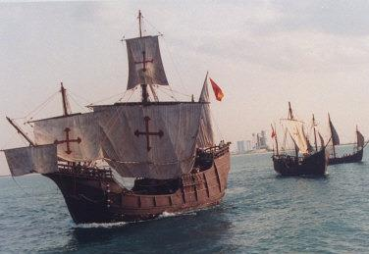
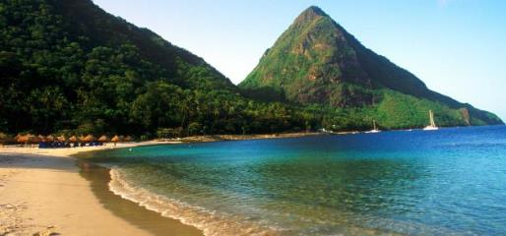
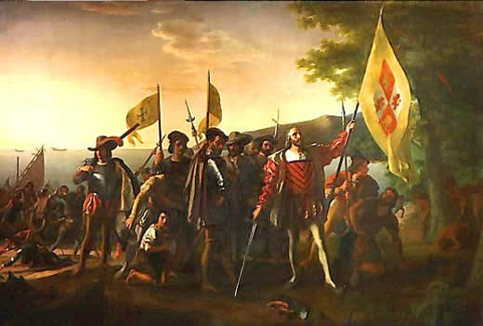
Columbus sailed for King Ferdinand the second and Queen Isabella of Spain. Columbus sailed with three ships, the Niña, the Pinta and the Santa Maria, and about 90 crew members. They set sail in August 1492 from Spain.
In October 1492 they spotted the Caribbean islands off the coast of America. They landed on an island they named it San Salvador. They were met by the native people. Many of these people were captured by Columbus' men and later sold as slaves. Columbus thought he had made it to India, and called this area the Indies, and called the people who lived there Indians.
Columbus didn’t know it at the time but he had discovered a new part of the world. Many people moved to the Americas after his great discovery. It became known as The New World.

Slide 23
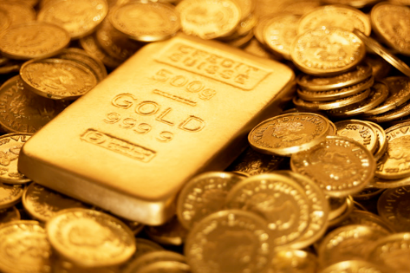
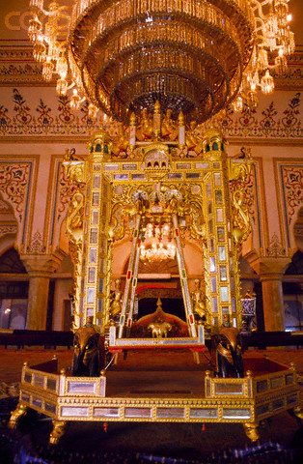
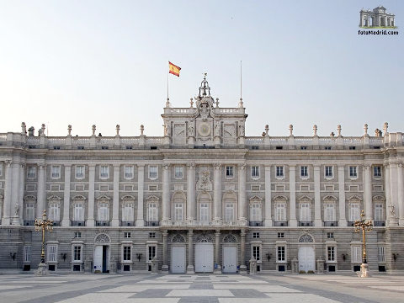
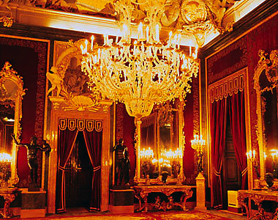
Columbus made four more trips to the Americas. Each time he and other explorers stole gold and new foods from the people already living on the land
Columbus and his other conquerors brought misery to many Native Americans. The Europeans stole their land. Many Native Americans were killed from diseases brought by Columbus and his men or by being forced to work in mines instead of growing food to eat.
The gold was taken back to the King and Queen in Spain.
Inside the royal palace
The royal palace in Madrid.

Slide 24
Write an extract from the ship’s log (diary) as though you were a sailor / Christopher Columbus on the first voyage
(Remember they hadn’t seen land for 6 weeks and were living in cramped conditions. Food and fresh water supplies would have been very low)

Slide 25
Choose from one of the following tasks:
Produce an information poster/booklet about the discovery of the Americas. You could use the internet to find even more facts too.
OR
2)Write an extract from the ship’s log (diary) as though you were a sailor / Christopher Columbus on the first voyage
(Remember they hadn’t seen land for 6 weeks and were living in cramped conditions. Food and fresh water supplies would have been very low)

Slide 26
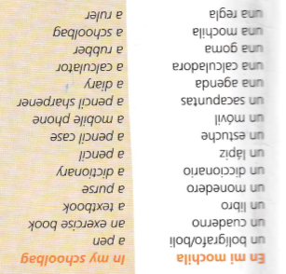
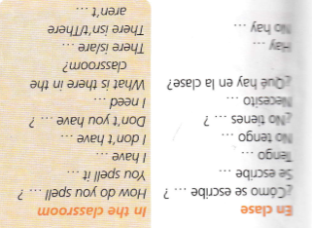
WEEK 5 – w/c 29th Nov
Copy this vocab in to your book and try and learn it. Also, look at the alphabet on the next slide and try and practise saying it too.

Slide 27
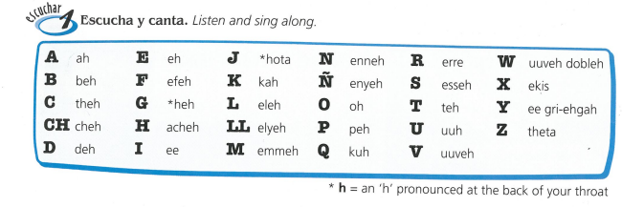

Slide 28
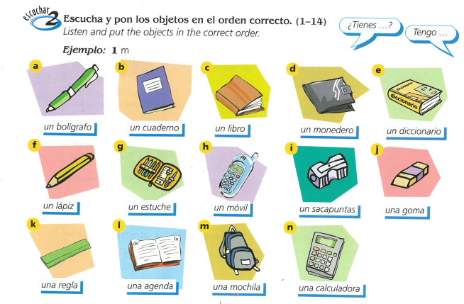
You could also make a poster of stationery items in your book

Slide 29
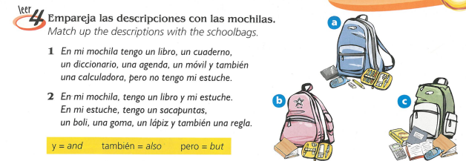

Slide 30
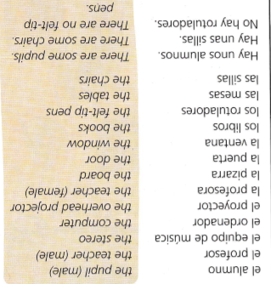

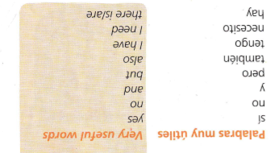
WEEK 6 – w/c 6th Dec
Copy this vocab in to your book and try and learn it

Slide 31
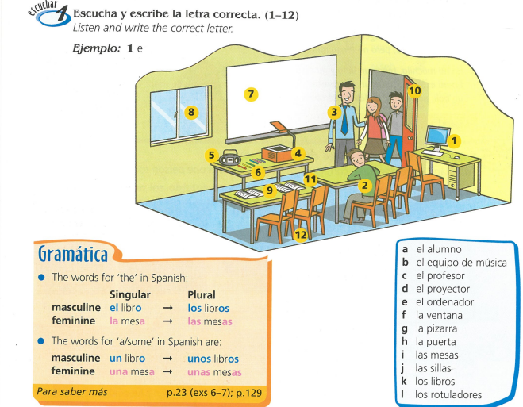

Slide 32
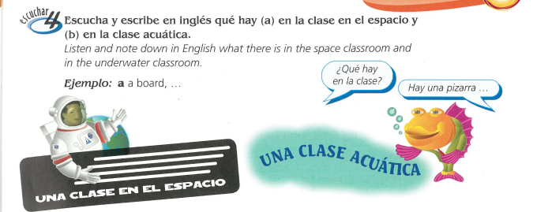

Slide 33
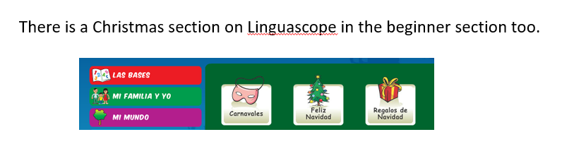
WEEK 7 – w/c 13th Dec
This week is assessment week. Spend some time revising all of the vocab on these slides so far and then email your teacher for the test papers. Also learn about Christmas in Spain by reading the following slides. Then make your own poster or Powerpoint about Christmas in Spain.

Slide 34
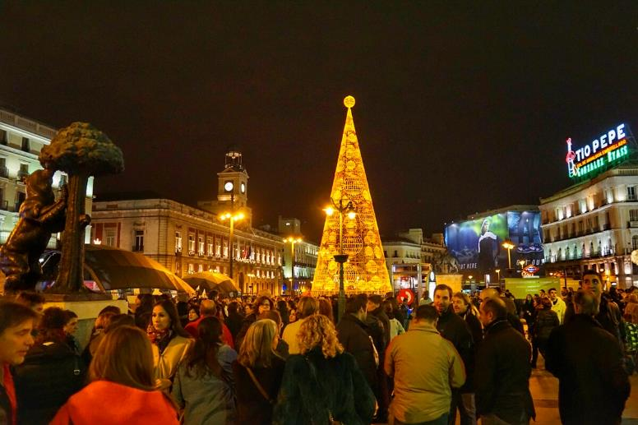

¡Feliz navidad!

Slide 35
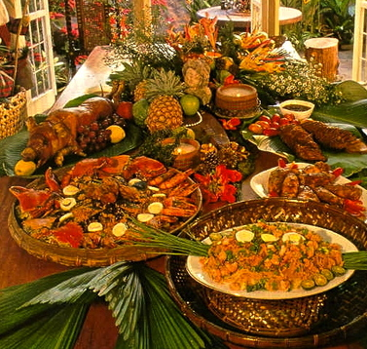
La nochebuena
La nochebuena is the night before Christmas day in Spain. This is when most families eat a large Christmas meal, usually turkey, pork or sea food. El turrón
is similar to nougat and is traditionally
eaten for dessert.
Then people usually go to Mass or
‘La Misa del Gallo’

Slide 36
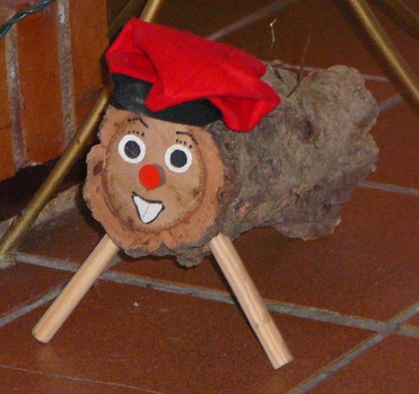
El Día de Navidad
El Día de Navidad is another day for celebrating with family.
There is a tradition of hitting a Christmas log in some parts of Spain. Children hit the log and receive presents from it.

Slide 37
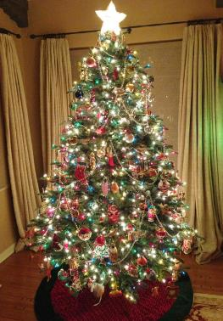
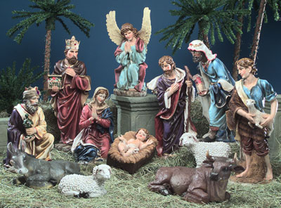
Un portal de Belén
In Spain, most houses display a Nativity scene which displays the scene of the birth of Jesus. What would you expect to see in it?
Some houses will also have a Christmas tree.

Slide 38
El día de los Santos inocentes
28th December is similar to April Fool’s Day in Great Britain. If you trick someone you call them ‘inocente, inocente’.

Slide 39
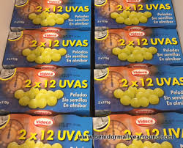
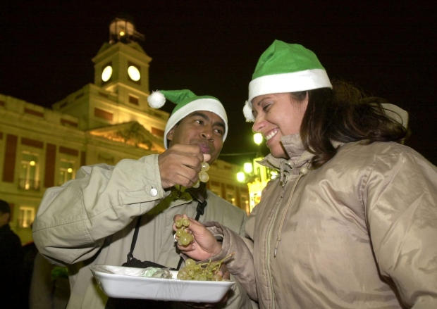
La noche vieja
New year’s eve is called La noche vieja in Spain. People go out to party. At midnight, the bells chime and traditionally everybody eats 12 grapes.

Slide 40


El Día de los Reyes
The 6th of January is one of the most important days in Spain over the Christmas period. On Epiphany, Spanish people receive presents to celebrate when the three kings gave presents to the Baby Jesus.
Children leave out shoes to be filled with presents instead of stockings!
There are the Tres Reyes Magos parades in the streets on the 5th January.

