Slide 1
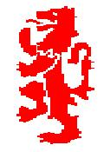
The Structure and Function of the Cardio-Respiratory System
Cirencester Kingshill School PE Department – GCSE PE
Chapter 1b
At the end of three theory lessons you will know …
Pathway of air through the body
Understand gaseous exchange
Cardiac Cycle
Key terminology such as Stroke Volume, Cardiac output…

Slide 2
Functions
What purpose does the Respiratory system serve?
To get Oxygen from the air into the lungs, which is then transported to the required muscles via our blood
To receive waste Carbon Dioxide, to exhale in the air.

Slide 3
Show me your H/W
USE TEXT BOOK TO CHECK IF YOU HAVE LABELLED THE DIAGRAM CORRECTLY – stick in book!

Slide 4
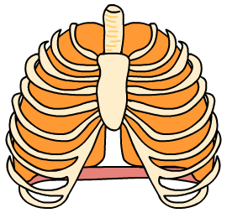
Mechanisms of breathing – Inspiration
When you breathe in:
Intercostal muscles pull ribs up and out
intercostal muscles between the ribs contract, pulling the chest walls up and out
the diaphragm muscle below the lungs contracts and flattens, increasing the size of the chest
the lungs increase in size, so the pressure inside them falls. This causes air to rush in through the nose or mouth.
Diaphragm contracts and moves down

Slide 5
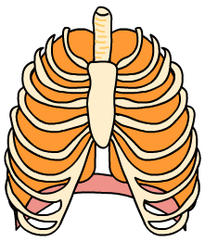
Mechanisms of breathing – Expiration
Ribs move in and down
When you breathe out:
Intercostal muscles between the ribs relax so that the chest walls move in and down.
The diaphragm muscle below the lungs relaxes and bulges up, reducing the size of the chest.
The lungs decrease in size, so the pressure inside increases and air is pushed up the trachea and out through the nose or mouth.
Diaphragm relaxes and bulges up

Slide 6
Complete this table …
 | INTERCOSTALS/RIBS | DIAPHRAGM | LUNGS
INSPIRATION
EXPIRATION

Slide 7
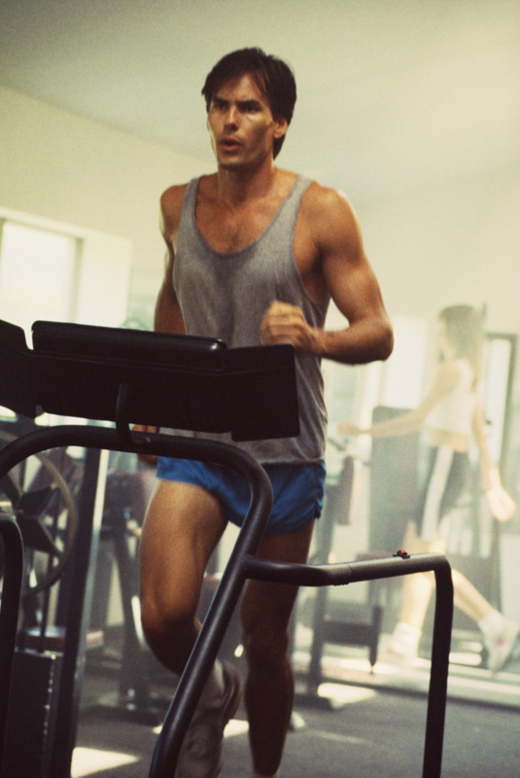
Breathing during exercise
During exercise the muscle cells use up more oxygen and produce increased amounts of carbon dioxide.
Your lungs and heart have to work harder to supply the extra oxygen and remove the carbon dioxide.
Your breathing rate increases and you breathe more deeply.
Heart rate also increases in order to transport the oxygenated blood to the muscles.
Notes:
Image © 2006 Jupiterimages Corporation

Slide 8
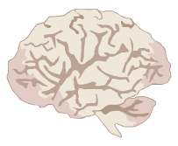
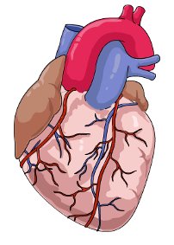
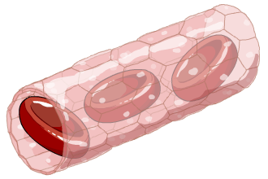
Breathing during exercise
Muscle cell respiration increases – more oxygen is used up and levels of CO₂ rise.
The brain detects increasing levels of CO₂ – a signal is sent to the lungs to increase breathing.
Breathing rate and the volume of air in each breath increase. This means that more gaseous exchange takes place.
The brain also tells the heart to beat faster so that more blood is pumped to the lungs for gaseous exchange.
More oxygenated blood gets to the muscles and more CO₂ is removed.

Slide 9
H/W
USE TEXT BOOK TO RESEARCH Lung Volumes …
Match the definitions and fill in the Spirograph.
Due 19/10

Slide 10
LUNG VOLUMES
Tidal volume is the amount you breathe in and out in one normal breath.
H/W Check!!
Respiratory rate is how many breaths you take per minute.
Minute volume is the volume of air you breathe in one minute.
Vital capacity is the maximum volume of air you can breathe out after breathing in as much as you can.
Residual volume is the amount of air left in your lungs after you have breathed out as hard as you can.
Notes:
Clarify and expand on the definitions with the students

Slide 11
H/W Check!!

Slide 12
Calculating minute volume
Remember:
Minute volume is the volume of air you breathe in one minute.
You can calculate a person’s minute volume by multiplying the volume of air they breathe in one breath, by their respiratory (breathing) rate.
Question
If you breathe 14 times in one minute (respiratory rate) and you breathe 0.5 litres in each breath, what is your minute volume?
Answer:
Minute volume = 14 × 0.5 litres
= 7.0 litres
Notes:
Get students to calculate the answer before revealing it.
Point out that at rest, the volume of air breathed in each breath will be the person’s tidal volume. During extreme exercise, it may be closer to their vital capacity.

Slide 13
What is GASEOUS EXCHANGE?

Slide 14
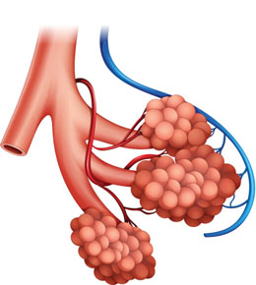
Gas exchange at the alveoli
The alveoli are bunches of tiny air sacks inside the lungs.
Each individual sack is called an alveolus.
When you breathe in, they fill with air.
The alveoli are covered in tiny capillaries (blood vessels).
Gases can pass through the thin walls of each alveolus and capillary, and into the blood stream.
Gases can also pass from the blood stream, into the alveolus.

Slide 15
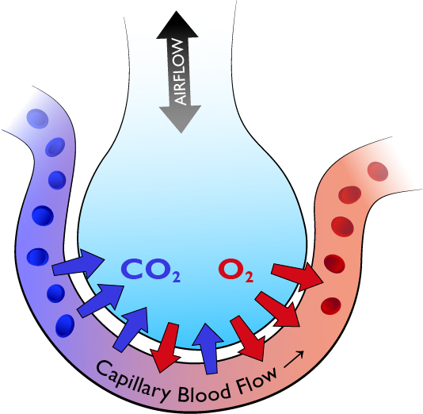
Task: Draw and explain the function of the alveoli
Equipment:
White board
Whiteboard pen Red and blue
Red and blue Smarties 3 of each! (two different colours)
Draw Alveoli outline
Use pages 11 and 12 to annotate and describe
After 8 mins we will go through some answers be prepared to share.
Take a picture of your finished diagram and annotations.
Email to yourself and print out and stick in your book for next lesson!

Slide 16
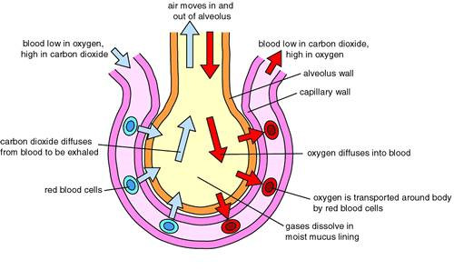
Copy or bullet point this diagram…
Use page 11 and 12 to create further notes on this process.

Slide 17
Exam-style questions
Describe the passage of oxygen from the nasal passages to the bloodstream.
David goes jogging once a week for 45 minutes.
David tries to increase his pace. He finds that he is forced to stop running and breathe hard for several minutes.
List two differences between the air that David inhales and the air that he exhales while jogging.
What two substances are used by David’s body cells to produce energy? What are the products of this reaction?
c) Explain why David had to stop.
d) How did breathing hard help him to recover?
Notes:
From the nasal passages, the oxygen in the air passes the larynx, down the trachea, into the bronchi. It then passes through the bronchioles and into the alveoli. Oxygen passes through the semi-permeable walls of the alveoli, into the capillaries which cover the alveoli walls.
a) There will be less oxygen, more carbon dioxide and more water vapour. b) Glucose and oxygen. The products are carbon dioxide and water. c) David had to stop because as exercise became more intense, his cardiovascular system could no longer supply his muscles with enough oxygen. Anaerobic respiration started, producing lactic acid. When the concentration of lactic acid in David’s muscles got too high, David was forced to stop and repay the oxygen debt. d) The body needs oxygen to neutralize lactic acid. Breathing hard after exercise also helps to get rid of any carbon dioxide that is left in the tissues.

Slide 18
CHECK you have all the terminology written down!!! Page 13
EXTENSION work…
Complete the
CHECK YOUR UNDERSTANDING QUESTIONS
(page 12 and 13)

Slide 19
CIRCULATORY SYSTEM

Slide 20
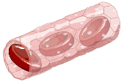
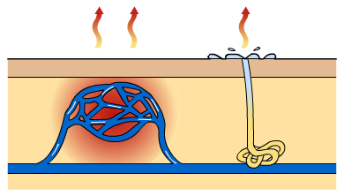
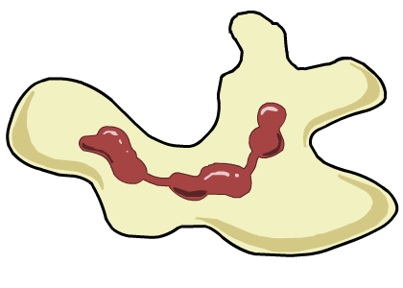
Functions of the blood
1. Transporting substances around the body. These include oxygen, glucose, carbon dioxide, nutrients, water and waste products.
2. Controlling body temperature.
3. Protecting the body. Blood contains cells and anti-bodies that fight infection and clotting agents to stop bleeding.

Slide 21
The Blood
Blood is the body’s means of transporting substances around. It transports:
oxygen from the lungs to the heart and then to the body’s tissues
carbon dioxide from the tissues to the heart and then to the lungs to be expired
materials like hormones from one organ to another
nutrients (especially glucose) and minerals from the intestines to the tissues
waste products to the kidneys.

Slide 22
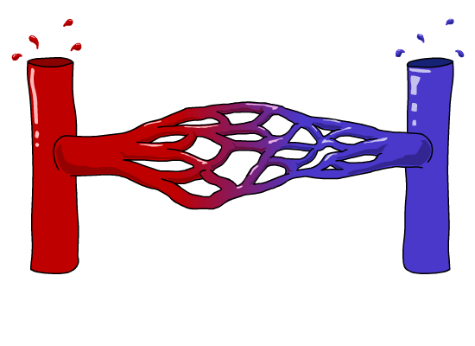
Blood Vessels
There are three types of blood vessels, as shown in this magnified part of the circulatory system.
blood from the heart
blood to the heart
artery
vein
carries blood away from
the heart
carries blood back into
the heart
carries blood to and from the body’s cells
Why are there different types of blood vessels?

Slide 23
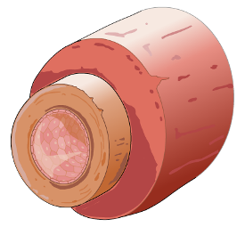
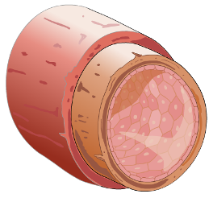
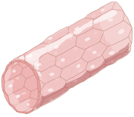
Blood Vessels
thick outer wall
thick inner layer of muscle and elastic fibres
narrow central tube (lumen)
ARTERY
thin outer wall
thin inner layer of muscle and elastic fibres
wide central tube (lumen)
CAPILLARY
VEIN
wall only one cell thick

Slide 24
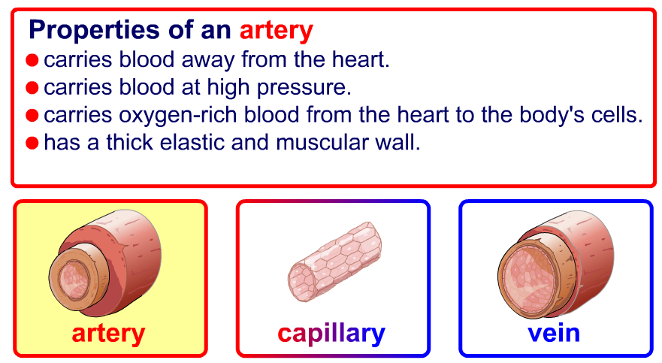
Arteries

Slide 25
Capillaries

Slide 26
Veins

Slide 27
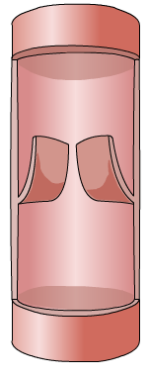
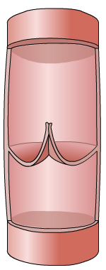
Veins
When blood is flowing against gravity, or when a vein is squeezed by muscle action, there is a risk that blood will flow in the wrong direction. Veins have valves to prevent backflow.
backflow
prevented
vein valve
open
vein valve
closed
blood to the heart
The valves allow blood to flow in the correct direction…
…but close if blood starts to flow in the wrong direction.

Slide 28
H/W
USE TEXT BOOK TO RESEARCH The Cardiac Cycle fill in your sheet …
(use your previous heart homework)
Due After half term 15/11

Slide 29
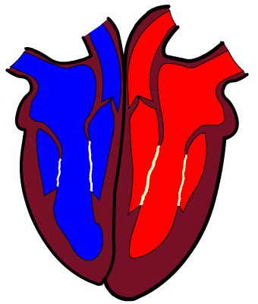
Cardiac system
H/W Check!!
The four chambers of the heart have special names:
An upper chamber is called an atrium (plural: atria).
right
atrium
left
atrium
right
ventricle
left
ventricle
A lower chamber is called a ventricle.

Slide 30
Cardiac system
H/W Check!!
Here are some other important parts of the heart:
The semi-lunar valves prevent expelled blood flowing back into the heart.
The walls are made of cardiac muscle.
The wall dividing the left and right sides of the heart is called the septum.
Bicuspid (mitral) valve
Tricuspid valve
These two valves prevent blood flowing back into the atria from the ventricles.

Slide 31
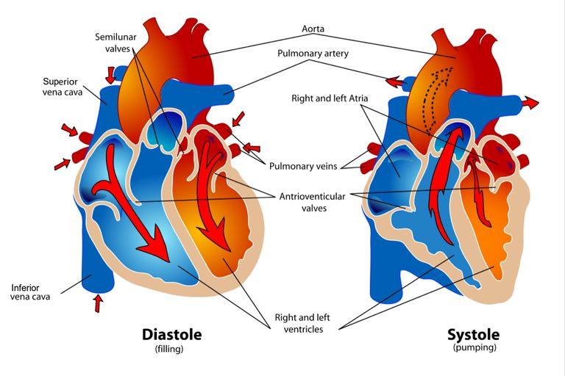
Cardiac Cycle
H/W Check!!

Slide 32
Cardiac Cycle
H/W Check!!
The cardiac cycle is the sequence of events that occurs when the heart beats. As the heart beats, it circulates blood through pulmonary and systemic circuits of the body.
In the diastole phase, the heart ventricles are relaxed and the heart fills with blood.
In the systole phase, the ventricles contract and pump blood out of the heart and to arteries.
One cardiac cycle is completed when the heart chambers fill with blood and blood is then pumped out of the heart.

Slide 33
The heart during exercise
Each individual has a maximum heart rate – the fastest that their heart is able to beat. Testing it properly is difficult and unpleasant, as it involves pushing your body to its absolute limit.
However, maximum heart rate can be estimated using a simple formula:
Maximum Heart Rate (MHR) = 220 – age
So, a 25 year-old would have a maximum heart rate of
220 – 25
= 195 bpm
What would your maximum heart rate be?
Notes:
It is generally accepted that maximum heart rate is not greatly affected by training and is constant. Get students to work out a variety of maximum heart rates for various ages. Emphasise that the unit of measurement is beats per minute (bpm). Consider referring to a maximum heart rate chart. Target zones are covered in the Principles of Training presentation.

Slide 34
Heart rate, stroke volume and cardiac output
The pulse rate is not the only way of measuring the heart.
Stroke volume is the amount of blood pumped
out of the left ventricle per beat.
Cardiac output is the amount of blood pumped
out of the left ventricle of the heart per minute.
Cardiac output can be calculated by multiplying the stroke volume by the heart rate:
cardiac output = stroke volume × heart rate
What is the cardiac output of someone with a heart rate of 60 bpm and stroke volume of 90 ml?
Notes:
60 × 90 = 5400 ml

Slide 35
The heart during exercise
During exercise, the body uses up oxygen and nutrients at a much faster rate. To keep the body supplied with what it needs, the heart beats faster and with greater force.
This means that the heart rate and stroke volume increase.
What do you think happens to the cardiac output?
Regular exercise causes changes to the heart.
The heart gets larger
The muscular wall become thicker and stronger
Stroke volume at rest increases, leading to a lower resting heart rate.
Notes:
A top athlete could have a resting heart rate as low as 40 bpm.

Slide 36
Can you remember all these keywords?
Aorta
Vena cava
Pulmonary artery
Pulmonary vein
Pulmonary circulation
Systemic circulation
Oxygenated
Deoxygenated
Arteries
Veins
Capillaries
Lumen
Atria
Ventricles
Septum
Tricuspid valve
Bicuspid (mitral) valve
Semi-lunar valve
Heart rate
Stroke volume
Cardiac output
Blood pressure
Vasodilation
Vasoconstriction
Red blood cells
White cells
Platelets
Plasma
Blood doping

Slide 37
CHECK the terminology (page 16)
EXTENSION work…
Complete the
CHECK YOUR UNDERSTANDING QUESTIONS
(page 17)

