Slide 1
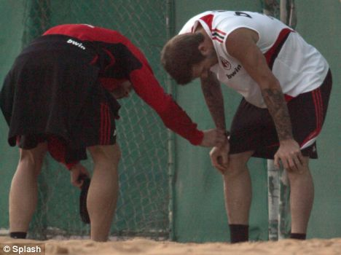
Cirencester Kingshill School
PE Department – GCSE PE
Chapter 1c
Anaerobic and Aerobic Exercise
At the end of one theory lesson you will know …
The immediate effects of exercise on the respiratory system
How levels of lactic acid, water and heat are affected by exercise
How the body recovers from exercise
Recovery rates
The long term effects of exercise on the heart, lungs, skeleton and muscles
Notes:
1

Slide 2
Immediate effects on the respiratory system
Exercise causes the muscles to use more oxygen.
This means that the lungs must work harder and faster to keep the body supplied with oxygen and also to exhale the carbon dioxide that is produced. This is why exercise makes you out-of-breath.
During aerobic exercise, the lungs are able to work fast enough to supply the muscles with oxygen.
During anaerobic exercise, the lungs can’t supply enough oxygen. Once the exercise is over, breathing remains fast to repay the ‘oxygen debt’.

Slide 3
Immediate effects on the circulatory system
The heart and blood vessels work to transport the oxygen from the lungs to the muscles where it is needed. Glucose and other substances needed by the muscles are transported in the blood too.
The by-products of respiration, including carbon dioxide and lactic acid, are also carried away from the muscles.
glucose
+ oxygen
energy
carbon dioxide
+
+ water
glucose
energy
+ lactic acid

Slide 4
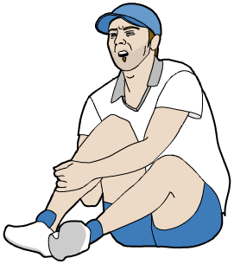
Lactic acid is produced during anaerobic respiration. This happens when there is not enough oxygen for normal aerobic respiration to take place.
glucose
energy
+ lactic acid
Lactic acid is responsible for the pain you feel in your muscles when they get tired.
When too much of it builds up in a muscle, it can prevent the muscle contracting. At this point, the performer’s muscles will cramp and they will be forced to stop.

Slide 5
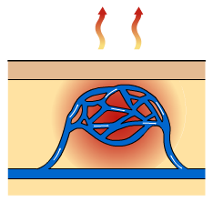
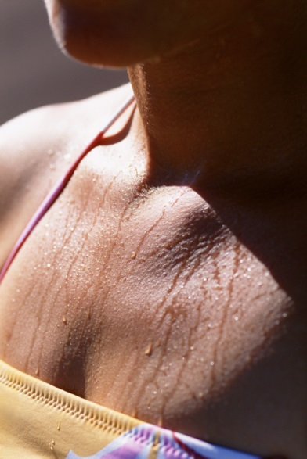
The immediate effects: heat loss
The body has two main ways of getting rid of the extra heat produced by muscles during exercise.
Vasodilation
The capillaries close to the surface of the skin dilate, allowing more blood to flow into them. Because the blood is closer to the skin, more heat is lost to the environment.
Sweating
Sweat glands in the skin excrete sweat – a mixture of water, salts and urea. As the sweat evaporates, it takes heat away with it.
Notes:
Sweat image © 2006 Jupiterimages Corporation

Slide 6
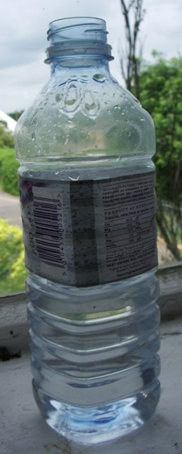
The immediate effects: water loss
When you sweat, water is lost from the body. Water is vital to maintaining proper body functions.
The body produces less urine to compensate, but during prolonged exercise or in hot weather, this is often not enough. Extra water must also be consumed.
The body does not only lose water – it also loses important salts called electrolytes. These are necessary in many areas of the body, including the nervous system.
Salts can be replaced during exercise by drinking isotonic drinks, or eating foods rich in these minerals.
Severe salt depletion can lead to cramps, fainting and, in extreme cases, death.
Notes:
Extreme cases of salt depletion may occur during ultra-long distance activities in very hot and humid climates. Strenuous hiking in tropical climates and dessert marathons are examples of high-risk activities.

Slide 7
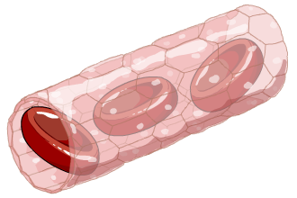
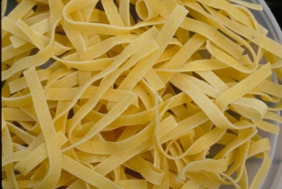
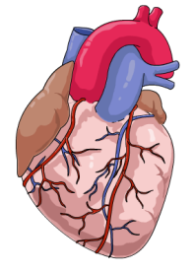
Recovery rates
Your recovery rate is how quickly your body returns to normal following a period of exercise.
Recovery rate is a good indicator of fitness. The quicker you recover, the fitter you are.
As you recover from exercise, changes happen in the following areas:
Lactic acid levels in the blood
Glycogen stores
Heart rate
Notes:
Pasta image © 2006 Jupiterimages Corporation

Slide 8
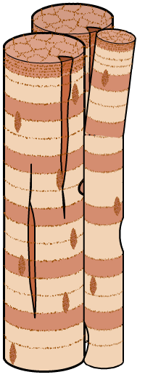
Muscles
Strenuous exercise can cause slight damage to the muscle fibres.
It is actually through this process of damage and repair that muscles become stronger.
As you would expect, your body needs time to repair the damage done to muscles during exercise or training.
After exercise, we sometimes experience stiffness or soreness for a period of time until our muscles have fully recovered.
This soreness can also be caused by lactic acid remaining in the muscles.

Slide 9
The long term effect of exercise
As you would expect, training causes the body to adapt and grow stronger.
The following areas are particularly affected:
the heart
the lungs
WHAT IS HYPERTROPHY?
COMPLETE PRACTICE QUESTIONS pg 25

Slide 10
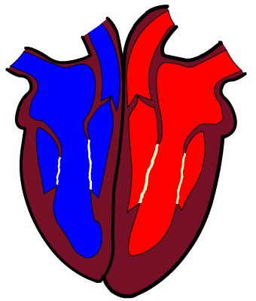
Aerobic exercise strengthens the heart
The heart becomes bigger.
The walls become thicker and stronger.
The result is that the heart becomes a more efficient pump.
Resting heart rate gets slower as you get fitter, because the heart needs fewer beats to pump blood round the body.
Training also results in new blood vessels growing to improve the supply of blood to the muscles.

Slide 11
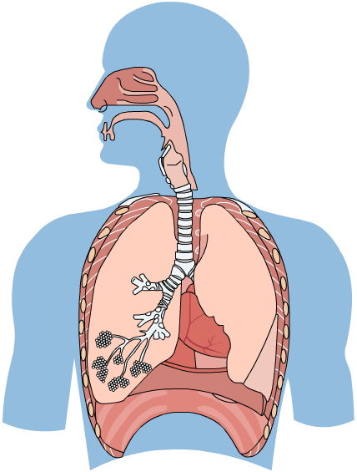
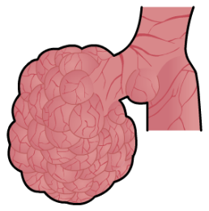
The long term effect of exercise – the lungs
Training makes the lungs more effective at supplying the body with oxygen.
New blood vessels grow around the alveoli, making gas exchange more efficient.
The muscles involved in breathing in and out become stronger and can work for longer.

Slide 12
The effects of exercise

Slide 13
Exam-style questions
1. Describe the changes that occur in the functioning of the respiratory system during moderate, sustained exercise.
2. Neena has just completed a 10 km fun run.
Explain how the run will have affected the levels of lactic acid and glycogen in her body.
Suggest two things that she could do to aid her recovery.
Notes:
1. Heart rate increases, stroke volume increases, arteries widen, breathing rate increases, volume of air in each breath increases.
a) Intercostal muscles and diaphragm grow stronger, chest cavity increases in size, vital capacity increases, more capillaries grow around the alveoli. b) The bones used in the training grow denser and stronger.
a) The level of lactic acid will have gone up, especially in her leg muscles – lactic acid is produced during respiration. The levels of glycogen in her muscles and liver will have decreased as it is used up in respiration. b) Neena could perform a cool-down consisting of 10 minutes of light aerobic work, followed by stretching. She should also eat a carbohydrate-rich meal to replenish her glycogen stores.

