Slide 1
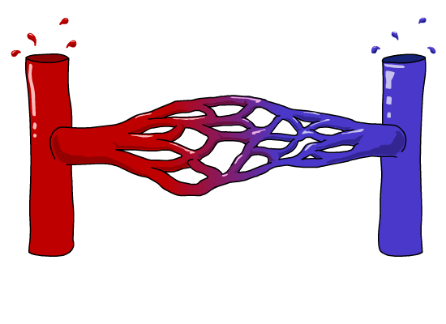
Blood Vessels
Why are there different types of blood vessels?

Slide 2
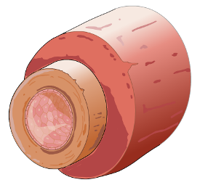
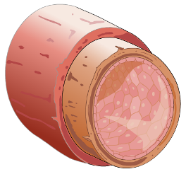
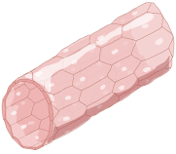
Blood Vessels
ARTERY
CAPILLARY
VEIN

