Slide 1
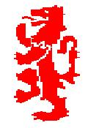
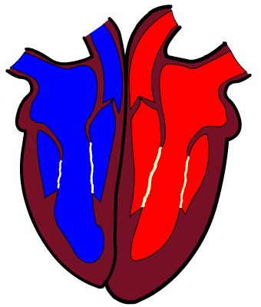
The Heart
Cirencester Kingshill School PE Department – GCSE PE
Chapter 1b

Slide 2
The Effects of Exercise
Cirencester Kingshill School PE Department – GCSE PE
Chapter 1c
IMMEDIATE EFFECTS | LONG TERM EFFECTS
H L | H
W L | H
O D | L
Other Immediate Effects …

Slide 3
Cirencester Kingshill School PE Department – GCSE PE
Chapter 1c
How do we recover?
Cool Down
Rehydration
Ice Baths

