Slide 1
Year 9 Product Design
Careers project
Name
Design & Technology group
Pathway
Clock Project
Practical Assessment:
Final Assessment:

Slide 2
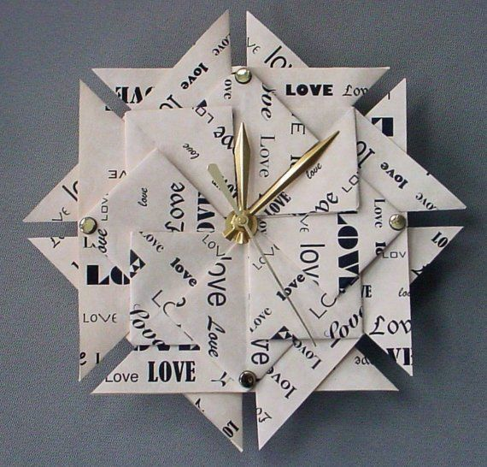

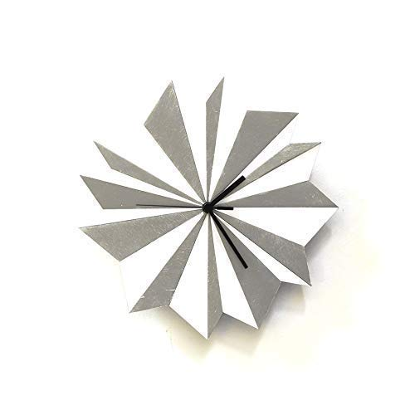

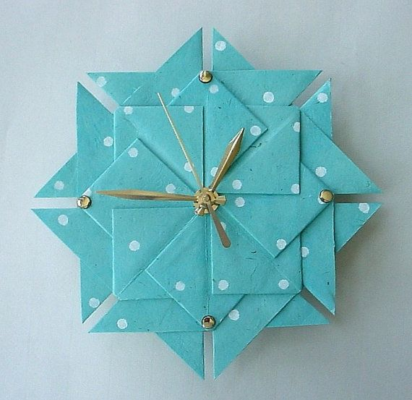
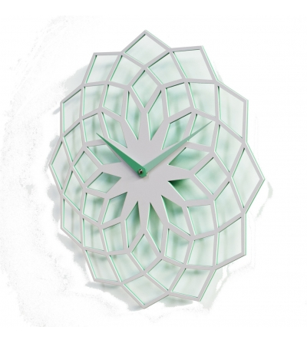
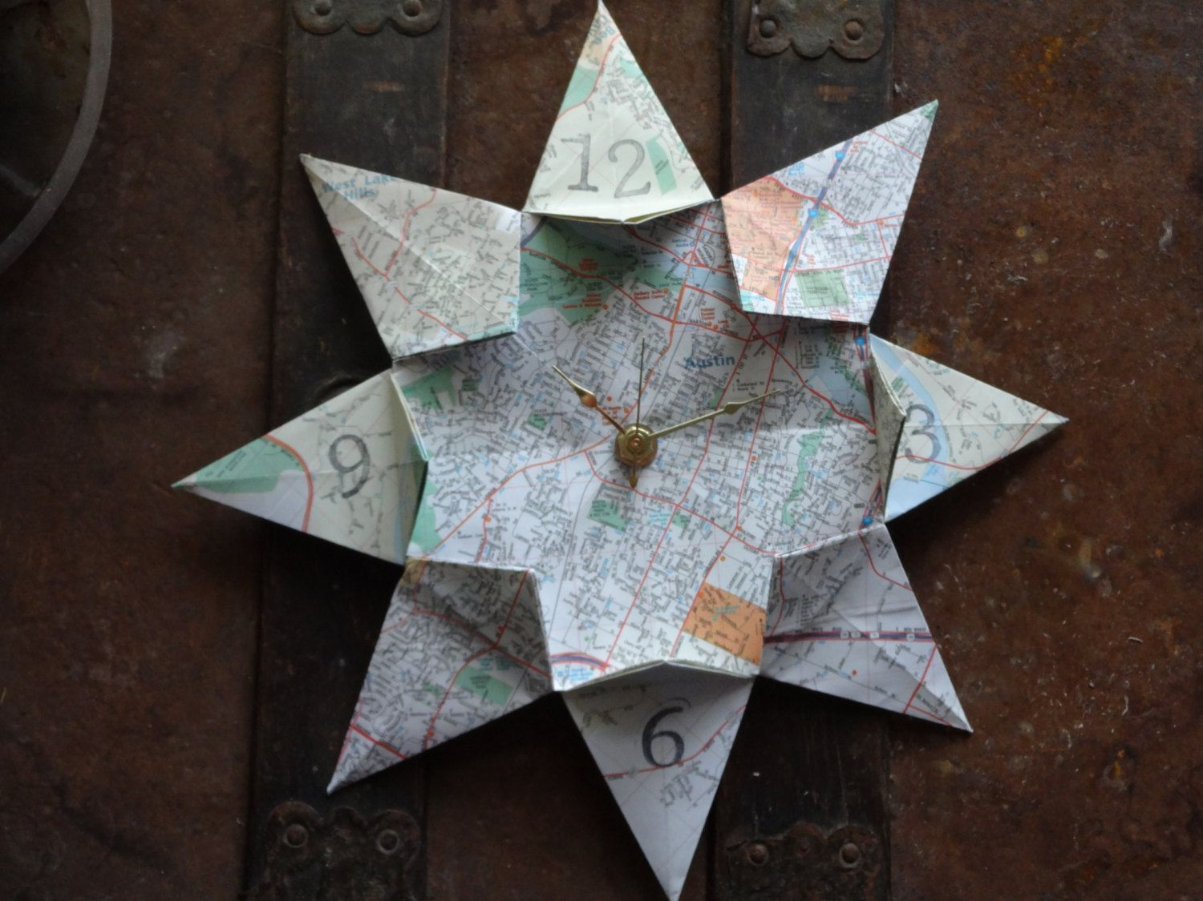

Slide 3
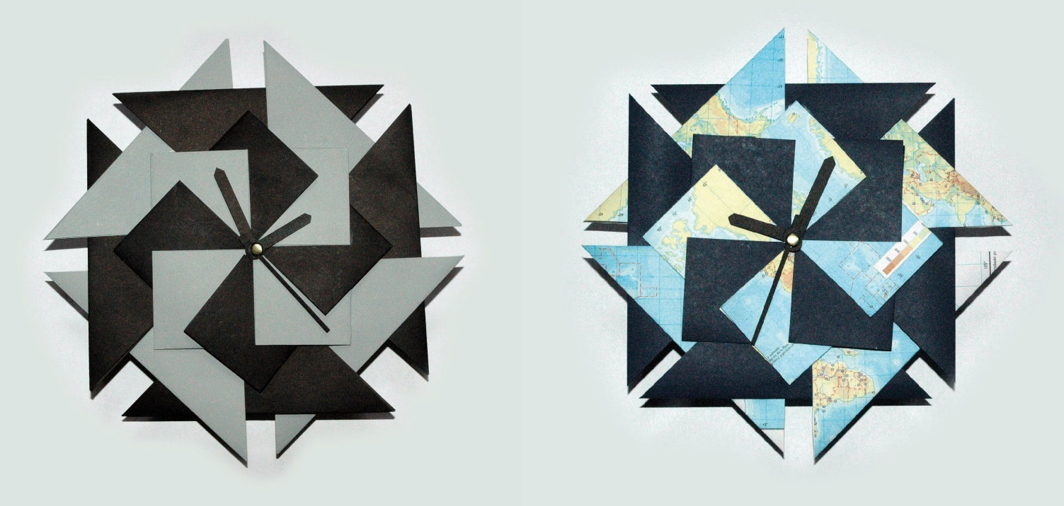
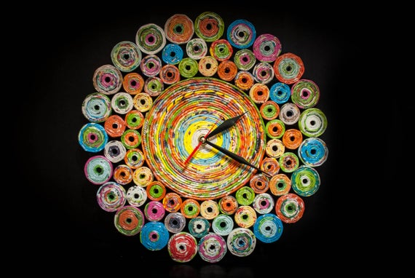
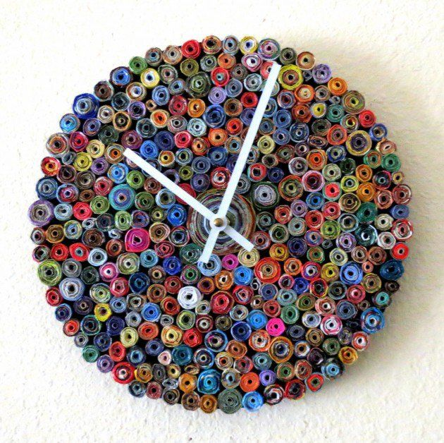
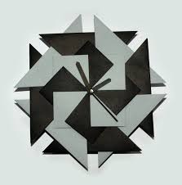
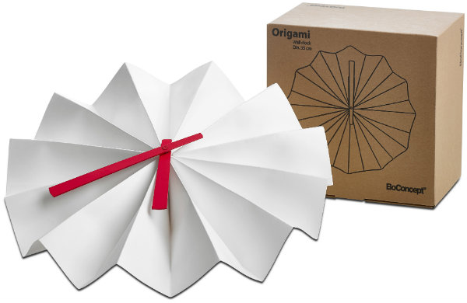
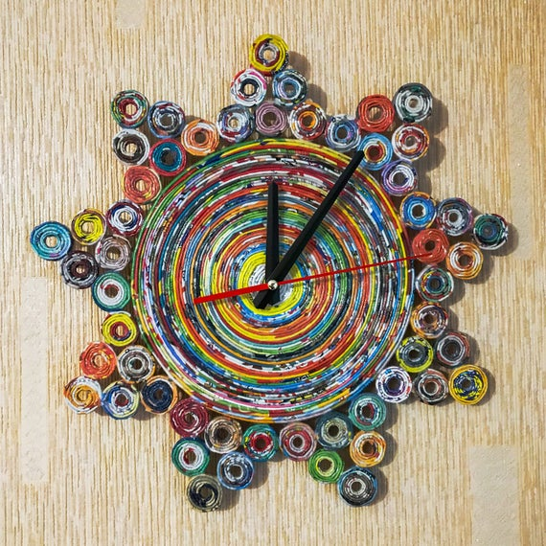

Slide 4
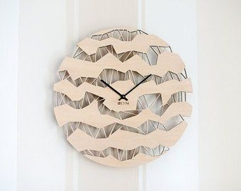
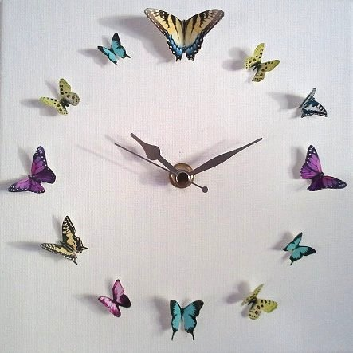



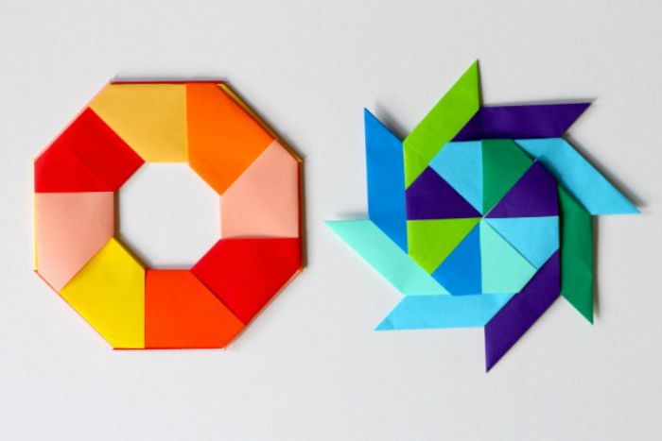

Slide 5

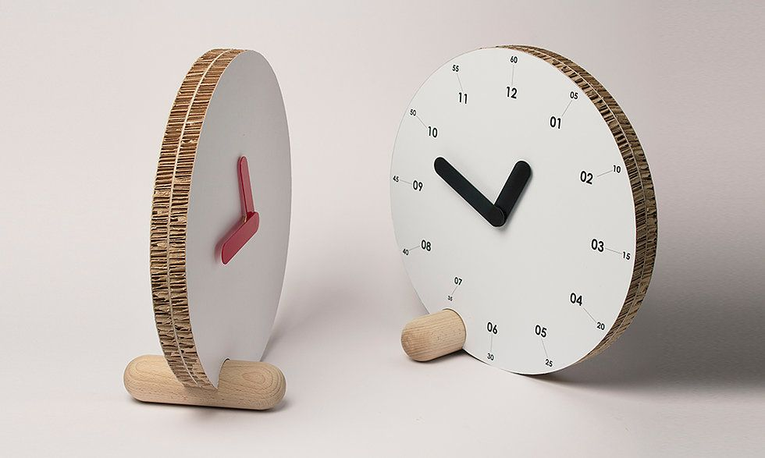
https://www.youtube.com/watch?v=n01fsCDWAUc&safe=true

Slide 6
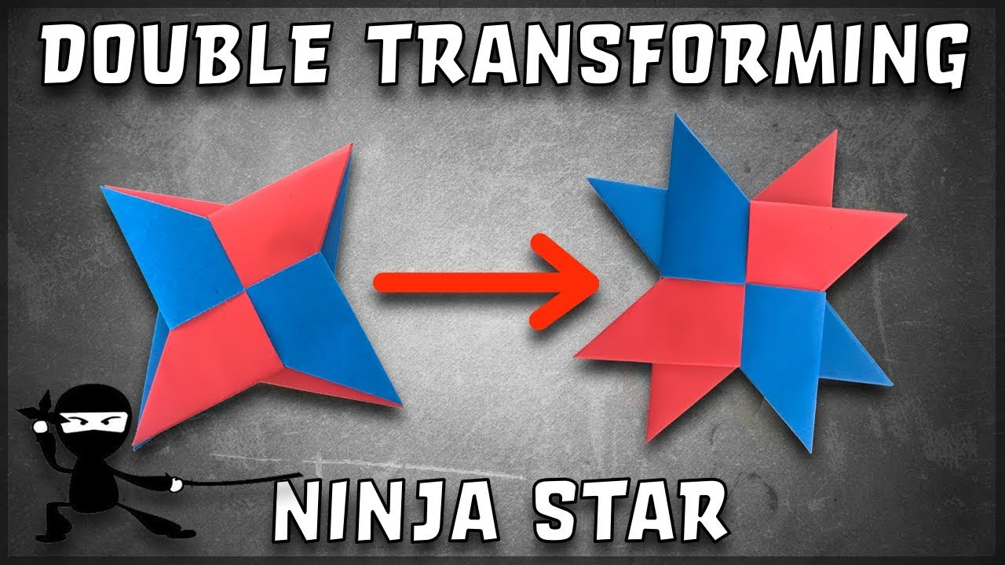
https://www.youtube.com/watch?v=fP8njkoBVCs&safe=true

Slide 7

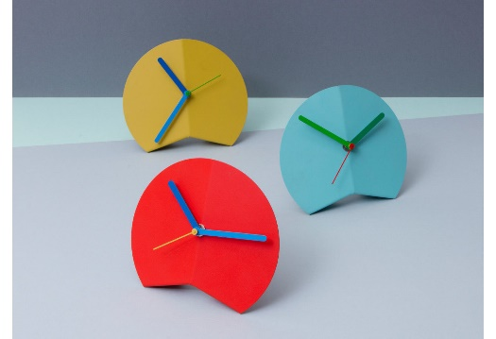

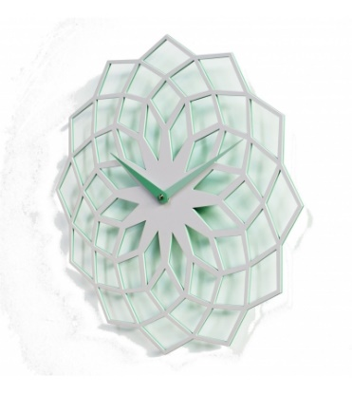

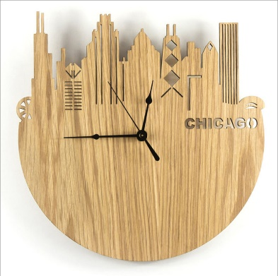
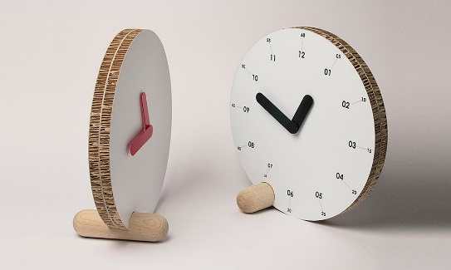


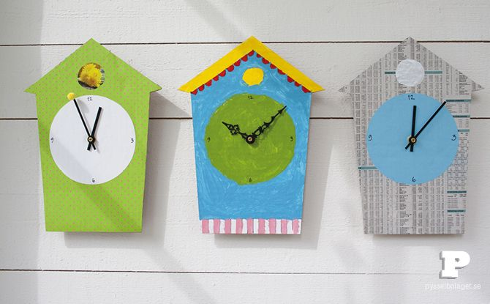

Slide 8
https://www.youtube.com/watch?v=g5vRCbYQ5Mo&safe=true

Slide 9
Homework – when completed stick over this page
2
In Design and Technology we would like you to understand and appreciate the characteristics of good and bad design.
Task: You are to write about one product you cannot live without and one product you wish you had never bought or been given. Explain what the features or characteristics are and why they are so successful or not!
Things to include:
What exactly are your two products?
Why have you chosen them?
What is so good or bad about them?
How could you improve the design?
Give an example where a product by a well known designer / engineer has been unsuccessful and explain why. For example Clive Sinclair’s electric car or James Dyson’s Ball barrow.
How should I present it?
On A4 paper
Remember a title and any sub-titles
Remember to support your written work with some images
Remember to put your name on your work
Homework Success Criteria
+ You have followed and included all of the “things to include” and presented your work very well by using titles, sub titles and images or drawings to support your written work. All written work must be in your own words and include your own opinions.
= You have followed and included some of the “things to include” and presented your work well by using a title and images or drawings to support your written work. All written work must be in your own words.
– You have followed and included few of the “things to include”. Your work may not be presented appropriately as it will be missing titles, sub titles or your name. There will be lots of information that is copied and pasted from the internet with no opinions of your own.

Slide 10
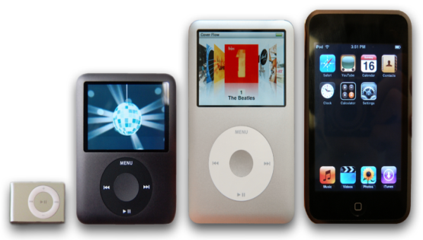
Homework – when completed stick over this page
4
In Product Design you need examine existing design ideas and how the design or/and technology has been developed to further improve the function and user experience.
Task: You are to investigate one product that has been developed examining the original product features and characteristics and comparing them to what are they like now and what they could be in the future?
Things to include:
A drawing or image of the product in the past and after being developed.
Explain in detail why you chosen to investigate the product.
Explain in detail how the product’s design features and characteristics have been developed for better or worse.
Draw a design idea for the next development to the product and explain how your development (s) will further improve the function and user experience.
How should I present it?
On A4 paper
Remember a title and any sub-titles
Remember to support your written work with some images
Remember to put your name on your work
?
Homework Success Criteria
+ You have followed and included all of the “things to include” and presented your work very well by using titles, sub titles and images or drawings to support your written work. All written work must be in your own words and include your own opinions.
= You have followed and included some of the “things to include” and presented your work well by using a title and images or drawings to support your written work. All written work must be in your own words.
– You have followed and included few of the “things to include”. Your work may not be presented appropriately as it will be missing titles, sub titles or your name. There will be lots of information that is copied and pasted from the internet with no opinions of your own.

Slide 11
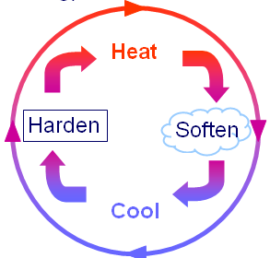
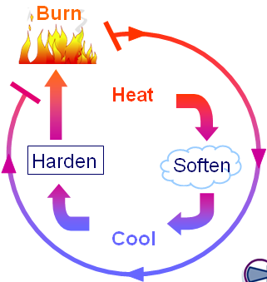
Homework – when completed stick over this page
7
In Product Design you need to learn about the different properties and characteristics of materials.
Task: You are to explain the difference between a Thermo and Thermo-set plastic
Things to include:
What is the main difference between a thermo and thermo-set plastic and why can one be reheated when the other cannot.
http://www.technologystudent.com/designpro/plastic1.htm
Explain where acrylic is used in some common everyday products.
Investigate what glue can be used to stick acrylic.
How should I present it?
On A4 paper
Remember a title and any sub-titles
Remember to support your written work with some images
Remember to put your name on your work
Homework Success Criteria
+ You have followed and included all of the “things to include” and presented your work very well by using titles, sub titles and images or drawings to support your written work. All written work must be in your own words and include your own opinions.
= You have followed and included some of the “things to include” and presented your work well by using a title and images or drawings to support your written work. All written work must be in your own words.
– You have followed and included few of the “things to include”. Your work may not be presented appropriately as it will be missing titles, sub titles or your name. There will be lots of information that is copied and pasted from the internet with no opinions of your own.

Slide 12
Homework – when completed stick over this page
9
In Product Design when making you need to make sure that your practical work is made with a high level of precision. To help you achieve this precision you will use templates and jigs as a method of quality control.
Task: The Science faculty have asked you to design and make 20 pencil holders each with 20 holes (2 rows of 10). They all need to be exactly the same and all the drilled holes must be in the same position in each pencil holder. You are to design a drilling jig that the Science Technician can use to drill through into each pencil holder.
Things to include:
Look carefully at the pencil holder required.
Draw the drilling jig and draw instructions as a step by step storyboard on how to use it for the Science Technician to follow.
Try to draw in 3D or as an Orthographic drawing (Plan – Top, Front, Side views).
Colour your drawing of the jig resembling the materials you think that it should be made of.
How should I present it?
On A4 paper
Remember a title and any sub-titles
Remember to put your name on your work
Homework Success Criteria
+ You have followed and included all of the “things to include” and presented your work very well by using titles, sub titles and images or drawings to support your written work. All written work must be in your own words and include your own opinions.
= You have followed and included some of the “things to include” and presented your work well by using a title and images or drawings to support your written work. All written work must be in your own words.
– You have followed and included few of the “things to include”. Your work may not be presented appropriately as it will be missing titles, sub titles or your name. There will be lots of information that is copied and pasted from the internet with no opinions of your own.

Slide 13
Homework – when completed stick over this page
11
In Product Design when making you need to investigate emerging technologies in manufacturing.
Task: Investigate the processes of laser cutting and three-dimensional printing. What is it, what do you need, how is it done and what sorts of things can be made using the two methods.
Things to include:
  Laser Cutting 3D Printing
  What is it?
  What do you need?
  How is it done?
  What sorts of things can be made
  Advantages over traditional making methods
  Disadvantages over traditional methods
How should I present it?
On A4 paper
Remember a title and any sub-titles
Remember to put your name on your work
Homework Success Criteria
+ You have followed and included all of the “things to include” and presented your work very well by using titles, sub titles and images or drawings to support your written work. All written work must be in your own words and include your own opinions.
= You have followed and included some of the “things to include” and presented your work well by using a title and images or drawings to support your written work. All written work must be in your own words.
– You have followed and included few of the “things to include”. Your work may not be presented appropriately as it will be missing titles, sub titles or your name. There will be lots of information that is copied and pasted from the internet with no opinions of your own.

Slide 14
Homework – when completed stick over this page
13
In Product Design you need to be creative with your design ideas and design to solve a problem or meet a need.
Task: You need to design a product / invention that meets a specific problem or person’s specific need. It must be completely original and feature at least one unique selling point (USP)
Things to include:
Write in detail what is the problem or need
Who specifically is the product for?
What is /are the Unique Selling Points (USP’s)?
Draw the product / invention.
Colour in your drawing.
Label all the parts of your drawing.
Think about if you can include smart materials in your product / invention like thermo chromic ink that changes colour with changes in temperature.
How should I present it?
On A4 paper
Remember a title and any sub-titles
Remember to put your name on your work
Homework Success Criteria
+ You have followed and included all of the “things to include” and presented your work very well by using titles, sub titles and images or drawings to support your written work. All written work must be in your own words and include your own opinions.
= You have followed and included some of the “things to include” and presented your work well by using a title and images or drawings to support your written work. All written work must be in your own words.
– You have followed and included few of the “things to include”. Your work may not be presented appropriately as it will be missing titles, sub titles or your name. There will be lots of information that is copied and pasted from the internet with no opinions of your own.

Slide 15
Homework – when completed stick over this page
14
In Product Design you need to learn about creativity in design and how you can keep your design ideas imaginative.
Task: You are to investigate the history of a design company called Alessi.
Things to include:
Who are Alessi and when did it all begin?
Who are the key designers at Alessi?
What do you think of the company’s design style?
What are you favourite Alessi products and why are they your favourite?
How should I present it?
On A4 paper
Remember a title and any sub-titles
Remember to support your written work with some images
Remember to put your name on your work
Check these out – http://www.designcouncil.org.uk/Case-studies/Alessi/
http://www.alessi.com/en/company/history
Homework Success Criteria
+ You have followed and included all of the “things to include” and presented your work very well by using titles, sub titles and images or drawings to support your written work. All written work must be in your own words and include your own opinions.
= You have followed and included some of the “things to include” and presented your work well by using a title and images or drawings to support your written work. All written work must be in your own words.
– You have followed and included few of the “things to include”. Your work may not be presented appropriately as it will be missing titles, sub titles or your name. There will be lots of information that is copied and pasted from the internet with no opinions of your own.

