Slide 1
Year 8 Product Design
Young Enterprise Project
Name
Design & Technology group
Pathway
Project Assessment :

Slide 2
Homework – when completed stick over this page
3
In Design and Technology we would like you to understand and appreciate the work of product designers, fashion designers, engineers, chefs.
Task: You are to complete a profile on a designer and 1 example of their work
Things to include:
Who is she / he?
What is she / he famous for?
Examine in detail one example of their work and explain why you have chosen it
What do you think about her / his design style?
Explain how you could further develop the design to enhance the aesthetics / function / ergonomics
How should I present it?
On A4 paper
Remember a title and any sub-titles
Remember to support your written work with some images
Remember to put your name on your work
Homework Success Criteria
+ You have followed and included all of the “things to include” and presented your work very well by using titles, sub titles and images or drawings to support your written work. All written work must be in your own words and include your own opinions.
= You have followed and included some of the “things to include” and presented your work well by using a title and images or drawings to support your written work. All written work must be in your own words.
- You have followed and included few of the “things to include”. Your work may not be presented appropriately as it will be missing titles, sub titles or your name. There will be lots of information that is copied and pasted from the internet with no opinions of your own

Slide 3
Homework – when completed stick over this page
1
In Design and Technology we would like you to understand and appreciate Iconic Product Designs
Task: You are to complete a profile on your chosen Iconic Design
Things to include:
What is the product?
Why did you choose the product?
Why do you think it is a DESIGN ICON?
Who is the designer or company that designed it?
What do you think about the FORM of the product?
What do you think about the FUNCTION of the product?
How should I present it?
On A4 paper
Remember a title and any sub-titles
Remember to support your written work with some images
Remember to put your name on your work
Homework Success Criteria
A – You have followed and included all of the “things to include” and presented your work very well by using titles, sub titles and images or drawings to support your written work. All written work must be in your own words and include your own opinions.
B- You have followed and included some of the “things to include” and presented your work well by using a title and images or drawings to support your written work. All written work must be in your own words.
C – You have followed and included few of the “things to include”. Your work may not be presented appropriately as it will be missing titles, sub titles or your name. There will be lots of information that is copied and pasted from the internet with no opinions of your own

Slide 4
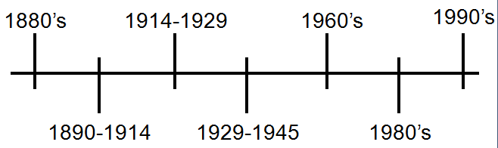
Homework – when completed stick over this page
9
In Product Design it is both interesting and helpful to examine the history of the product that you are designing and making.
Task: Examine the technological advancements of playing music. Explore the history along a timeline from the gramophone – cassette tape – CD – MP3 players.
Things to include:
You need to collect images of device that play music and trace the history of playing music along a timeline.
Write next to each what the key dates were and who were the key people who invented or were involved in each technological advancement in playing music.
In your timeline predict what technology will be next for playing music.
How should I present it?
On A4 paper
Remember a title and any sub-titles
Remember to put your name on your work
?
Homework Success Criteria
+ You have followed and included all of the “things to include” and presented your work very well by using titles, sub titles and images or drawings to support your written work. All written work must be in your own words and include your own opinions.
= You have followed and included some of the “things to include” and presented your work well by using a title and images or drawings to support your written work. All written work must be in your own words.
- You have followed and included few of the “things to include”. Your work may not be presented appropriately as it will be missing titles, sub titles or your name. There will be lots of information that is copied and pasted from the internet with no opinions of your own

Slide 5
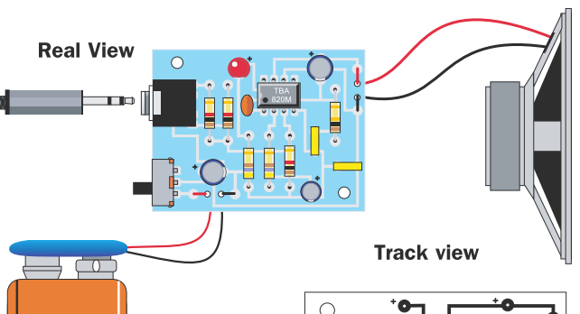
Identify each component on your circuit and write it in the box
In the 3 boxes identify and write down what each of the 3 main components does in your circuit.
6
A……………..... determines the flow of current in an electrical circuit
A……………..... stores electrical charge
A……………..... is a Diode that lasts for a long time and requires very little power
…………….is the measure of how much electric charge flows through a circuit.
……….is the measure of the difference in electrical energy between two parts of a circuit.
The energy in a sound wave can be measured using …………………..

Slide 6
Research on Woods: Using words and diagrams explain where softwood, hardwood and manufactured woods come from
Write 2 examples of softwoods, hardwoods and man made woods in here.
11
Softwood
Draw a coniferous tree in here
Name
Characteristics
Properties
Hardwood
Draw a deciduous tree in here
Manufactured Woods
Draw how ply wood is made in here

Slide 7
Research Finishes for Wood
12
Varnish
What is it and how is it applied?
Good points for varnishing are:
Bad points for varnishing are:
Shellac (white polish)
What is it and how is it applied?
Good points for using white polish are:
Bad points for using white polish are:
Wax
What is it and how is it applied?
Good points for using wax are:
Bad points for using wax are
Wood Stain
What is it and how is it applied?
Good points for using stain are:
Bad points for using stain are
Colours to make Green are:
Orange are:
Purple are:

