Slide 1
GCSE 3D design- Jewellery
Three-dimensional design is defined here as the design, prototyping and modelling or making of primarily functional and aesthetic products, objects, and environments (gardens, buildings, theatre sets), drawing upon intellectual (thinking), creative and practical skills.
Knowledge and understanding
The way sources inspire the development of ideas relevant to three-dimensional design including:
how sources relate to historical, contemporary, cultural, social, environmental and creative contexts
how ideas, feelings, forms, and purposes can generate responses that address specific needs, be these personal or determined by external factors such as the requirements of an individual client's expectations, needs of an intended audience or details of a specific commission.
The ways in which meanings, ideas and intentions relevant to three-dimensional design can be communicated include the use of:
figurative and non-figurative forms of representation, stylisation, simplification, exaggeration, the relationship between form and surface embellishment, constructional considerations and imaginative interpretation
visual and tactile elements such as:
Colour, line,form,tone,texture,space,proportion,decoration,scale,structure,shape,pattern
Skills
Within the context of three-dimensional design, students must demonstrate the ability to use three-dimensional techniques and processes, appropriate to students’ personal intentions, for example:
model making
constructing
surface treatment
assembling
modelling
And to use media and materials, as appropriate to students’ personal intentions, for example:
drawing materials
clay
wood
metal
plaster
plastic
found materials.

Slide 2
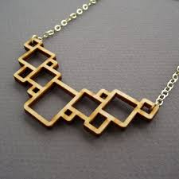
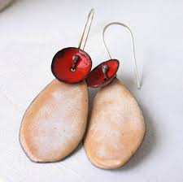
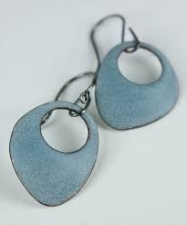
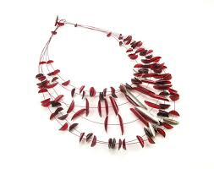
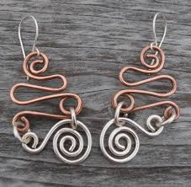
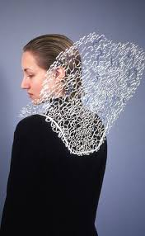
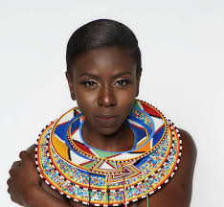
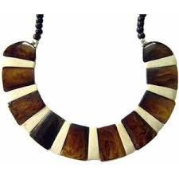
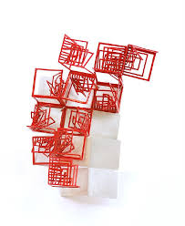
GCSE 3D design Controlled assessment
AQA ART & DESIGN 3D
Jewellery – Tatty Divine, Ethnic, Art Deco
Artists, designers and craftspeople make jewellery from a variety of materials such as paper, clay, wood, metal, plastic, glass, stone and found materials. Some pieces may have a particular religious, social or personal significance for the wearer.
From studies of suitable examples, design and make your own piece of jewellery which will have significance for the wearer.
Your coursework will be assessed by the following assessment objectives (AO):
AO1. Develop ideas through investigation
AO2. Refine work by exploring ideas
AO3. Record ideas
AO4. Present a personal response

Slide 3
GCSE 3D design
Analysis of the brief:
What are you required to do?
AO1. Develop ideas through investigation
Research:
Focus of research should be on
Materials- paper, clay, wood, metal, plastic, glass, stone and found materials
Artists & designers*
Processes
Use this session to research Jewellery. Use the bullet points above to start the research process.
At the end of the lesson you should have the following:
2 x moodboards of the following:
A range of examples of jewellery made from the materials and designers listed in the question
A range of processes you could use to produce your own jewellery. This could be processes such as: casting with metal (making moulds) , laser cutting with wood & plastic, enamelling, brazing (soldering) using metal such as copper & bronze. Using a lathe to turn wood & metal, cutting and shaping wood using traditional woodworking tools, use of strip heater & vacuum former

Slide 4
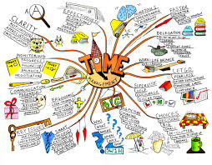
3D Design
Lesson objectives:
New page in book
Write the word JEWELLERY
Spider diagram of the word jewellery
For example:
Include thumbnail drawings of jewellery objects such as rings, pendants, bracelets, earrings, necklace.
These should be doodles and as such could be the genesis of an idea that can be later expanded. What you are looking to do here is to display creativity. You could include small samples of wood/metal/plastic. Tape or glue them to the page.
To help you use the SCAMPER example as a guide to what your page should/could look like
+

Slide 5
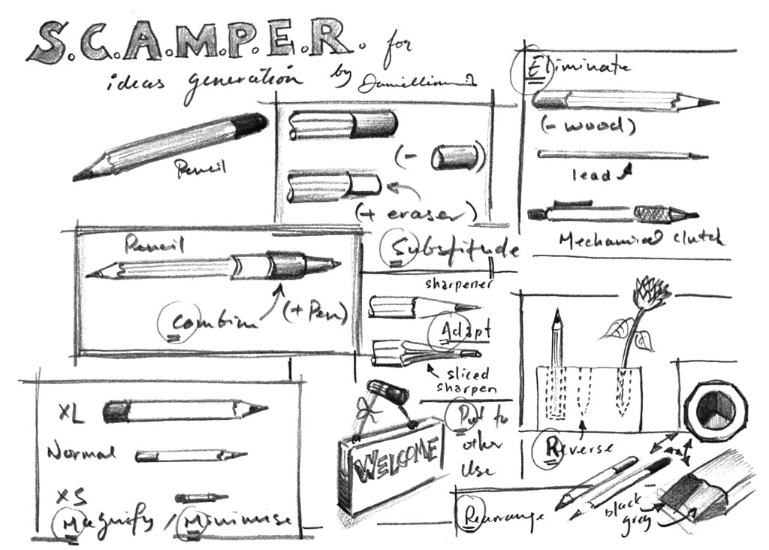

Slide 6
Artists, designers & design movements
Artists & designers-
Tatty Divine
Design movements-
Art Deco
Ethnic

Slide 7
3D Design - Jewellery
Lesson objectives:
To continue design work for jewellery project.
Your designs must use a range of materials (plastic, wood, metal) and must include designs for the following:
Necklace/pendant
Ear rings

Slide 8
3D Design- Jewellery
Lesson objectives:
To continue design work for jewellery project.
Your designs must use a range of materials (plastic, wood, metal) and must include designs for the following:
Necklace/pendant
Ear rings

Slide 9
3D Design- Jewellery
Lesson objectives:
To continue design work for jewellery project.
Your designs must use a range of materials (plastic, wood, metal) and must include designs for the following:
Necklace/pendant
Ear rings

Slide 10
Lesson objectives:
Task 1
To continue design work for jewellery project.
Your designs must use a range of materials (plastic, wood, metal) and must include designs for the following:
Necklace/pendant
Ear rings
Task 2
Start making when your sketch book work has been seen and designs discussed

Slide 11
Evaluation of jewellery project
The jewellery project has introduced you to new processes and materials and has allowed you to experiment and play with materials. The structure of the project has introduced you to the format we will use for each project. New projects will allow you to explore in depth the assessment objectives and you will have more time for development of ideas and making. For this project evaluation you are to reflect on how well you responded to:
The brief-to design and make jewellery
Use of materials-use of a range of materials
Use of a range of processes-use of different ways of making
Presentation and communication- good communication and drawing skills
Made outcomes-creative and well made outcomes

Slide 12
Jewellery project week by week timetable
Week 1- Moodboards on Tatty Divine, Art Deco and Ethnic presented in sketch books and annotated-AO1
Week 2 – Spider diagram/ mind map examining the question-AO1
Week 3 – SCAMPER exercise complete. Coloured and annotated-AO1&2
Week 4- Initial ideas for all 3 design movements- earrings and pendant. Designs to include a range of materials and processes. Pewter casting, laser cutting, Use of 2D design, vaccum former & strip heater-AO 2&3
Week 5- Initial ideas for all 3 design movements- earrings and pendant –AO 2&3
Week 6- Begin making- AO 2&3
Week 7- continue making- AO 2&3
Week 8- continue making- AO 2&3
Week 9- continue making and recording your made outcomes-AO2,3&4
Week 10- complete making of jewellery-AO 2&4
Week 11- evaluation of jewellery project. The evaluation should be a reflection on the making of earrings, pendant and any other jewellery items. You should have used a range of processes and materials and experimented with a range of different outcomes-AO3

