Slide 1
Persistent Data Storage
Data that are required by programs can be stored in a variety of different kinds of file for safe keeping. This is known as persistent storage.
The simplest kind of files useful for this purpose would be those that store data as text, or in a grid, e.g. csv files. These are often known as flat file databases.
Flat file databases have a very serious drawback which is data redundancy.

Slide 2
Flat File Databases
Imagine storing data about patients at a doctors surgery. For each patient, you would store names, address, DOB and other personal details.
Each time a patient made an appointment a new entry would need to be added to the file, but this would require all the personal data to be repeated.
Eventually your data file would become enormous, storing mostly repeated data (redundant data).

Slide 3
Flat File Databases
Surname | Fname | DOB | Address | Appt Date | Etc.
Bloggs | Joe | 16/3/78 | Blah, blah, blah | 13/8/06
Bloggs | Joe | 16/3/78 | Blah, blah, blah | 23/8/07
Smith | Dave | 13/5/90 | More blah | 23/7/05
Smith | Dave | 13/5/90 | More blah | 30/7/05
In a flat file database, data soon gets repeated. This is known as redundancy. It makes the file unnecessarily large and difficult to use.

Slide 4
Databases
Databases are used to store and organise vast quantities of information. They are also used to rapidly find particular pieces of information, from all that is stored.
Databases are hugely important to modern computing. For example, e-mail, Facebook, Youtube, shopping online, Google etc. could not exist without them!
Databases are complex collections of data. They can be accessed and manipulated by external software or may be managed by a DBMS (DataBase Management System). A DBMS will store, manage, retrieve and present data.

Slide 5
Database Planning
Databases need to be carefully planned and designed.
Early on, entities are defined, these are real world things about which data will be stored. These will become the data tables. For each entity there will be a number of attributes identified. These will become the fields.
Careful planning avoids data redundancy (storing multiple copies of data) which would increase the size of the database unnecessarily. It also ensures that querying (searching) can be as fast as possible.

Slide 6
Tables
Databases store information in tables. Each row of a table is called a record and holds all the information about a particular thing. Each record is made up of fields (columns of the table).
For example, a school database table holding information about students could be represented like this:

Slide 7
Primary Key
One field in each table must be unique for each record. This field is known as the Primary Key (or Key Field). In our example, ID Number would be the key field because no two students would have the same number.

Slide 8
Linking Tables
All but the very simplest databases will have many tables. Tables are linked together using relationships. Linking tables in this way avoids redundancy.
This is called an
ER diagram
(Entity Relationship)
Student ID
Surname
Firstname
DOB
Gender
Tel Number
Teaching Group ID
Student ID
Teacher ID
Room
Teacher ID
Surname
Firstname
DOB
Gender
Tel Number
In the centre table, the Key Fields from the other two tables re-appear to link the tables together. Within the centre table they are known as Foreign Keys (not Primary Keys).

Slide 9
SQL
All databases are controlled and constructed using a language invented during the 1970s called SQL (pronounced “seequal”).
There are several variations of SQL so it is important that the SQL that you are using matches the database structure.
Using SQL databases can be created/deleted; tables can be created/deleted; records can be written to tables, read from tables, appended to tables or edited; data can be searched and retrieved from any combination of tables.

Slide 10
Queries 1
If a teacher needed to find some particular information from the database they would need to create what is called a query using SQL.
Queries can combine data from various tables according to certain criteria.
Select Surname, DOB, Gender From Students Where DOB >= 13/4/87 AND Gender=“F”

Slide 11
Queries 2
For example, if a teacher needed a list of all the female students whose surname is Smith, the query would need to work with two of the fields, Sex and Surname. The query might look something like this:
Student ID | Surname | Firstname | DOB | Sex | Tel Number
 | = “Smith” |  |  | = “F”
The computer would take this query as an instruction to search very quickly through the tables looking for all those students who fit the bill. i.e.
3235 | Smith | Jane | 4/2/88 | F | 345654

Slide 12
Reports
If the teacher wanted to print or display any information from the data tables or queries in an attractive way they may well design a report. Their report might look something like this:
Surname: SMITH
First Name: JANE
Sex: FEMALE
Date of Birth: 4/2/88
Phone Number: 345654
A report allows the user to show text, pictures and the contents of specified fields from the database in any design they wish. A report is a database output.

Slide 13
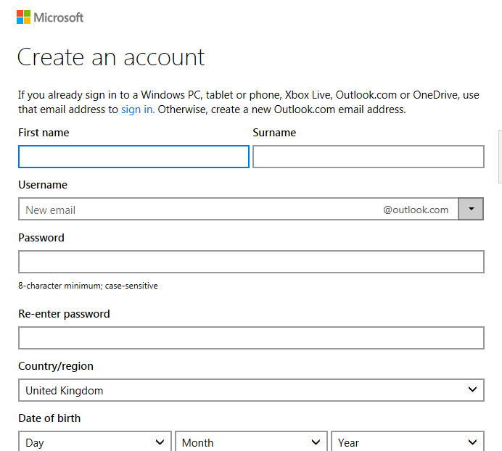
Forms
A DBMS will always possess a feature for creating forms. Forms are the main way that data is collected for processing by a database. They are the main method of data input to a database.
A form is literally something that is filled in by the user. The data provided could be added to a table or maybe used to build a query to search for something
Forms are user friendly and should be designed to make it easy for the user to provide the required data. Forms should have built in validation to prevent junk data getting into the database.
Above shows the web form for creating a new hotmail account

Slide 14
What features does a DBMS bring?
The 4 essential features of a DBMS can be summarised as:
Tables – store and organise data. Relationships connect the tables together in the most efficient way. Validation can be built in to reduce errors.
Forms – allow input and editing of data. They are user friendly. Validation works through these.
Queries – allow the data to be searched and recombined.
Reports – allow output of data on to paper or screen in a customised easy to understand way.
But beyond this, a DBMS will also provide:
Security – through usernames and passwords for users, access to data can be secured. Logs track what users do.
Utilities – tools to backup/restore the database. Tools to repair problems with the database.
Stability – the ability to allow multiple users to access the data simultaneously across a network.
Connectivity – through SQL, other software, particularly web pages, can access the data stored.

