Slide 1
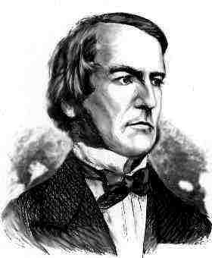
LOGIc gates
Lesson Objectives:
To understand the functions of logic gates.
To apply gained knowledge and design answer a number of example questions.
George Boole,
(1815-1864)
Did you know?
George Boole Inventor of the idea of logic gates. He was born in Lincoln, England and he was the son of a shoemaker in a low class family.
Notes:
About G. Boole:
http://www.google.co.uk/imgres?imgurl=http://library.thinkquest.org/C0126120/boole.jpg&imgrefurl=http://
http://www.kerryr.net/pioneers/boole.htm

Slide 2
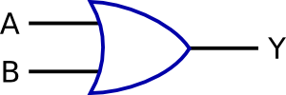
A logic gate is a digital circuit which either allows a signal to pass through it or to stop it.
There are three basic logic gates: AND, OR, and NOT.
NOT
GATE
OR
GATE
AND
GATE
?Logic !
Did you know?
Logic gates allow the computer to do things such as add, divide, multiply, do simple yes and no reasoning in certain situations along with other things.
Notes:
http://www.kpsec.freeuk.com/gates.htm

Slide 3
Input
An AND gate can have two or more inputs.
The output will be positive (true) when both inputs (the input one AND the input two) are positive (true).
Y = A AND B
AND
GATE
Output
Input
ON/OFF
ON/OFF
PERSON SENSOR
AND
GATE
BURGLAR ALARM
c
ON SWITCH
FOR ALARM
ON /OFF
Notes:
The output is "true" when both inputs are "true.” Otherwise, the output is "false."
If one input will be off – the output will be off as well.
http://whatis.techtarget.com/definition/0,,sid9_gci213512,00.html

Slide 4
Input
An OR gate can have two or more inputs.
The output will be positive (True) if at least one input is true.
Y = A OR B
OR
GATE
Output
Input
ON/OFF
ON/OFF
FRONT DOORBELL
SWITCH
OR
GATE
DOORBELL
BACK DOORBELL
SWITCH
ON /OFF
Notes:
The output is "true" if either or both of the inputs are "true." If both inputs are "false," then the output is "false.”
It is doesn’t matter if one input will be off- the output will be on
http://www.kpsec.freeuk.com/gates.htm

Slide 5
To add more sensors to alarm
BEDROOM
SENSOR
ON or OFF ?
OR
GATE
AND
GATE
FRONT ROOM
SENSOR
BURGLAR
ALARM
ON SWITCH
FOR ALARM

Slide 6
A NOT gate (inverter) has only one input.
It reverses the logic state.
Y = NOT A
NOT
GATE
Input
Output
ON
OFF
HEAT DETECTOR
(ABOVE 20 C)
NOT
GATE
CENTRAL
HEATING
OFF
ON
Notes:
NOT gate has only one input. It reverses the logic state.
If the input will be on – the output will be off
If the input will be off –the output will be on.

Slide 7
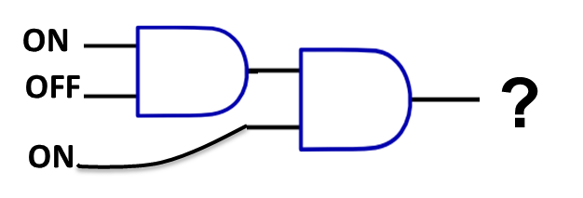
Truth Tables
Sometimes it is easy to draw what is called a truth table to help track the values as 1 or 0
1
D
0
E
1
A | B | C | D | E
What would be the values at D and E?
Use the table to help you

Slide 8
Test Answers: Remember on = 1, off =0
1.
4.
1
A
ON
0
A
OFF
1
B
OFF
0
?
?
C
ON
B
ON
S=(A^B)^C
S=¬A^B
5.
2.
A
ON
1
0
?
A
OFF
1
1
?
B
ON
B
ON
C
OFF
6.
S=¬(A^B)
3.
S=(AvB)vC
A
ON
0
1
?
B
OFF
A
ON
1
?
0
The output is ON or OFF ?
S=¬(A^B)
B
OFF
C
OFF
S=(AvB)^C
Notes:
1- off, 2- on, 3-off, 4- on, 5-off, 6-on

Slide 9
Test 2: Remember on = 1, off =0
8.
ON
OFF
ON
OFF
?
7.
ON
ON
A
B
OFF
OFF
?
ON
C
D
OFF
OFF
S=(AvB) ^ ¬(C^D)
ON
The output is ON or OFF ?
Notes:
7- on, 8- on

