Slide 1
Binary Logic 1
Regulated by the processor’s clock, pulses of electricity move along the internal wiring of the computer carrying data.
The presence of a pulse can be represented by a 1, and the absence 0.
Inside the processor there are specialised circuits called logic gates that are used to manipulate/process some of these pulses.

Slide 2
Binary Logic 2
A number of wires can bring electric impulses into a logic gate – these are called inputs.
A single wire carries away the output of a logic gate.
The 3 most basic kinds of logic gate are called NOT, AND and OR.

Slide 3
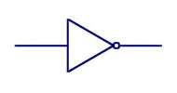
Binary Logic 3
A NOT gate (symbol ¬) has one input and one output. If there is a current on the input wire (1) then the output wire will carry no current (0). If there is no current on the input wire (0) then the gate will produce a current on the output wire (1). This can be shown in a truth table:
Input | Output
0 | 1
1 | 0
In circuit diagrams, this is the symbol for a NOT gate

Slide 4
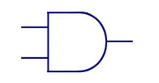
Binary Logic 4
An AND (symbol ^ ) gate has two inputs and one output. Only a current arriving on both inputs produces an output. This can be shown in truth table:
Input A | Input B | Output
0 | 0 | 0
0 | 1 | 0
1 | 0 | 0
1 | 1 | 1
In circuit diagrams, this is the symbol for an AND gate

Slide 5
Binary Logic 5
An OR gate (symbol ˅ ) has two inputs and one output. A current arriving on either of the two inputs produces an output. This can be shown in truth table:
Input A | Input B | Output
0 | 0 | 0
0 | 1 | 1
1 | 0 | 1
1 | 1 | 1
In circuit diagrams, this is the symbol for a OR gate

Slide 6
Binary Logic 6
The outputs from logic gates are recombined and fed into other logic gates as new inputs!
In this way, complex logical expressions can be created and processed.
This diagram shows an AND gate and an OR gate feeding into another OR gate
1
0
If the inputs are as shown then the combined output will be 1
0
1
1
1
0
Assuming the inputs are called A, B, C & D (top to bottom). The logical expression for this circuit is:
Output = (A AND B) OR (C OR D)

Slide 7
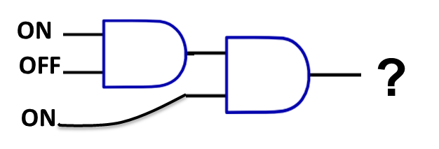
Truth Tables
The logical expression for this circuit is:
E= (A AND B) AND C
A:1
D
B:0
E
C:1
Sometimes it is easiest to draw a truth table to help track the values as 1 or 0
What would be the values at D and E?
Use the table to help you
A | B | C | D | E
1 | 0 | 1

Slide 8
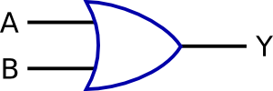
Test 1: Remember on = 1, off =0
1.
4.
ON
OFF
OFF
?
?
ON
ON
5.
2.
ON
?
OFF
?
ON
ON
OFF
6.
3.
ON
?
OFF
ON
?
Is the output ON or OFF ?
OFF
OFF

Slide 9
Test 2: Remember on = 1, off =0
8.
ON
OFF
ON
OFF
?
7.
ON
ON
OFF
OFF
?
ON
OFF
OFF
ON
Is the output ON or OFF ?

Slide 10
Notation
In an exam, the symbols: ¬, ^ and ˅, will be used for NOT, AND and OR.
So, the following are the same:
Q = P AND R is the same as Q = P ^ R
Q = NOT(P OR R) is the same as Q = ¬ (P ˅ R)

