Slide 1
Relationships & families
Philosophy & ethics - christianity

Slide 2
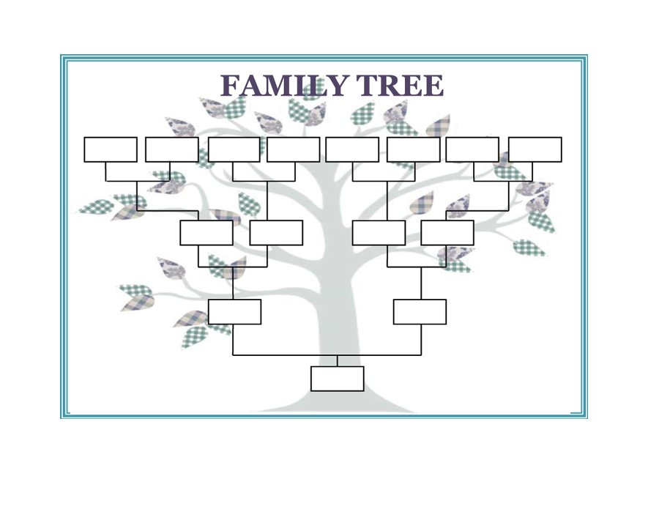
Family
https://www.youtube.com/watch?v=beuvyZfBFGQ
https://www.youtube.com/watch?v=8ArX3bbAoHk
Notes:
Start by showing the clip. Ask students how they would develop and or improve the definition of family. What does this tell us about families in general? Display the family tree. Model how the family tree works, using your own family (or make one up if necessary, but it is probably better to use your own family where possible). Hand out sheets. Students can use the template or make their own if they wish, but should then create their own family tree with members of their family and extended family. They may have to add extra branches etc but this is ok.

Slide 3
Royal Family Tree
How does your family compare to this one?
https://www.youtube.com/watch?v=vEuAr7zi9Vw&safe=true

Slide 4
FAMILY MEMBER | WHY S/HE IS IMPORTANT TO ME | PRACTICAL CONTRUBITIONS TO FAMILY LIFE
Notes:
Using the members of their family from their family tree, students should complete the table (it can be done on the back of their family tree sheet). Again, it would be helpful if you model this first. Be as honest and open as you can. Practical contributions can include money, jobs around the house, just being there to talk to etc. Once students have completed this table it should be easier for them to do the group work on the following slide.

Slide 5
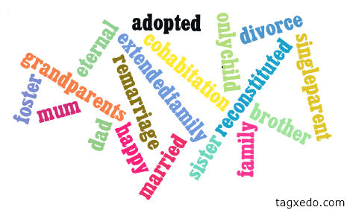
Family?
http://www.youtube.com/watch?v=-_oLfC5Z_Ys
“I’m on a swing”?
“I’m Peter Hand”?
“Just let me staple the
vicar”?
Family is.....................
http://www.youtube.com/watch?v=eBpYgpF1bqQ

Slide 6
Diamond Nine
Best type
Men should be the head of the family | Men and women should be equal in a household. | Having two parents of the same sex is as effective as two different sex parents.
To be a good family you don’t need to love each other | Divorce can ruin a family unit. | Any family unit can be successful as long as the people love each other
Parents need to be married to raise children properly. | You become a better person if you are from a nuclear family. | A successful family doesn’t need a male role model
Worst type

Slide 7
Cohabitation
Nuns living in one house
Living together without being married
Marrying more than one person at a time

Slide 8
Cohabitation
b) Living together without being married

Slide 9
Civil Partnership
Being polite to each other
Working with other religions
Legal ceremony giving homosexual couple rights

Slide 10
Civil Partnership
C) Legal ceremony giving homosexual couple rights

Slide 11
Marriage
a) Man and woman buying a house together
b) Man and woman having children
c) the condition of a man and woman legally united for the purpose of living together and, usually, having children

Slide 12
Marriage
c) the condition of a man and woman legally united for the purpose of living together and, usually, having children

Slide 13
Pre-marital sex
a) Sex before marriage
b) Sex after midnight
c) Teenage sex

Slide 14
Pre-marital sex
Sex before marriage

Slide 15
Faithfulness
Living together
staying with your marriage partner and having sex only with them
Eating meals together as a family

Slide 16
Faithfulness
b) Staying with your marriage partner and having sex only with them

Slide 17
Adultery
An act of sexual intercourse between a married person and someone other than their marriage partner
Sex between people over eighteen
Having more than one husband

Slide 18
Adultery
An act of sexual intercourse between a married person and someone other than their marriage partner

Slide 19
Reconstituted family
Two sets of children become one family when divorced parents marry
A family with both boy and girl children
A family who lives abroad

Slide 20
Reconstituted family
Two sets of children become one family when divorced parents marry

Slide 21
Promiscuity
Making a promise to stay with a partner for life
The act of breaking a marriage vow
Having sex with a number of partners without commitment

Slide 22
Promiscuity
Having sex with a number of partners without commitment

Slide 24
SO WHAT DO THEY SAY ABOUT MARRIAGE AND FAMILY LIFE?

Slide 25
1. THE CHURCH OF ENGLAND
The C of E has always valued family life.
The family unit is highly important – it is the best way to bring up children.
Monogamy (having one wife) is the true form of marriage.
Technically, love between homosexual partners is acceptable.
Marriage is a lifelong commitment.
2. ROMAN CATHOLIC
The family is the fundamental unit of society.
The RC church should uphold the teachings of the gospel by supporting family life.
Marriage is forever. Divorce is not allowed.
The RC church is concerned for the rights of the family to housing, education etc. It is also concerned for the rights of the unborn.
All children should be brought up with family support.

Slide 26
3. The Baptist Church
Marriages are a sign of God’s love in the world. So the Baptist church must help marriages to last.
The key relationships that most people have are with their family.
The Bible does not just endorse the nuclear family. In the Old Testament God shows special concern for lone parents and children without fathers.
Support for all kinds of families should be priority for the Baptist church.
4. The Methodist Church
Bringing up children is god’s will for most men and women.
To maintain a home is one of the greatest acts men and women can achieve.
Although families are important, it is possible to have a fulfilling life without marriage and without engaging in sexual intercourse.

Slide 27
5. Quakers
Parents should not impose their views, but should encourage children to discuss, ask questions, listen and think.
Many Quakers are not in married relationships eg sons or daughters caring for aged parents, friends who share a home, widows or widowers, divorced or separated people, single parents and those who are in homosexual relationships. All of us need to feel that we belong, are valued and included.
6. The Salvation Army
The family is God’s idea. For this reason the Salvation Army seeks to promote family life.
God has created human beings with sexual drives. Family structures based around marriage are the right setting for the expression of sexuality.
Family structures are also the environment in which children may be safely reared.
The Salvation Army works closely with many single parent families to offer support and care. It regrets that some people deliberately set out to create one-parent families.

Slide 28
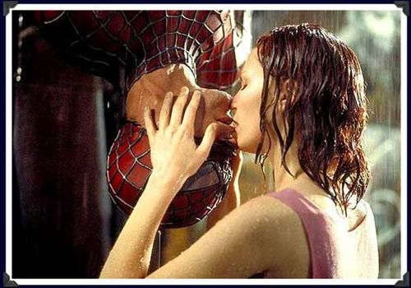

Slide 29
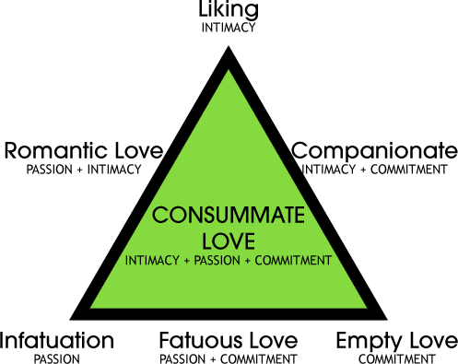
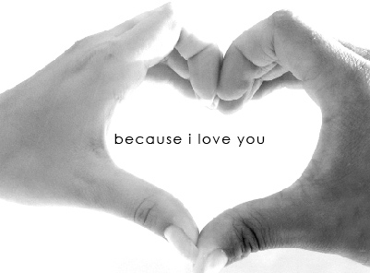
LOVE
Is love real?
Can love really last forever?
What are the different types of love?
Is there such a thing as love at first sight?
Is love really the answer?

Slide 30
LOVE
DEFINE LOVE IN
45 WORDS EXACTLY!

Slide 31
PHILOS
AGAPE
3. Eros
Friends, family, pets etc.
People you don’t know. Those in need.
BoyF, GirlF

Slide 32
The Best Love Song Ever
Written!
https://www.youtube.com/watch?v=0uNLw3pXlVM
https://www.youtube.com/watch?v=WU1XYvIUOrM
https://www.youtube.com/watch?v=_zUjMrvrraw

Slide 33
When your heart is black and broken And you need a helping hand When you're so much in love You don't know just how much you can stand When your questions go unanswered And the silence is killing you Take my hand baby I'm your man I got loving enough for two Ten story love song I built this thing for you Who can take you higher than twin peak mountain blue? Oh well, I built this thing for you And I love you true There's no sure-fire set solutions No shortcut through the trees No breaching the wall that they put there to keep you from me As you're lying awake in this darkness This everlasting night Some day soon don't know where or when You're gonna wake up and see the light Ten story love song I built this thing for you Who can take you higher than twin peak mountain blue? Oh well, I built this thing for you And I love you true Ten story love song I built this thing for you Who can take you higher than twin peak mountain blue? Oh well, I built this thing for you And I love you true

Slide 34
When I saw you for the first time (first time) My knees began to quiver (quiver) And I got a funny feeling (feeling) In my kidneys and my liver (digestive system baby) My hands they started shakin' (shakin') My heart it started thumpin' (boom, boom, boom!) My breakfast left my body (Heuey, heuey, heuey) It really tells me something. Girl, you make me tongue tied (tongue tied) Tongue Tied. Whenever you are near me (near me) Tied tongue (tied tongue) Tied tongue (tied tongue) Whenever you're in town. You make me feel like a clown, girl. Yes, you make me tongue, tongue (tied, tied) Tongue Tied. Why can't I tell you clearly? (clearly) Tied, tied tongue, tongue (tongue tied, tongue tied) Whenever you're around. I saw you 'cross the dance floor. (dancing) I thought of birds and bees (reproductive system baby) But when I tried to speak to you (talk, talk) My tongue unravelled to my knees (flippity, flippity flop) I tried to say, "I love you" (love you) But it came out kind of wrong girl (wrong girl) It sounded like, "Noo-noo-na-nee-noo" (tongue tied) Na-ner-ner-ner-nee-nung-nirl. Because you make me tongue tied (tongue tied) Tongue Tied. Whenever you are near me Nurmy, murmy (nurmy, murmy) Murmy, nurmy (murmy, nurmy) Whenever you're in town (in town) My trousers, they go brown, girl. Yes, you make me nungy-nangy (nangy-nungy) Tongue tied. Why can't I tell you cleary? (cleary) Be-dobby-durgle-dobby-durgle (tongue tied, tongue tied) Whenever you're around. Oh, I'm begging on my knees Sweet, sweet darling listen please Understand me when I say: Be-durble-diggle-doggle-diggle-doddle-diddle-day I'm trying to say I'm tongue tied (tongue tied) Tongue tied. Whenever you are near me (baby) Nurmy, murmy (nurmy, murmy) Murmy, nurmy (murmy, nurmy) Whenever you're in town (in town) I feel so much like cryin', girl. Yes, you make me nungy-nangy (nangy-nungy) Ningy-nungy. Why can't I tell you clearly? (clearly) Be-dobby-durgle (dobby-durgle) Durgle-dobby (durgle-dobby) Whenever you're around (around) Whever you're around, girl

Slide 35
Restless hearts, it has been along time, Out here on the journey, for a glimpse of paradise, It's getting hard to find a place to go, Where peaceful water flow;
I took a walk past the old Saxon well, Down by the cathedral I heard the chapel bell, And joined the people singing for a way to go, Where peaceful waters flow;
And if you don't know by now, you never will, Only love can find the door, If you could see it now, it's in your hand, Only love can reach the shore to heaven,
Always, she is standing by my side, She's my inspiration, and she's my battle cry, And in her arms is the only place I know, Where peaceful waters flow;
And if you don't know by now, you never will, Only love can find the door, If you could see it now it's in your hand, Only love can reach the shore, forevermore, Where peaceful waters flow

Slide 36
20, 3, 19, 85, 21, 9, 16, 30, 12
72, 4, 1, 32, 42, 7

Slide 37
When your heart is black and broken And you need a helping hand When you're so much in love You don't know just how much you can stand When your questions go unanswered And the silence is killing you Take my hand baby I'm your man I got loving enough for two Ten story love song I built this thing for you Who can take you higher than twin peak mountain blue? Oh well, I built this thing for you And I love you true There's no sure-fire set solutions No shortcut through the trees No breaching the wall that they put there to keep you from me As you're lying awake in this darkness This everlasting night Some day soon don't know where or when You're gonna wake up and see the light Ten story love song I built this thing for you Who can take you higher than twin peak mountain blue? Oh well, I built this thing for you And I love you true Ten story love song I built this thing for you Who can take you higher than twin peak mountain blue? Oh well, I built this thing for you And I love you true
Love, heart, in, you, you, you, you’re, when, helping, mountain, is, when, questions, my , broken

Slide 38
When I saw you for the first time (first time) My knees began to quiver (quiver) And I got a funny feeling (feeling) In my kidneys and my liver (digestive system baby) My hands they started shakin' (shakin') My heart it started thumpin' (boom, boom, boom!) My breakfast left my body (Heuey, heuey, heuey) It really tells me something. Girl, you make me tongue tied (tongue tied) Tongue Tied. Whenever you are near me (near me) Tied tongue (tied tongue) Tied tongue (tied tongue) Whenever you're in town. You make me feel like a clown, girl. Yes, you make me tongue, tongue (tied, tied) Tongue Tied. Why can't I tell you clearly? (clearly) Tied, tied tongue, tongue (tongue tied, tongue tied) Whenever you're around. I saw you 'cross the dance floor. (dancing) I thought of birds and bees (reproductive system baby) But when I tried to speak to you (talk, talk) My tongue unravelled to my knees (flippity, flippity flop) I tried to say, "I love you" (love you) But it came out kind of wrong girl (wrong girl) It sounded like, "Noo-noo-na-nee-noo" (tongue tied) Na-ner-ner-ner-nee-nung-nirl. Because you make me tongue tied (tongue tied) Tongue Tied. Whenever you are near me Nurmy, murmy (nurmy, murmy) Murmy, nurmy (murmy, nurmy) Whenever you're in town (in town) My trousers, they go brown, girl. Yes, you make me nungy-nangy (nangy-nungy) Tongue tied. Why can't I tell you cleary? (cleary) Be-dobby-durgle-dobby-durgle (tongue tied, tongue tied) Whenever you're around. Oh, I'm begging on my knees Sweet, sweet darling listen please Understand me when I say: Be-durble-diggle-doggle-diggle-doddle-diddle-day I'm trying to say I'm tongue tied (tongue tied) Tongue tied. Whenever you are near me (baby) Nurmy, murmy (nurmy, murmy) Murmy, nurmy (murmy, nurmy) Whenever you're in town (in town) I feel so much like cryin', girl. Yes, you make me nungy-nangy (nangy-nungy) Ningy-nungy. Why can't I tell you clearly? (clearly) Be-dobby-durgle (dobby-durgle) Durgle-dobby (durgle-dobby) Whenever you're around (around) Whever you're around, girl
A, saw, got, whenever, funny, first, quiver, digestive, knees, you, you, when, baby, started, first

Slide 39
Restless hearts, it has been along time, Out here on the journey, for a glimpse of paradise, It's getting hard to find a place to go, Where peaceful water flow;
I took a walk past the old Saxon well, Down by the cathedral I heard the chapel bell, And joined the people singing for a way to go, Where peaceful waters flow;
And if you don't know by now, you never will, Only love can find the door, If you could see it now, it's in your hand, Only love can reach the shore to heaven,
Always, she is standing by my side, She's my inspiration, and she's my battle cry, And in her arms is the only place I know, Where peaceful waters flow;
And if you don't know by now, you never will, Only love can find the door, If you could see it now it's in your hand, Only love can reach the shore, forevermore, Where peaceful waters flow
Hard, it, getting, its, to, here, of, flow, journey, will, has, restless, took, the, time

Slide 40
Love, heart, in, you, you, you, you’re, when, helping, mountain, is, when, questions, my , broken
A, saw, got, whenever, funny, first, quiver, digestive, knees, you, you, when, baby, started, first
Hard, it, getting, its, to, here, of, flow, journey, will, has, restless, took, the, time

Slide 41
20, 3, 19, 85, 21, 9, 16, 30, 12
72, 4, 1, 32, 42, 7

Slide 42
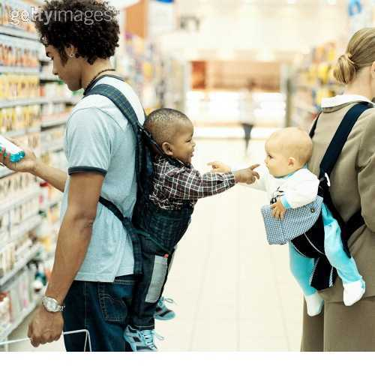
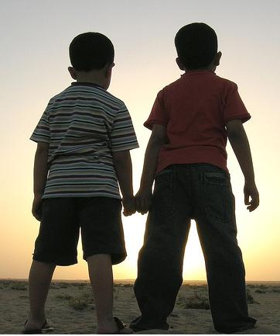
Why should we try to help each other?
Is it really possible to show love to all other people?
Is it so bad that there are people you dislike?
Can a person get through life without having help from others?

Slide 43
https://www.youtube.com/watch?v=OIVB3DdRgqU
https://www.youtube.com/watch?v=OIVB3DdRgqU

Slide 44
LOVE IS
REAL
N’T

Slide 45
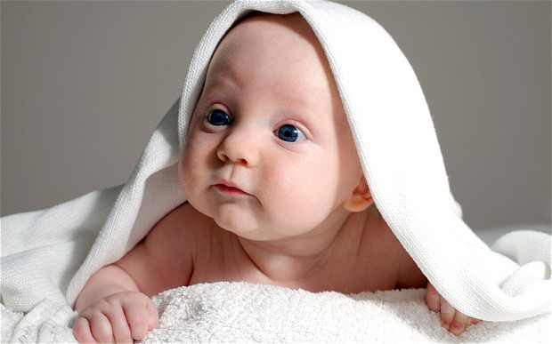
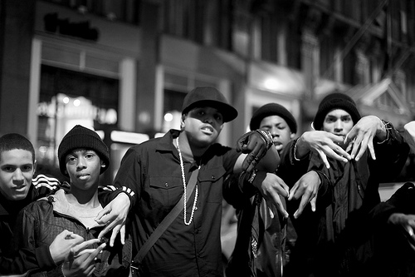
Love isn’t a real thing – it is just a word we use to describe certain urges or actions. Love as concept therefore doesn’t exist.

Slide 47
LOVE IS
REAL
N’T

Slide 48
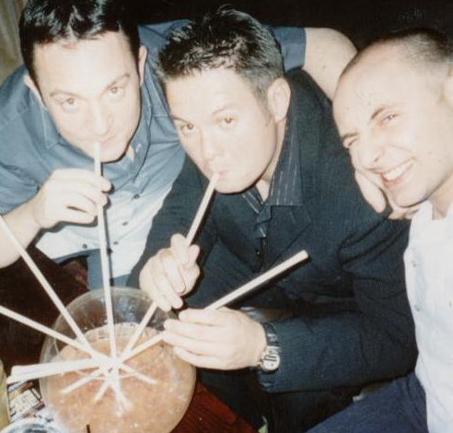
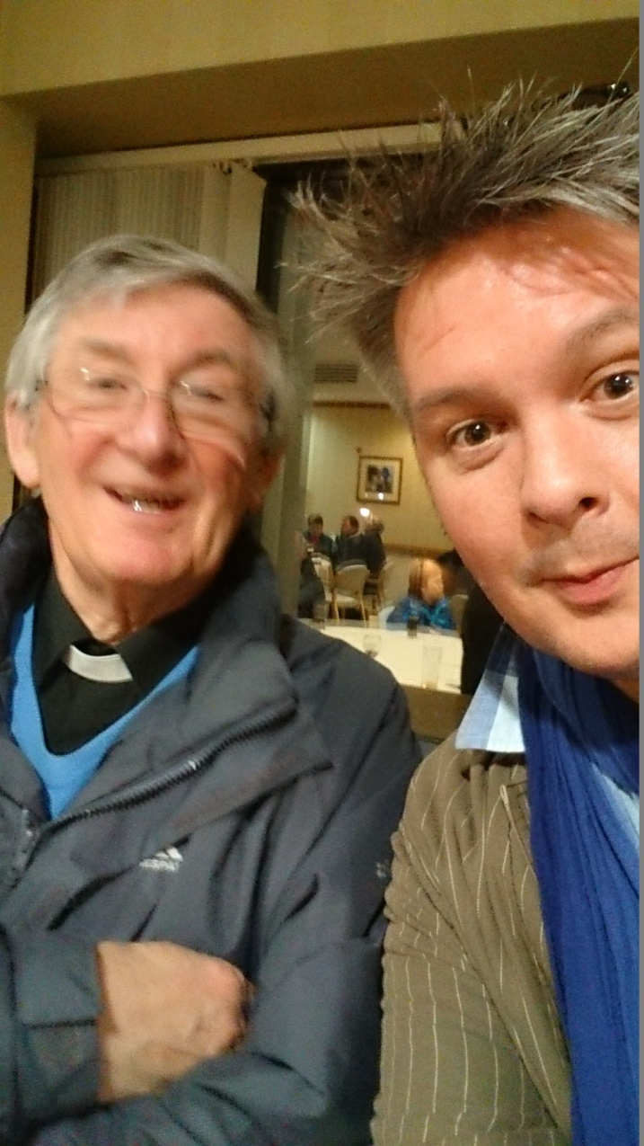
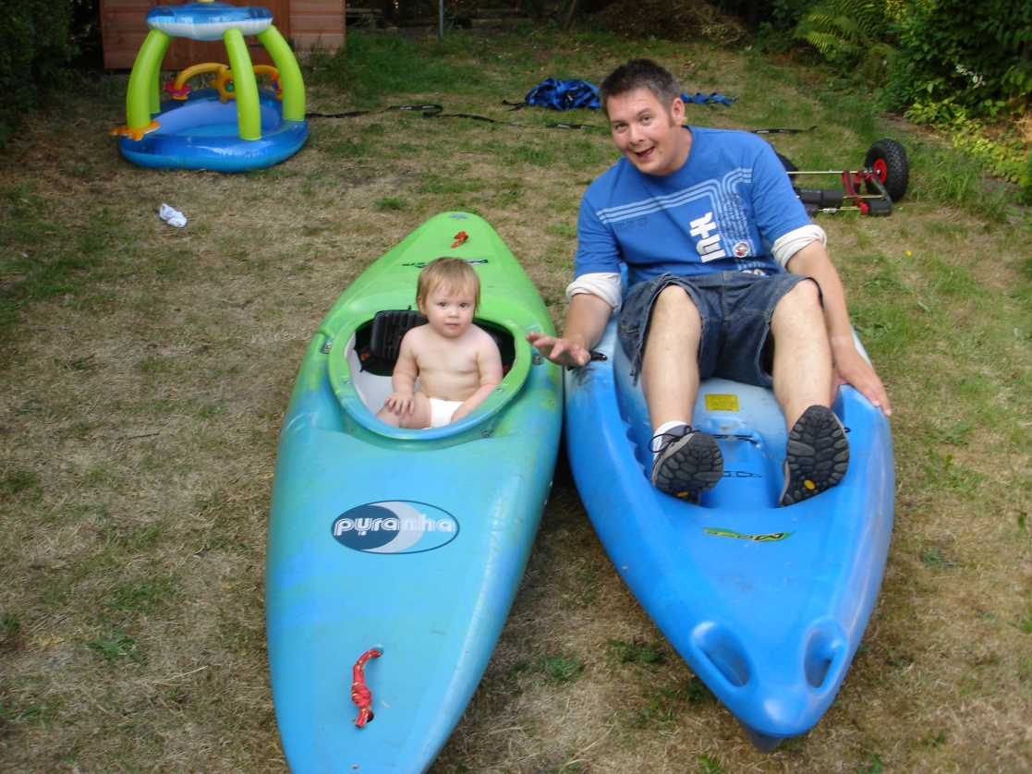
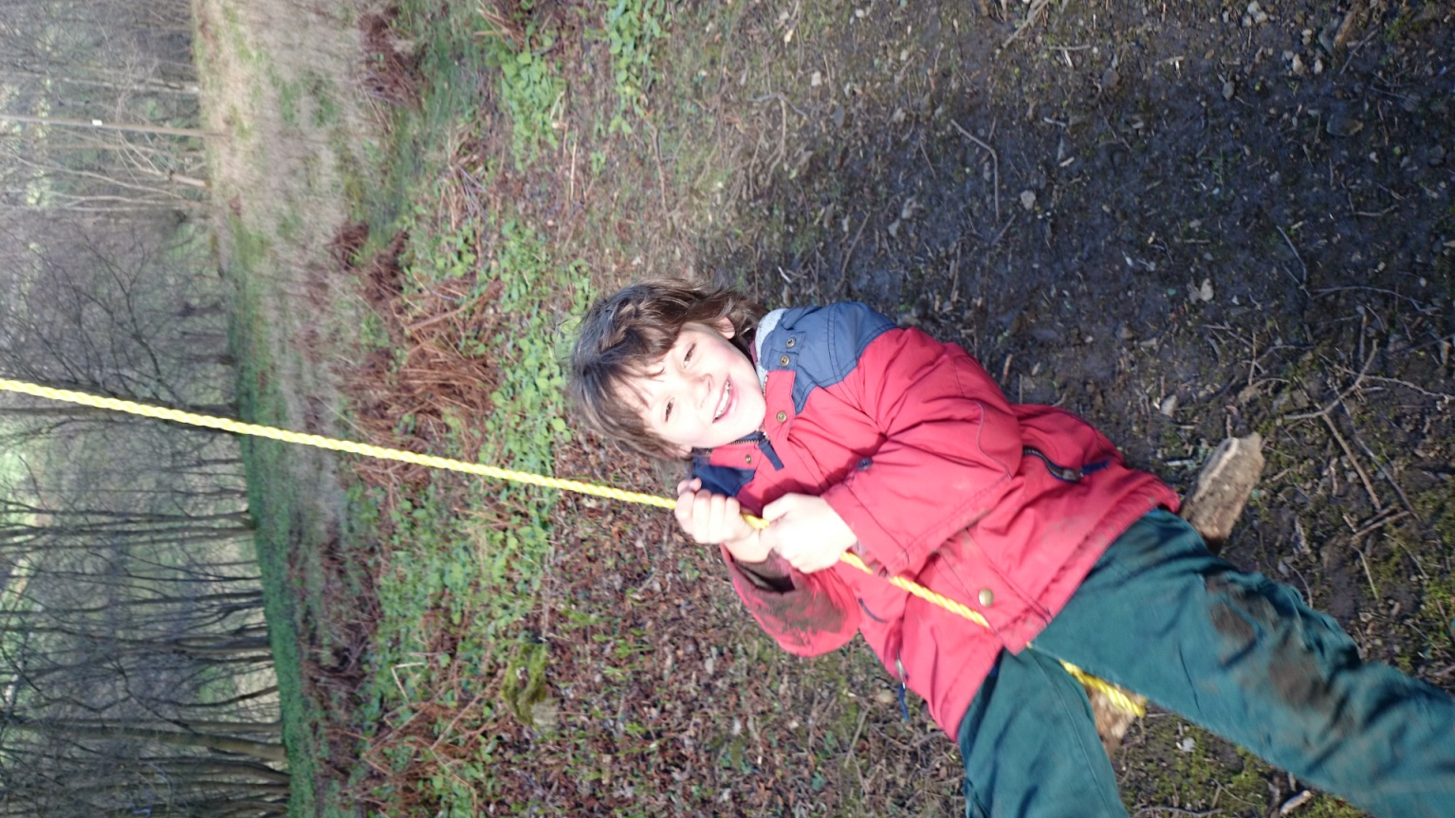
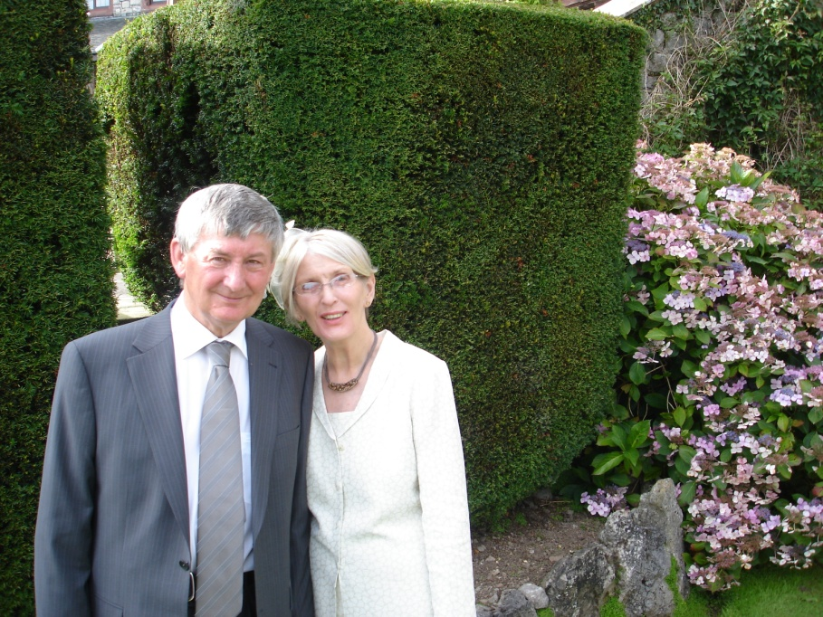

Slide 49
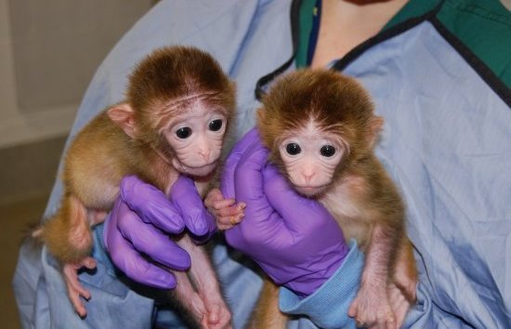

Slide 50
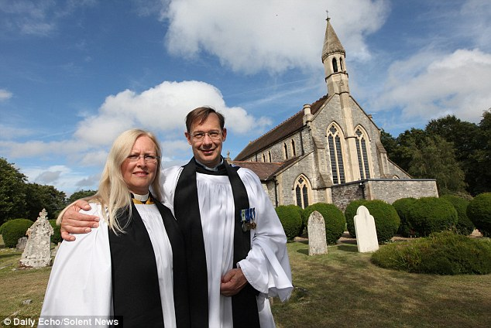
Why Is Marriage So
Important To Christians?

Slide 51
Church Of England
A learning process.
Commitment.
Reflection of Christ’s love for the Church.
Until death.
Three Blessings:
The creation of children
The correct place for sex
Help and comfort through life

Slide 52
The Catholic Church
A unique bond.
Permanent.
Reflection of Christ’s love for the Church.
Reveals God’s unconditional love.
Marriage brings God’s grace to a couple
The current world culture can be
damaging. Marriage is an ancient
and permanent institution that helps
to protect you from it.

Slide 53
Some Bible Quotes
“…a man leaves his father and mother
and is united with his wife, and they
aecome one flesh.”
“…man must not separate what God has joined together.”
“…a cord of three strands is not quickly broken.”

Slide 54
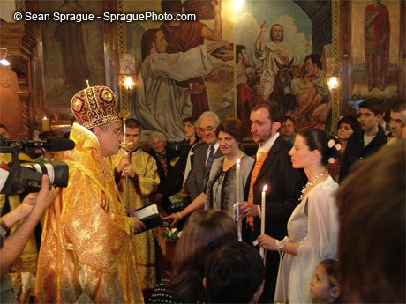
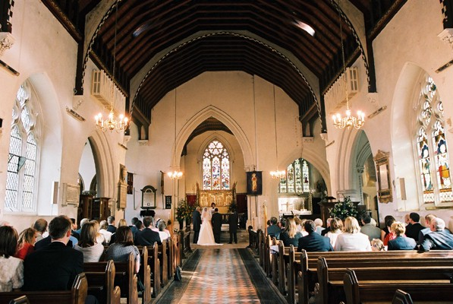
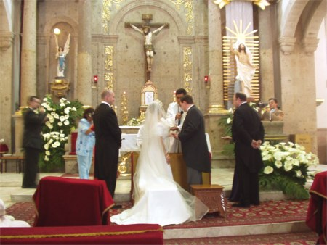
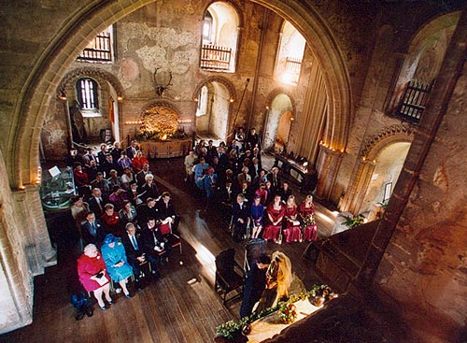

Slide 55
Which is the odd one out?
WHY?

Slide 56
https://www.youtube.com/watch?v=1cP4qRTQyIM
Describe John and Mary’s relationship.
Why are they like this?
Why do they behave differently
when there are priests around?

Slide 57
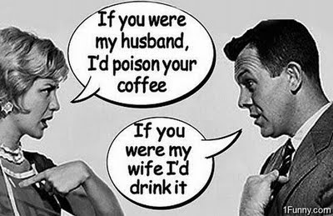
DIVORCE

Slide 58
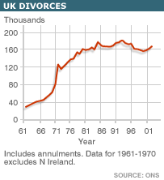
https://www.youtube.com/watch?v=-JUWbe8j-U0&safe=true
Is the Thackers’ marriage beyond saving?
Are there things that simply cannot be forgiven in a marriage?
How would a Roman Catholic priest resolve this situation?
What is happening to the divorce rate in UK?
Why?
Would banning divorce make society better or worse?

Slide 59
“Divorce is bad!”
POSITIVES | NEGATIVES

Slide 60
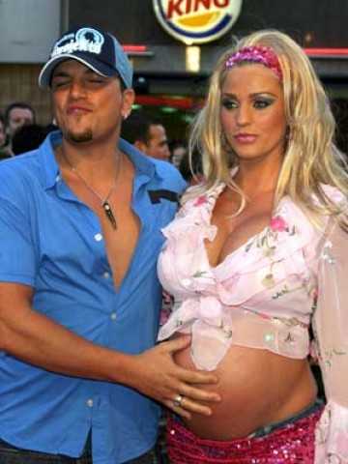
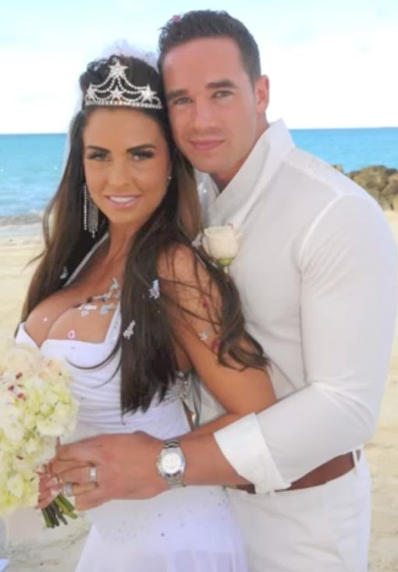
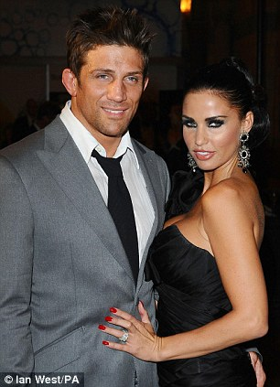
Do you think when couples divorce it should be private? Why?
Make a list of as many other celebrity divorces as you can think of.

Slide 61
Key Terms
What is meant by ‘conflict?’
- Disagreements & quarrels.
- Working against each other rather than together
What is meant by ‘reconciliation?’
- Making up & starting together again, saying sorry & having it accepted.

Slide 62
What pressures can there be on a marriage?
Financial
Unemployment/work/career
Children
Adultery/unfaithful
Religious differences
Alcohol/drug problems
Lack of children

Slide 63
What can a religious community do when things go wrong?
Priest/imam can offer advice to the couple.
Older & more experienced couples can offer advice.
Marriage guidance counselling.
Family members can offer help & advice.
Pray.
Booklet or leaflet with the religious teachings about marriage.

Slide 64
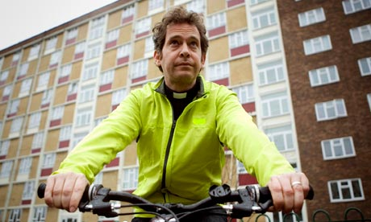
CHRISTIAN TEACHING ON DIVORCE
BELIEF/TEACHING | CHURCH OF ENGLAND | ROMAN CATHOLIC
Marriage is a holy relationship, the vows are made in front of God and should never be broken. Divorce is wrong. Divorce is sometimes the kindest thing to do. A separated couple may never re-marry. In exceptional cases a marriage may be annulled. Divorce is permitted because Jesus said the right course of action is the most loving thing to do. To re-marry is to commit adultery. Jesus allowed divorce for unfaithfulness. Our interpretation of the Bible has to move with the times.
J
J
J
J
J
J
J
J
J
J

Slide 65
DIVORCE
All Christians know that sometimes ____________ don’t work. But there are _____________ views about what Christians should do if they don’t want to stay with the person they married.
The teaching in the ___________ is not always clear about divorce.
The ROMAN CATHOLIC CHURCH teaches that married ____________ may live apart if they want to, but they may not ____________. Catholics believe marriage is a _____________ - something holy that ____________ has done and it cannot be undone. Roman Catholics must not marry someone new if their husband/wife is still alive.
Other Christian churches, such as THE CHURCH OF ENGLAND have different ideas. They believe that divorce can be _____________ and both partners are then _____________ to marry other people. It is up to the ___________ to decide if they can get married in ____________ if they have been divorced before.
marriages
different
bible
couples
divorce
sacrament
God
allowed
free
vicar
church
marriages | allowed | couples | different | church | bible
vicar | divorce | cardigan | free | sacrament | God

Slide 66
WORDSEARCH – FIND THE WORDS AND WRITE A SENTENCE ON EACH ONE
B | O | B | E | R | T | R | E | O
E | E | L | H | S | N | E | F | M
S | A | E | T | Y | E | C | I | P
T | P | S | A | L | M | S | L | R
M | A | S | S | V | A | N | R | A
A | G | I | I | E | R | A | S | Y
N | O | N | S | F | C | T | N | E
E | D | G | T | I | A | R | I | R
S | W | O | V | W | S | A | P | S

Slide 67
What can a religious community do when things go wrong?
Priesty can offer advice to the couple.
Older & more experienced couples can offer advice.
Marriage guidance counselling.
Family members can offer help & advice.
Pray.
Booklet or leaflet with the religious teachings about marriage.

Slide 68
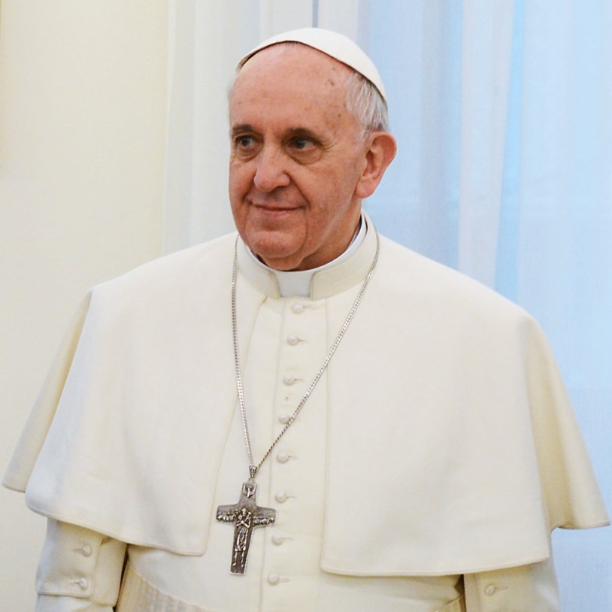
Christian attitudes to divorce
There are two attitudes…
Catholic = not allowed. Only the death of one of the partners can end the relationship.

Slide 69
However, they do allow an annulment (this says the marriage never existed). Must prove the marriage was never consummated or that it was not a true Christian marriage.

Slide 70
An annulment is given for any reason as long as the couple can prove to the church that one of them was not fully aware of what marriage meant…
Too young
Mentally unprepared
Forced into marriage

Slide 71
What do Christians believe about divorce?
Catholic
- Do n____ believe in divorce. Why..?
Breaking the v____ “till d_____ do us part”
Not G_____ intention.
Marriage is a s___________.
J_____ forbid divorce in the Bible (Mark’s Gospel)

Slide 72
Catholics do allow annulment – this means it didn’t take place.
If…
They didn’t u________ what they were doing.
They were f__________ into marriage.
The marriage hasn’t been c_________. (they haven’t had s_____)
One of the partners hasn’t been b_______.

Slide 73
Non-Catholics:
Do allow divorce in certain c_______.
Jesus allowed divorce for a__________.
Lesser of 2 e_________.
Accept divorce as UK l_______ allow it.
Discourage r_____________.

Slide 74
Catholic Church
Jesus taught divorce was wrong (Mark).
Couple have made an agreement with God, in the sacrament of marriage. Can’t be broken by earthly powers.
Non-Catholics
Jesus allowed divorce for adultery (Matt.19:9)
Christians are allowed forgiveness for confessed sins. Should be the same for marriage.
Better to divorce than live in hatred.

Slide 75
Juicy Evidence
Jesus said, ‘Whoever divorces his wife and marries another is guilty of adultery against her. And if a woman divorces her husband and marries another, she is guilty of adultery too.’ (Mark.10:10-12)
So if you are a Catholic who has a civil divorce then in the eyes of the church you are still married.

Slide 76
Juicy Evidence
Now I say to you: the man who divorces his wife – I am not speaking of fornication – and marries another, is guilty of adultery. (Matt.19:8-9)
Some understand this to mean that it is OK to divorce on the grounds of adultery.

Slide 77
Men & Women
https://online.clickview.co.uk/exchange/videos/79239/gcse-gender-stereotypes-in-adverts
Who does what in
your family?

Slide 78
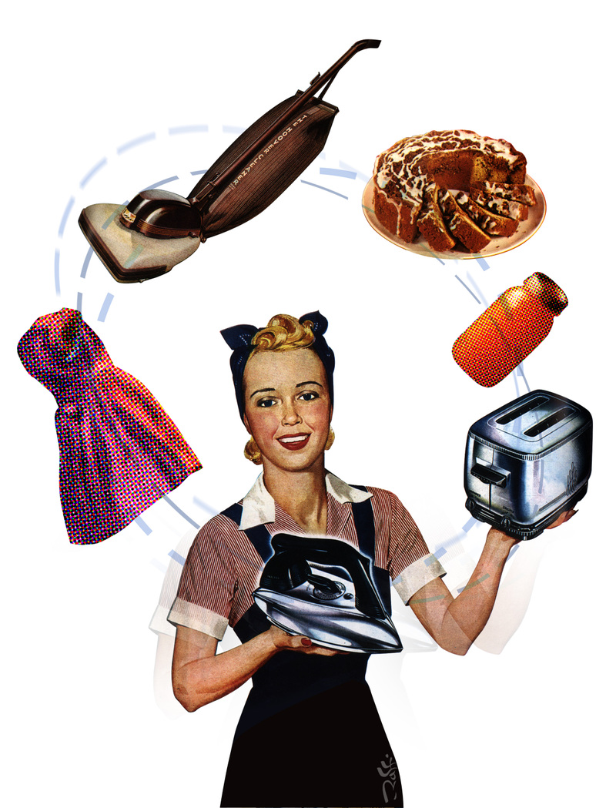

Slide 79
https://www.youtube.com/watch?v=DWBYP02EbmQ&safe=true

Slide 80
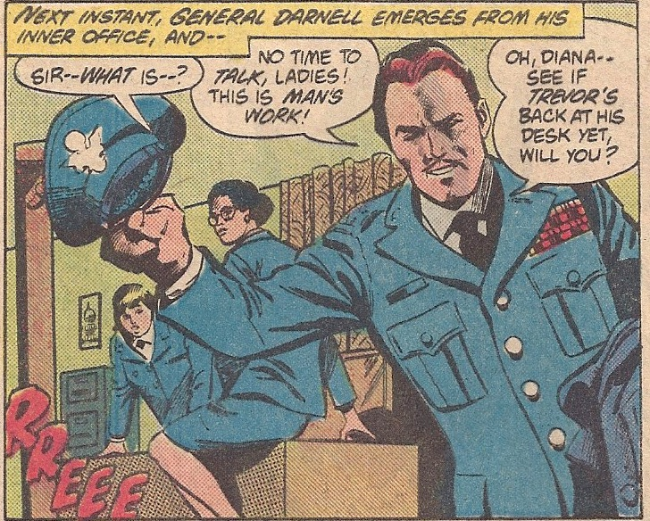
Whose work is more
important?

Slide 81
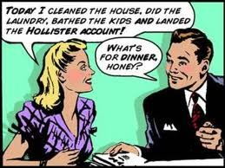
CHRISTIANITY AND FAMILY ROLES
I will think about men and women’s roles in the family.
I will know what Christianity says about the roles about men and women.
I will understand how and why society is changing.

Slide 82
MAN’S JOB | WOMAN’S JOB
MAN’S ROLE | WOMAN’S ROLE

Slide 83
https://online.clickview.co.uk/exchange/videos/69822/the-family
Watch the episode.
What roles are performed by the different family members?

Slide 84
What does Christianity say about the roles of men and women in the family?

Slide 85
“The Lord God said: ‘It is not good for the man to be alone.
I will make a helper suitable for him.” GENESIS 2:18
“There is neither male nor female,
for you are all one in Christ Jesus.”
GALATIANS 3:28
“Wives…be submissive to your husbands. Husbands, in the same way be considerate
as you live with your wives, and treat them with respect as the weaker partner.”
1 PETER 3:1-7
The Christian wedding vows say a wife must obey her husband.
Jesus took no women for his disciples – he chose men to do his work for him.
Both men and women were made in the image of God in Genesis.
Eve was the first person to sin. She then led Adam astray.

Slide 86
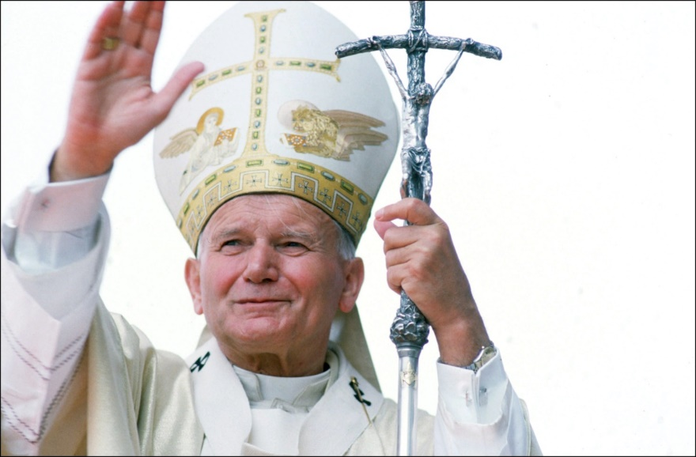
In the human
“ and female”, God
gives man and
an personal with
the rights and
proper to the
person.
woman
creating
human
equal
dignity
male
race

Slide 87
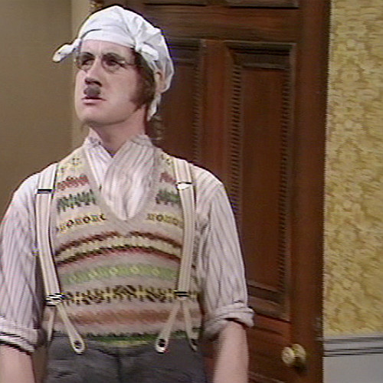
The problem these days is that there should be one person in each household who goes out to work. Not two.

Slide 88
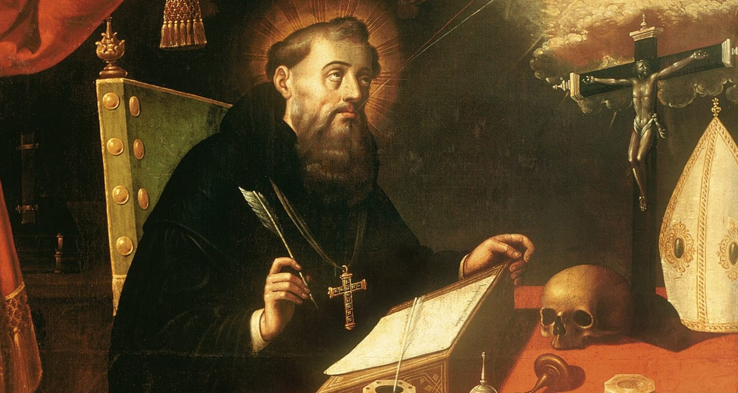
What is the difference whether it is in a wife or a mother, it is still Eve the temptress that we must beware of in any woman…I fail to see what use woman can be to man, if one excludes the function of bearing children.

Slide 89
What A_____ do Catholics allow instead of divorce?
What B_____ is a feature of a Christian wedding?
What C_____ is disagreements & quarrels?
What D _____ is forbidden by the Roman Catholic Church?
What E_____ is a type of love?
What H_____ a feature of a Christian marriage ceremony?
What I______ could offer a couple advice?
What J_____ forbids divorce?
What M_____ is the official term for the state of marriage,
often preceded by the word “Holy…”?
What N_____ means “related to marriage or weddings.”?
What P_____ could a religious community do to help a
couple having marriage problems?
What Q_____ is a feature of a Muslim wedding?
What R_____ is ‘making up’ & starting together again?
What S_____ is a type of love?
What V_____ are promises?
What W _____is a marriage ceremony?
Can you think of any for F, G K, L , O, T X and Z?

Slide 90
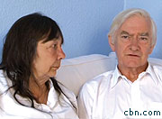
Holiday S-Inn: gay couple refused room at Christian guesthouse
Tuesday, December 7th, 2010
The Christian owners of a seaside guesthouse are being sued in a landmark case – for refusing to allow a gay couple to share a double bed.
Peter and Hazelmary Bull refused to let civil partners Martyn Hall and Steven Preddy use a double room because it would be ”an affront to their faith”.
They operate a strict policy which only allows married heterosexual couples to share rooms at their B&B in Cornwall.
The gay couple claim the snub was a ”direct discrimination on the grounds of sexual orientation”.
The hearing could determine whether Christians are permitted to operate B&Bs that restrict double bed accommodation to married couples.
Martyn and Steven’s legal fees are being paid for by the Government-funded Equality and Human Rights Commission.
Mr and Mrs Bull’s legal defence is being financed by The Christian Institute, a charity that protects the religious liberty of Christians.

Slide 91
What are your views?
Are you born gay?
Are same sex relationships acceptable?
Is same sex marriage acceptable?

Slide 92
Homosexuality
http://www.tes.co.uk/teaching-resource/Homosexuality-Nature-or-Nurture-6062032/

Slide 93
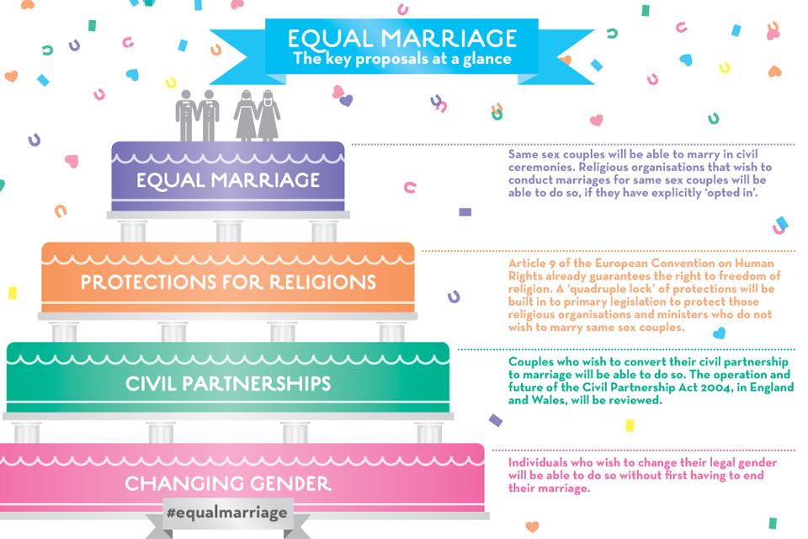
UK law

Slide 94
Christian attitudes to same sex relationships
Some Christians think that same sex relationships are acceptable as it doesn’t specifically condemn it in the Bible.
For example Quakers.
Methodists may officially bless same sex couples.

Slide 95
Christian attitudes to same sex relationships
Other Christian’s are against same-sex relationships.
Sex is for procreation
The story of Sodom and Gomorrah (Genesis 19)
The story of Ham and Noah (Genesis 17)
Leviticus 19

Slide 96
Christian attitudes to same sex relationships
The Roman Catholic Church is against any form of same-sex union but will encourage members to stay within the church if they do not engage in sexual acts.

Slide 97
Part D
“Marriage should always be between a man and woman”
Answer this question in relation to Christianity and include your own opinions
15 marks

Slide 98
Sex!

Slide 99
It is just for reproduction.
The bible says fornication is wrong.
Casual sex can be damaging.
God has made it enjoyable, so it should be enjoyed.
Sex is the body’s language.
Nothing is more important than love

Slide 100
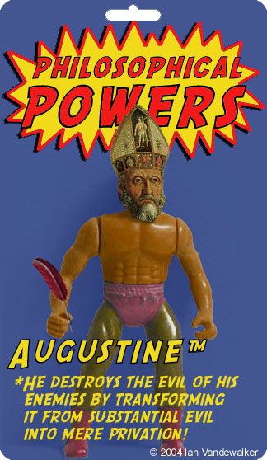
St Augustine again!
He was responsible for changing Christian attitudes to sex.
He said…
Sex is sinful.
Sex should not be enjoyed.
It is only acceptable between a married couple, and then solely for the purpose of reproduction.
Priests, monks, nuns etc should be celibate.
His reasoning…

Slide 101
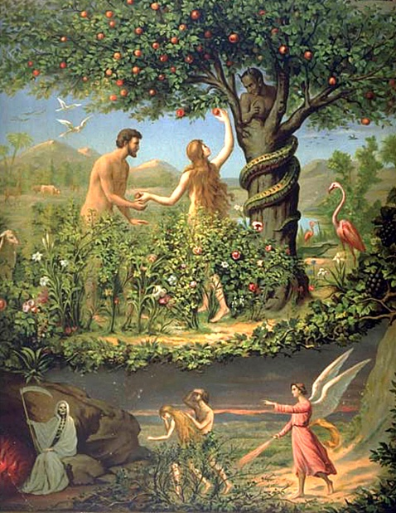
Sin entered the world during the story of the Fall. When Eve was tempted by the serpent. She shared the forbidden fruit with Adam. They realised they were naked. Augustine believed this was a metaphorical story about sex.
This first sin is called the Original Sin. All humans carry Original Sin because it is passed on at the moment of conception.
God sent Jesus to save us from this Original Sin. That is why Jesus was born of a virgin womb.
Therefore sex is a sinful activity.

Slide 102
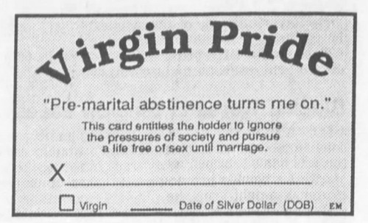
https://youtu.be/6Zb40CTvj98
All of these objections to abstinence can be answered with, “The Bible still says premarital sex is a sin.” There is not context that makes a sin not a sin. God’s character does not change. His laws are a reflection of his character. Therefore his law to only have sex in marriage will not change either.

Slide 103
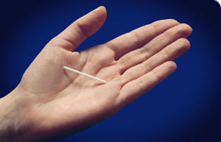
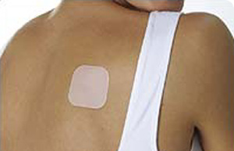
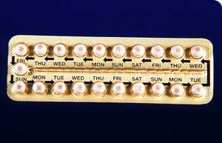
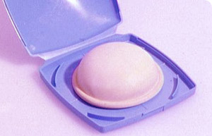
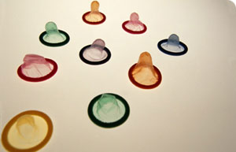
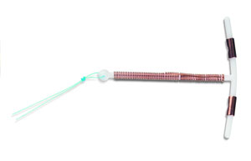
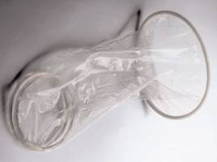
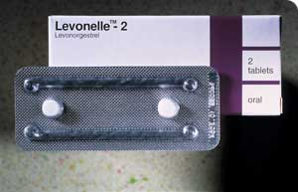
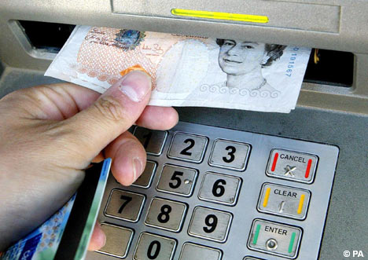
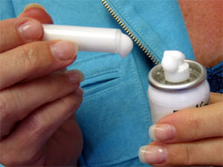
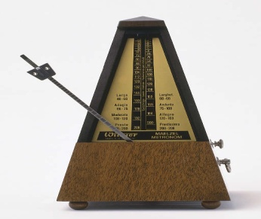
CONTRACEPTION
A | B | C | D
E | F | G | H
I | J | K | L

