Slide 1
ISLAM

Slide 2
Key Concepts…
Tawhid
Prophethood
Halal
The Oneness of God.
Or “risalah” – the messengers of God from Adam to the Prophet Muhammad.
Permitted/Allowed
Mosque
Jihad
Or “masjid” – place of prostration/ communal worship
Shari’ah
“To Strive” – inner spiritual struggle is Greater Jihad, holy war is Lesser Jihad.
Straight path – a way of life set out by God.
Haram
Ummah
Forbidden/Not allowed
The worldwide community of Muslims

Slide 3
Islam Worldwide
500
There are…
…Muslims in the
world today
500 billion
1.6 billion
1st
Islam is the world’s
2nd
largest religion.
3rd
The Middle East &
North Africa
The highest concentration of the
world’s Muslims is in…
Central Europe
Cirencester
However, nearly…
One
2/3
1/350
of the world’s Muslims
live in the AsiaPacific region

Slide 4
In Britain today there are nearly ______________ Muslims, making up __________ % of the population.
Up until the __________ twentieth century there were very ____________ Muslims in the __________. From the ___________ onwards significant numbers of __________ came from the former __________, taking up the offer of __________ in post Second _______________ Britain.
The 2011 ___________ shows that Britain is home to one of the most __________ Muslim communities in the ___________. The majority of British Muslims are __________ (95%) with remaining 5% coming from the __________ tradition.
How much can you work out without the missing words?
World War few Shi’a mid 3 million
crumpets 4.5 UK colonies diverse 1950s
world Sunnis people work

Slide 5
ISLAM - KEY WORDS
ISLAM | SHAHADAH | ZAKAT | WUDU
HAJJ | MUSLIM | SALAT | MOSQUE
RAMADAN | KAABA | MAKKAH | ALLAH

Slide 6
The Life of MUHammad
KEY POINTS FROM THE VIDEO

Slide 7
P
H
B
U
Can you create an acronym to help you remember?
…Pink and Blue Umbrella Handle…

Slide 8
https://www.youtube.com/watch?v=Kt3yFGiElrs

Slide 9
The World Muslim Population
Sunnis and Shi’as have coexisted for centuries, living peaceably side by side, often worshipping together in the same mosques, sometimes inter-marrying.
87% of Muslims are Sunni.
13% are Shi’a

Slide 10
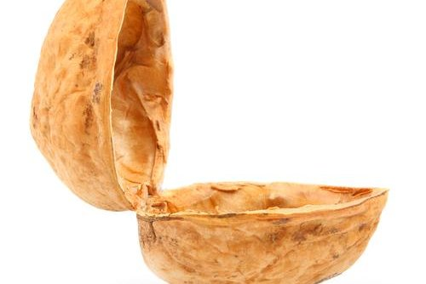
After Muhammad’s death an argument started about who should lead the Muslim Community.
A large group of believers chose Abu Bakr to be the new Khalifah (leader) as he had been a close friend of Muhammad.
After Abu Bakr’s death Umar became the leader, then Uthman and then Ali.
These four leaders have come to be known as the Rightly Guided Khalifahs.
Sunni Muslims accept that they were God’s appointed leaders.
Sunni

Slide 11
There was a smaller group of Muslims who, after Muhammad’s death, believed that Ali – Muhammad’s cousin and son-in-law – should have become the first Khalifah. They believed this was what Muhammad wanted. They rejected Abu Bakr, Umar and Uthman. They were angry that Ali had been overlooked.
Ali eventually became Khalifah but was murdered.
The group then began to separate themselves.
They believe that Prophet Muhammad appointed 12 Imams (successors) from his own descendants.
Shi’a

Slide 12
Key difference – in Sunni Islam
an imam is the leader in a local
mosque. In Shi’a Islam there
were only 12 Imams. They are
holy figures who were all
diviniely appointed descendants.

Slide 14
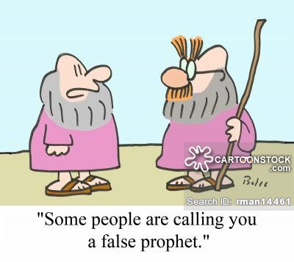
Why are prophets important?
Hints….
Guidance Messengers Warnings

Slide 16
“People, no prophet or messenger will
come after me, and no new faith
will emerge.”
“I leave behind me two things, the
Qur’an and the example of my life
(the Sunnah). If you follow these
you will not fail.”
Muhammad’s last sermon, Hadith

Slide 17
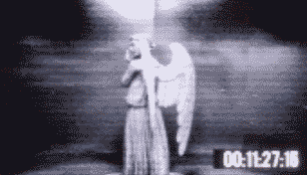

Slide 18
Heavenly
Immortal
Messengers
God’s first creation
Made out of light.
No free will
Invisible
Without sin
All around us
No Knowledge
No physical bodies
Male
They’ve got wings

Slide 19
Jibril (Gabriel)
Angel Of Revelation.
Responsible for revealing the Qur’an to Muhammad
Israfil (Raphael)
The archangel responsible for blowing
the trumpet on the Day of Judgement to
announce the resurrection.

Slide 20
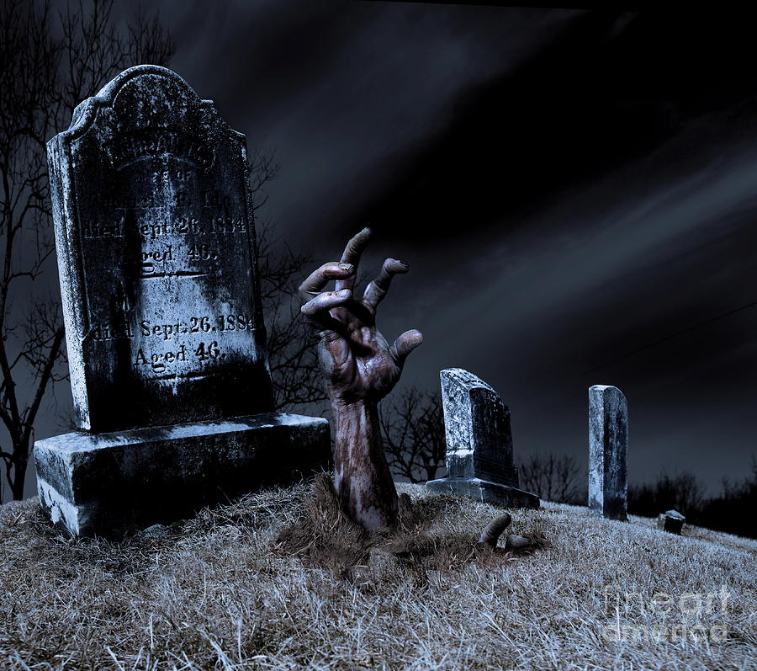
AKHIRAH
The Afterlife

Slide 21
Earthly life is just a preparation for the eternal life to come.
It is also a test.
We will be judged according to how we have lived.
We have been given free will so we can make choices,
BUT WE WILL BE HELD RESPONSIBLE!
Repent,
The end is
Nigh!

Slide 22
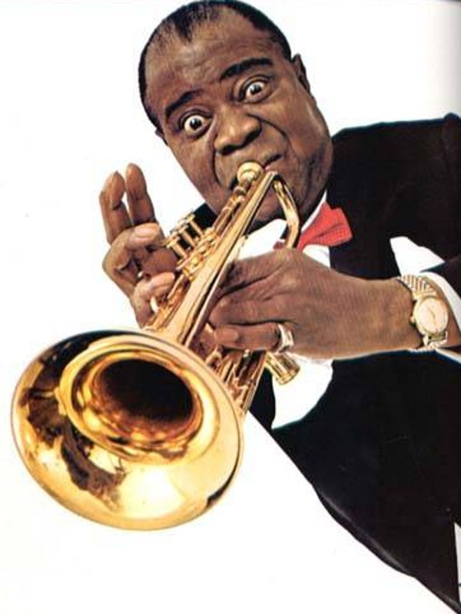
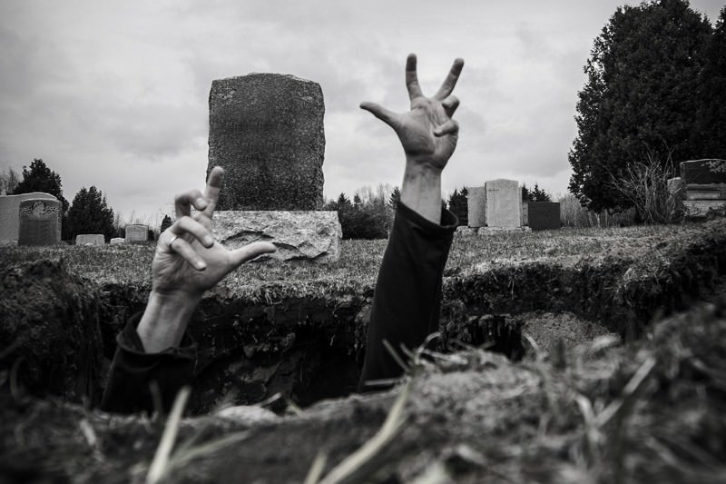
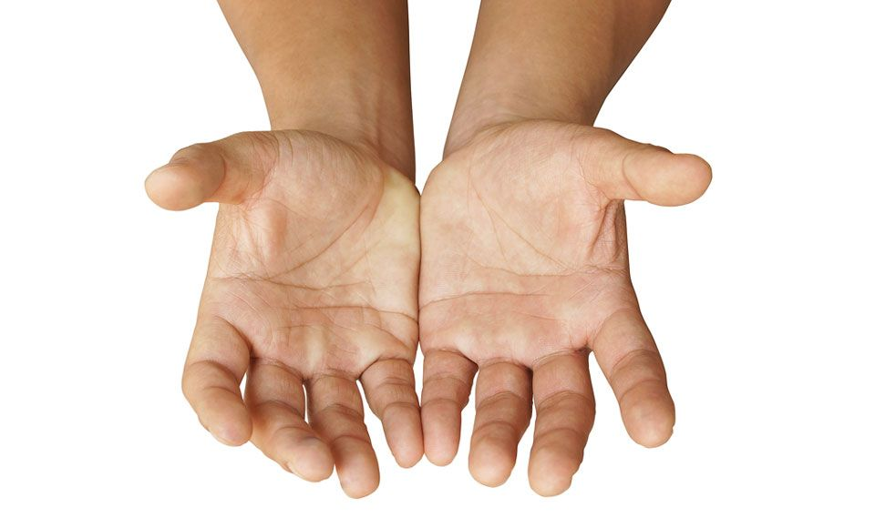
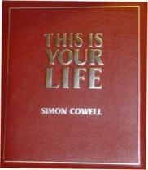

Slide 23
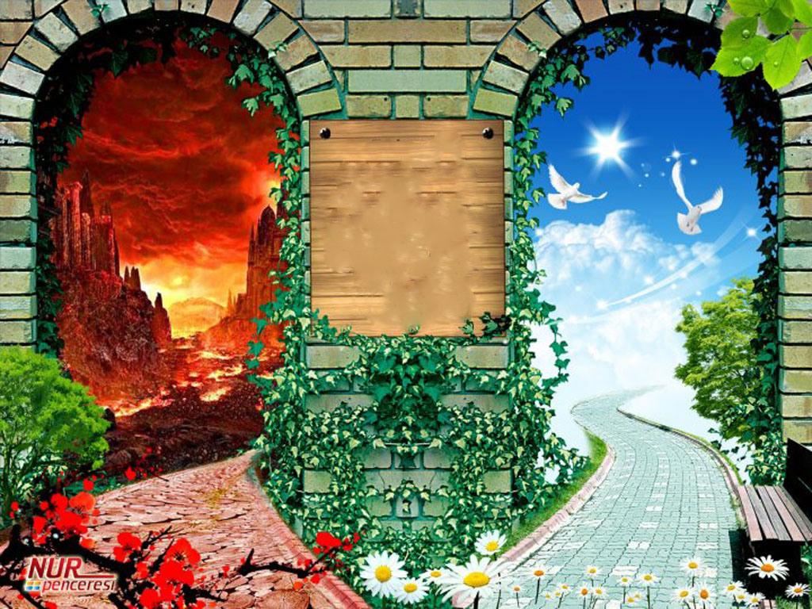

Slide 24
https://www.youtube.com/watch?v=BkL1uDuta2U
Watch the clip.
DON’T MAKE NOTES!
But try to remember what you
Can.
Notes:
https://www.truetube.co.uk/film/five-pillars-islam

Slide 25
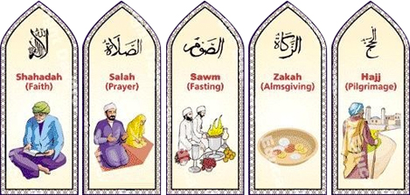
Actions speak louder than
words.

Slide 26
How Do You Do
Wudu?

Slide 27
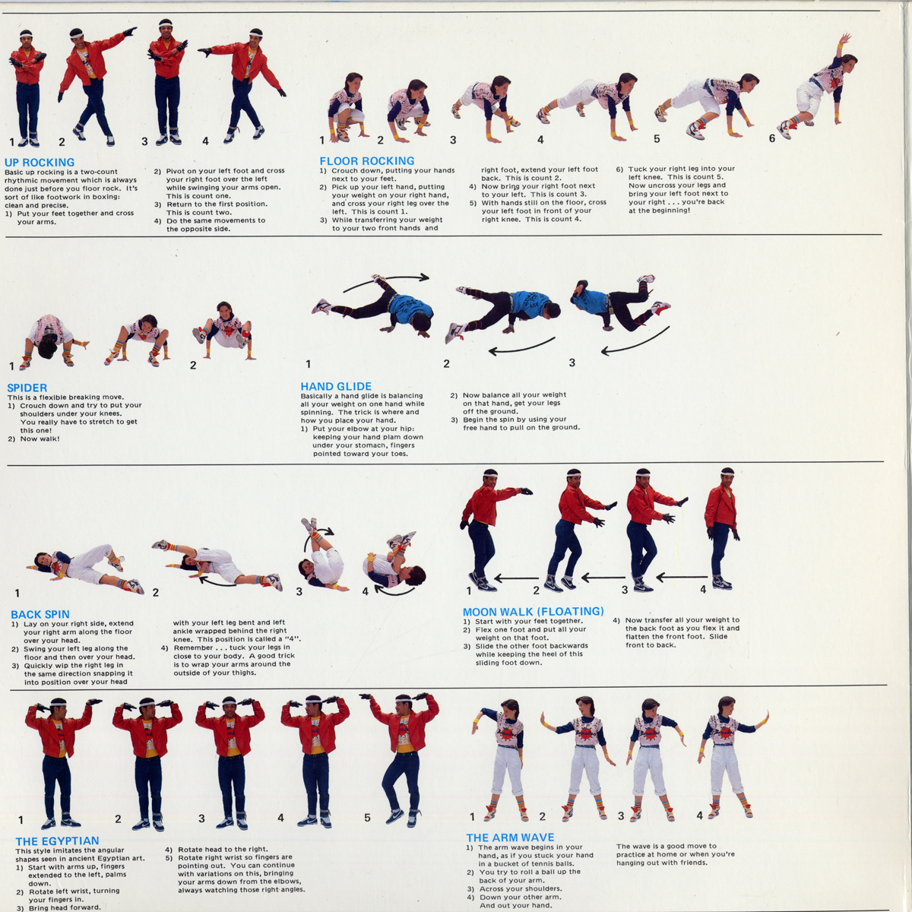

Slide 28
