Slide 1
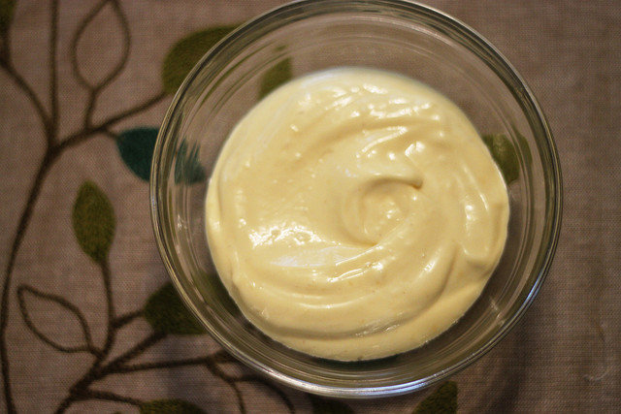
Food Preparation & Nutrition – Butter, Oil, Sugar & Syrup – lesson 5
LO’s
To make potato salad with home made mayonnaise
Success criteria –
A creamy and rich mayonnaise, uniformly cubed potatoes
Skills & Techniques used-
2,5,6,8,9,13,19,20
Making an emulsification, knife skills, separating
Eggs,
Science involved
The lecithin in the eggs stabilises the mayonnaise and stops it from splitting.
Notes:
10X – 19/6/18 10W – 25/6/18

Slide 2
Food Preparation & Nutrition – Butter, Oil, Sugar & Syrup
Ensure your skills chart is up-to-date along with your dish evaluations.
If finished, ensure your work area is immaculate, then check to see if you have completed your homework.
Ext. task 1 – read w/s BOM 1 (parts 1 & 2).
Ext. tasks 2 – complete w/s BOM 3
A reminder – catch-up club will be in here on Wednesday 3.00 – 4.15.

