Slide 1
What goes on a Book Cover?

Slide 2
Anatomy of a Book Cover
Author
Title
Illustration
Spine
Book Summary
Barcode / Price
Publishers Logo

Slide 4
You will need the following
Name of Author
Book Title
Price
Possible images for illustrations
Book summary
Publishers Logo

Slide 5
Book Cover Design
Design a front cover along with a spine and back cover for your Pop-Up Book
Remember to include your publishers logo, a title for the book, the blurb you wrote along with appropriate images.

Slide 8
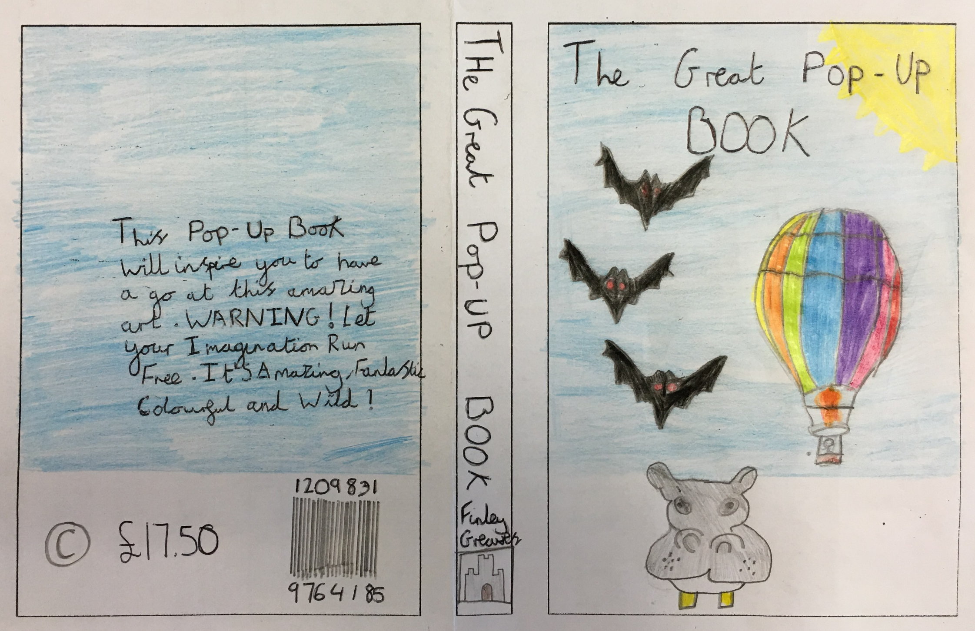

Slide 10
