Slide 1
A & V Fold Mechanism

Slide 7
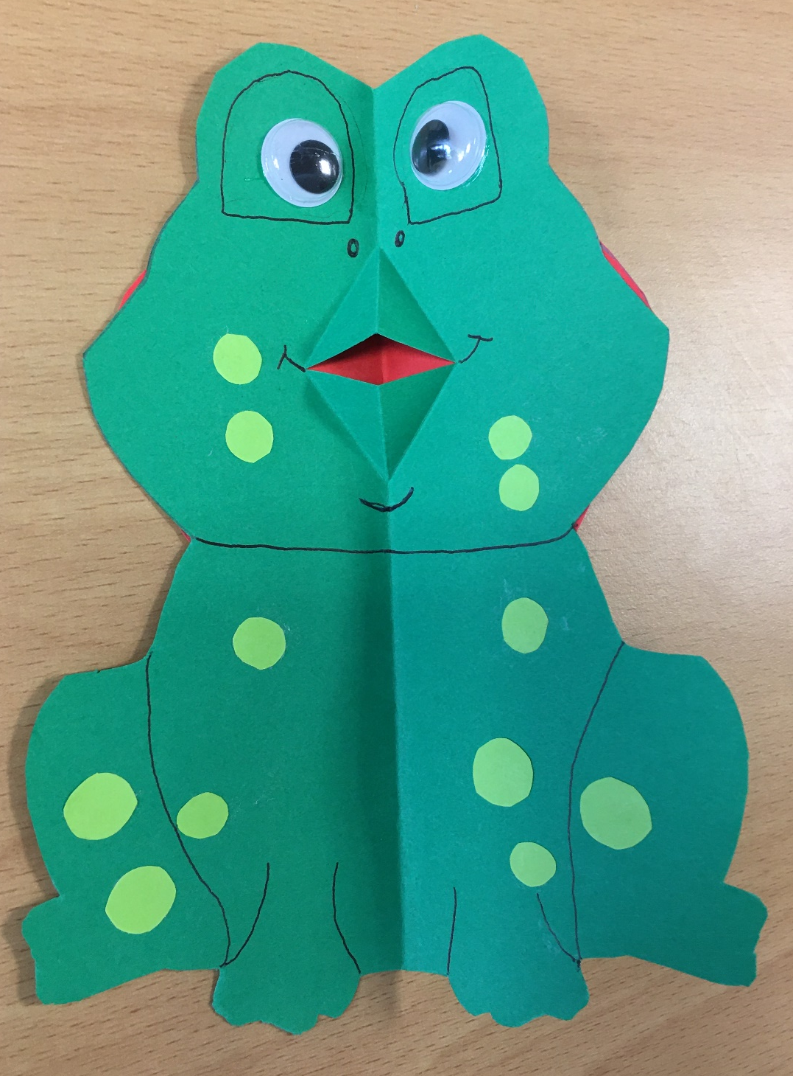
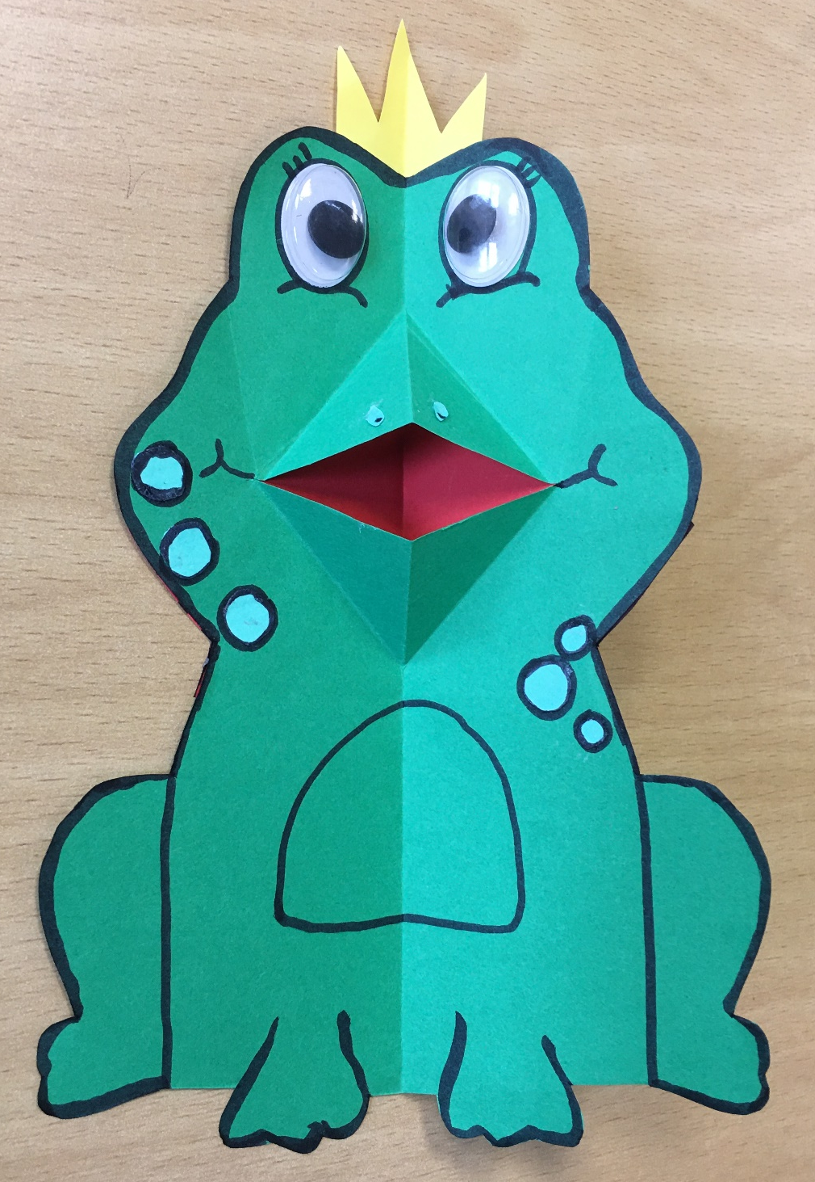

Slide 8
Frog Research Design Ideas

