Slide 8
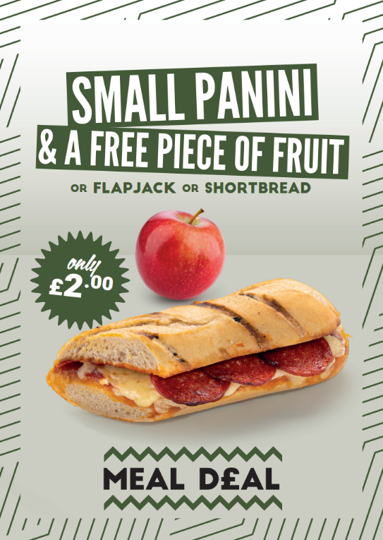

Slide 9
£2.70

