Slide 1
Design development
Develop your 2 best initial idea designs.
On each page write at the top design development of design ….. Draw the design and either around it or going around the page draw 4-5 different aesthetic(the look) developments
Next to your development drawings, draw how your could make some of the parts using 1-2 different making methods (constructional development )
Fully explain all aspects of each development.
What has changed?
Has it improved the design?
How is it suitable for a large furniture and homeware store?
How have you incorporated the theme Curves with curved, arched, bending, bowing, rounded design features?
DEVELOPING A DESIGN
ADD – add bits to the design
Design Development
SUBTRACT – take bits away from the design
SQUASH – make bits smaller in the design
STRETCH – make bits bigger in the design

Slide 3
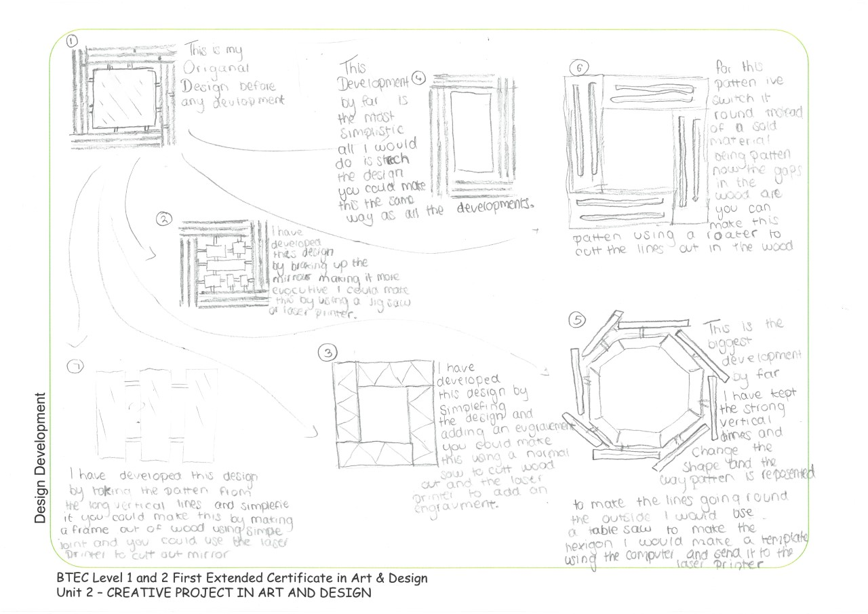

Slide 5
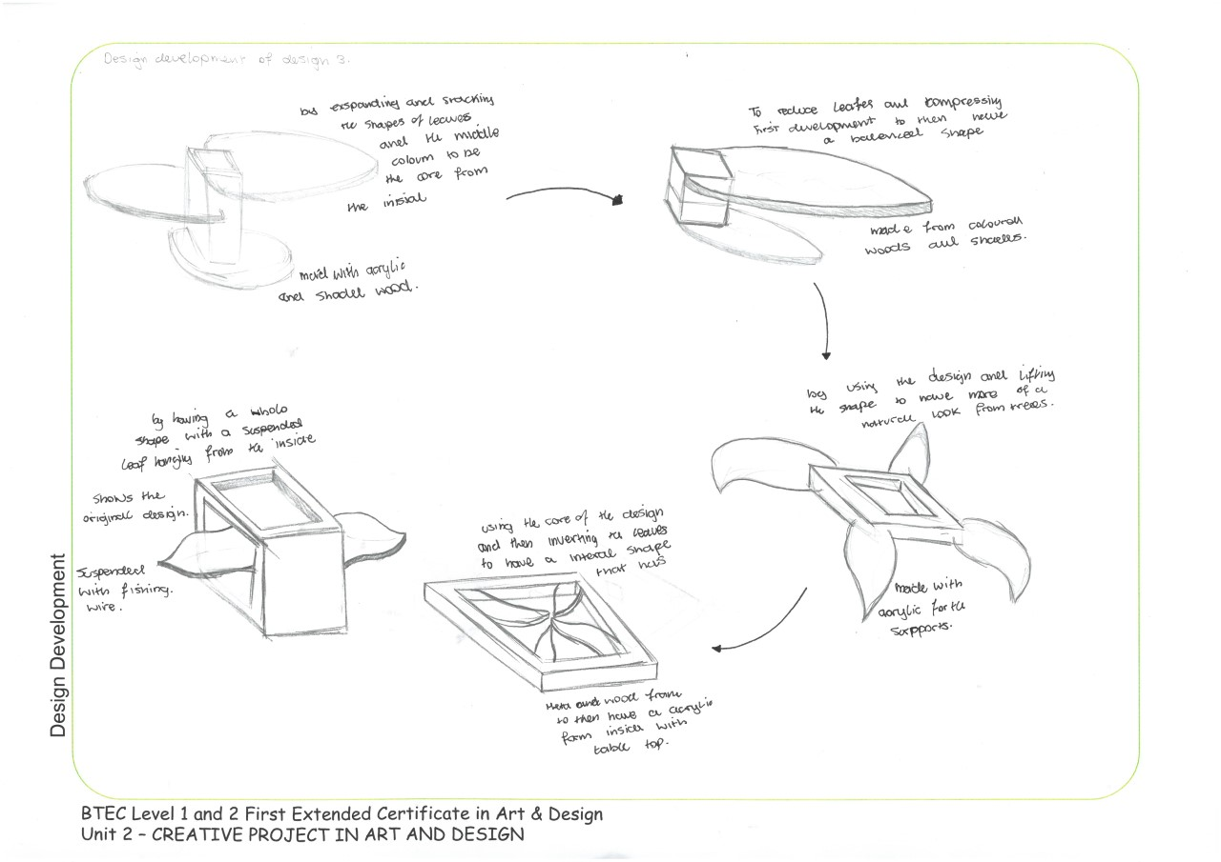

Slide 7
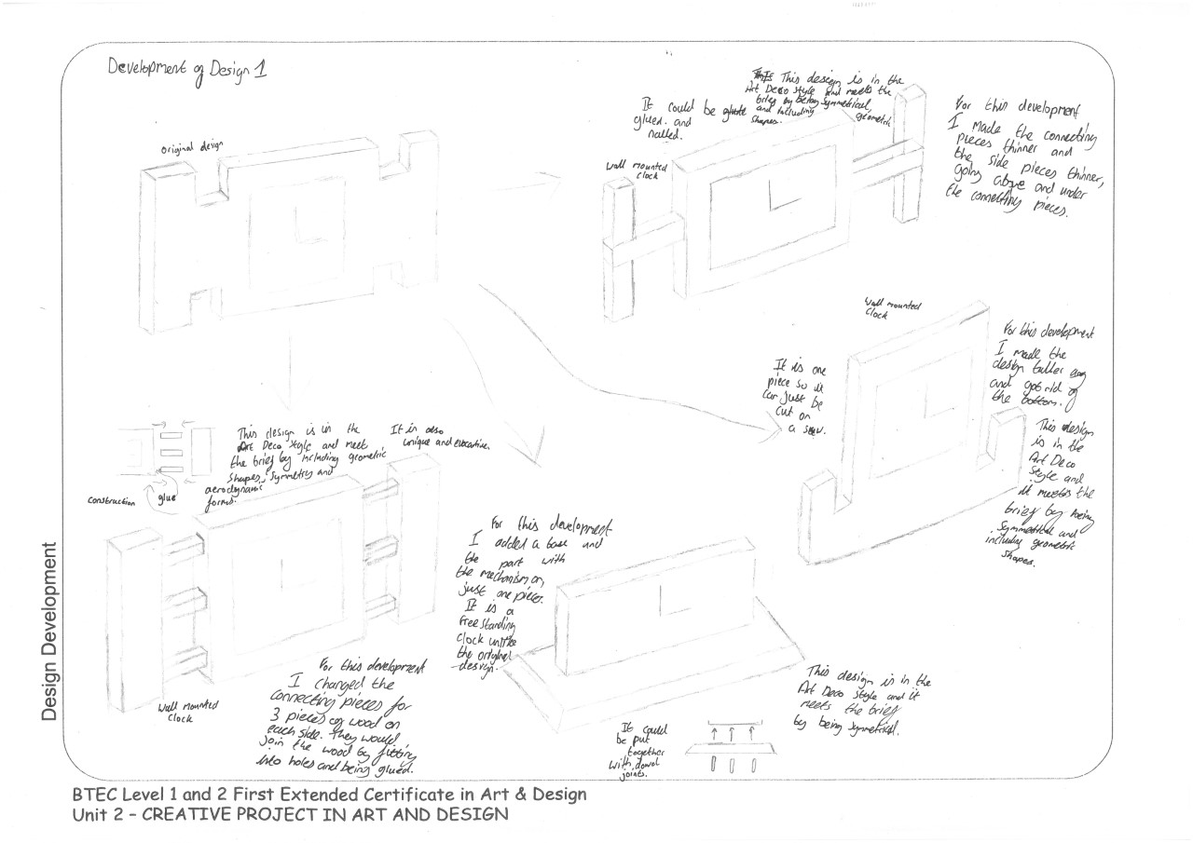

Slide 8
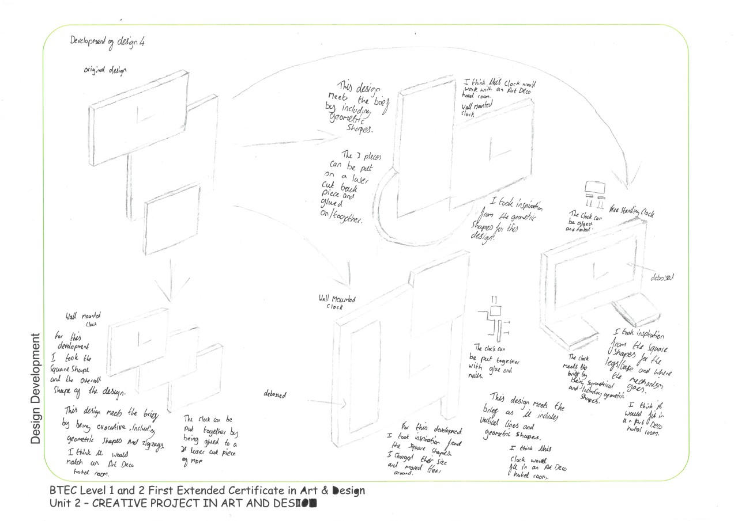

Slide 9
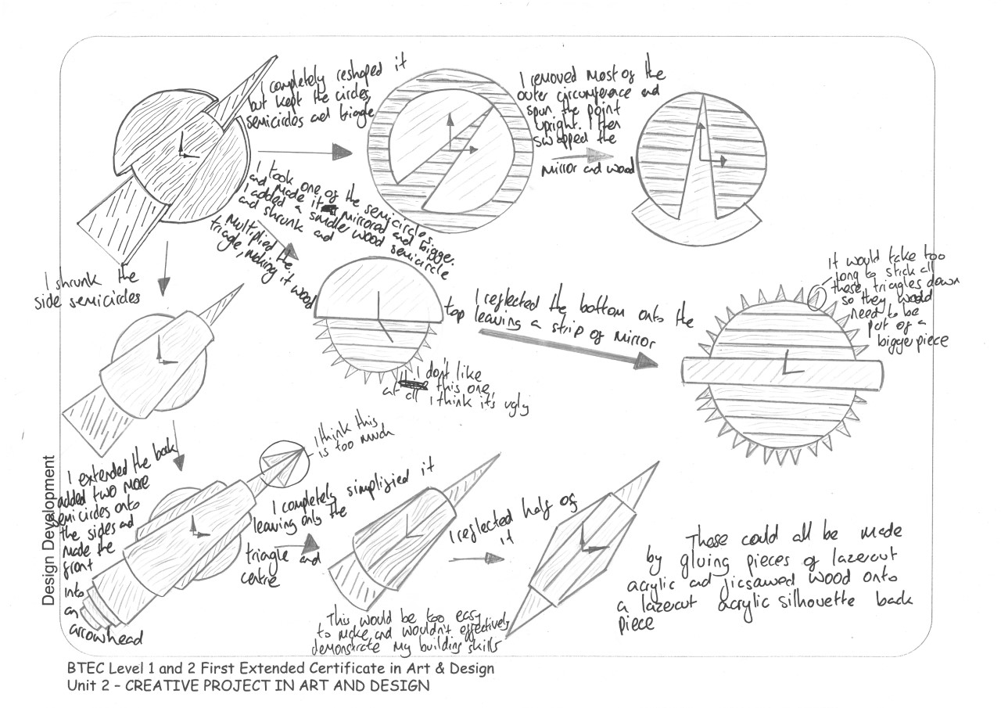

Slide 10
