Slide 1
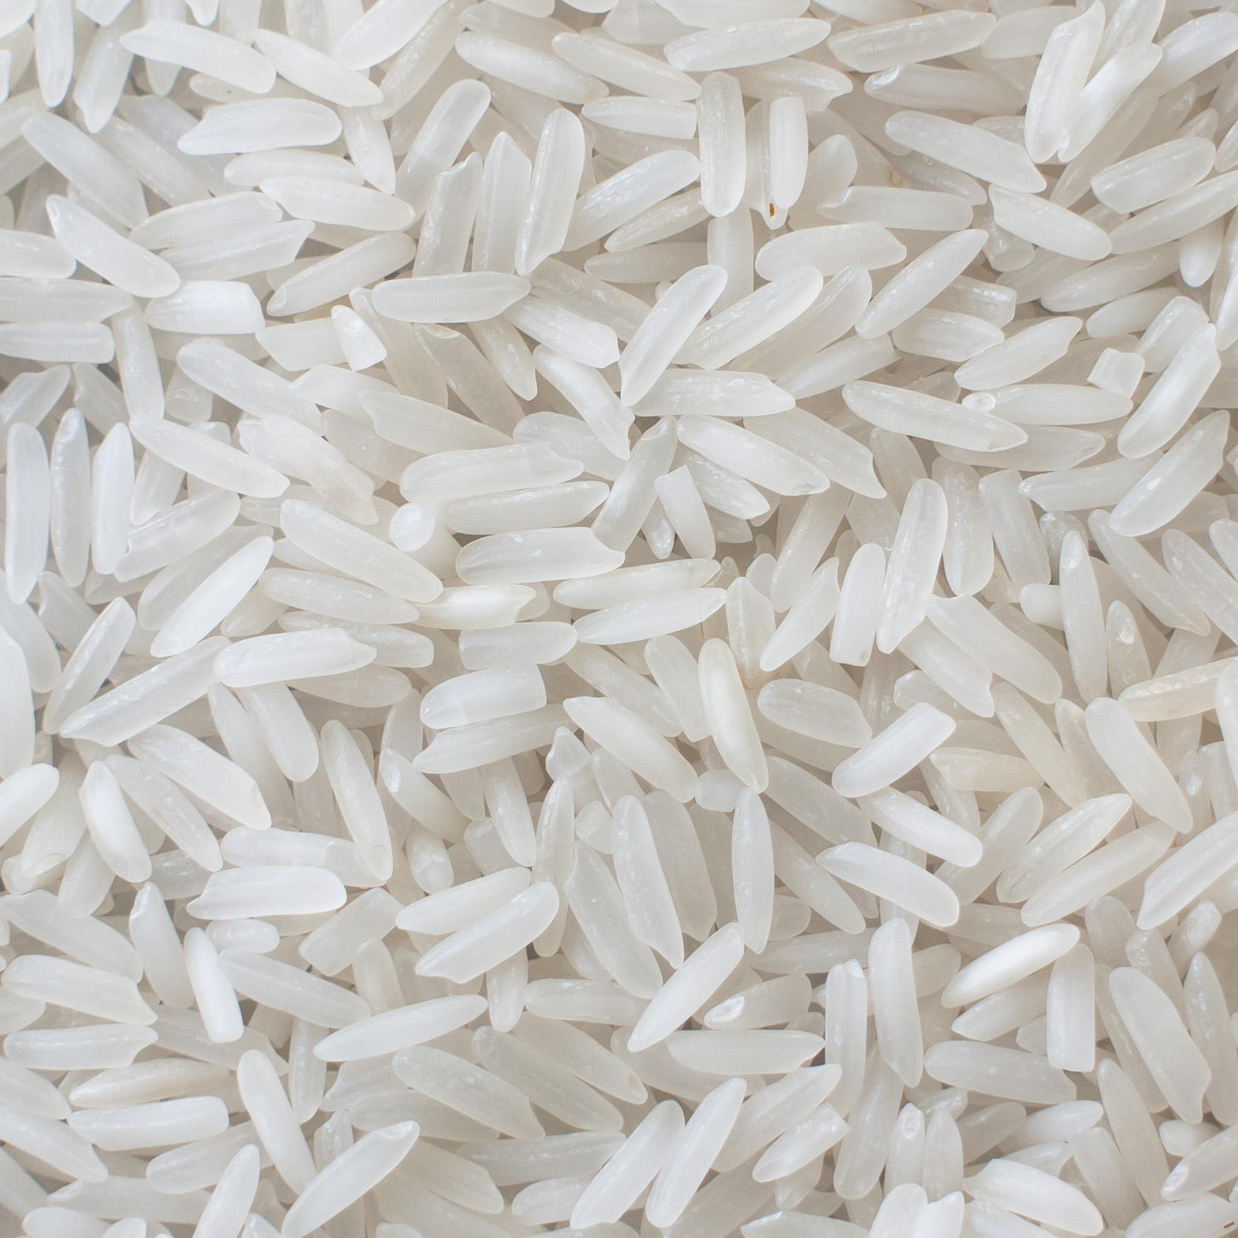
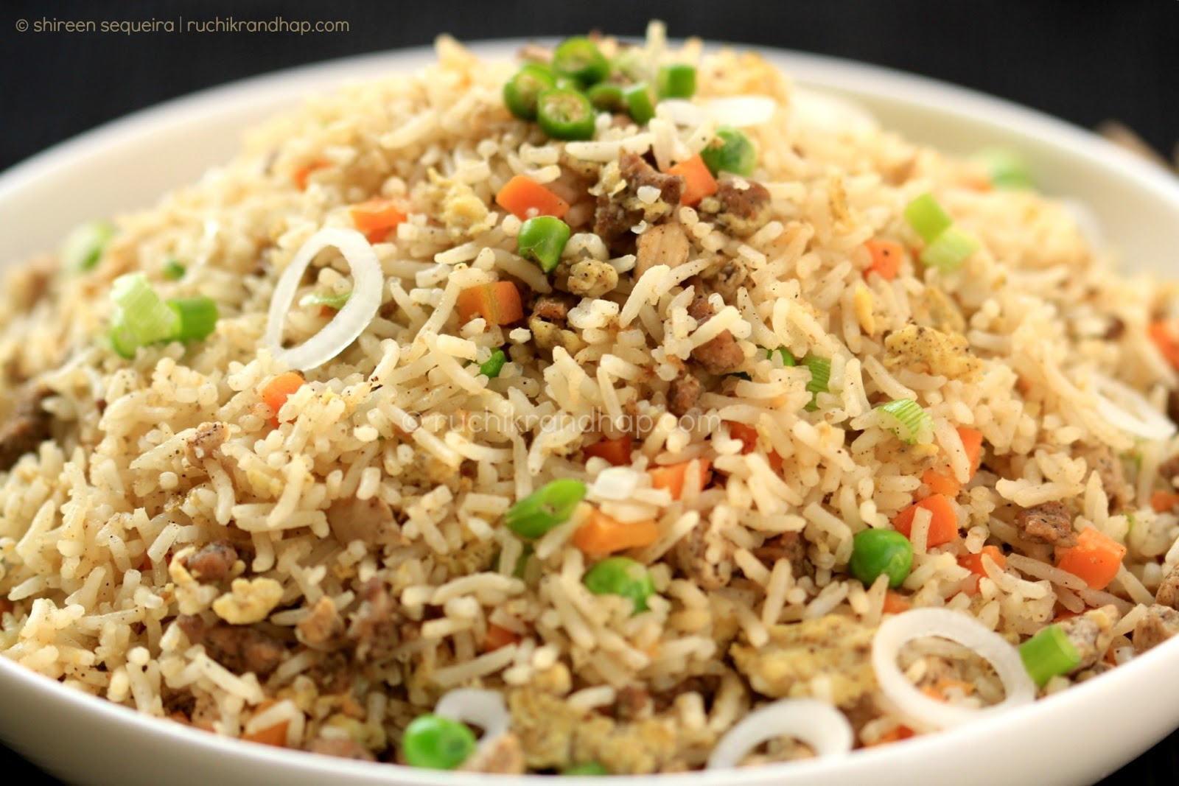
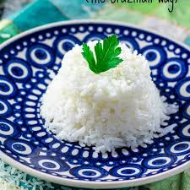
Food Preparation & Nutrition - Cereals lesson 6 Rice
LO – To learn about how rice is grown and processed (primary and secondary processing)
To know about the nutritional value of rice.
To understand what beri beri is and what causes it.
Starter – Watch the 2 videos and use the information to answer the questions on worksheets C21 & 22. Stick the w/s into your book.
Task 1. Put todays date at the top of the page, then under the title Nutritional Value of Rice, explain what is in rice. P. 199
Task 2. In your book, discuss what Beri beri is and what causes it.
Click on the picture for a link to the worksheets

Slide 2
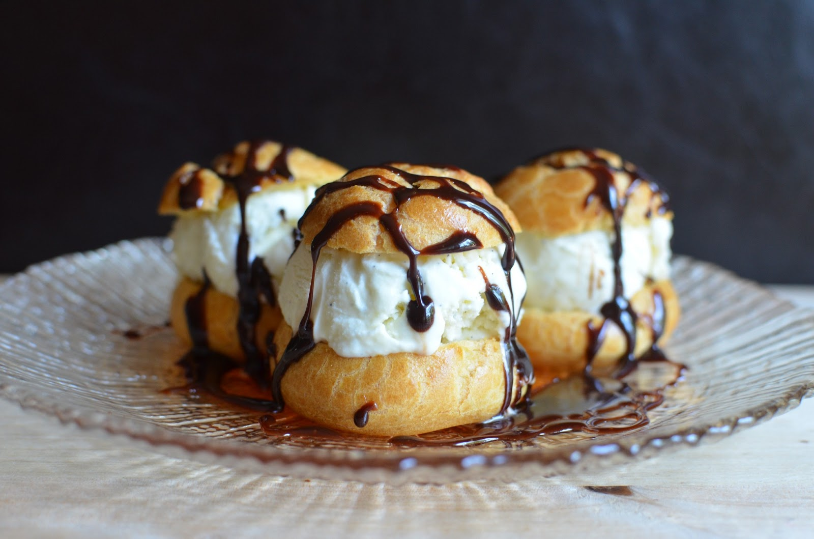
Food Preparation & Nutrition Cereals
On Tuesday you will be making profiteroles – I will be demonstrating and you will be making notes. I suggest you watch videos on Youtube so that you know what you are doing.
Homework – complete all 3 worksheets. To be handed in on Monday.

