Slide 1
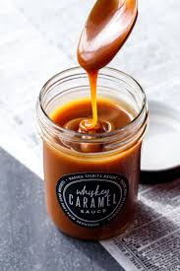
Food Preparation & Nutrition – Butter, Oil, Sugar & Syrup – lesson 7
LO’s
The nutritional value of sugar in the diet.
The hidden sugar in food.
The function of sugars/sweeteners in food preparation
Starter – watch the video about sugar in the diet
Task 1. Write notes explaining the following terms:
Adding sweetness, Adding texture (include the word ‘hygroscopic’), Adding colour, As a raising agent, For preservation, Fermentation, Coagulation, Foaming & Enzymic browning.
Notes:
p.358 for videos on fermentation, coagulation & enzymic browning

Slide 2
Food Preparation & Nutrition – Butter, Oil, Sugar & Syrup
Task 2. Learn the terms in the blue ‘Key Terms’ box ready for a text next week.

