Slide 1
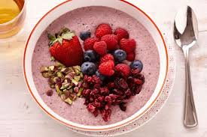
Food Preparation & Nutrition – Butter, Oil, Sugar & Syrup – lesson 6
LO’s
The composition of artificial sweeteners.
The uses of artificial sweeteners in the diet.
The composition of sugar
Starter – watch the video about swapping non-healthy breakfasts for healthier ones. Think about what you eat for breakfast – is it healthy or rammed full of hidden sugars?
Task 1. Watch the PowerPoint and make notes about the following:
Sugar is this country comes from sugar beet not cane, that monosaccharides are simple sugars and disaccharides are two sugars joined together.
Monosaccharides are Glucose, Fructose and Galactose.
Disaccharides include sucrose, fructose, glucose, lactose and maltose.
They occur naturally in fruits, vegetables and dairy products.
They are also used as an ingredient in many foods and drinks products.

Slide 2
Food Preparation & Nutrition – Butter, Oil, Sugar & Syrup
Task 2. Read pages 352 & 353 and read about artificial sweeteners and their uses.
Task 3. Read about the nutritional value of sugar and about the hidden sugar in food. Do you know what this means?
Task 4. Complete w/s BOM 6. If necessary, complete for homework
Next practical – find your own recipe that uses honey as a sweetener.

